Slide 1


FY24 Unit Controller Call Series
  September, 2023
We’ll get started momentarily
PLEASE keep lines muted
This call will be recorded
corinne.szabo@sodexo.com
Notes:
Welcome – this call will be recorded. Start recording!
Welcome to the FY24 Unit Controller Network call series!
The purpose of the monthly Controller Network Call is to inform the network group about topics that impact the controller role on a timely schedule.
The topics in this call series address programs/system updates to support change management, drive adoption and finance reporting best practices.
Feedback and topic suggestions are always welcome.
Previous call content resources can be found on the UFS launch site, “Controller Corner,” main page, lower right. Content is posted at the conclusion of each call and distributed in chat during the call. Content is available for previous 6 months.
I am CS, w/ Financial Shared Services (FSS), coordinator of the CN call series, and your host for today.
This is the first of two calls for the month of September and our first agenda for FY24. If you wish to include other team members for this month’s agenda, please forward the meeting invitation for Thursday am. If you would like to invite other members on your team to join the Controller Network Call Series. please send an email to corinne.szabo@sodexo.com. I will add them to the Controller Network Call meeting invite distribution list.
Thank you for joining today. To anyone new to the network – Welcome to the call series.

Slide 2
  Agenda
    Safety Moment – Jill Helms
FY24 Q1 Collections – Brad Hamman
Citi Visa Supplier Payments and PCard Purchases, Concur Expense Reporting - Lucia Riccio
Kronos Timecard Reporting (Salaried) – Rhonda Bowen
    Q&A
Notes:
Today’s agenda –
To demonstrate our commitment to safety and our safety culture at Sodexo, we begin each meeting with a Safety Moment – I have an open invitation to anyone listening in to volunteer for a future call and present a safety moment. If you’re looking for an opportunity to share a safety experience or learning, or just want to practice presenting, please reach out to me. Jill will be presenting out safety moment today.
Let’s kick of the FY with guidance for FY24 Q1 collections and we welcome back Brad Hamman, DIR, FSS C&C
Our next topic will review
Citi Visa Supplier Payments and Pcard Purchases, Concur Expense Reporting – Lucia Riccio, Accounting Analyst from FSS Purchase to Pay team
special thanks to Jona Bridge for suggesting these topics. Jona is a multi-controller and a member of this network.
Final topic today is Kronos Timecard Reporting – Rhonda Bowen from Labor Optimization team.
Please use the chat function to submit any questions that you may have as we run through the agenda topics. We will pause to address questions between topics and if we run out of time we will follow up via email.
Finally – feel free to use the Reactions button as we proceed through today’s call. With everyone muted, it is a nice way to contribute and engage and we appreciate the energy.

Slide 3
  Safety Moment
  Pedestrian Safety
  Jill Helms
Notes:
Jill Helms

Slide 4
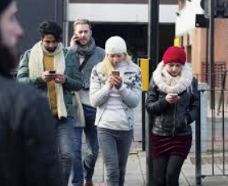
Pedestrian Safety – Distracted Walking
According to the National Safety Council, the number of people injured (wandering into on-coming traffic or other objects) while using electronics and mobile devices has quadrupled over the last year!
Follow these tips to stay safe as a pedestrian:
  Keep your eyes on the path where you are walking.
  Stay alert! Avoid cell phone use and wearing earbuds.
  Walk on sidewalks whenever they are available.
  Don’t jay walk…Use the crosswalk.
  Avoid Alcohol and drug impairment when walking
  Wear bright and/or reflective clothing and use a flashlight at night
  Watch for cars entering or exiting driveways or backing up in parking lots.
It Can Wait…Head Up, Eyes Forward
Notes:
September is Pedestrian Safety Month. According to the National Safety Council, the number of people injured (wandering into on-coming traffic or other objects) while using electronics and mobile devices has quadrupled over the last year! At some point in the day, everyone is a pedestrian.
Follow these tips to stay safe as a pedestrian
Keep your eyes on the path where you are walking. We rarely are more vulnerable than when walking in urban areas, crossing busy streets and negotiating traffic
Stay alert! Avoid cell phone use and wearing earbuds. If texting, move out of the way of others and stop until finished.
Walk on sidewalks whenever they are available. If there is no sidewalk, walk facing traffic and as far from traffic as possible.
Don’t jay walk…Cross streets at crosswalks or intersections. Don’t cross between parked cars and if a crosswalk or intersection isn't available, cross in a well-lit area only when there is a gap in traffic, enough to cross safely.
Avoid Alcohol and drug impairment when walking
Wear bright and/or reflective clothing and use a flashlight at night
Watch for cars entering or exiting driveways or backing up in parking lots. Always hold the hands of children when walking in a parking lot.

Slide 5
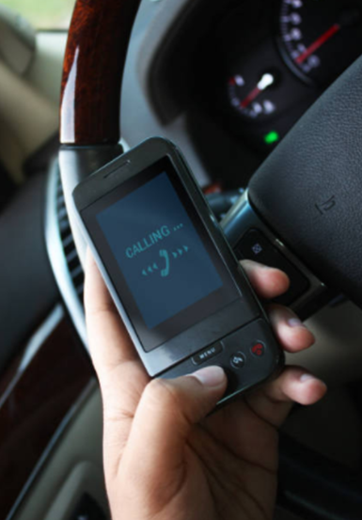
Pedestrian Safety – Distracted Driving
Thousands die needlessly each year because people continue to use their cell phones and other distracting activities while driving.
Urge Those You Care About to:
  Stop using cell phones while driving.
  Use extra caution when driving in hard to see conditions
  Never pass vehicles stopped at a crosswalk.
  Yield to pedestrians in crosswalks,
  Follow the speed limit!
  Never drive under the influence of alcohol and/or drugs.
Ignoring Road Safety Measures Can Prove Costly!
Notes:
Thousands die needlessly each year because people continue to use their cell phones handheld or hands-free and other distracting activities like eating or applying makeup while driving.
Urge those you care about to:
Stop using cell phones while driving. Don’t text or call someone you know is driving
Use extra caution when driving in hard to see conditions, such as
nighttime or bad weather
Never pass vehicles stopped at a crosswalk. There may be people crossing where you can’t see. Look out for pedestrians everywhere, at all times.
Yield to pedestrians in crosswalks, making eye contact to indicate you see them
Follow the speed limit! Especially around people on the street, in school zones and in neighborhoods where children are present.
Never drive under the influence of alcohol and/or drugs. Verify any prescriptions medications you take are safe for operating a vehicle
When drivers maintain safe speeds and practice other safe driving behaviors, safer walking environments are created for you, your loved ones and others in your community.

Slide 6
AR Collections deadline for Q4 FY23
Q1 Collections
and Best Practices

Slide 7
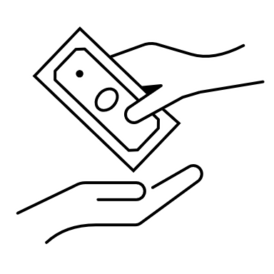
CRS Overview
Best Practices &
Payment Fraud

Slide 8
Top Reasons for Past Dues unrelated to cash flow
Client did not receive invoice on time.
Client has questions about the invoice or did not receive expected support documentation.
Client has unaddressed service issues.
Client believes invoice was already paid or is looking for credits.
Client has contract issues that need to be addressed.
Client Purchase Order is missing or expired.
Client AP process is slow or overcomplicated.

Slide 9
Best Practices for Collections
Be professional, be courteous – but firm.
It is important to be understanding with the Client; however, we have the right to know when payment is expected for services rendered.
Bill it! Sodexo Noram saw a sizeable increased in unbilled AR in FY23 which impacts DSO and Cash Flow. Please make best efforts for billings to be generated in a timely fashion.
Working with client AP Departments - they might be difficult to communicate with at times. If the 1st level contacts are not responding, escalate to the next level.
Follow up is key for past due and missed payments.
Other Vendors are asking for payment. We need to ensure ours are given the same priority as other vendors.
Are you hearing financial distress?
If the client is unable to commit to any payment and/or if claims of financial distress (i.e. cash flow issues). Refer the account immediately the FSS Credit and Collections team at Creditcollection.NORAM@Sodexo.COM.
Need help with missing payments? Reach out to FSS Accounts Receivables department at: AccountsReceivableNorAm@sodexo.com

Slide 10
Payment Fraud
Threat Actors are continuing their efforts posing as Sodexo employee to commit fraud against our clients.
  Tell customers NEVER to conduct electronic funds transactions with Sodexo via email.
  Always call the AR Department to verify any requests and to check the sender’s domain
  Ensure that any requests for funds transfer received have 2nd and/or 3rd level validation procedures in place (i.e., DM/GM approvals, always call your customer to verify legitimacy etc.)
  Using email for financial transactions in general is strongly discouraged
  Immediately contact FSS Accounts Receivables department if you suspect possible fraud at: AccountsReceivableNorAm@sodexo.com or 1-800-828-7762, Option 2, Option 2
Thank you, your actions are making a difference!

Slide 11

Questions

Slide 12
  01
Visa Payment Initiative

Slide 13
Visa Payment Initiative (VPI)
Vendors are paid with a virtual Visa card
  Participating in VPI
  Vendors who meet a certain criteria are contacted.
  Participating is voluntary
  Vendors agree to not charge fee- receives accelerated terms
  Vendor enrolls through Visa
  If vendor is removed from VPI terms are retuned to what they were prior.
  Processing of Card
  Vendor is given the card information via email to process payment
  All cards must be processed for full amount
  Cards initially have a 30 day expiry period – we can extend date if needed.
  Payment Process
  Invoices are entered via UFS, EDI, AP Portal, etc.
  Cards are sent out on Wednesday
  Payment Notification is emailed to vendor on same day
  Extra
  Contact lucia.riccio@sodexo.com to see if card was successfully processed
  If there are any questions regarding vendors on VPA

Slide 14
  02
  Purchase cards

Slide 15

Purchase Cards
PCards, Expense Reports and Concur
  Overview
  PCards are to be used for emergency transactions – vendors paid on reoccurring basis should be submitted through the EVAR portal
  Utility Bills
  Transactions are to be submitted in the month they’re incurred. Submit multiple transactions on a report (fee)
  Transactions that have not been cleared by month end are accrued
  Accruals reverse on first week of new period
  Concur and Expense Reports
  Transactions are fed into Concur via a Citi feed
  Only when an expense report is released will transactions hit GL’s and Cost Centers as dictated by the expense report
  There is a report available showing how expenditures were posted
  All expense reports go through an audit process prior to being approved
  Extras
  Contact me lucia.riccio@sodexo.com for a link to the PCard accrual file and Procurement data
  Email purchasecards.noram@sodexo.com for all things related to PCards.

Slide 16
Q&A

Slide 17
Salaried Exempt Employees and Kronos Timecards

Slide 18
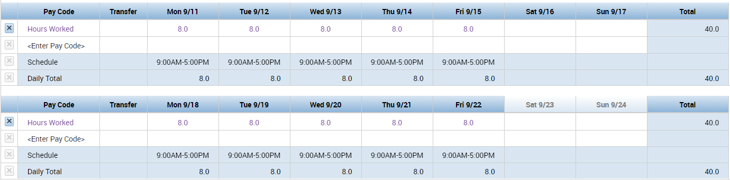
Salaried Exempt Employee Timecards
Guidelines
        A full-time exempt employee’s timecard is prepopulated with 80 regular hours (10 days) each pay cycle in a standard schedule.
  Reporting any time over 80 hours per pay cycle can result in overpayment and is a violation of group policy.*
  Exempt employees do not need to and should not alter the timecard in Kronos unless entering PTO or a Transfer.*
  Exempt timecards are audited to ensure proper payment
  *Not applicable to Government exempt employees. Government exempt employees must record all hours worked.

Slide 19
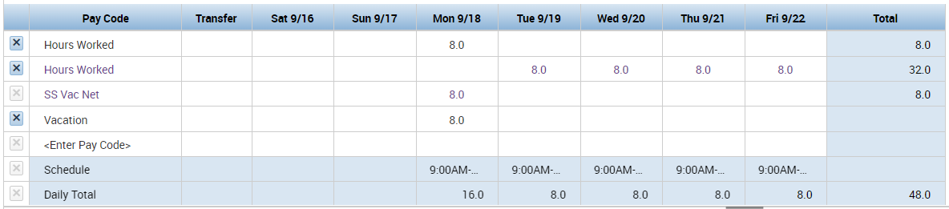
Salaried Exempt Employee Timecards
Recording Exceptions
        When entering PTO in your timecard as a salaried exempt employee, the Hours Worked must be adjusted.
Remove
x

Slide 20
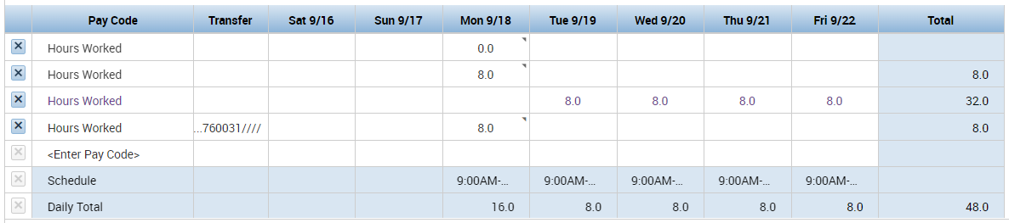
Salaried Exempt Employee Timecards
Recording Exceptions
        When entering a Transfer in your timecard as a salaried exempt employee, the Hours Worked at your Home account must be adjusted.
Remove
x

Slide 21
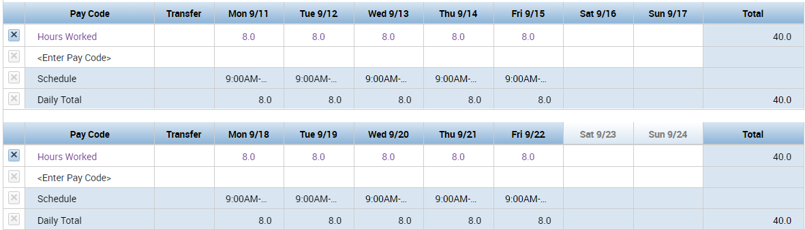
Salaried Exempt Employee Timecards
Always Verify Totals
        Weekly totals should never be over 40.

Slide 22
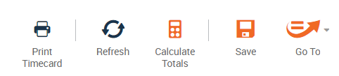
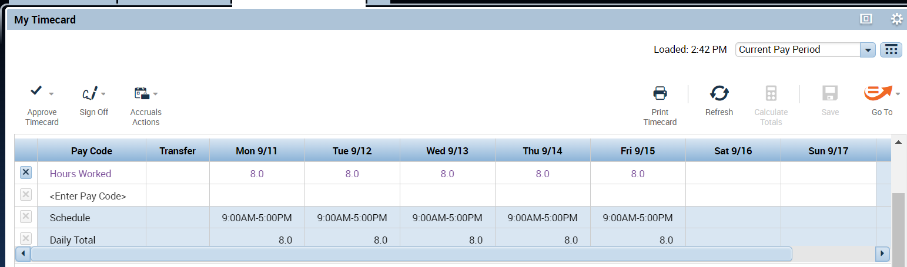
Salaried Exempt Employee Timecards
Tip for Verifying Totals
        Often, a user adjusts Hours Worked, saves, then exits out of Kronos before calculations are completed.
        Best practice is to use the ‘Calculate Totals’ button and validate the weekly totals prior to saving. This ensures the calculations are complete.

Slide 23
Salaried Exempt Employee Timecards
Top 3 Over 80 Reasons
63%
Entered PTO but did not remove Hours Worked
9%
Added Hours Worked outside of default schedule
4%
Entered a Transfer but did not adjust Hours Worked at home account

Slide 24
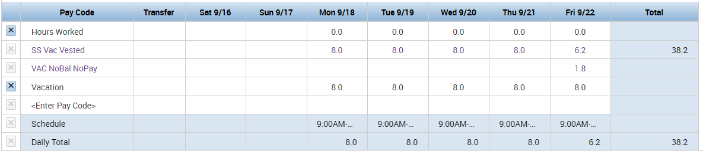
Salaried Exempt Employee Timecards – Under 40
NoBal NoPay
        NoBal NoPay (No Balance, No Payment) means there is not enough hours in that accrual to cover that day.

Slide 25

Next Steps
Please share this information with managers at your account.

Slide 26
Sodexo References
Administration and Finance (A&F) Manual; ADP HR and Payroll Processes: AF 401-04
Company Policy Manual; Fair Labor Standards Act: CP 409
Timekeeping Procedures: Management Timekeeping Procedures (sodexolink.com)

Slide 27
Questions

Slide 28
Thank you

