Slide 1
FY24 Unit Controller Call Series
November, 2023
We’ll get started momentarily
PLEASE keep lines muted
This call will be recorded
corinne.szabo@sodexo.com
Notes:
Welcome – this call will be recorded. Start recording!
Welcome to the FY24 Unit Controller Network call series!
The purpose of the monthly Controller Network Call is to inform the network group about topics that impact the controller role on a timely schedule.
The topics in this call series address programs/system updates to support change management, drive adoption and finance reporting best practices. Feedback and topic suggestions are always welcome.
Previous call content resources can be found on the UFS launch site, “Controller Corner,” main page, lower right. Content is posted at the conclusion of each call and distributed in chat during the call. Content is available for previous 6 months.
I am CS, w/ Financial Shared Services (FSS), coordinator of the CN call series, and your host for today.
This is the first/second of two calls for the month of November. If you wish to include other team members for this month’s agenda, please forward the meeting invitation for Thursday am. If you would like to invite other members on your team to join the Controller Network Call Series. please send an email to corinne.szabo@sodexo.com. I will add them to the Controller Network Call meeting invite distribution list.
Thank you for joining today. To anyone new to the network – Welcome to the call series.

Slide 2
Agenda
Safety Moment – Jill Helms
Credit & Collections – Brad Hamman, Marilyn Burt
MySodexo (MSA) Landing Page – Rebecca Miller
SAP Fiori JE App Update – Wendy Cano, Sue Burns, Ann Marie Marbaker
Q&A
Notes:
Today’s agenda –
To demonstrate our commitment to safety and our safety culture at Sodexo, we begin each meeting with a Safety Moment – I have an open invitation to anyone listening in to volunteer for a future call and present a safety moment. If you’re looking for an opportunity to share a safety experience or learning, or just want to practice presenting, please reach out to me.
Topics today:
Credit & Collections – Brad Hamman / Marilyn Burt
MySodexo landing page – Rebecca Miller
SAP Fiori JE App Update – Wendy Cano / Sue Burns, Ann Marie Marbaker
Please use the chat function to submit any questions that you may have as we run through the agenda topics. We will pause to address questions between topics and if we run out of time we will follow up via email.
Finally – feel free to use the Reactions button as we proceed through today’s call. With everyone muted, it is a nice way to contribute and engage and we appreciate the energy.

Slide 3
Safety Moment
Food – Safety Tips
Notes:
Jill Helms

Slide 4
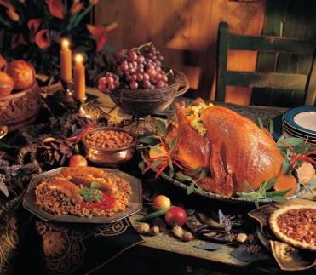
Food Safety Tips for Thanksgiving
Enjoy your favorite Thanksgiving foods safely by using the
following safety food handling and cooking practices:
Make sure to wash your hands thoroughly before preparing food, after handling any raw poultry or meat and before eating.
Keep your food preparation surfaces and utensils clean and sanitized.
Use separate cutting boards—one for meat, poultry and fish and one for cooked foods, vegetables and fruits. Sanitize the cutting board after use.
Wash all vegetables and fruits before you prepare them.
Thaw a frozen turkey safely in the refrigerator allowing 3-4 days for thawing or approximately one day for every five pounds.
Refrigerate a thawed, or fresh, turkey for no longer than two days before cooking.
Immediately cook a small turkey that is defrosted in the microwave.
If you cook your stuffing inside the turkey, stuff it just before roasting.
Always use a meat thermometer to see if the turkey is completely cooked. The temperature needs to reach 165 degrees Fahrenheit when inserted in the thickest area of the thigh.
Refrigerate all leftovers within two hours after cooking.
Notes:
Enjoy your favorite Thanksgiving foods safely by using the following safety food handling and cooking practices:
Make sure to wash your hands thoroughly before preparing food, after handling any raw poultry or meat and before eating.
Keep your food preparation surfaces and utensils clean and sanitized to reduce the risk of salmonella poisoning.
Use separate cutting boards—one for meat, poultry and fish and one for cooked foods, vegetables and fruits. Sanitize the cutting board after each use.
Wash all vegetables and fruits before you prepare them.
Thaw a frozen turkey safely in the refrigerator allowing 3-4 days for thawing or approximately one day for every five pounds. Another way to safely thaw a frozen turkey is submerging it in cold water. Replace the water every 30 minutes until the turkey is thawed.
Refrigerate a thawed, or fresh, turkey for no longer than two days before cooking.
Immediately cook a small turkey that is defrosted in the microwave.
If you cook your stuffing inside the turkey, stuff it just before roasting.
Always use a meat thermometer to see if the turkey is completely cooked. The temperature needs to reach 165 degrees Fahrenheit when inserted in the thickest area of the thigh.
Refrigerate all leftovers within two hours after cooking.

Slide 5
Q1 Collections and FSS Credit and Collections Team
November, 2023
Notes:
Brad Hamman or Amelia Pandolfi

Slide 6
Let’s Collect It for Q1 FY24
Deadline for November Payments

Slide 7
Collection Deadline for Quarter 1, FY24
Your help is needed to increase our cash flow. To ensure that your AR payments, bank deposits, cash receipts, and cash balances are properly credited for Quarter 1, all deposits must be made on or before Thursday November 30th.
Please observe the following deadlines depending on your payment method.
Select the payment link(s) for your current payment method below for further details :
ELECTRONIC (ACH/WIRE) PAYMENTS
CHECK PAYMENTS
REMINDER:
The preferred method of invoice payments is ACH. ACH payments are timely, more secure and less costly.
Please contact Accounts Receivable at AccountsReceivable.NorAm@sodexo.com or 1-800-828-7762, Option 2, Option 2 for more information and to request the ACH details for your client.

Slide 8
Electronic Payments – Deadline for Quarter 1 FY24
Client ACH payments post to Sodexo’s bank account 1 to 2 business days after the client releases the payment to their bank. Determine with your client Finance or AP Department whether their bank ACH is 1- or 2-Day processing.
2 Day ACH: Tuesday November 28th
If ACH is 2-day processing, ACH must be released from client’s bank on or before the 28th with a value date of November 30th
1 Day ACH: Wednesday November 29th
If ACH is a 1-day processing, ACH must be released from client’s bank on or before the 29th with a value date of November 30th
Thursday November 30th
For client payments to post to Sodexo’s bank account on Thursday November 30th, client must initiate a SAME DAY electronic funds transfer payment on the 30th with a value date of November 30th

Slide 9
Check Payments – Deadline for Quarter 1 FY24
Deadline for Q1-24 AR Collections for CHECK payments sent to Lockbox must be deposited in the Lockbox by 10:30 AM (ET) Thursday November 30th
Lock Box address:
Sodexo Inc & Affiliates
Attn: 360170
500 Ross St 154-0455
Pittsburgh, PA 15262-0001
Telephone (412) 234-4381
Total Check Amounts | Important Dates | Action to Take
Total Checks greater than $2,500 | Tuesday November 28th | Overnight checks to the Lockbox address above with Next day delivery
Total Checks greater than $2,500 | Wednesday November 29th | Overnight checks to the Lockbox with Next Day Air EARLY AM Delivery
Total Checks greater than $100,000 | Thursday November 30th before 2:00 PM ET. | Call the FSS AR Department at 1-800-828-7762 option 2, option 2 before 2 PM ET

Slide 10
Payment Fraud
Threat Actors are continuing their efforts posing as Sodexo employee to commit fraud against our clients.
Tell customers NEVER to conduct electronic funds transactions with Sodexo via email. Always call the AR Department to verify any requests and to check the sender’s domain
Ensure that any requests for funds transfer received have 2nd and/or 3rd level validation procedures in place (i.e., DM/GM approvals, always call your customer to verify legitimacy etc.)
Using email for financial transactions in general is strongly discouraged
Immediately contact FSS Accounts Receivables department if you suspect possible fraud at: AccountsReceivable.NorAm@sodexo.com or 1-800-828-7762, Option 2, Option 2
Thank you, your actions are making a difference!

Slide 11
CRS Overview
FSS Credit and Collections Team

Slide 12
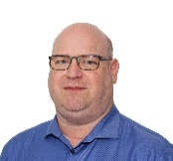
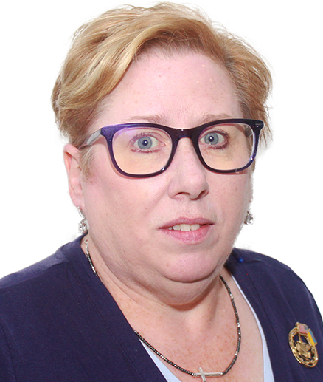
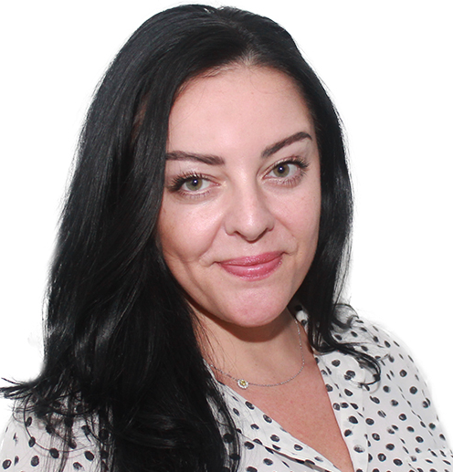
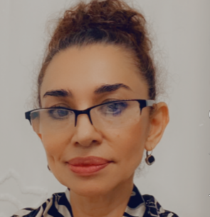
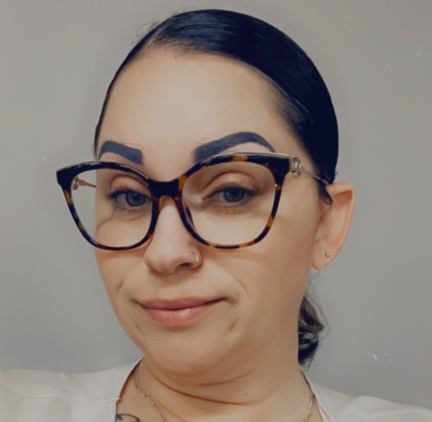
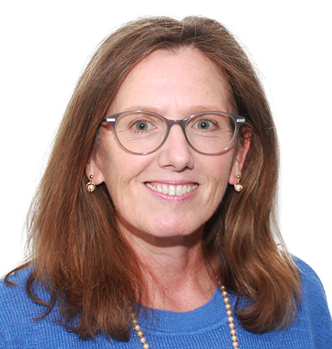
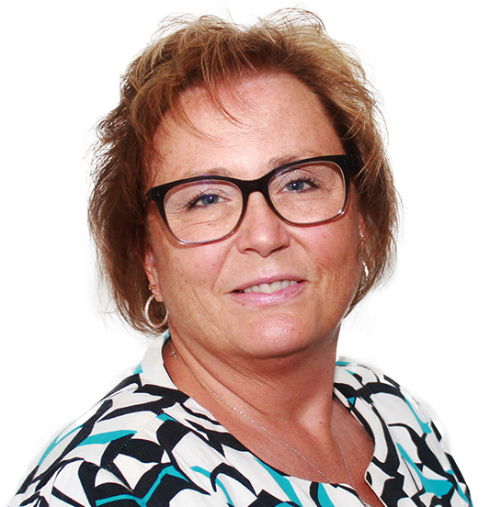
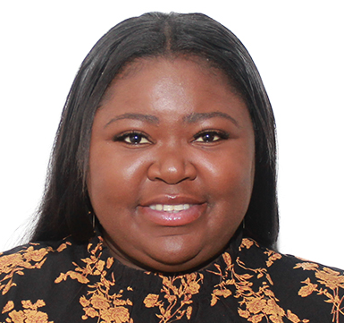
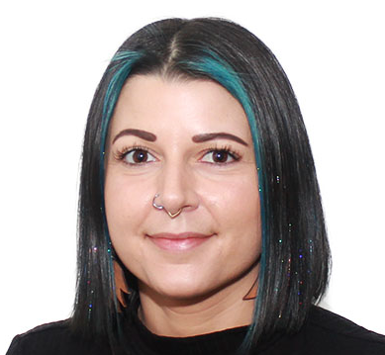
NorAm Finance Shared Services (FSS) Credit and Collections Team
Brad Hamman
Director, Credit & Collections
Nov 2023
Team Riley
Supporting Corporate Services, Campus, At Schools, Roth Brothers, Airlines, Government
Team Pandolfi
Supporting Healthcare, Seniors, Energy and Resources, Canada
InReach+Accent (Added in Sept 23)
Mary Beth Riley
Senior Manager II
Amelia Pandolfi
Senior Manager II
Richard Defino
Manager
Marilyn Burt
Manager
Violet Deleon
Collections Specialist
Paul Donnelly – Special Projects
Collections Specialist
Amber Sypho
Collections Specialist
Amy Sherman – Healthcare East
Collections Specialist
Wendy Doster –Campus East
Collections Specialist
Ralph Lee Jr –Healthcare West
Collections Specialist
James Kegler – Campus West
Collections Specialist
Nicole O’Field - Seniors
Collections Specialist
Maevonne Luckman – At Schools, Airlines
Collections Specialist
Concetta Celestino – Corp Services
Collections Specialist
Brittany Randles – Canada, E&R
Notes:
Manager daily task lists

Slide 13
Best Practices for Collections
Be professional, be courteous – but firm. It is important to be understanding with the Client; however, we have the right to know when payment is expected for services rendered.
Bill it! Sodexo Noram saw a sizeable increased in unbilled AR in FY23 which impacts DSO and Cash Flow. Please make best efforts for billings to be generated in a timely fashion.
Working with client AP Departments - they might be difficult to communicate with at times. If the 1st level contacts are not responding, escalate to the next level.
Follow up is key for past due and missed payments. Other Vendors are asking for payment. We need to ensure ours are given the same priority as other vendors.
Are you hearing financial distress? If the client is unable to commit to any payment and/or if claims of financial distress (i.e. cash flow issues). Refer the account immediately the FSS Credit and Collections team at Creditcollection.NORAM@Sodexo.COM.
Need help with missing payments? Reach out to FSS Accounts Receivables department at: AccountsReceivable.NorAm@sodexo.com

Slide 14
Q&A
Audience Q&A
This Photo by Unknown Author is licensed under CC BY-SA-NC

Slide 15
MySodexoApps (MSA) Landing Page Updates
Notes:
Suggested Design Tollgate Attendance (at minimum):
- Business Project Lead
- Technical Project Lead
- IS&T Operations & Infrastructure Lead
- IS&T Information Security Lead
- Business Process Leader (ITSC Representative)
- IT Leader (IT VP)
- Receiver
- Project Sponsor
- Other respective stakeholders (technical / non-technical)

Slide 16
What is happening?
There is a project in progress to move the Enterprise Portal Suite of applications to Azure, cloud environment. This project moves the application suite away from aged, outdated, non-supported physical servers to the more stable cloud environment.
Along with the Enterprise Portal suite of applications, the MySodexoApps (MSA) Landing page is also moving to the cloud.
What does this mean to me?
The MySodexoApps Landing page is going to have a new look after the move December 11, 2023. It is important to remember, application functionality will remain the same.
Below you will see a screen shot of the current MSA Landing page and the “New” MSA Landing page.
Current MSA landing page: “New” MSA landing page:
Notes:
Rebecca

Slide 17
Q&A

Slide 18
Fiori Journal Entry Application Update

Slide 19
Journal Entry (JE) Application Updates
Phase 1 (7 JE types) is in Pilot
Period 11 financial close was the first time pilot site operators used the application for financial adjustment requests
Requests are routed to the accountants during close to approve and post the entries
There were 43 entries posted during close
Very few issues or defects were encountered
Pilot site operators provided valuable feedback and suggestions for enhancements to the application
Some enhancements will be moved to Production with the Phase 2 JE types
More complex enhancements will be developed during the enhancement phase of the project
The project team has worked to correct and re-test defects and issues discovered during period 11 close and throughout the months of August and September

Slide 20
Journal Entry Application Usage
There were 305 Journal Entries submitted for period 12:
Transfer JEs submitted during the month = 181
JE requests received during financial close = 122 Approved & 2 Rejected
There were 339 Journal Entries submitted for period 1:
Transfer JEs submitted during the month = 165
JE requests received during financial close = 166 Approved & 8 Rejected
There were 339 Journal Entries submitted for period 2:
Transfer JEs submitted during the month = 236
JE requests received during financial close = 100 Approved & 3 Rejected

Slide 21
Journal Entry Application Next Steps
Phase 2 (remaining 6 JE types) is currently in User Acceptance Testing (UAT)
Once UAT is completed successfully, the additional JE types will be available to the existing pilot site operators in Production
When the project team is comfortable that all the JE types in the application are working as expected, the application will be rolled out to one segment at a time
Roll out will include adding the FOOD O2C or FM O2C roll to user’s Fiori access
Roll out will also include training all users on how to use the application
Once the roll out has been completed for all segments, the transfer module in UFS will be disabled

Slide 22
Q&A

Slide 23
Thank you

