Slide 1
FY24 Unit Controller Call Series
May, 2024
We’ll get started momentarily
PLEASE keep lines muted
This call will be recorded
corinne.szabo@sodexo.com
Notes:
Welcome – this call will be recorded. Start recording!
Welcome to the FY24 Unit Controller Network call series! The purpose of the monthly Controller Network Call is to inform the network group about topics that impact the controller role on a timely schedule.
The topics in this call series address programs/system updates to support change management, drive adoption and finance reporting best practices. Feedback and topic suggestions are always welcome.
Previous call content resources can be found on the UFS launch site, “Controller Corner,” main page, lower right. Content is posted at the conclusion of each call and distributed in chat during the call. Content is available for previous 6 months.
I am CS, w/ Finance Shared Services (FSS), coordinator of the CN call series, and your host for today.
This is the first/second of two calls for the month of May. If you wish to include other team members for this month’s agenda, please forward the meeting invitation for Thursday am. If you would like to invite other members on your team to join the Controller Network Call Series. please send an email to corinne.szabo@sodexo.com. I will add them to the Controller Network Call meeting invite distribution list.
Thank you for joining today. To anyone new to the network – Welcome to the call series.

Slide 2
Agenda
Safety Moment – Jill Helms
Q3 Credit & Collections – Mary Beth Riley, Brad Hamman
SAP Fiori Journal Entry Update – Wendy Cano
Cashier Guidelines and Cashier Audits
– Rubylyn Tantoy, Chad Mayerhofer
RA Reporting Procedures on Unit-Managed Deferred Income Programs – Paul Pasco
Q&A
Notes:
To demonstrate our commitment to safety and our safety culture at Sodexo, we begin each meeting with a Safety Moment – I have an open invitation to anyone listening in to volunteer for a future call and present a safety moment. If you’re looking for an opportunity to share a safety experience or learning, or just want to practice presenting, please reach out to me.
Supporting this month we have Jill Helms
Credit & Collections Q3 – update provided by Brad Hamman
SAP Fiori JE Update – Wendy Cano
Cashier Guidelines and Cashier Audits – Rubylyn Tantoy, Chad Mayerhofer from FSS Integrated Internal Control
Revenue Accounting Reporting Procedures on Unit-Managed Deferred Income Programs – Paul Pasco
Q&A – we will continue to pause between topics to address questions in chat
Please use the chat function within this Team meeting to submit any questions that you may have as we run through the agenda topics. We will pause to address questions between topics and if we run out of time we will follow up via email.
Finally – feel free to use the Reactions button as we proceed through today’s call. With everyone muted, it is a nice way to contribute and engage and we appreciate the energy.

Slide 3
Safety Moment
Skin Cancer Awareness
Notes:
Jill Helms
With Spring and Summer comes fun in the sun! As you have fun in the sun, here are some tips on how to stay safe and protected from one of the leading causes of skin cancer. This topic is very personal for me as I have had multiple cancers removed from my skin.
Next slide …

Slide 4
Skin Cancer Awareness
It’s best to use sun protection year-round. Working in the yard, watching a ballgame, or taking an afternoon walk, make sun safety an everyday habit so you can avoid getting a sunburn and lower your chance of getting skin cancer.
Sun Protection can help reduce your risk!
Clothing, hat and sunglasses with UPF protection rating of 50 or better
Sunscreen with an SPF of 15 or higher
Seek shade especially between 10 - 2
Early detection of skin cancer can be a true-life saver. Perform a monthly skin exam to check for these warning signs:
Is the mole irregularly shaped?
Are the borders/edges uneven?
Is the mole multi=colored or changing colors over time?
Is the mole larger than 6 mm? a bit shy of ¼” and gradually getting larger
Is the mole harder than the surrounding skin?
Notes:
Sun protection is important all year round, any time you are outside. When you’re working in the yard, watching a ballgame, or taking an afternoon walk, make sun safety an everyday habit so you can avoid getting a sunburn and lower your chance of getting skin cancer. You probably put sunscreen on yourself and your kids when you go to the pool or the beach. But you should protect your skin with more than just sunscreen.
Wear sun protective clothing – look for a label of UPF 50
Wear sunscreen- the FDA recommends that you use broad spectrum sunscreen with an SPF of 15 or higher, even on cloudy days. Apply sunscreen liberally and reapply every two hours. Consult a physician before applying sunscreen to infants younger than 6 months.
Seek shade – Limit your time in the sun, especially between 10 a.m. and 2 p.m., when the sun’s rays are most intense
Check your skin! Most skin cancers can be found early with skin exams. Early detection of skin cancer can be a true-life saver. Perform a monthly skin exam checking for these warning signs.
Is the mole irregularly shaped?
Are the borders/edges uneven?
Is the mole multi=colored or changing colors over time?
Is the mole larger than 6 mm? a bit shy of ¼” and gradually getting larger
Is the mole harder than the surrounding skin?
Next slide….

Slide 5
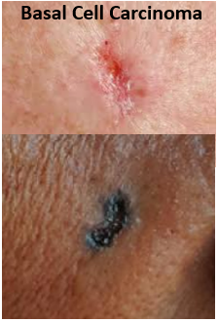
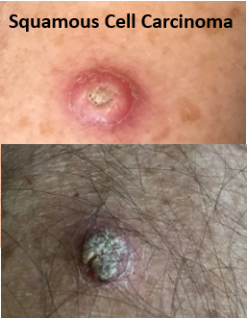
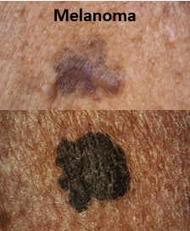
Skin Cancer Awareness
Three Common Types of Skin Cancer:
Basal Cell Carcinoma - usually flat, with an uneven smudgy outline
Squamous Cell Carcinoma - can appear firm, red bump or a flat lesion with scaly surface.
Melanoma - looks similar to a mole with irregular borders and color
Notes:
Here are three common types of skin cancer.
Basal Cell Carcinoma is the most common form. It is usually flat, with an uneven smudgy outline. Can present as a darker flesh color patch of skin sore that heals and then comes back.
Squamous Cell Carcinoma occurs most often on areas of the body exposed to the sun with a firm red bump or flat scaly lesion that heals and then reopens. One tell-tale sign are these lesions may bleed if they are disturbed or bumped.
Melanoma – is the deadliest type of skin cancer. It can grow quickly and become life-threatening. While melanoma may look similar to a mole, there are may differences. A mole can be melanoma if it has irregular borders, if the color of the area is not uniform, or if its diameter is more than 6 millimeters.
Early detection of skin cancer can be a true-life saver. Visit a dermatologist for regular exams if you have a high-risk factor or notice a suspicious change in your skin.

Slide 6
Let’s Collect It for Q3 FY24
Deadline for May 2024 Payments
Notes:
Brad Hamman

Slide 7
Collection Deadline for Quarter 3, FY24
Your help is needed to increase our cash flow. To ensure that your AR payments, bank deposits, cash receipts, and cash balances are properly credited for Quarter 3, all deposits must be made on or before Friday May 31st.
Please observe the following deadlines depending on your payment method.
Select the payment link(s) for your current payment method below for further details :
ELECTRONIC (ACH/WIRE) PAYMENTS
CHECK PAYMENTS
REMINDER:
The preferred method of invoice payments is ACH. ACH payments are timely, more secure and less costly.
Please contact Accounts Receivable at AccountsReceivable.NorAm@sodexo.com or 1-800-828-7762, Option 2, Option 2 for more information and to request the ACH details for your client.

Slide 8
Electronic Payments – Deadline for Quarter 3 FY24
Client ACH payments post to Sodexo’s bank account 1 to 2 business days after the client releases the payment to their bank. Determine with your client Finance or AP Department whether their bank ACH is 1- or 2-Day processing.
2 Day ACH: Wednesday May 29th
If ACH is 2-day processing, ACH must be released from client’s bank on or before the 29th with a value date of May 31st
1 Day ACH: Thursday May 30th
If ACH is a 1-day processing, ACH must be released from client’s bank on or before the 30th with a value date of May 31st
Friday May 31st
For client payments to post to Sodexo’s bank account on Friday May 31st, client must initiate a SAME DAY electronic funds transfer payment on the 31st with a value date of May 31st

Slide 9
Check Payments – Deadline for Quarter 3 FY24
Deadline for Q3 FY24 AR Collections for CHECK payments sent to Lockbox must be deposited in the Lockbox by 10:30 AM (ET) Friday May 31st
Lock Box address:
Sodexo Inc & Affiliates
Attn: 360170
500 Ross St 154-0455
Pittsburgh, PA 15262-0001
Telephone (412) 234-4381
Total Check Amounts | Important Dates | Action to Take
Total Checks greater than $2,500 | Wednesday May 29th | Overnight checks to the Lockbox address above with Next day delivery
Total Checks greater than $2,500 | Thursday May 30th | Overnight checks to the Lockbox with Next Day Air EARLY AM Delivery
Total Checks greater than $100,000 | Friday May 31st before 2:00 PM ET. | Call the FSS AR Department at 1-800-828-7762 option 2, option 2 before 2 PM ET

Slide 10
Payment Fraud
Threat Actors are continuing their efforts posing as Sodexo employee to commit fraud against our clients.
Tell customers NEVER to conduct electronic funds transactions with Sodexo via email. Always call the AR Department to verify any requests and to check the sender’s domain
Ensure that any requests for funds transfer received have 2nd and/or 3rd level validation procedures in place (i.e., DM/GM approvals, always call your customer to verify legitimacy etc.)
Using email for financial transactions in general is strongly discouraged
Immediately contact FSS Accounts Receivables department if you suspect possible fraud at: AccountsReceivable.NorAm@sodexo.com or 1-800-828-7762, Option 2, Option 2
Thank you, your actions are making a difference!

Slide 11
Q&A

Slide 12
Fiori Journal Entry Application Update

Slide 13
SAP Fiori Journal Entry Application
Replaces the Excel Standard Close Adjustment Form used during financial close
The application will replace the Transfer Module in UFS
Phase 1 was rolled out to pilot site operators in July 2023 and contained the following journal entry request types:
Non-Reimbursable Client Expense Adjustments
Labor Transfers
Expense Transfers
Revenue Transfers
Month-End Late Payables
Month-End Sodexo Owned/Managed Inventory Adjustments
Month-End Client Owned Inventory Adjustments
Phase 2 was rolled out this month to the same pilot site operators and contains the following remaining journal entry types:
Month-End Revenue Adjustments - Sales Accrual/Deferral
Month-End Payroll Accrual Adjustments
Month-End Deferral of Expenses
Expense to Contract Accruals
Month-End Operating Statistical Adjustments
Month-End OSI (Operating Statement Input) Adjustments - For School Cost Centers

Slide 14
Journal Entry Application Benefits
Enables Sodexo Users to Post a Transfer or Request an Adjustment During Financial Close
Adjustment Requests Will Be Automatically Routed for Approvals When Appropriate
Transfers and Adjustments Will Be Visible in CCOR Once Posted
Enables Sodexo Users to Upload Applicable Support Documentation

Slide 15
Additional Journal Entry Application Features
Optional Reference Field
Appears in the Document Header for quick reference
Limit 16 characters
Ability to create Templates for future use
Handy for recurring journal entries
Able to change Templates when necessary
Hint Messages available
Tips and Tricks provided for each journal entry type to help users create entries
Available in English and French

Slide 16
Journal Entry (JE) Application Updates
Phase 1 (7 JE types) has been in pilot since July 2023
Period 11 financial close was the first time pilot site operators used the application for financial adjustment requests
Requests are routed to the accountants during close to approve and post the entries
Very few issues or defects were encountered
Pilot site operators provided valuable feedback and suggestions for enhancements to the application
Some enhancements were moved to Production with the Phase 2 JE types this month
More complex enhancements will be developed during the enhancement phase of the project
The project team has been testing the phase 2 journal entry types as they were developed and they are now ready for the pilot site operators to use

Slide 17
Journal Entry Application Next Steps
Pilot site operators will begin using the newly released journal entry types and alert the project team of any issues and provide valuable feedback
Since most of the phase 2 JE types are used only during month-end, the project team would like the pilot site operators to use them for two closes to be sure all is working as expected
When the project team is comfortable that all the JE types in the application are working well, the application will be rolled out to one segment at a time
Roll out will include adding the FOOD O2C or FM O2C roll to user’s Fiori access
Roll out will also include training all users on how to use the application
Once the roll out has been completed for all segments, the transfer module in UFS will be disabled

Slide 18
Questions?

Slide 19
Guidance to improve cash handling on-site

Slide 20
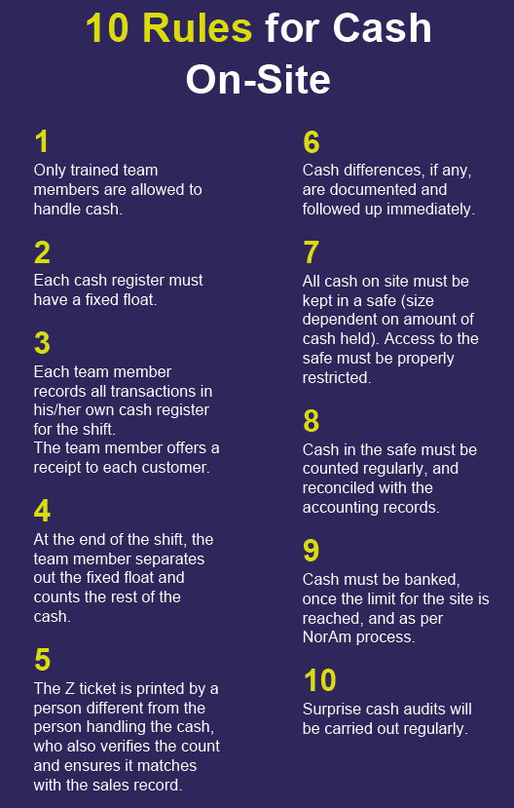
Proper Cash handling is critical to our success
Cash is very attractive; Cash fraud is a question of opportunity. Strong processes and discipline around cash handling is required to help ensure we prevent the risks of fraud, theft or other inappropriate activity.
10 Rules for Cash On-Site
These rules detail the fundamentals that must be implemented and adhered to on site. Refer to Audit and Compliance on SodexoNet.
10 Golden Rules for Cash
These rules detail the fundamentals that must be implemented and adhered to on site and by FSS and Banking. Refer to Appendix (slide 5).

Slide 21
Most Common Findings
Noted from I2C Testing and GIA Investigations
Cash Handling Training module in Ingenium is not completed
Key Cash Controls
Policy: AF Topic 711-01 Cash Controls and Procedures
Segregation of Duties: More than one person must be involved in the cash handling to provide checks and balances (AF 711-01 Exhibit A Segregation of Duties for Cash Handling).
Personnel involved in cash handling should complete the Cash Handling Training in Ingenium.
Each manager must read, sign and retain the Cash Control Rules for Management (Form 1102).
Each person involved in the cash handling process must read, sign, and follow the Cashier Guidelines (Form 1103).
Each cost center must establish cashier handling guidelines for situations unique to the cost center not covered by the Cashier Guidelines such has handling of meal plans.
Management should conduct Surprise Cashier Audits to ensure that each cashier is audited at least once per month (or once per 90 days for Corporate Services, Leisure and Government). Document the audits performed.
Cashier Guidelines are not signed
Surprise Cashier Audit is not being conducted at all sites
Lack of proper segregation of duties
Lack of management oversight

Slide 22
Action
Share this information with your General Managers/Unit Managers to review cash handling – to identify control gaps, implement corrective actions and ensure compliance.
Operational option to limit the risks and improprieties associated to Cash: Consider Going Cashless when possible (if allowed by client contract and local law/regulation) – Please reach out to Banking team.
Questions on Cash Handling / Cash Management: Please reach out to FSS Revenue Accounting by submitting a ticket under Revenue Accounting General Request in SoFinance.
FY24 YTD Cash & Card Volumes (data reflects thru Friday 5/17)
These volumes reflect incoming activity, not just sales.
Note: The reference to Cashless in the above table are card solutions (including Starbucks & Tim Hortons) and not locations no longer accepting Cash.
FY24 YTD Cash & Card Volumes (data reflects beginning of Feb 2024

Slide 23
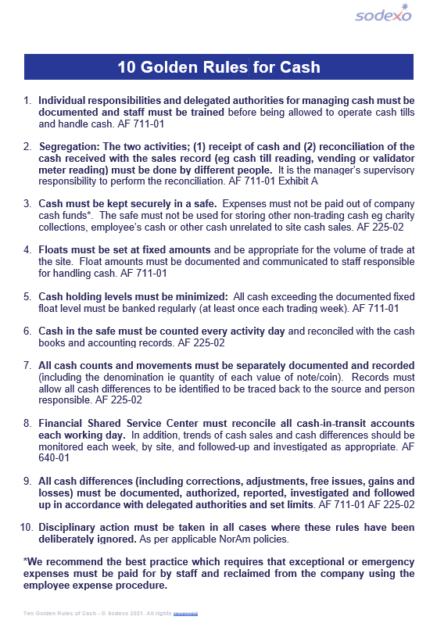
Appendix
10 Golden Rules for Cash

Slide 24
Q&A

Slide 25
Revenue Accounting
Unit Managed Deferred Income
May 2024

Slide 26
Agenda
What is Deferred Income?
How to Report Deferred Income Redemptions
How to Report Deferred Income Loads
Deferred Income Logs
Review Starbucks Gift Card Reporting Procedures
Revenue Accounting Resources

Slide 27
What is Deferred Income?
Deferred Income is when funds are received before a sale occurs
Examples of Deferred Income
Unit Managed Deferred Income Programs
Prepaid Gift Cards/Purchase Cards – G/L 4870.2030
Deferred Income – Miscellaneous – G/L 4870.2001
Enterprise Deferred Income Programs
SoGo – G/L 4870.2075
Chase Gift Cards – G/L 4870.2077
Dynamify Stored Value – 4870.2082
Epay – G/L 4870.2002
Subscriptions
Memberships/Subscriptions – G/L 4870.2015
Kiwibot Subscriptions – G/L 4870.2026
SodexoMyWay – G/L 4870.2040
Deferred Income differs from Unbilled Retail Activity which is when funds have not been collected at the time a sale occurs. This usually happens when the sale is invoiced to the client based on redemptions.
Notes:
Explain what is deferred income
Highlight Prepaid Purchase Cards & Deferred Income Miscellaneous

Slide 28
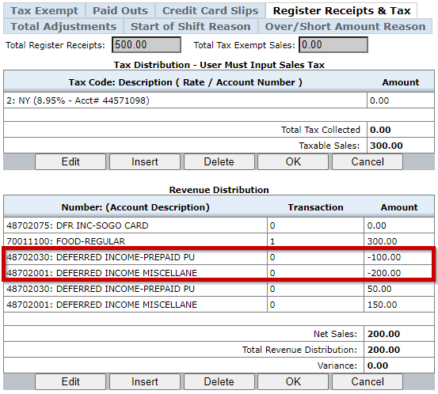
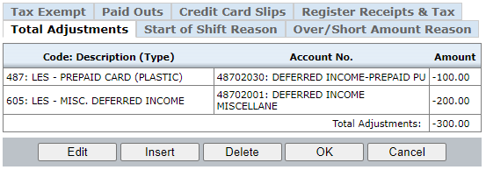
How to Report Deferred Income
In UFS, Deferred Income Redemptions must be reported as less line adjustments in the Adjustments section.

Slide 29
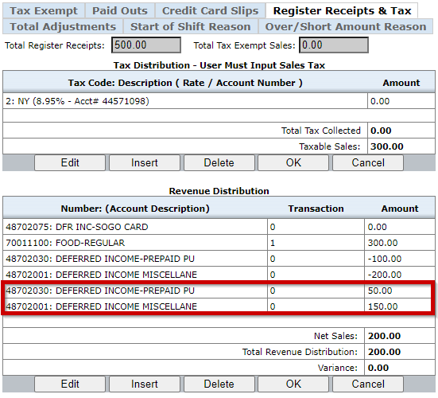
How to Report Deferred Income Loads
In UFS, deferred income loads must be reported as a positive number in the Revenue Distribution section
Do not report deferred income loads as tax exempt sales

Slide 30
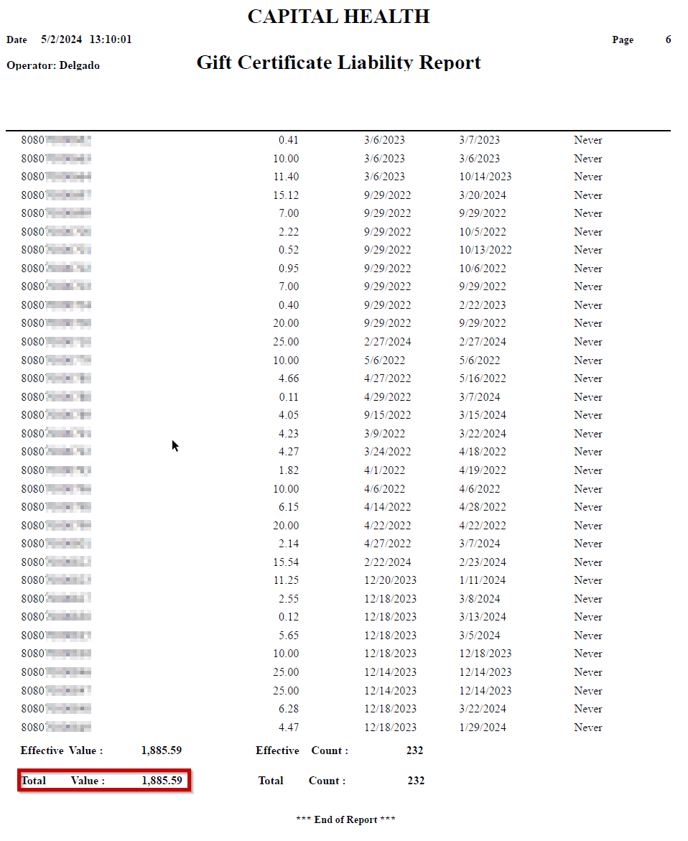
Deferred Income Logs
As a stipulation for utilizing a unit managed deferred income program, units are required to submit a deferred income log no later than EOD on BD+1.
All deferred income programs utilizing a third-party system must be able to generate a report that supports the life-to-date outstanding balance for all card in that program.
Deferred Income Logs should be submitted to: RevenueAccountingLogs.NorAm@sodexo.com

Slide 31
Starbucks Stored Value Cards
Starbucks Stored Value Cards operate like a unit managed deferred income program
Units accepting Starbuck Stored Value Cards should have access to Business Track, with is the third-party system that processes the activity from Starbucks Cards. For access, please submit a SoFinance ticket to NorAm Banking Administration Team using the Credit Card Services request
Starbuck cards should be rung through the POS like all other transactions
On the Starbucks NCR POS reports, mobile orders appear as “MOP”
When reconciling your Business Track report, the total of the Activations and Reloads from the Business Track report should match the total Starbucks Card activations/reloads processed at the POS.
The total Redemptions on the Business Track Report should agree to the total of SBUX Card and MOP (redemptions) from the POS reports.
Notes:
Explain what is deferred income
Highlight Prepaid Purchase Cards & Deferred Income Miscellaneous

Slide 32
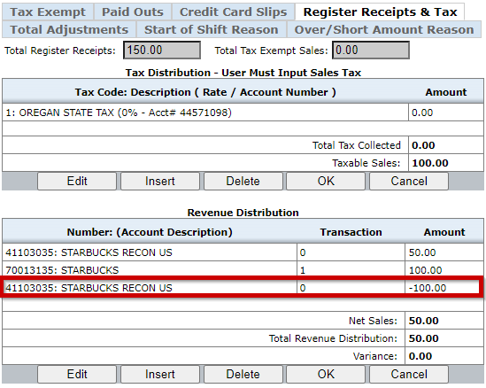
How to Report Starbucks Card Redemptions
In UFS, Deferred Income Redemptions must be reported as less line adjustments in the Adjustments section using Adjustment Code 834 – Redemptions Starbucks-US coded to G/L Account 4110.3035

Slide 33
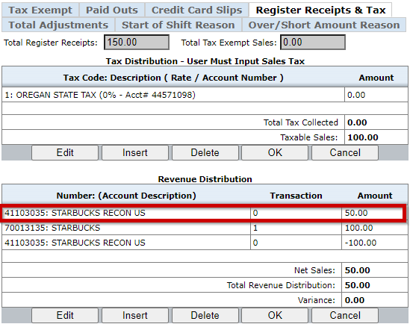
How to Report Starbucks Activations
In UFS, Starbucks activations must be reported as a positive number in the Revenue Distribution section to G/L Account 4110.3035

Slide 34
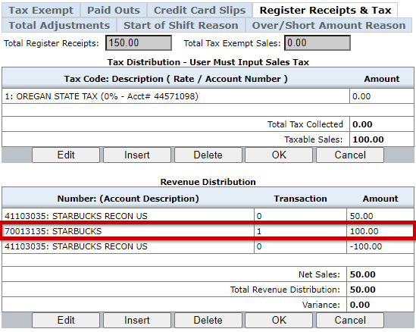
How to Report Starbucks Retail Purchases
In UFS, Starbucks purchases must be reported to G/L Account 7001.3035 (Starbucks) or G/L Account 7001.3036 (Starbucks Coffee) in the Revenue Distribution section.
All applicable sales taxes should be reported as you normally would

Slide 35
Revenue Accounting Resources
ag someone to explain how to do PTO requests and calendar documentation of them
Procedures on Unit Managed Deferred Income and other Revenue Accounting Desk procedures can be found on SodexoNet
If you have any questions, please submit a Revenue Accounting General Request ticket in SoFinance

Slide 36
Questions?

