Slide 1
FY24 Unit Controller Call Series
March, 2024
We’ll get started momentarily
PLEASE keep lines muted
This call will be recorded
corinne.szabo@sodexo.com
Notes:
Welcome – this call will be recorded. Start recording!
Welcome to the FY24 Unit Controller Network call series! The purpose of the monthly Controller Network Call is to inform the network group about topics that impact the controller role on a timely schedule.
The topics in this call series address programs/system updates to support change management, drive adoption and finance reporting best practices. Feedback and topic suggestions are always welcome.
Previous call content resources can be found on the UFS launch site, “Controller Corner,” main page, lower right. Content is posted at the conclusion of each call and distributed in chat during the call. Content is available for previous 6 months.
I am CS, w/ Finance Shared Services (FSS), coordinator of the CN call series, and your host for today.
This is the first/second of two calls for the month of March. If you wish to include other team members for this month’s agenda, please forward the meeting invitation for Thursday am. If you would like to invite other members on your team to join the Controller Network Call Series. please send an email to corinne.szabo@sodexo.com. I will add them to the Controller Network Call meeting invite distribution list.
Thank you for joining today. To anyone new to the network – Welcome to the call series.

Slide 2
Agenda
Safety Moment – Corinne Szabo
Simplify Scanning Solution – Chris Lepovich
SoFinance – Anthony Priore
Q&A
Notes:
To demonstrate our commitment to safety and our safety culture at Sodexo, we begin each meeting with a Safety Moment – I have an open invitation to anyone listening in to volunteer for a future call and present a safety moment. If you’re looking for an opportunity to share a safety experience or learning, or just want to practice presenting, please reach out to me.
Next up:
Simplify Scanning Solution – Chris Lepovich
SoFinance Update – we welcome back Tony Priore
Q&A – we will continue to pause between topics to address questions in chat
Please use the chat function within this Team meeting to submit any questions that you may have as we run through the agenda topics. We will pause to address questions between topics and if we run out of time we will follow up via email.
Finally – feel free to use the Reactions button as we proceed through today’s call. With everyone muted, it is a nice way to contribute and engage and we appreciate the energy.

Slide 3
Safety Moment
Stay Hydrated!

Slide 4
Are you drinking enough WATER?
Water Benefits
Water helps your body:
Keep a normal temperature.
Lubricate and cushion joints.
Protect your spinal cord and other sensitive tissues.
Get rid of wastes through urination, perspiration, and bowel movements.
Your body needs more water when you are:
In hot climates.
More physically active.
Running a fever.
Having diarrhea or vomiting.
Tips to Drink More Water
Carry a water bottle with you and refill it throughout the day.
Freeze some freezer safe water bottles. Take one with you for ice-cold water all day long.
Choose water over sugary drinks.
Opt for water when eating out. You’ll save money and reduce calories.
Serve water during meals.
Add a wedge of lime or lemon to your water. This can help improve the taste.
Make sure your kids are getting enough water too. Learn more about drinking water in schools and early care and education settings.
Notes:
With warmer weather fast approaching, take a minute to assess your water intake and steps to ensure you’re meeting recommendations.
Getting enough water every day is important for your health. Drinking water can prevent dehydration, a condition that can cause unclear thinking, result in mood change, cause your body to overheat, and lead to constipation and kidney stones. Water has no calories, so it can also help with managing body weight and reducing calorie intake when substituted for drinks with calories, such as sweet tea or regular soda.

Slide 5
Mindful is full plates. Full flavor. Positive support for your journey to good health.
Visit mindful.sodexo.com for recipes, fitness tips, motivation and a lot more!
Try the Hydration Calculator
How Much Water Do I Need?
Our Hydration Calculator helps you figure out how much water you need to drink today.
TRY THE HYDRATION CALCULATOR

Slide 6
https://www.mindful.sodexo.com/
Notes:
Why Mindful?
Sodexo is committed to creating healthy environments for our customers. Central to this effort is providing healthy, nutritious foods. We’ve listened to our customers. We’ve researched marketplace trends. Our executive chefs and registered dietitians worked together to create an exciting collection of recipes. The result is Mindful by Sodexo – an approach that focuses on transparency of ingredients, delicious food, satisfying portions and clarity in message so that making Mindful choices becomes second nature. While designed for use in our cafes, Mindful is an approach that you can easily adopt at home with your family.
https://www.mindful.sodexo.com/

Slide 7
Simplify Scanning Solution
Notes:
Chris Lepovich

Slide 8
Simplify Scanning Solution
Financial Shared Services has in place a scanning solution for Unit Transmittals and Non-Halo Cash Management documents.
This process will cut labor time in half and eliminate the cost of mailing files to the BSC.
Eliminates the cost of envelopes.
No need to make copies of paperwork anymore.
Follow this link for the required training on this process: https://us.sodexonet.com/home/tools-x0026-resources/guidelines-and-standards/operations/accountingx002c-finance-x0026-in/reference-library/ap-support-center/document-scanning-solutions.html
Contact Chris Lepovich-Manager Imaging/Record Retention at chris.Lepovich@Sodexo.com with any questions.

Slide 9
Simplify Scanning Solution

Slide 10
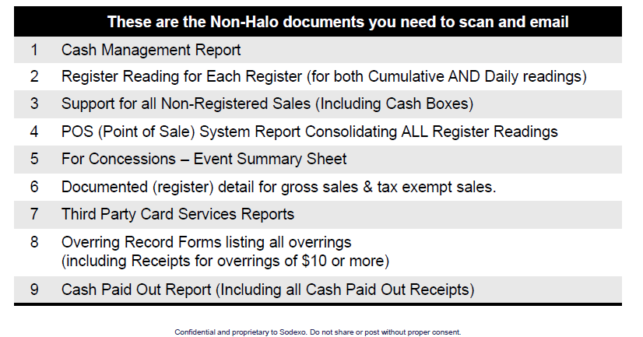
Simplify Scanning Solution

Slide 11
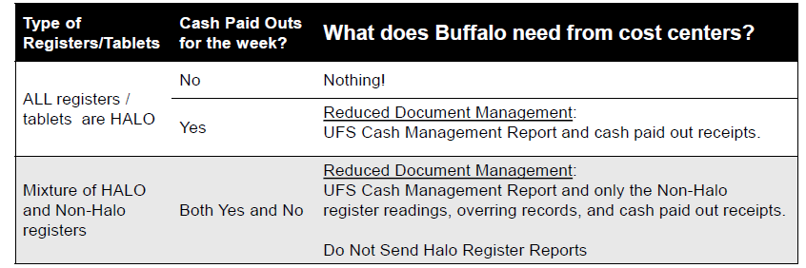
Simplify Scanning Solution
If your cost center is on the Sodexo Halo Network, the Financial Shared Services center automatically generates Halo Sales & Operations Reports for central record retention.
The matrix below details what the FSS needs to receive from your cost center (based on the types of register or tablets you use – and whether or not you have cash paid-out activity).

Slide 12
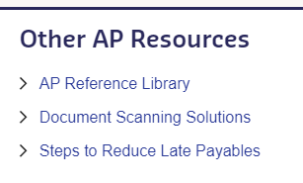
Simplify Scanning Solution
Training information For the Simplified Scanning Solution
There is a link on SodexoNet that will take you to a training video on this process. Below is a screenshot of where to find it:
Scroll down to the bottom of the page on the right-hand side you will see “Other AP Resources.” Click on “Document Scanning Solution”
On the Document Scanning Solution page you will find all the resources you need including a Training Video and an explanation of what documents need to be scanned.
Contact Chris Lepovich-Manager Imaging/Record Retention at chris.Lepovich@Sodexo.com with any questions.
Accounts Payable (AP) Support Center
Required Training Video
Watch the Document Scanning Solution Training video
Notes:
https://us.sodexonet.com/home/tools-x0026-resources/guidelines-and-standards/operations/accountingx002c-finance-x0026-in/reference-library/ap-support-center.html

Slide 13
Record Retention
Closing Cost Center Information
• If your unit is closing you will receive an email from me regarding what the guidelines are for all your paper documents. If you do not receive one, contact me.
• Do not send your records to the FSC. I will provide you with the address to ship to.
• Follow the Guidelines that are sent to you.
• Unit Name, Unit # and a brief description of the contents need to be written on the face of the box.
• If you are sending your Cash Mgmt and Unit Trans in weekly to the Records Dept these documents can be discarded.
• Contact me with any questions chris.Lepovich@sodexo.com.

Slide 14
Q&A

Slide 15
Getting Ready for Phase II
Communication Deck for Ops Teams
Notes:
Hello everyone, I’m (name and role) and I asked for a few minutes on the agenda to talk about SoFinance.
(NEXT SLIDE)

Slide 16
Two Phases of Deployment
Phase I (Pilot)
Go Live
Phase II
Go Live
December
11th
Happening Now…
April
22nd
Coming Soon…
Accounts Receivable
Banking Administration
Credit & Collections Management
Finance Continuous Improvement & Integrations
Revenue Accounting
PCards
UFS
R2R - Segment Support
(Includes Accountant of Record)
R2R – Corporate Activities
Contract Analytics & Reporting
P2P
Internal Controls
Banking
Notes:
So Finance is rolling out in two phases – which you can see on the screen.
Phase I – the pilot was launched in December and some of you have most likely already interacted with it.
The team specifically limited the roll out to so they could learn from the pilot and course correct prior to the second roll out.
Phase I covered the FSS/Banking functions you see on the screen.
CLICK
For Phase II – the REST of Finance Shared Services & Banking will begin using SoFinance, WHICH MEANS SIGNIFICANTLY MORE OF YOU WILL INTERACT WITH SOFINANCE IF THEY HAVE NOT DONE SO ALREADY
Today – you only interact with SoFinance if you have a service request regarding one of the functions on the left side of the screen – while for the other functions you do not.
For this reason, the team did a soft launch, meaning they helped people start to know what to expect and encouraged them to use SoFinance, but we didn’t actively drive people to use it yet since the whole menu of FSS & Banking functions was not yet available.
Soon –April 22nd to be exact, you will interact with SoFinance for ALL FSS/Banking functions – and the functions added in phase II handle a high volume of inquiries – so if you have not interacted with SoFinance, you most likely will after April 22nd–

Slide 17
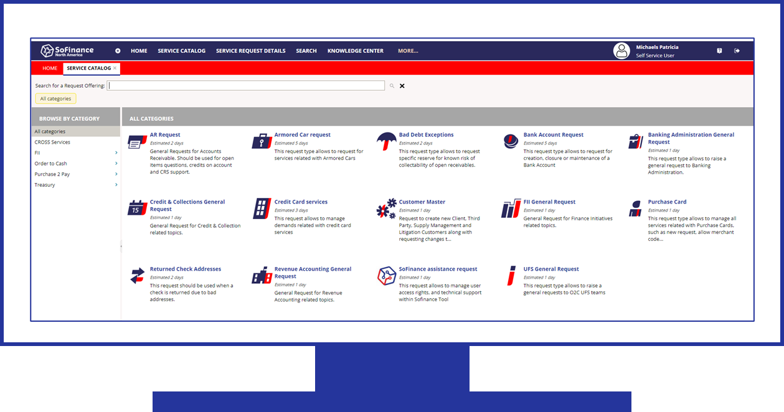
- The Experience
 | You are strongly encouraged to use the SoFinance self-service portal to submit service requests to Finance Shared Services & Banking You will receive a ticket number via a SoFinance e-mail You can monitor your request directly in the SoFinance poral
 | For future correspondence related to a specific service request: You may reply to the SoFinance email Or add comments directly within the SoFinance portal.
 | If you happen to contact FSS/Banking by e-mail or phone, you will receive a SoFinance e-mail confirmation: Acknowledges your request Provides a ticket number and a link to the SoFinance portal where you can monitor progress.
Notes:
Overall, SoFinance is fairly intuitive, but if you are not used to it, it will take a small learning curve.
For those of you who have already used SoFinance, this is not new information, but for those of you who have not, this can be helpful.
The first thing to know is that after the roll out of Phase II – essentially all inquiries to Finance Shared Services/Banking will cause a ticket to be created. (there are a few exceptions – but this is the general rule)
Right now, tickets are only created for requests submitted to the FSS/Banking departments included in the pilot phase.
The ticket is important because it houses all correspondence, notes, and the final resolution for request for support.
The best thing to do is to start using the SoFinance portal to submit service requests to Finance Shared Services & Banking. We want you to get used to using SoFinance to initiate inquiries instead of using shared mailboxes or the phone, because this is most direct way to get a resolution to your request. Also, when you e-mail Finance Shared Services , you create a high probability of duplicate tickets that can cause unnecessary correspondence and confusion.
But if you happen to contact FSS/banking the old way, a ticket will still be created for you to track your inquiry through to the end. If you go straight to SoFinance yourself, you are eliminating the “middle man” – either human or automated – to translate your request into a ticket.
Once a ticket is created, you can continue to communicate about the request in two ways:
You can respond to the sofinance e-mail (be sure not to change the subject line), and your correspondence will be captured in the ticket or…..
You can go straight into the SoFinance portal to add comments and information to the ticket. When you are in the portal, you can monitor progress or communicate on all of your open ticket if you have more than one, and you can also look up completed tickets.
DO NOT continue to use regular Outlook e-mail to follow –up or it could create duplicate tickets and confusion.
Also be aware, on April 22nd, when phase II goes live, tickets will be created for any requests to FSS/Banking that has not yet been resolved – so for this point in time only, tickets and confirmation e-mails will be created for “in flight” topics.
Next Slide

Slide 18
Getting Ready for Phase II
Getting Yourself Ready
Helping Your Team Get Ready
Lead by Example
Become familiar with SoFinance by using it
Take the E-Learning and review the user guides
Help your team get ready
Build Awareness & Capability
Discuss SoFinance with your teams who interact with Finance Shared Services & Banking
Encourage your team to visit the SoFinance page on Sodexo_Net
Take the E-Learning
Practice Using the SoFinance portal
Notes:
So what can you do to get ready?
First – I encourage you to lead by example
Become familiar with SoFinance by using it
Take the e-learning and review the user guides
Help your team members who interact with Finance Shared Services & Banking get ready
CLICK
Now, to help your team get ready…….
Discuss SoFinance with your teams who interact with Finance Shared Services & Banking
Encourage your teams to access the resources on Sodexo_net – if nothing else, at least the brief e-learning course
And encourage them to visit the SoFinance portal itself – it’s open now for the pilot functions – they can play around and do everything up to hitting “submit” if they are playing – or if they have a real service request, then of course , submit it!

Slide 19
Resources
Accessing the SoFinance Portal
SoFinance Resources
Sodexo_Net
Sodexo_Net
SoFinance Page
E-Learning
Quick Reference User Guide
Comprehensive User Guide
Quick Tip for Including Screenshots
SoFinance Page
SoFinance
Quick Link
My Sodexo
KNOWLEDGE ARTICLES
Notes:
No as I mentioned, SoFinance is fairly intuitive, but it still takes a little practice
First, let’s talk about how to access the SoFinance Portal
On sodexonet – you can set up a quick link from the choices provided– or it might already be in your quick link selection area.
You can also access the link on the SoFinance page of Sodexonet
And you can also access so finance through the my Sodexo applications button on the Sodexo north America home page
The user guide also walks you through how to set up a desk top short cut to get to the portal
Now, how to get support – again ,the sofinance sodexonet page has links to resources such as a brief e-learning course, which I strongly encourage you to take –
I’ll put the e-learning link in chat since the publishers are still working on adding the link to the page, plus there is a quick reference and a comprehensive user guide.
Within the sofinance portal – the home page also has a knowledge article section with additional support materials.

Slide 20
Questions?
Notes:
What questions do you have?
Note, if you receive a question that you don’t know how to answer, please reach out to Patricia Michaels or Anthony Pirore for follow-up.

