Slide 1
FY23 Unit Controller Call Series
March 2023
We’ll get started momentarily
PLEASE keep lines muted
This call will be recorded
corinne.szabo@sodexo.com
Notes:
Welcome – this call will be recorded. Start recording!
Welcome to the Unit Controller Network call series!
The purpose of the monthly Controller Network Call is to inform the network group about topics that impact the controller role on a timely schedule.
The topics in this call series address programs/system updates to support change management, drive adoption and finance reporting best practices. Feedback and topic suggestions are always welcome.
Previous call content resources can be found on the UFS launch site, “Controller Corner,” main page, lower right. Content is posted at the conclusion of each call and distributed in chat during the call. Content is available for previous 6 months.
I am CS, w/ Financial Shared Services (FSS), coordinator of the CN call series, and your host for today.
This is the first of two calls for the month of March. If you wish to include other team members for this month’s agenda, please forward the meeting invitation for Thursday am. If you would like to invite other members on your team to join the Controller Network Call Series. please send an email to corinne.szabo@sodexo.com. I will add them to the Controller Network Call meeting invite distribution list.
Thank you for joining today. To anyone new to the network – Welcome to the call series.

Slide 2
Agenda
Safety Moment – Jill Helms
E=Vision has a New Look – Susan Chapman
Sodexo Labor – Scott Myer, Tom Simpson
Q&A
Notes:
Today’s agenda
To demonstrate our commitment to safety and our safety culture at Sodexo, we begin each meeting with a Safety Moment – I have an open invitation to anyone listening in to volunteer for a future call and present a safety moment. If you’re looking for an opportunity to share a safety experience or learning, or just want to practice presenting, please reach out to me.
Today we welcome back Jill Helms to present
E=Vision has a new look! Susan Chapman is here to demo the new E=Vision links and icons
Are incorrect pay issues impacting your employees? Scott Myer from labor optimization team is here to present this topic
Please use the chat function to submit any questions that you may have as we run through the agenda topics. We will pause to address questions between topics and if we run out of time we will follow up via email. Please keep your questions related to the topic in focus – you can always email me directly with questions, comments, or concerns.

Slide 3
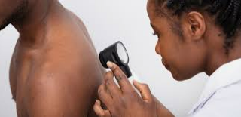
Safety Moment
Skin Cancer Awareness
Notes:
Keeping in theme with Health & Wellness, today’s Safety Moment is a personal one for me - Skin Cancer Awareness. I know some of you are still dealing with snow but with Spring and Summer comes fun in the sun! As you have fun in the sun, here are some tips on how to stay safe and protected from one of the leading causes of skin cancer. Over the past year I have had 6 spots removed that were cancer. One spot on my face turned out to be Melanoma and to get it all they nearly cut completely through my cheek.
Next slide …

Slide 4
Skin Cancer Awareness
Check your skin! Skin cancers can be found early with skin exams. Perform a monthly skin exam following the “A B C D E F G” warning signs. Early detection of skin cancer can be a true-life saver.
A
Asymmetry – is the mole irregularly shaped?
Borders – Are the borders/edges uneven?
Color – is the mole multi=colored?
Diameter – is the mole larger than 6 mm? a bit shy of ¼ “
Evolution – has the mole changed over time?
Firm – is the mole harder than the surrounding skin?
Growing – is the mole gradually getting larger?
B
C
D
E
F
G
Notes:
Unprotected exposure to UV Rays via sunlight or indoor tanning beds can be extremely hazardous to your health. To help lower your skin cancer risk, always protect your skin from the sun and avoid indoor tanning.
Check your skin! Most skin cancers can be found early with skin exams. Perform a monthly skin exam following the “A B C D E F G” warning signs. Early detection of skin cancer can be a true-life saver. Visit a dermatologist for regular exams if you have a high-risk factor or notice a suspicious change in your skin.
Next slide…

Slide 5
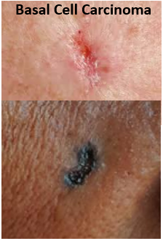
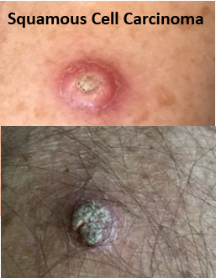
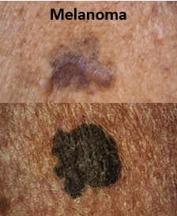
Skin Cancer Awareness
Three Main Types of Skin Cancer:
Basal Cell Carcinoma - usually flat, with an uneven smudgy outline
Squamous Cell Carcinoma - can appear firm, red bump or a flat lesion with scaly surface.
Melanoma - looks similar to a mole with irregular borders and color
Notes:
There are three main types of skin cancer.
Basal Cell Carcinoma is the most common form. It is usually flat, with an uneven smudgy outline. Can present as a darker flesh color patch of skin sore that heals and then comes back.
Squamous Cell Carcinoma occurs most often on areas of the body exposed to the sun with a firm red bump or flat scaly lesion that heals and then reopens. One tell-tale sign are these lesions may bleed if they are disturbed or bumped.
Melanoma – is the deadliest type of skin cancer. It can grow quickly and become life-threatening. While melanoma may look similar to a mole, there are may differences. A mole can be melanoma if it has irregular borders, if the color of the area is not uniform, or if its diameter is more than 6 millimeters.
Next slide….

Slide 6
Skin Cancer Awareness
It’s best to use sun protection year-round. Working in the yard, watching a ballgame, or taking an afternoon walk, make sun safety an everyday habit so you can avoid getting a sunburn and lower your chance of getting skin cancer.
Sun Protection can help reduce your risk!
Wear sun protective clothing - Look for clothing with a protection rating of 50 or better
Wear sunscreen - with an SPF of 15 or higher
Seek shade - especially between 10 - 2
Wear Sunglasses - check the UV protection rating
Put on a hat - wear a broad-brimmed hat
Some “Not so Fun” Facts:
1 in 5 Americans will develop skin cancer in their lifetime
A person's risk for Melanoma doubles if they have had more than 5 sunburns, at any age
20 – 30% of melanomas are found in existing moles
More people develop skin cancer from tanning that develop lung cancer from smoking
Sun damage is cumulative. Only about 23 percent of lifetime exposure occurs by age 18
Notes:
Sun protection is important all year round, any time you are outside. When you’re working in the yard, watching a ballgame, or taking an afternoon walk, make sun safety an everyday habit so you can avoid getting a sunburn and lower your chance of getting skin cancer. You probably put sunscreen on yourself and your kids when you go to the pool or the beach. But you should protect your skin with more than just sunscreen.
Wear sun protective clothing – look for a label of UPF 50
Wear sunscreen- the FDA recommends that you use broad spectrum sunscreen with an SPF of 15 or higher, even on cloudy days. Apply sunscreen liberally and reapply every two hours to all uncovered skin, especially your nose, ears, neck, hands, feet, and lips. If you take medications, ask your health care professional about sun-care precautions. Consult a physician before applying sunscreen to infants younger than 6 months.
Seek shade – Limit your time in the sun, especially between 10 a.m. and 2 p.m., when the sun’s rays are most intense
Wear Sunglasses – Choose sunglasses with a UV400 rating or “100% UV protection” on the label. These sunglasses block more than 99% of UVA and UVB radiation and provide the most protection against UV rays
Put on a hat – with a wide brim of at least 2 inches
Some not so fun facts:
1 in 5 Americans will develop skin cancer in their lifetime
A person's risk for Melanoma doubles if they have had more than 5 sunburns, at any age
20 – 30% of melanomas are found in existing moles
More people develop skin cancer from tanning that develop lung cancer from smoking
Sun damage is cumulative. Only about 23 percent of lifetime exposure occurs by age 18

Slide 7
E=Vision Updates Demo
March 2023
Notes:
E=Vision has a new look! Susan Chapman is here to review the new E=Vision links and icons.

Slide 8
E=Vision UI Update
March 14, 2023

Slide 9
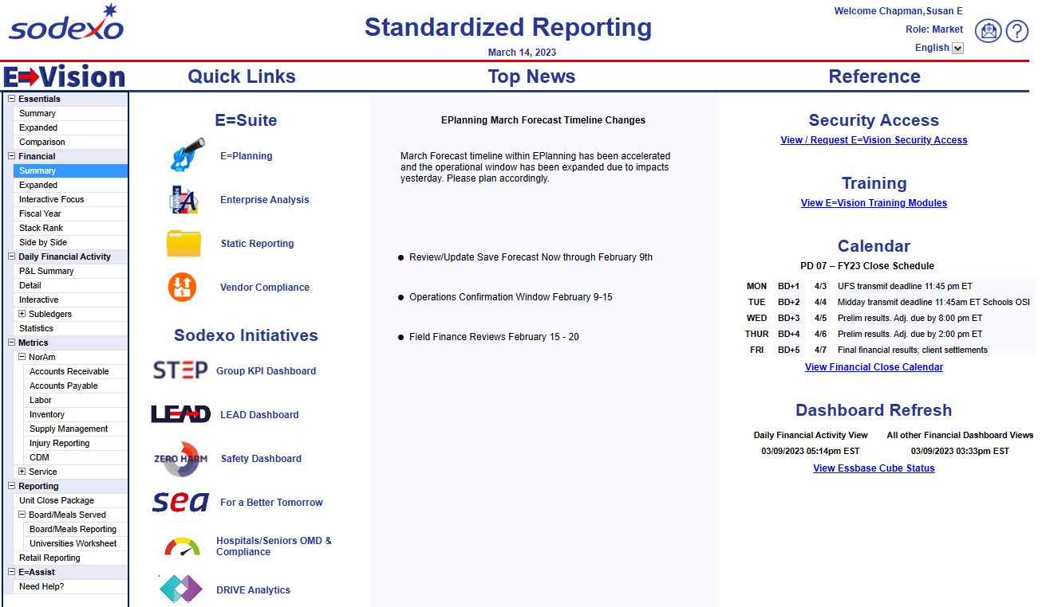
E=Vision UI Update
Landing Page
New Features
New support icons
Access any page in the dashboard
Quick links streamlined to only show other dashboard/module interactions
Focused reference section
New security display and links

Slide 11
E=Vision UI Update
Header
New Features
New icons
Cleaner view
Updated Navigation Bar
Icons | Actions
Home | Return to the landing page
Email | Submit feedback, questions, or issues to the reporting team
Question | View support guides containing tips, tricks, and calculations. If multiple options are available, select desired content.
Export | Select the format you want to export data from the options listed. Each page may have different options for PDF, Excel and/or Specialty Reports.
Hierarchy | Select a different hierarchy view or consolidation based on hierarchy access.
Attribute | Appears when data onscreen is filtered by an attribute.
Favorite | Select from your saved favorite hierarchy/attribute selections.
Links to other Dashboards | Quick links designed to navigate users to other reporting to support their business decisions.

Slide 12
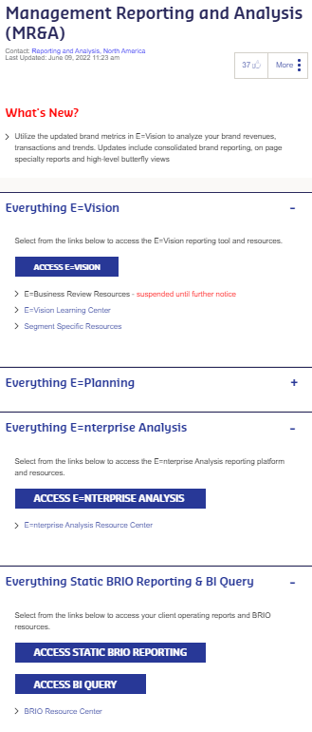
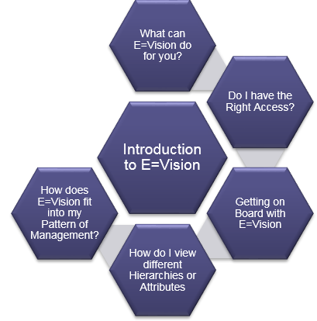
Resources
Technical Assistance: 888-667-9111 and follow the prompts for E=Vision
Functional Assistance: ReportingAndAnalysis.Noram@Sodexo.com
Access Resources from MR&A Page on Sodexo Net.
Learning Center
View Micro Trainings
Access Support Guides
Enterprise Analysis
Support Guides
On Screen Assistance
Click on ? Icons to view instructions, quick tips & calculation information
Open E=Assist tab to view Micro learning videos or support materials

Slide 13
Questions

Slide 14
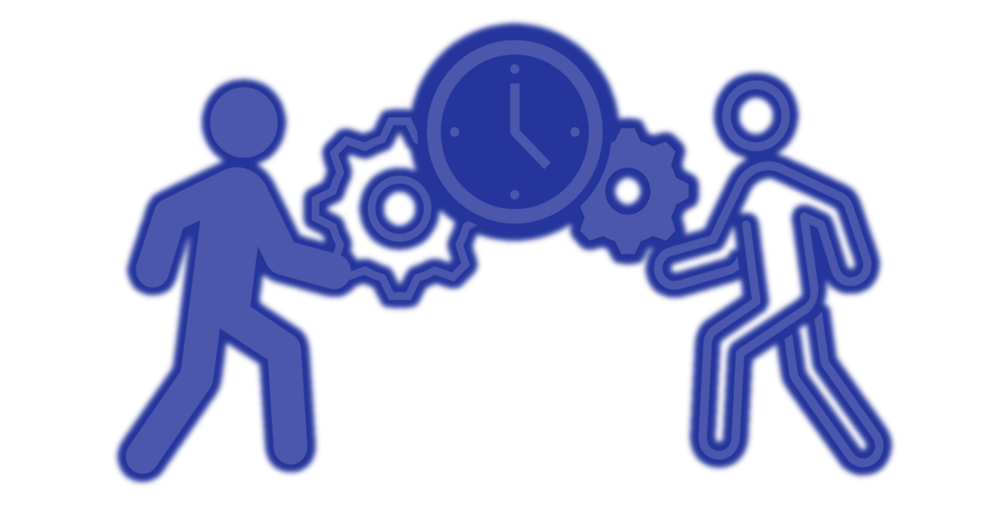
The Cost of Incorrect Pay
Sodexo Labor Optimization Team
Sodexo Labor Optimization Team
Notes:
(Turn over visual and audio to Scott Meyer from Sodexo Labor Team)
Welcome to the Demand Based Operations overview with the Labor Pulse as the supporting tool to manage our labor performance

Slide 15
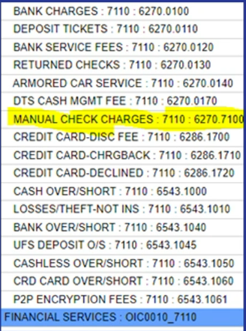
Historical Edits & Manual Checks
Incorrect Pay Causes:
FRUSTRATION!!!
Poor Morale
Financial Hardship
Additional Work
Additional Expense
Sodexo currently issues 1500 manual pay checks per month
This is costing all of us over $500,000 per year!

Slide 16
How You Can Save Your Unit $$$
Have Employees Approve Their Timecard Before Processing Payroll
How? Its Easy!!!
Employees should approve their timecard after their last punch for the pay period
They can do this at the timeclock, within Web Timestamp or Kronos Mobile
Managers can print the Kronos Employee Punch Detail Report and have Employees sign off and then retain.

Slide 17
WIIFMs – What's In It For Me??
Fix or Eliminate Pay Errors Before They Happen!
Less Frustration, Better Morale for EVERYONE!
Getting Paid Correctly Helps Employee Retention
Less Work
Less Stress for EVERYONE
Improved Compliance with Sodexo Policies and Procedures
Reduced Audit Risk

Slide 18
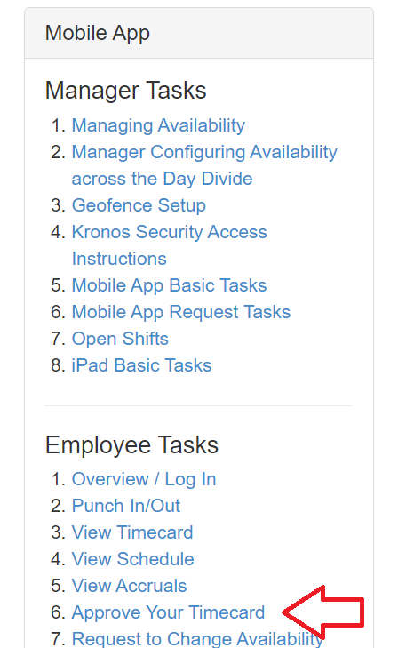
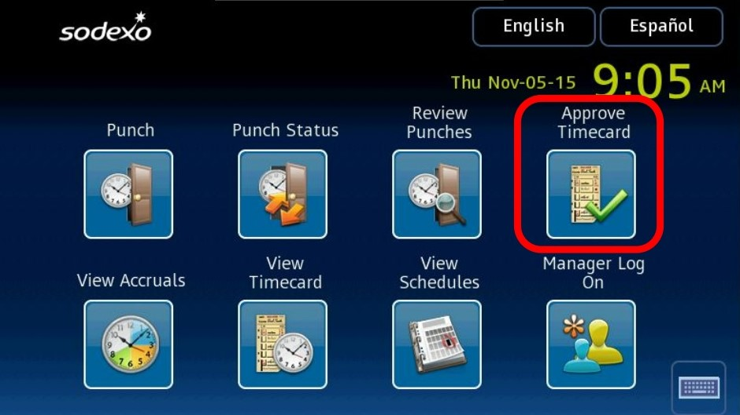
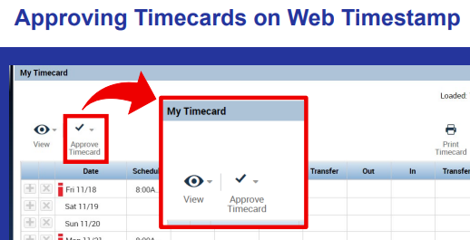
More Information
The Labor and Kronos Resource page is Your Source for More Information
Next to the Access Kronos button
Approving at the clock is found in our Training Video Library, click on Timeclocks
Web Timestamp training is located under the Kronos Scheduling and Timekeeping menu
Click the image to access the resource
Notes:
If there is time, demo the navigation to these resources.
If no time, mention that the each image has a direct link to the resource and that they may have to scroll within each resource to find the Approval content.

Slide 19
Questions?

Slide 20
Thank you

