Slide 1
FY24 Unit Controller Call Series
July, 2024
We’ll get started momentarily
PLEASE keep lines muted
This call will be recorded
corinne.szabo@sodexo.com
Notes:
Welcome – this call will be recorded. Start recording!
Welcome to the FY24 Unit Controller Network call series! The purpose of the monthly Controller Network Call is to inform the network group about topics that impact the controller role on a timely schedule.
The topics in this call series address programs/system updates to support change management, drive adoption and finance reporting best practices. Feedback and topic suggestions are always welcome.
Previous call content resources can be found on the UFS launch site, “Controller Corner,” main page, lower right. Content is posted at the conclusion of each call and distributed in chat during the call. Content is available for previous 6 months.
I am CS, w/ Finance Shared Services (FSS), coordinator of the CN call series, and your host for today.
This is the first/second of two calls for the month of July. If you wish to include other team members for this month’s agenda, please forward the meeting invitation for Thursday am. If you would like to invite other members on your team to join the Controller Network Call Series. please send an email to corinne.szabo@sodexo.com. I will add them to the Controller Network Call meeting invite distribution list.
Thank you for joining today. To anyone new to the network – Welcome to the call series.

Slide 2
Agenda
Safety Moment – Jill Helms
Q4 Collections – Brad Hamman
Internal Control Updates –
Rubylyn Tantoy, Yvonne Daloise, Chad Mayerhofer
Inventory Management Year-End Inventory/Cash Audit NorAm Site Audit Program
New Identity Access Management Form (SoUnified)
*UFS Update Access – Corinne Szabo, Jill Helms
Stars of Finance Reminder
Q&A
Notes:
Our July Agenda:
To demonstrate our commitment to safety and our safety culture at Sodexo, we begin each meeting with a Safety Moment – I have an open invitation to anyone listening in to volunteer for a future call and present a safety moment. If you’re looking for an opportunity to share a safety experience or learning, or just want to practice presenting, please reach out to me.
From our FSS Order to Cash team we have Brad Hamman from Credit & Collections to review Q4 collections
From FSS Integrated Internal Control we have Yvonne Daloise & Chad Mayerhofer, led by Rubylyn Tantoy to cover
Internal Control Updates – which includes
Inventory Mgt
YE Inventory/Cash Audit
NorAm Site Audit Program
To continue the introduction of the new Identity & Access Management Form (SoUnified) –
This month we’ll provide an update on the UFS Access process. Last month we had Susan Chapman join us to demonstrate E=vision access requests via the new form on SoUnified, (check the recording if you want to revisit that topic, or if you missed it) and this month Jill Helms, and I will cover from the FSS Unit financial system Initiatives team
Q&A
Please use the chat function within this Team meeting to submit any questions that you may have as we run through the agenda topics. We will pause to address questions between topics and if we run out of time we will follow up via email.
Finally – feel free to use the Reactions button as we proceed through today’s call. With everyone muted, it is a nice way to contribute and engage and we appreciate the energy.

Slide 3
Safety Moment
Thunderstorms & Lightning
Notes:
With heat comes thunderstorms and lightning! Here are some tips to help keep you safe during a storm.

Slide 4
Stay Safe During Thunderstorms & Lightning
Know your area’s risk for thunderstorms. In most places they can occur year-round at any hour.
Thunderstorms are dangerous storms that include lightning and can create or cause:
Powerful winds over 50 mph
Hail
Flash flooding and/or tornadoes
If you are under a thunderstorm warning:
When thunder roars, go indoors! Move from outdoors into a building or car with a roof.
Pay attention to alerts and warnings.
Avoid using electronic devices connected to an electrical outlet.
Avoid running water.
Turn Around. Don’t Drown! Do not drive through flooded roadways. Just six inches of fast-moving water can knock you down, and one foot of moving water can sweep your vehicle away.
Pay attention to authorities and weather forecasts for information on whether it is safe to go outside and instructions regarding potential flash flooding.
Watch for fallen power lines and trees. Report them immediately.
For more information, visit: Thunderstorms & Lightning | Ready.gov
Notes:
Know your area’s risk for thunderstorms. In most places they can occur year-round at any hour. Lightning is a leading cause of injury and death from weather-related hazards. Although most lightning victims survive, people struck by lightning often report a variety of long-term, debilitating symptoms.
Thunderstorms are dangerous storms that include lightning and can create or cause:
Powerful winds over 50 mph
Hail
Flash flooding and/or tornadoes
If you are under a thunderstorm warning:
When thunder roars, go indoors! Move from outdoors into a building or car with a roof.
Pay attention to alerts and warnings.
Avoid using electronic devices connected to an electrical outlet.
Avoid running water.
Turn Around. Don’t Drown! Do not drive through flooded roadways. Just six inches of fast-moving water can knock you down, and one foot of moving water can sweep your vehicle away.
Pay attention to authorities and weather forecasts for information on whether it is safe to go outside and instructions regarding potential flash flooding.
Watch for fallen power lines and trees. Report them immediately.

Slide 5
Let’s Collect It for Q4 FY24!
Deadline for August 2024 Payments

Slide 6
Collection Deadline for Quarter 4, FY24
Your help is needed to increase our cash flow. To ensure that your AR payments, bank deposits, cash receipts, and cash balances are properly credited for Quarter 4, all deposits must be made on or before Friday August 30th.
Please observe the following deadlines depending on your payment method.
Select the payment link(s) for your current payment method below for further details :
ELECTRONIC (ACH/WIRE) PAYMENTS
CHECK PAYMENTS
REMINDER:
The preferred method of invoice payments is ACH. ACH payments are timely, more secure and less costly.
Please contact Accounts Receivable at AccountsReceivable.NorAm@sodexo.com or 1-800-828-7762, Option 2, Option 2 for more information and to request the ACH details for your client.

Slide 7
Electronic Payments – Deadline for Quarter 4 FY24
Client ACH payments post to Sodexo’s bank account 1 to 2 business days after the client releases the payment to their bank. Determine with your client Finance or AP Department whether their bank ACH is 1- or 2-Day processing.
2 Day ACH: Wednesday August 28th
If ACH is 2-day processing, ACH must be released from client’s bank on or before the 28th with a value date of August 30th
1 Day ACH: Thursday August 29th
If ACH is a 1-day processing, ACH must be released from client’s bank on or before the 29th with a value date of August 30th
Friday August 30th
For client payments to post to Sodexo’s bank account on Friday August 30th, client must initiate a SAME DAY electronic funds transfer payment on the 30th with a value date of August 30th

Slide 8
Check Payments – Deadline for Quarter 4 FY24
Deadline for Q4 FY24 AR Collections for CHECK payments sent to Lockbox must be deposited in the Lockbox by 10:30 AM (ET) Friday August 30th
Lock Box address:
Sodexo Inc & Affiliates
Attn: 360170
500 Ross St 154-0455
Pittsburgh, PA 15262-0001
Telephone (412) 234-4381
Total Check Amounts | Important Dates | Action to Take
Total Checks greater than $2,500 | Wednesday August 28th | Overnight checks to the Lockbox address above with Next day delivery
Total Checks greater than $2,500 | Thursday August 29th | Overnight checks to the Lockbox with Next Day Air EARLY AM Delivery
Total Checks greater than $100,000 | Friday August 30th before 2:00 PM ET. | Call the FSS AR Department at 1-800-828-7762 option 2, option 2 before 2 PM ET

Slide 9
Present and Pay
Please consider utilizing Sodexo’s secure online invoice delivery and payment platform, Citi Present and Pay.
Additional features included in the platform:
View and download Invoices and Monthly statements
Schedule automatic delivery of Invoices and Statements
Set up recuring or auto payments
Securely manage bank details
Raise and manage invoice disputes
If interested in utilizing, please contact CRSTeam.Noram@sodexo.com.

Slide 10
Payment Fraud
Threat Actors are continuing their efforts posing as Sodexo employee to commit fraud against our clients.
Tell customers NEVER to conduct electronic funds transactions with Sodexo via email. Always call the AR Department to verify any requests and to check the sender’s domain
Ensure that any requests for funds transfer received have 2nd and/or 3rd level validation procedures in place (i.e., DM/GM approvals, always call your customer to verify legitimacy etc.)
Using email for financial transactions in general is strongly discouraged
Immediately contact FSS Accounts Receivables department if you suspect possible fraud at: AccountsReceivable.NorAm@sodexo.com or 1-800-828-7762, Option 2, Option 2
Thank you, your actions are making a difference!

Slide 11
Q&A

Slide 12
Internal Control Updates Inventory Management EY Year-End Inventory/Cash Audit NorAm Site Audit Program
Notes:
Hello. Today we will be discussing some Internal Control updates with you. The updates will be related to Inventory Management, the Ernst and Young year-end Inventory and Cash Audit and the return of the NorAm Site Audit Program.
Please move to the next slide.

Slide 13
Inventory Management
Policy and Training
Inventory training is mandatory for all employees (frontline and management) involved with the inventory process and must be familiar with AF Topic 832-01 Inventory Control.
Ingenium: Inventory Management Training
TOPS Training
All DMs/GMs, Operations Managers and Finance Managers/Unit Controllers must complete inventory training through Ingenium (confirmed by Certificate of Course Completion)
All frontline employees involved with inventory processes must complete TOPS or Ingenium inventory training (Inventory Management).
The site GM is responsible to conduct the TOPS training, obtain, and keep on-site, signed training confirmations/records for all frontline employees involved with inventory processes.
Notes:
The keys to having success with inventory management is reading and understanding AF Topic 832-01 Inventory Control and completing the training. All employees that are involved with the inventory process, including frontline and management employees, are required to complete the inventory training.
For those employees involved with the inventory process and that have access to Ingenium, they are required to complete this Inventory Management training. Link to the training is in the box on this slide.
For all frontline employees or others that do not have access to Ingenium, the Site Manager is responsible to conduct the TOPs training with them. Be sure to have a sign-in sheet to document those that completed the training and keep on site.
Next slide please.

Slide 14
Inventory Management
Steps – Roles & Responsibilities (Segregation of Duties)
Segregation of inventory management duties will ensure accountability, better control of inventory and reduce risks of fraud and theft
 |  | Employee |  |  | Unit
Process | Procedures | A | B | C | Mgmt | DM
1 | Order new inventory | X
 | Receive new inventory * |  | X
2 | Perform physical inventory count | X
 | Record physical inventory count on Count Sheets ** |  | X
3 | Enter the inventory counts from the Count Sheets into the Inventory Extension Tool |  |  | X
4 | Maintain and update Inventory System i.e. price updates, new items, size differences |  |  | X
5 | Review Extension Report to the Count Sheets |  |  | X
6 | Enter ending inventory values into UFS, Inventory Summary |  |  | X
7 | Review and approve Inventory Summary to Extension Report to Count Sheets (Approve electronically in The Market Connection (TMC)) |  |  |  | X
8 | Reporting of inventory values to Buffalo FSS |  |  | X
9 | Observe inventory counts at least once a year |  |  |  |  | X
10 | General Managers/District Managers are to utilize E=Vision to review various inventory metrics/trends for reasonableness / fraud prevention |  |  |  | X | X
Segregation of duties
Counter and Writer (two employees)
Data Entry person
Enter final counts into inventory tool (cannot be counter/writer)
Enter inventory extension dollar values into UFS Inventory summary report or Hub Accounting document
Unit Management to review UFS inventory Summary Report and reconcile it to the final inventory extension total report. Must sign/date and keep on file.
* The receiver may participate in the two-person count but is not allowed to conduct a physical inventory count alone.
A = Counter
B = Writer
C = Data Entry person
** In small units where two individuals are not available to perform and record the physical inventory counts, one individual can perform and record the count with the prior written approval of DM or Controller or Segment Finance.
Notes:
Segregation of inventory management duties will ensure accountability, better control of inventory and reduce risks of fraud and theft. Here in the chart, you can see the different activities that should be completed by different people. For the physical inventory count there should be a counter and a writer, the counter counts and the writer records the count on the count sheet. Both the counter and writer need to sign and date the count sheets when finished counting. Someone different from the counter and writer should then input the counts from the count sheets into the extension file. That same person or a different person would then input the extension totals into the UFS Inventory Summary Report. Unit management should review the UFS Summary report and be sure it ties to the extension file. The manager must sign and date the UFS Inventory Summary Report evidencing their review. Unit managers and District Managers should use E=Vision to review inventory metrics and trends for reasonableness and fraud prevention. We will show the E=Vision page that includes the trends and metrics on a later slide.
Next slide please.

Slide 15
Inventory Management
Past Issues / Audit Points
Issue
Resolution
Training Documents are not signed and retained at Unit
GMs complete Ingenium training and conduct TOPS training for employees without access to Ingenium.
Unit Inventory Sheets do not match UFS Input values
GMs compare count sheets to extension report to UFS Inventory Summary Report prior to transmission.
Lack of Trend analyses performed on Inventory balances by GM/DM
GM/DM review inventory metrics/trends, investigate variances or abnormalities with the relevant parties and escalate as necessary to take corrective actions and document it.
Inventory Cost extensions are not consistent with TMC pricing. Non-TMC item costing must match last purchase price
GMs review pricing for all items unless they are TMC/Primero Edge automatic pricing. Prices should match most current invoice price.
Segregation of duties, count team members should not be involved in data entry work for inventory extensions or Inventory summary report
Someone other than counter and writer should enter data into extension and UFS summary report. If proper segregation of duties is not in place, the DM is to spot check inventory levels during site visits.
Inventory adjustments and transfers are not properly reviewed and documented
Units to complete inventory transfer form or complete transfer in UFS when moving inventory from one unit to another, in order for product cost to be accurate.
Notes:
This slide shows some prior issues and audit points. I will discuss just a few of them, you can review the others on our own. We’ve already discussed the importance of training, be sure to take the training if you haven’t already done so and be sure everyone involved with the process is also trained.
# 2. Unit inventory sheets do not match UFS input values. This could be the count sheets don’t tie to the extension report and / or the extension report doesn’t tie to the UFS Summary report. GMs should compare count sheets to extension reports and then to the UFS Summary prior to transmission.
#3. Lack of trend analysis by General Manager and District Managers. Be sure to utilize the Inventory page in E=Vision to review the metrics and trends. Investigate variances or abnormalities and escalate as needed.
#4. Inventory Cost extension are not consistent with TMC pricing and non-TMC item costing must match the last purchase price or invoice. GMs should review pricing for all items unless they are TMC or Primero Edge products to ensure the price matches the most current invoice price. Please note, if you have items that were manually added to TMC/Primero Edge be sure to check the prices each month to ensure they match the current invoice price.
Next slide please.

Slide 16
Inventory Management
Best Practices
Have a copy of the Inventory Policy and 10 Golden rules available on-site for easy and quick reference
Take inventory count after the last meal is served on to ensure matching of Sales with COGS and Inventory
Obsolete, expired, spoiled and damaged inventory should be clearly identified and separated from inventory and not counted. Follow First In First Out.
Ensure that items not to be counted are clearly identified, labeled and segregated
Ensure pricing of inventory is consistent with most current invoice
GM to ensure values are accurately recorded in UFS Inventory Summary Report
Work with your DM to obtain support staff to take inventory for Segregation of Duty requirements
Ensure inventory count sheets are signed and dated by the counter and the writer (must be different for Segregation of duties)
Ensure the UFS Inventory Summary Report is signed and dated by the GM
Review inventory results against prior financial results by using data and KPI’s identified in E=Vision:
Examine trends of COGS % to Revenue
Review DOH and inventory value trends
Review inventory trend results with site Management to understand fluctuations and reasons
Review AF Topic 832-01 Inventory Control for further information
Notes:
To help you manage the inventory process we’ve included some best practices. Similar to the last slide we will just discuss a few points.
- Obsolete, expired, spoiled and damaged inventory should be clearly identified and separated from inventory and not counted. Follow First In First Out. The inventory that came in first should be used first.
- Ensure that items not to be counted are clearly identified and segregated. This could be a client asking you to keep something in the cooler for the day such as a birthday cake, be sure to label it as DO NOT INVENTORY and move it away from the rest of the inventory.
- As mentioned on previous slides, regarding management oversight, we will discuss in the next few E=Vision slides.
Please review the rest on your own.
Next slide please.

Slide 17
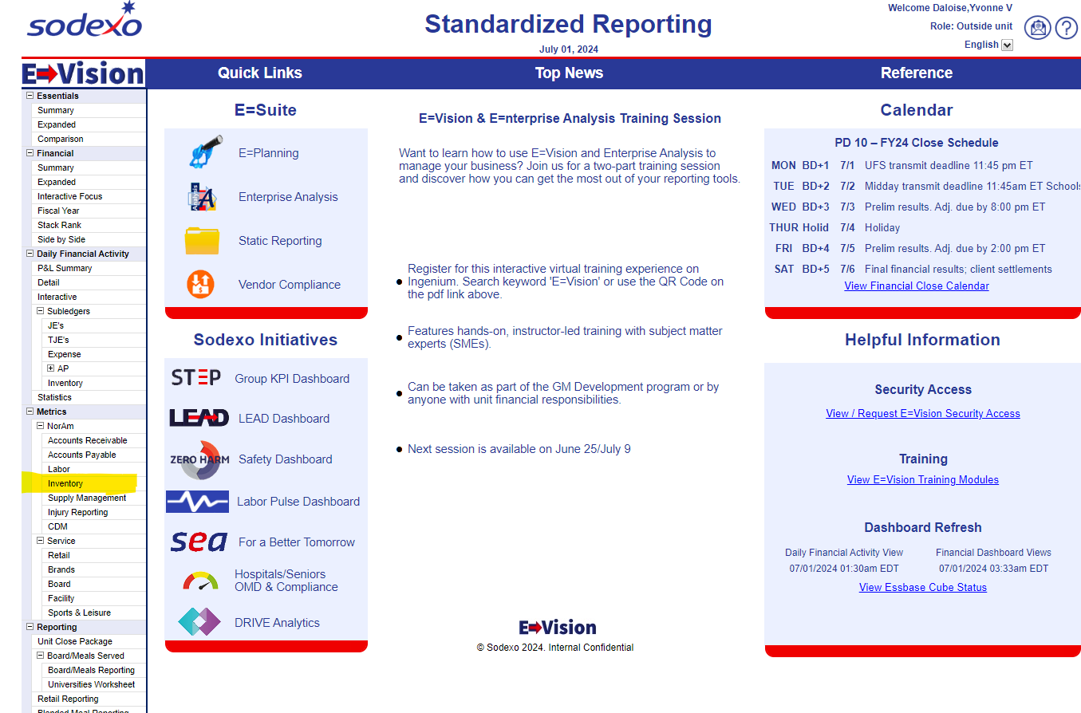
Inventory Trend Analysis
E=Vision
Click on “Inventory” & update hierarchy if needed
Notes:
Here is the screenshot of the E=Vision home page. On the left menu in the Metrics section there is a link to the Inventory page. If you click on that you will see the Inventory metrics and trends. Please note there are E=Vision training modules on the right-hand side as well.
Next slide please.

Slide 18
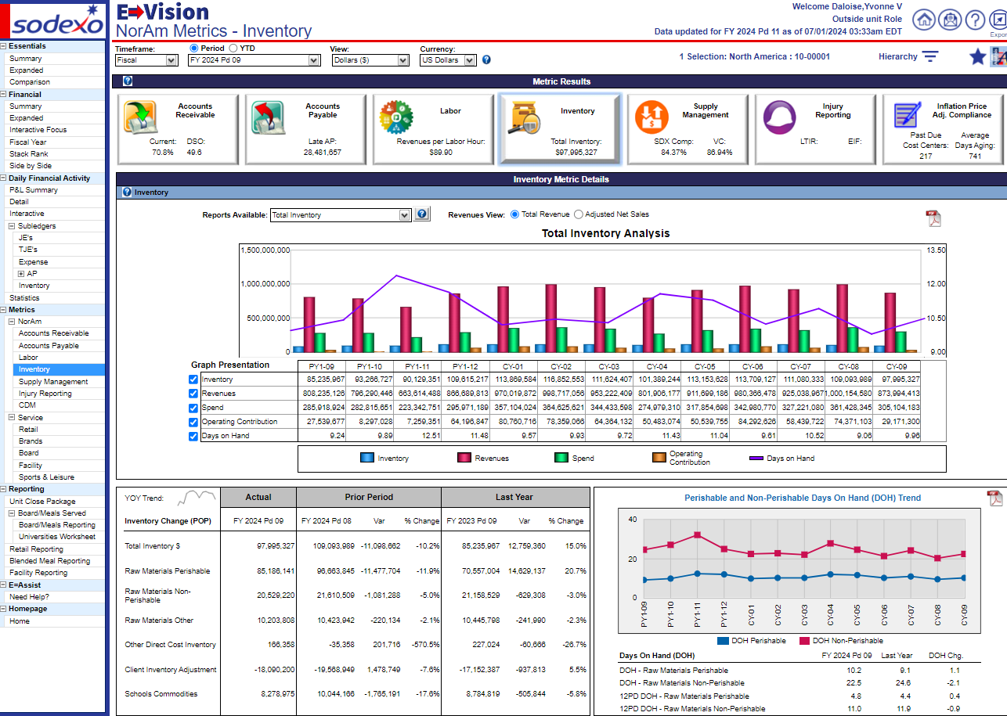
Inventory Trend Analysis (con’t)
Key Inventory Metrics to review:
Inventory Change – Current Pd. vs Prior Pd. & Same Pd. LY. No change in POP or Negative Inventory Balance need to be checked; Change vs LY, did business change?
Inventory Trends – Inventory balance comparisons to Revenues, Spend, UOP and DOH (e.g., investigate inventory growth while Revenue decline)
Days on Hand (DOH) – Compare unit inventory turnover rate vs. Segment Targets; Excessive DOH may lead to theft, spoilage, over portioning and inefficient use of Sodexo resources such as extra labor to put away orders and conduct inventory count
E=Vision
Notes:
Here is the Inventory page, your view will be based on your access, and so you may be able to view 50 level down to unit level.
Right in the middle chart, Total Inventory Analysis is where you can compare the inventory balance to Revenues, Spend, UOP and Days on Hand. One quick check is if the inventory balance grows while Revenue decreases, then you will need to investigate to determine the reason.
The table on the lower left side shows inventory changes. Current period versus prior period and the last year prior period. Here look for no change in period over period or negative inventory, if those occur you will need to research further.
The chart and table on the lower right side shows inventory Days on Hand. Here you can compare the inventory turnover versus your segment targets. Excessive Days on Hand may lead to theft, spoilage, etc.
Maintain any documentation you have to evidence your review and/or research in case of audit.
Next slide please.

Slide 19
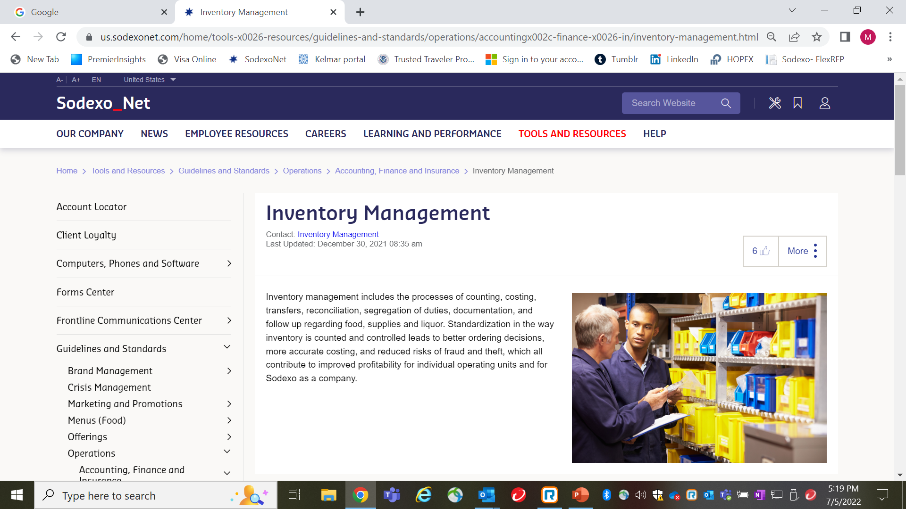
SodexoNet Inventory Management page
Scroll down
Notes:
This is the Inventory Management page on SodexoNet that has a lot of good resources. You will see you can link to the AF Topic, to the TOPS and Ingenium trainings, also to the 10 Golden Rules on Managing Inventory and some job aids around inventory items.
That concludes the Inventory Management section.
Next slide please.

Slide 20
EY Year-End Inventory / Cash Audit
Notes:
Next we will discuss the Ernst and Young year-end inventory and cash audit.
Next slide please.

Slide 21
Year-end Inventory / Cash Audit
Summary
Ernst and Young will conduct an inventory / cash audit for period 12
Initial list received but can change
~ 20 units
Year-End Audit Command Center
716-428-8008
On-site and Desk audits
A support resource to define/defend and to answer questions prior, during and after the on-site and desk audits
Available Tuesday, August 27th – Friday, September 6th
On-site August 30th or 31st
Document review August 31st – September 30th
Notes:
Like every year our external auditor, Ernst and Young conducts audits around inventory and cash. There will be on-site audits, where an auditor will be at the unit to observe the inventory count and count the cash on-site and desk audits where the auditor will review all the inventory documentation.
They chose 20 units so far this year (the list could change at any time). All units that have been selected have already been notified. For the on-site audits, the auditor will be on-site on August 30th or August 31 depending on the unit's business schedule. If open on Saturday August 31st, the unit must take inventory that day per policy.
Our Internal Control department will operate the Year-End Command Center similar to prior years. The number is shown here and will be available starting Tuesday, August 27th and run through Friday, September 6^{th.} Anyone can call in for support with their inventory process or for support with the year-end audit.
Next slide please.

Slide 22
Year-end Inventory / Cash Audits
What to Expect
On-Site
1. Tour of Facilities
Looking for organization of inventory and count, receiving activity and damaged or spoiled inventory.
Physical Inventory Observation
Auditors will request an electronic blank copy of inventory count sheets in advance.
Observe physical inventory by counter and writer.
(Segregation of duties - Count team members should not be involved in data entry of inventory extensions or Inventory Summary report (Contact DM to get help if needed))
3. Cash
Count the cash in the safe and compare to the Unit Fund balance (account 5300.0001).
On-Site and Desk
Verification and Reconciliation
Auditor will complete the following:
Recount a sample of items to check counter/writer’s work. (On-site units only)
Reconcile manual count sheets to inventory extension (TMC/UFS/Excel)
Reconcile inventory prices in extension calculation (to TMC for system vendors or copies of invoice for out of system vendors (keep invoices on hand))
Reconcile the inventory extension reports to the UFS Summary Report
Reconcile the UFS Summary Report to the general ledger
Notes:
If your unit is chosen for the on-site audit here is what you can expect. We will be holding one on one meetings with each unit selected for the year-end audit and will be going over this slide, so we will not discuss it today, but feel free to review on your own.
Next slide please.
For reference:
Tour of Facilities - The audit will start with a tour of the unit.
Auditor will note any damaged or spoiled inventory, organization of inventory, receiving activity, and overall organization of the inventory count.
Physical Inventory Observation:
Auditors will request an electronic blank copy of inventory count sheets in advance.
Auditors will observe physical inventory count performed by counter and writer.
Segregation of duties note:
Count team members should not be involved in data entry work for inventory extensions or Inventory Summary report.
If you don’t have enough employees to have segregation of duties in place, please contact your DM to get help (maybe from a nearby unit).
Cash
Count the cash in the safe and compare to the Unit Fund balance (account 5300.0001)
Verification and Reconciliation
Auditor will complete the following:
Select and recount a sample of items to check counter/writer’s work.
Reconcile inventory item prices used in the inventory extension calculation for reporting final inventory values to:
The Market Connection (TMC) pricing for in system vendors
or
The most current vendor invoices* for out of system vendors - Keep separate copies of those invoices on hand for the auditor to review.
Reconcile completed manual count sheets to the inventory extension report from TMC/UFS/Excel (count sheets must be signed by counter and writer).
Reconcile the inventory extension reports to the UFS Summary Report (must be reviewed/signed by management).

Slide 23
Contacts
Accounts Payable and Internal Control Departments
Accounts Payable: Inventory | Steve Dabrowski 716-428-8286 Laurie Edgar 716-428-8343 Stephen.Dabrowski@sodexo.com Laurie.Edgar@sodexo.com
Integrated Internal Control Department (I2C) | Chad Mayerhofer 716-428-8124 Yvonne D’Aloise 716-428-8637 Chad.Mayerhofer@sodexo.com Yvonne.Daloise@sodexo.com Rubylyn Tantoy Rubylyn.Tantoy@sodexo.com
Notes:
Accounts Payable owns the Inventory Control policy AF Topic 832-01 and so you can see their contact information here. And our Team from Internal Control contact information is here as well.
Next slide please.

Slide 24
NorAm Site Audit Program
Notes:
Our final topic is the NorAm Site Audit program.
Next slide please.

Slide 25
NorAm Site Audit Program – Internal Controls
Summary
On-Site Audits starting soon
Site Audit Objectives
FY24: July / August – limited number of site audits
FY25: Full program starting September 2024
Units (DM/GM) will be notified via email at least 2 weeks in advance
Full-scope Site Audits to include (but not limited to)
Contract Management
Purchasing and Inventory
HR/Payroll
Cash
Accounts Receivable
Accounts Payable
Fixed Assets
Legal & Regulatory
Site Audit Reports will be issued and communicated to the relevant stakeholders
Limited scope or themed audit with specific scope may be performed depending on common or recurring issues or trends
Evaluate whether internal controls around contract management and key processes are in place and operating effectively at the unit
Verify compliance with applicable policies & procedures, and standard business practices
Recommend improvements on processes and internal control environment to remediate gaps, deficiencies and non-compliance noted
Notes:
We are reviving the NorAm Site Audit program. As you can see our objectives with the site audits are:
1. Evaluate whether internal controls around contract management and key processes are in place and operating effectively at the unit.
2. Verify compliance with applicable policies & procedures, and standard business practices.
And 3. Recommend improvements on processes and internal control environment to remediate gaps, deficiencies and non-compliance noted.
We are in the process of conducting 5 site audits in July and August and with the full program starting in September. These will not be surprise audits like they were in the past. We will give at least 2 weeks advance notice to the DM and GM of the site. You can see here the focus areas included in the audits, with potential for other areas as we deem necessary. Following our audit, we will issue the Site Audit Report to relevant stakeholders.
Also, there could potentially be limited scope or themed audits if we see common or recurring issues or trends.
That concludes our presentation.
Our last slide is for questions….

Slide 26
Questions
Notes:
Any questions?

Slide 27
Identity Access Management Forms (SoUnified)
New process
Effective June 21
Notes:
What - Info Security Access Request form is evolving into a centralized IT hub called SoUnified (access, service requests, incidents, changes, etc.).
When: Friday, June 21. Starting Friday, if you need to request access to applications (all included), you will need to use the new request process through SoUnified.
How: The form can be found within SoUnified, which is the center tile on the SDX Net launch site.
Training is available - You may have seen communications in The Loop, or on the training calls offered at the end of May and again this week.
Training available
How to log into SoUnified (like submitting an incident for the SDX Service Desk) very much the same process – option to submit a request
How to navigate – Noram Identity & Access Requests to show the Service Catalog tiles
How to request – select tile from KB
How to create a Service Request – form populates from selected tile – your user details populate as beneficiary
How to access and existing Service Request
Training Join the live training at 11:00 a.m. ET on Thursday, June 20
Information Security Access Request Moving to SoUnified (sodexonet.com)
Impacts both access requests and approvals, if you have Direct Reports. (approvers will still receive emails)
Enhanced visibility to tracking and status

Slide 28
Information Security Access Request Moving to SoUnified
Effective June 21, all information security access requests must be submitted through SoUnified. You will use SoUnified to request employee access to Sodexo_Net, MySodexo, email and all other Sodexo applications previously requested through the Information Security Access Request Form.
Want to learn more?
Review these valuable resources for training:
SoUnified – Access Request End User Training (PowerPoint)
SoUnified Self-Service Portal Lunch & Learn Meeting Recording
SoUnified Training – Application Access Requests Meeting Recording
Identity & Access Management – End User Training Meeting Recording
Be sure to visit the SoUnified knowledgebase for specific application access user guides.
Notes:
Beginning June 21, all information security access requests must be submitted through SoUnified. You will use SoUnified to request employee access to Sodexo_Net, MySodexo, email and all other Sodexo applications previously requested through the Information Security Access Request Form.
SoUnified is a self-service portal that provides a single place to request and track your support requests. This is part of a global initiative to streamline how we manage information technology support and provide customers with quicker, more efficient service.

Slide 29
Information Access Management - UFS
How to Request, Update, or Remove Your Web UFS Access Note that this process has changed! You will need to submit a Service Request through the SoUnified Self Service Portal > Virtual Helpdesk.
User Guides are posted on the UFS Launch site, UFS Support Center on Sodexo_Net, and SoUnified knowledgebase
Notes:
User guides are available for UFS update/remove access and UFS New Node security change requests. (Same as before)
User guides are posted on the UFS launch site, the UFS Support site on Sodexo Net, and the SoUnified Knowledgebase.

Slide 30
Demo IAM Form – Unit Financial Systems
Notes:
Information and Access Management Form

Slide 31
Questions?

Slide 32
Stars of Finance

Slide 33
Our 2023 Stars of Finance Winners Celebrating With
the NorAm Finance Leadership Team
Our 2023 Stars of Finance Winners Celebrating With
the NorAm Finance Leadership Team
33

Slide 34
Our finance professionals make amazing contributions every day!
Show your appreciation for our Finance professionals who have gone above and beyond by nominating one or more of them for a Stars of Finance award.
Every nominee will be notified, so even those who do not ultimately win an award will know their contributions were recognized.
Nominations open through August 31st.
Finance Professional of the Year (individual)
Unit Controller of the Year (individual)
Operations Excellence (individual or team)
Finance for Growth (individual or team)
Process Improvement (individual or team)
Visit the Stars of Finance page on Sodexo_Net
Notes:
Stars of Finance Awards (sodexonet.com)
There is no limit to the number of nominations you can submit, and you need not be a member of Finance to enter a nomination--anyone can nominate an outstanding finance professional.
This extended nomination period is a great way to recognize our Finance colleagues for their achievements as they occur, while also avoiding the rush to submit a nomination during the typical shorter call for nominations period, which could be months after the individual or team’s accomplishment.
Shortly after you submit a nomination, your nominee will receive a notification along with a personalized message from you recognizing their contribution.
In September, our selection team will review the nominations submitted throughout the year and choose our FY2024 winners, who will be announced and receive their awards during the annual ceremony in the fall.

