Slide 1


FY22 Unit Controller Call Series
  July 2022
We’ll get started momentarily
PLEASE keep lines muted
Notes:
Welcome – this call will be recorded. Start recording!
Welcome the FY22 Controller Call Series. this call series – *created by unit controllers and supported by Finance to review topics and inform the Controller Network about topics that impact the controller role. This is our first/second of two calls for the month of July.
I am CS, w/ Financial Shared Services (FSS), coordinator of the CN call series, and your host for today.
To anyone new to Network - *Welcome to this call series.
Just a little background on who is included - Our DL for these calls is refreshed each FY with anyone who has a “Controller” title. We also have many different in-unit finance roles included from US and CA and encourage your assistance in shoring up the DL as members transition and our network develops. A recent sweep of UFS user data at the end of H1, identified a few additional members who were added to the call series. I’m glad you’re listening in today.
To include others, as applicable, send me an email to add them, or simply forward invites when you see topics that benefit your team.

Slide 2

  Agenda
    Safety Moment
    UFS Update –Jill Helms
    PD12 Close Schedule –Ann Marie Marbaker
    Q4 Collections -Brad Hamman
    Inventory Training and Review -Mark Dobosz
    Career Profile -Bob Schweickert
    Questions
Diversity, Equity & Inclusion (DE&I)
Notes:
To demonstrate our commitment to safety and diversity at Sodexo, we begin each meeting with a Safety Moment and diversity spotlight – I have an open invitation to anyone listening in to volunteer for a future call and present either. If you’re looking for an opportunity to share a safety experience or learning, or just want to practice presenting, please reach out to me.
To kick off today’s topics we have Jill Helms from our UFS team to share a brief update.
We welcome back Ann Marie Marbaker from OA to talk about the PD12 close calendar, Brad Hamman from Credit & Collections to discuss Q4 collections and Mark Dobosz to discuss Inventory, training as we lead into the final period of FY22 and prepare for YE close.
To continue our series on career profiles, we welcome Bob Schweickert from FSS contract analytics and Reporting to share his career lattice.
Please use the chat function to submit any questions that you may have as we run through the agenda topics. We will pause to address questions between topics and if we run out of time we will follow up via email.
HONOR Your Hero
In July, we recognize our active duty, veteran and reserve communities. At Sodexo, the HONOR (Honoring Our Nation’s finest with Opportunity & Respect) EBRG (employee business resource group) has many initiatives to recognize the military heroes of our Sodexo community. We encourage you to take advantage of these resources and share them with your teams.

Slide 3

  Safety Moment
  Conference Call Workout
Notes:
As employees of Sodexo, no matter what level, you are expected to personally demonstrate your commitment to improving our health and safety culture. Our goal is zero accidents. A Safety Moment during every meeting will demonstrate the importance of the health and safety culture at Sodexo.
Today’s Safety Moment is Conference Call Workout

Slide 4

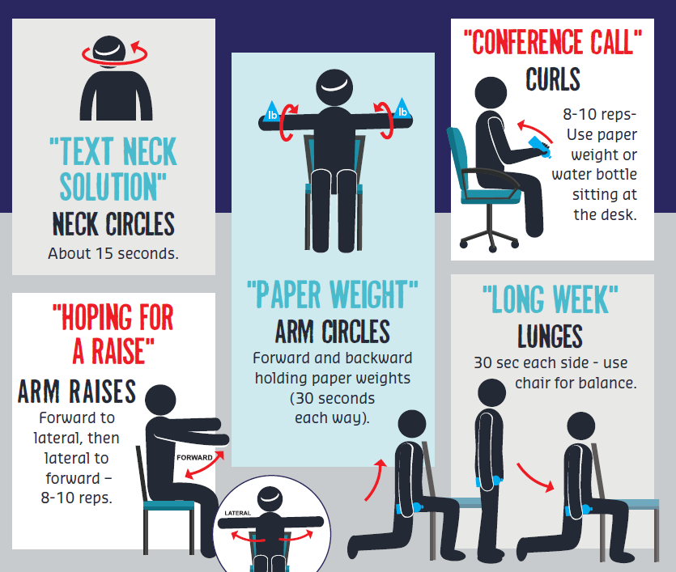
CONFERENC E
. CALL
. WORKOUT
Notes:
Though many in operations roles get plenty of movement opportunities during their day to day work tasks, many out of unit finance roles require a great deal of time sitting in front of the desktop. Especially when work through year-end close procedures and computer-based reporting deadlines at end of month. With that in mind, please note the following:
Sitting is the “new smoking” in terms of potential negative health impacts, due to inactivity. During times of prolonged sitting, especially if you are at your desk 8 hours a day – find time to give your body stretch breaks and opportunities to stand and move. Who made the rule that says you have to sit still when you’re on a conference call? A conference call can be a great time to move your body and take a moment for your health.
Why not use this time today, as you’re listening to the controller call, to take a moment for You.
We all multi – task! Perhaps break from that routine and use this time, to move while you’re listening to our agenda today. Here are a few creative titles and clever ways to incorporate some activity while you sit, or stand, during calls. PLEASE ensure your area is clear with ample space to execute these exercises, as always, safety first!!
Use TOOLS & RESOURCES on SodexoNet to access this Safety Moment or “QUICK SHAREs” as you promote the Sodexo safety culture with your team meetings.
This deck will be shared today in our chat function and on the UFS launch site.

Slide 5
UFS Updates
Tuesday, July 19

Slide 6
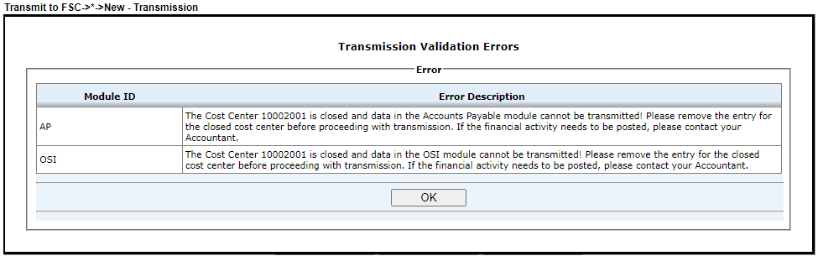
UFS Updates - Closed Unit Transmission
Effective July 20th, UFS will not allow transmission of activity posted to a closed cost center.
  SAP close dates within 60 days will be allowed
  Impacts both “Inside” and “Outside” units
Why are we doing this:
  To prevent data being posted to a closed unit in error
  To prevent transfers to or from outside units that are closed.
You will not be able to continue until the data has been removed for the closed unit
If the financial activity is valid and posting is required, user is directed to contact their Accountant
Notes:
Effective July 20th, UFS will not allow transmission of activity posted to a closed cost center.
On Tuesday July 19 (today or this past Tuesday), the UFS Team will install an update that will prevent the transmission of data for a closed unit where the SAP close date is older than 60 days.
This update will require an outage, from 5 pm until approximately midnight.
Why are we doing this:
To prevent data being posted to a closed unit in error
To prevent transfers to or from outside units that are closed.
An outage (tonight) begins at 5 pm
When transmitting, the user will receive a pop-up error message when data has been entered for a closed unit. The message will identify which module of UFS holds data for a closed unit. If you have entered multiple transactions for a closed cost center, the error message will clearly identify each module ID that must be cleared.
You will not be able to continue until the data has been removed for the closed unit
If the financial activity is valid and posting is required, user is directed to contact the Accountant

Slide 7
PD 12
Financial Close Schedule
Notes:
Ann Marie Marbaker

Slide 8

FY22 PD12 – Monthly Financial Close Update
August Financial Close Schedule Changes
Close schedule has been adjusted to recognize the Labor Day Holiday
Schedule PD12 | THUR 9/1 | FRI 9/2 | SAT 9/3 | SUN 9/4 | MON 9/5 | TUE 9/6 | WED 9/7 | THUR 9/8
Original > | BD+1 | BD+2 |  |  | BD+3 | BD+4 | BD+5
Revised > | BD+1 | BD+2 |  |  | HOLIDAY | BD+3 | BD+4 | BD+5
 | UFS transmission deadline 11:45 pm ET | Midday transmission 11:45 am ET (Schools OSI) |  |  |  | Review prelim results & request adjustments due by 8:00 pm ET | Analyze financial results – final adjustments due by 2:00 pm ET | Final financial results; client settlements available
Notes:
Pd 12 close which also marks the last close for FY 22 has been adjusted to recognized the US and Canada Labor Day holiday. We will be celebrating the holiday on Monday September 5th.
We are taking a “pause” on September 5th which would have been BD+3.
We will resume on Tuesday September 6th, with our typical BD+3 activities. Adjustments will be processed through 8 pm Eastern Time.
Wednesday September 7th is BD +4 and the cut off for PD 12 adjustments is 2 pm Eastern Time
Thursday September 8th is BD+5 and all reports will be final and client statements and settlements will be available.
Since it is year end, there are high level entries and processes that need to be completed before we can finalize PD 12 and FY 22
Once these year end processes are complete, the following Period 1 FY 2023 activities will resume:
Period 1 E=vision/CCor reporting: Estimated availability - September 14th
September weekly invoices will be delayed, their estimated availability is September 13th
One question that we typically get, is what happens with Transmission deadlines for the first week of Period 1/23 if I do not transmit on September 5th?
If you are unable to transmit by the Monday 11:45pm Eastern Time deadline, your transmission will post in the following week of Period 1. This will not affect your Period 12 data.

Slide 9
FY22 PD12 - Mise à jour de la clôture financière mensuelle
Modifications du calendrier de clôture financière d'août
L'horaire de fermeture a été ajusté pour reconnaître la fête du Travail
programme PD12 | jeudi 9/1 | vendredi 9/2 | samedi 9/3 | dimanche 9/4 | Lundi 9/5 | mardi 9/6 | mercredi 9/7 | jeudi 9/8
Original > | BD+1 | BD+2 |  |  | BD+3 | BD+4 | BD+5
Modifié > | BD+1 | BD+2 |  |  | HOLIDAY | BD+3 | BD+4 | BD+5
 | Délai de transmission UFS 11:45 pm ET |  |  |  |  | Examinez les résultats préliminaires et demandez des ajustements avant 20 h 00 HE | Analyser les résultats financiers - ajustements finaux dus avant 14h00 HE | Résultats financiers définitifs ; règlements clients disponibles
Notes:
La clôture du Pd 12, qui marque également la dernière clôture de l'exercice 22, a été ajustée pour tenir compte des jours fériés de la fête du Travail aux États-Unis et au Canada. Nous fêterons les vacances le lundi 5 septembre.
Nous prenons une "pause" le 5 septembre qui aurait été BD+3.
Nous reprendrons le mardi 6 septembre, avec nos animations typiques BD+3. Les ajustements seront traités jusqu'à 20 h, heure de l'Est.
Le mercredi 7 septembre est BD +4 et la limite pour les ajustements PD 12 est 14 h, heure de l’Est
Le jeudi 8 septembre est BD + 5 et tous les rapports seront finaux et les relevés et règlements des clients seront disponibles.
Comme c'est la fin de l'année, il y a des entrées et des processus de haut niveau qui doivent être terminés avant que nous puissions finaliser PD 12 et FY 22
Une fois ces processus de fin d'année terminés, les activités suivantes de la période 1 de l'exercice 2023 reprendront :
Période 1 Rapport E=vision/CCor : Disponibilité estimée - 14 septembre
Les factures hebdomadaires de septembre seront retardées, leur disponibilité estimée est le 13 septembre
Une question que nous recevons généralement est la suivante : que se passe-t-il avec les délais de transmission pour la première semaine de la période 1/23 si je ne transmets pas le 5 septembre ?
Si vous n'êtes pas en mesure de transmettre avant la date limite du lundi 23 h 45, heure de l'Est, votre transmission sera publiée la semaine suivante de la période 1. Cela n'affectera pas vos données de la période 12.

Slide 10

Do you have questions?

Slide 11
AR Collections deadline for Q3 FY22
Q4 Collections Deadlines
  July, 2022
Notes:
Brad Hammon

Slide 12


CRS Overview
US – Collect It!

Slide 13
Collect It! Deadline for Quarter 4, FY22
Your help is needed to increase our cash flow. To ensure that your AR payments, bank deposits, cash receipts, and cash balances are properly credited for Quarter 4, all deposits must be made on or before Wednesday, August 31st.
Please observe the following deadlines depending on your payment method.
Select the payment link(s) below for further details:
ELECTRONIC (ACH/WIRE) PAYMENTS
CHECK PAYMENTS

Slide 14
Electronic Payments – Deadline for Quarter 4 FY22
Client ACH payments post to Sodexo’s bank account 1 to 2 business days after the client releases the payment to their bank. Determine with your client Finance or AP Department whether their bank ACH is 1- or 2-Day processing.
2 Day ACH: Monday August 29th
If ACH is 2-day processing, ACH must be released from client’s bank on or before the 29th with a value date of August 31st
1 Day ACH: Tuesday August 30th
    If ACH is a 1-day processing, ACH must be released from client’s bank on or before the 30th with a value date of August 31st
Wednesday August 31st
    For client payments to post to Sodexo’s bank account on Wednesday August 31st, client must initiate a SAME DAY wire transfer payment of up to $1,000,000 on the 31st with a value date of August 31st

Slide 15
Check Payments – Deadline for Quarter 4 FY22
Quarter 4 Deadline for AR Collections for CHECK payments sent to Lockbox must be deposited in the Lockbox by 10:30 AM (ET) Wednesday August 31st
Lock Box address:
Sodexo Inc & Affiliates
Attn: 360170
500 Ross St 154-0455
Pittsburgh, PA 15262-0001
Telephone (412) 234-4381
Total Check Amounts | Important Dates | Action to Take
Total Checks greater than $2,500 | Monday August 29th | Overnight checks to the Lockbox address above with Next day delivery
Total Checks greater than $2,500 | Tuesday August 30th | Overnight checks to the Lockbox with Next Day Air EARLY AM Delivery
Total Checks greater than $100,000 | Wednesday August 31st before 2:00 PM ET. | Call the FSS AR Department at 1-800-828-7762 option 2, option 2 before 2 PM ET

Slide 16
Payment Fraud
Threat Actors are continuing their efforts posing as Sodexo employee to commit fraud against our clients.
  Tell customers NEVER to conduct electronic funds transactions with Sodexo via email.
  Always call the AR Department to verify any requests and to check the sender’s domain
  Ensure that any requests for funds transfer received have 2nd and/or 3rd level validation procedures in place (i.e., DM/GM approvals, always call your customer to verify legitimacy etc.)
  Using email for financial transactions in general is strongly discouraged
  Immediately contact FSS Accounts Receivables department if you suspect possible fraud at: AccountsReceivableNorAm@sodexo.com or 1-800-828-7762, Option 2, Option 2
Thank you, your actions are making a difference!

Slide 17

CRS Overview
Canada – Collect It!

Slide 18
Collect It! Deadline for Quarter 4, FY22
Your help is needed to increase our cash flow. To ensure that your AR payments, bank deposits, cash receipts, and cash balances are properly credited for Quarter 4, all deposits must be made on or before Wednesday, August 31st.
Please observe the following deadlines depending on your payment method.
Select the payment link(s) below for further details:
ELECTRONIC (EFT/WIRE) PAYMENTS
CHEQUE PAYMENTS

Slide 19
Electronic Payments – Deadline for Quarter 4 FY22
Client EFT payments post to Sodexo’s bank account 1 to 2 business days after the client releases the payment to their bank. Determine with your client Finance or AP Department whether their bank EFT is 1- or 2-Day processing
2 Day EFT: Monday August 29th
If EFT is 2-day processing, EFT must be released from client’s bank on or before the 29th with a value date of August 31st
1 Day EFT: Tuesday August 30th
    If EFT is a 1-day processing, EFT must be released from client’s bank on or before the 30th with a value date of August 31st
Wednesday August 31st
    For client payments to post to Sodexo’s bank account on Tuesday August 31^{st,} client must initiate a SAME DAY wire transfer payment on the 31st with a value date of August 31st

Slide 20
Cheque Payments – Deadline for Quarter 4 FY22
Quarter 4 Deadline for AR Collections for Cheque payments sent to Lockbox must be deposited in the Lockbox by 10:30 AM (ET) Wednesday August 31st
Lock Box address:
BMO Wholesale Remittance Processing Services
4 Prince Andrew Place (Loading Dock 4)
Don Mills, Ontario M3C 2H4
Attn: T57840C – Sodexo Canada Ltd.
416-643-4398
Total Check Amounts | Important Dates | Action to Take
Total Cheques greater than $2,500 | Monday August 29th | Overnight cheques to the Lockbox address above with Next day delivery
Total Cheques greater than $2,500 | Tuesday August 30th | Overnight cheques to the Lockbox with Next Day Air EARLY AM Delivery
Total Cheques greater than $100,000 | Wednesday August 31st before 2:00 PM ET. | Call the FSS AR Department at 1-800-828- 7762 option 2, option 2 before 2 PM ET

Slide 21

CRS Overview
Payment Fraud and CRS aides

Slide 22
Payment Fraud
Threat Actors are continuing their efforts posing as Sodexo employee to commit fraud against our clients.
  Tell customers NEVER to conduct electronic funds transactions with Sodexo via email.
  Always call the AR Department to verify any requests and to check the sender’s domain
  Ensure that any requests for funds transfer received have 2nd and/or 3rd level validation procedures in place (i.e., DM/GM approvals, always call your customer to verify legitimacy etc.)
  Using email for financial transactions in general is strongly discouraged
  Immediately contact FSS Accounts Receivables department if you suspect possible fraud at: AccountsReceivableNorAm@sodexo.com or 1-800-828-7762, Option 2, Option 2
Thank you, your actions are making a difference!

Slide 23


Training, Tools & Resources
Sodexo_Net CRS Page
  SHORT Overview video for CRS end to end process
  Infographic with talking points
  FAQs
  Present & Pay client introduction sheet
Office Hours
  Drop in to ask a question or share feedback during the times posted on your calendar
Help & Job Aides
  Help built right into the CRS tools
  Updating Your Account's CRS Client Contract Information
  Job aides to view or download
  Send questions to CRS team at
  Sodexocrsteam.noram@sodexo.com
Virtual Training Sessions
  Learn the CRS process, tools available, and how to use them
Rise & Thrive Webcast
  Watch recording of Rise & Thrive Webcast,
  Thursday, October 21st on Sodexo_Net
Notes:
Brad
SodexoNet is the best source of information
Includes:
Short video
Infographic
FAQ’s which are updated frequently
Recorded Rise & Thrive from Oct 21
Office Hours Schedules
Job Aids

Slide 24

Q&A
Audience Q&A
This Photo by Unknown Author is licensed under CC BY-SA-NC

Slide 25
04
  Inventory
Notes:
We welcome back Mark Dobosz from AP

Slide 26
  FY22 JULY CONTROLLER CALL
  JULY 19 and 20, 2022
  INVENTORY TRAINING and REVIEW
  MARK DOBOSZ

Slide 27
INVENTORY – GIA Audit AREAS OF FOCUS
  Audit covers Inventory included on Sodexo balance sheet
    Sodexo Owned or Client Owned / Sodexo Managed should be separately identified & access restricted to essential staff only
    Training Documents are not signed and retained at Unit
    Unit Inventory Sheets do not match UFS Input values
    Lack of Trend analyses performed on Inventory balances by GM/DM
    Inventory Cost extensions are not consistent with TMC pricing. Non-TMC item costing must match last purchase price
    Segregation of duties note: count team members should not be involved in data entry work for inventory extensions or Inventory summary report.
    Inventory adjustments & transfers are not properly reviewed & documented
  All frontline staff must be provided annual inventory training

Slide 28
INVENTORY FY2022 – What’s New
  Exempt employees required to take Ingenium Training yearly
  GM’s / DM’s must ensure all frontline staff are properly trained using the TOPS inventory training module
    Universities & K-12 should be part of “Back to School” training
    HealthCare should include in monthly training sessions
    New employees involved with taking of inventories should be provided training ASAP
  GM responsible for documenting frontline staff that were included in the TOPS training sessions using the sign-in sheet example provided in TOPS material
  Training sign-in sheets must be kept on premises by GM and available to Auditors as requested

Slide 29
INVENTORY FY2022 – Focus on Training
  Inventory training will be mandatory for all employees involved with the inventory process (counters, writers, GM/DM, recorders)
  Inventory training will be provided to all frontline staff during employee training sessions and also ASAP for all new employees
  Refresher testing every 2 years for all staff
  Revised training materials available on SodexoNet
  Training results to be maintained by Units to be presented to Sr Management/GIA upon request
  Ingenium training for Site Leads to be mandatory
    Knowledge test option in process for FY23
    TOPS modules updated to train frontline staff
    Must ensure all members have taken training and document

Slide 30
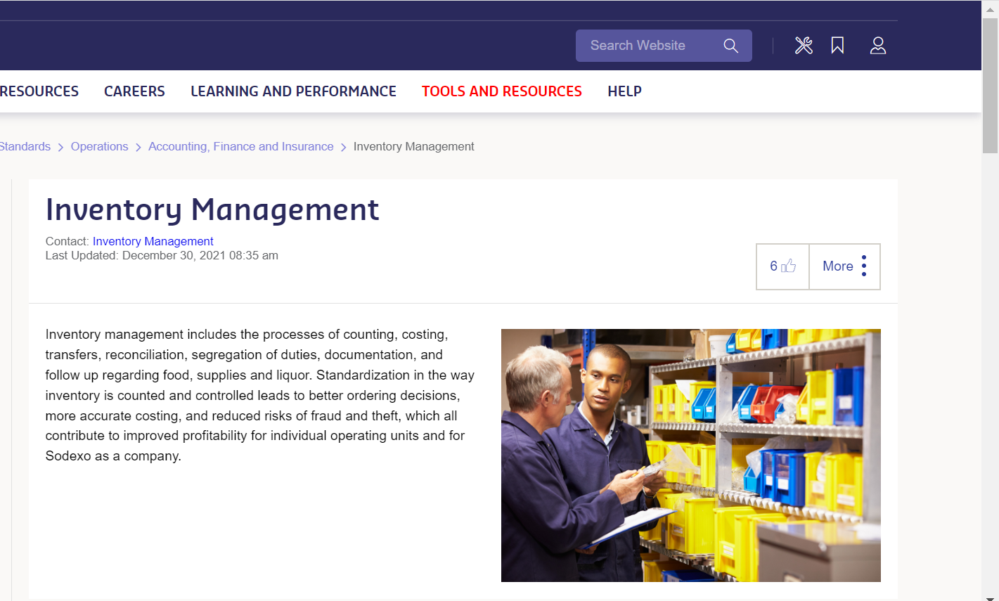
SODEXONET: INVENTORY MANAGEMENT PAGE

Slide 31
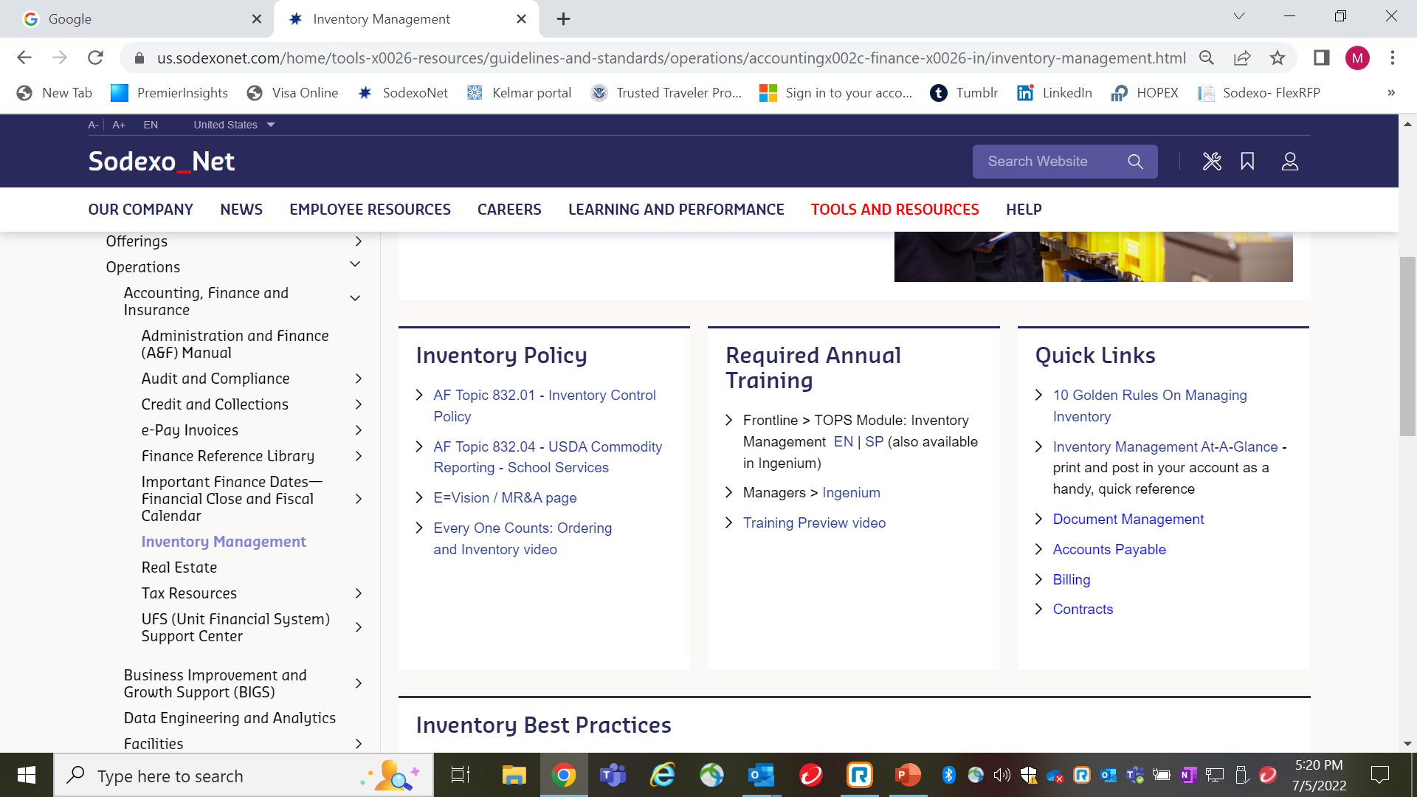

Slide 32
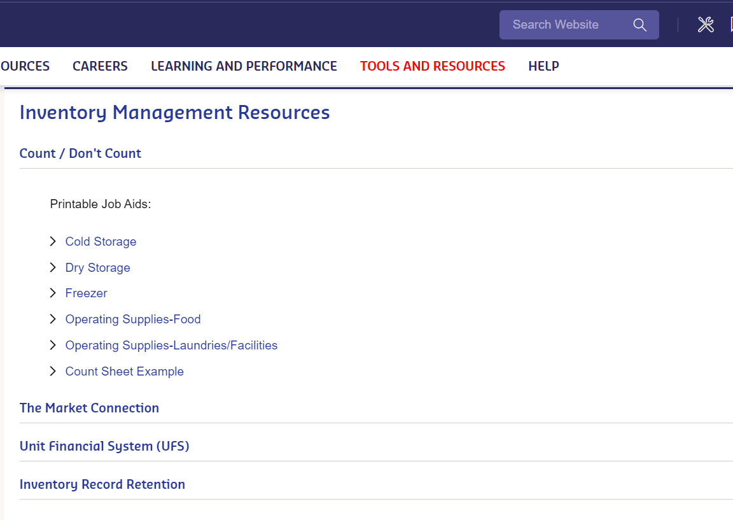

Slide 33
PwC Year-End Inventory Audit
Coming soon…
What:
      PwC Year-End Inventory Audit
      ~20 on-site audits (PwC will be at the unit)
      ~15 desk audits (documentation review only)
      1 surprise on-site audit
    When:
    On-site audits - Wednesday, August 31st
    Desk audits - Thursday, September 1st - Wednesday, September 7th
Who:
All segments – any active unit can be selected for audit
Additional information and opportunities to ask questions:
August Controller Calls on August 16th and 18th
Subject Matter Expert Call(s) – see Year-End Audit Command Center on SodexoNet
YE Audit Command Center open August 25th – September 7th - call 1-347-779-1810

Slide 34
INTERNAL CONTROL / AP CONTACTS
Integrated Internal Control Department (I2C) | Greg Steele 716-428-8563 Bob Borrelli 716-428-8744 Greg.Steele@sodexo.com Robert.Borrelli@sodexo.com Chad Mayerhofer 716-428-8124 Yvonne D’Aloise 716-428-8637 Chad.Mayerhofer@sodexo.com Yvonne.Daloise@sodexo.com
Accounts Payable: Inventory | Mark Dobosz 716-428-8271 Laurie Edgar 716-428-8343 Mark.Dobosz@sodexo.com Laurie.Edgar@sodexo.com

Slide 35
APPENDIX: RESOURCE INFORMATION
Pg 10, 11: Inventory Best Practices
Pg 12-17: UFS Transfer Module
Pg 18-20: Month-End Corrections:
  Pg 19 = Sodexo Owned Inventory
  Pg 20 = Client Owned Inventory
Pg 21-24: :Trend Analysis using Enterprise Analysis

Slide 36
INVENTORY AUDIT – Monthly Inventory Best Practices
  Make sure that the inventory is taken with respect to your sites knowledge of food receipts being delivered & sales YTG
    P6 and P12 +> MUST take inventory on last day of the month, preferably after last meal served
    All other inventories can be counted within last 4 days of the month-end
    Some operating Segments may have more strict guidance on when to take inventories based on thei business models. Please follow those guidelines if they apply to your business.
  Ensure that all inventory sheets are signed by both the counter and the recorder (must be different for Segregation controls).
  Have a copy of the Inventory Policy and 10 Golden rules available on-site for easy and quick reference
  Ensure that items not to be counted are clearly identified and segregated
  Ensure pricing of inventory is consistent with TMC costs

Slide 37
INVENTORY AUDIT – Best Practices (Continued)
  Review inventory results against prior financial results by using data and KPI’s identified in e-Vision:
    Examine trends of COGS % to Revenue
    Review DoH (Days on Hand) calculation and inventory value trends
    Review trend results with site Management to understand fluctuations and reasons
  Obsolete, spoiled, and damaged inventory should be clearly identified and separated from inventory
  GM to ensure that inventory count sheets are properly costed and values are accurately recorded on UFS
  Work with your RDM to obtain support staff to take inventory so that you can meet “Segregation of Duty” requirements

Slide 38
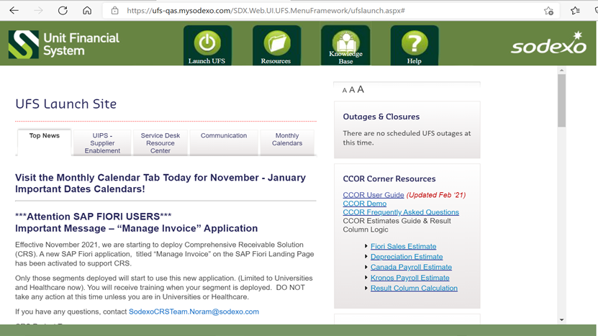
UFS INVENTORY TRANSFER MODULE

Slide 39
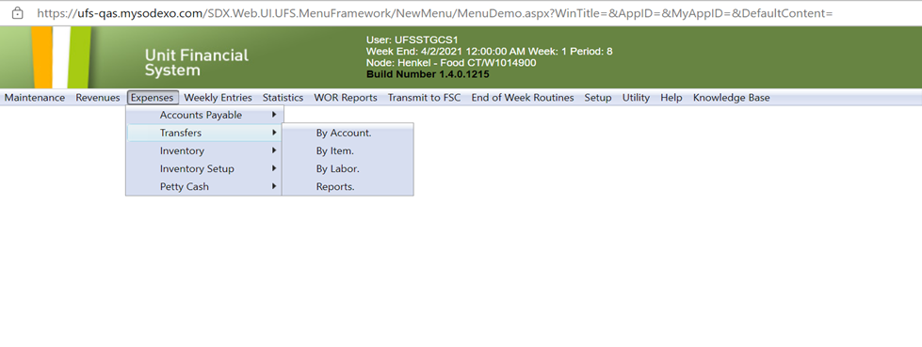
INVENTORY TRANSFER OPTION

Slide 40
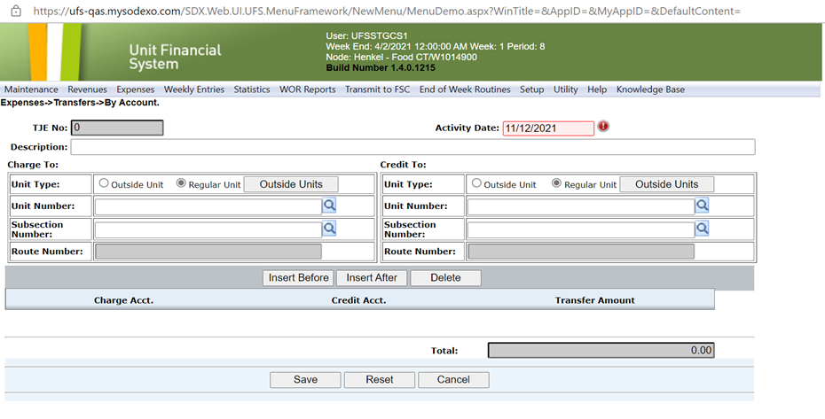
Inventory Transfers by “Account”

Slide 41
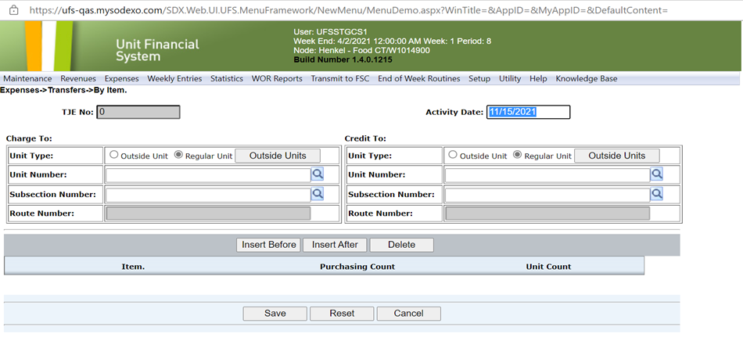
Inventory Transfers by “Item”
“ROUTE NUMBER” used by Vending Units only

Slide 42
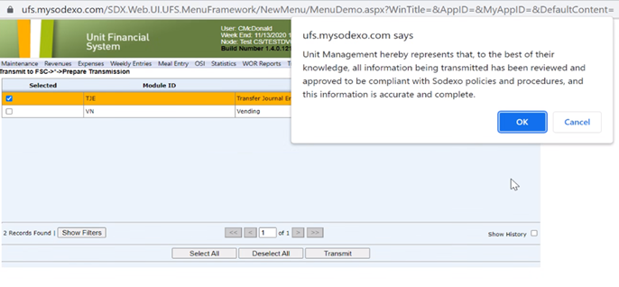
JE Submission & Confirmation receipt

Slide 43
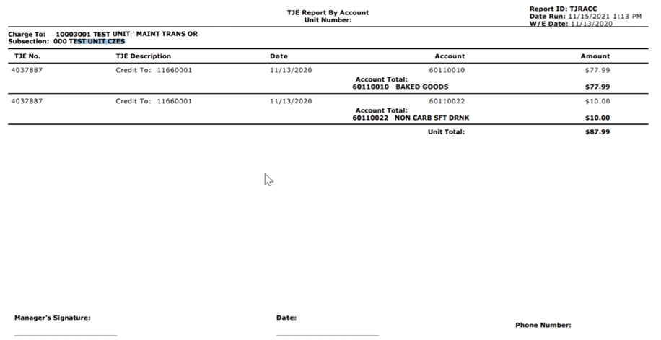
JE Details
Signed JE and backup details should be held by the Unit for audit review as needed

Slide 44
Month-End Inventory Corrections
See FSS AF TOPIC 821-01: “Transfers Cost & Non-Employee Labor”
Identifies rules for cost transfers (communication & approval, timing, U2U xfers, Direct vs O/H units, etc)
Excel based form with separate tabs for each area of correction (form includes tabs for other corrections as well)
Available on SodexoNet or from your OA
Used for correcting month-end balances only after final transmission has been sent into SAP (typically BD+2 or early BD+3)
Work with OA ClientAccounting.NorAm@sodexo.com as needed to help with filling out the form if necessary

Slide 45
Std Close Adj Form: SDX Owned Inventory adjustment
“Prelim Ending Inv Amount” is the amount shown on Financial reports (DFAV, CCOR, CRED).
Commodities are also adj for ending inventory amount
Ensure that all Inventory is costed at latest UFS cost w/o mark-up
Should only be used after last w/e inventory was transmitted
to SAP
Example shown is a small sample of the entire Excel file
Back-up for the inventory Xfer or adj should be held at the Unit for future audit as needed

Slide 46
Std Close Adj Form: CLIENT Owned Inventory Adjustment
Cannot Xfer Commodity inventory from 1 cost center to another.
Unlike Sdx owned inv, this tab corrects the reported “variance” in GL accounts from P-A to P-B
Form to be used only after final inventory transmission sent in SAP
All Back-up details are to be kept by the Unit to support audits as needed
Example shown is a small example of the full form

Slide 47
Inventory Trend Analysis – Accessing the Enterprise Tool
GIA observation: Sites reporting inventory values without review of results or trends:
SodexoNet
E=nterprise Analysis Resource Center (icon – page 2)
Management Reporting & Analysis (Finance Link in Right Hand margin)
Everything E = vision
Access E = Vision
Welcome to E=Vision (see next slide)

Slide 48
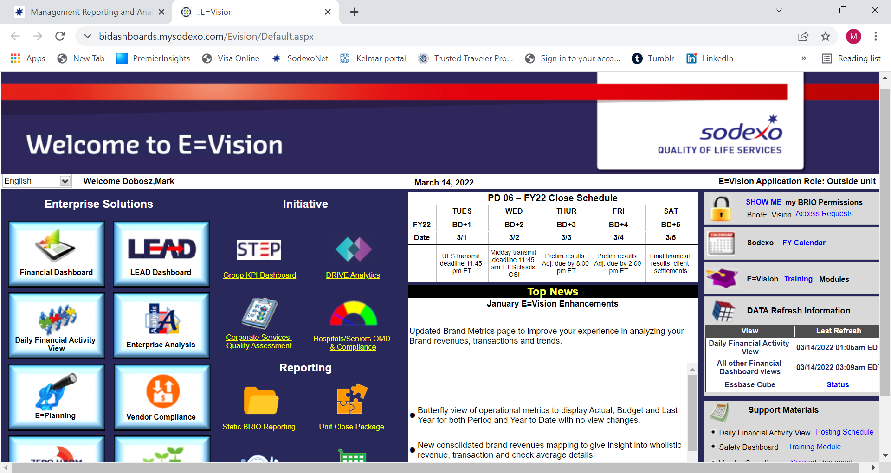
Inventory Trend Analysis (con’t)
Click on “Financial Dashboard”

Slide 49
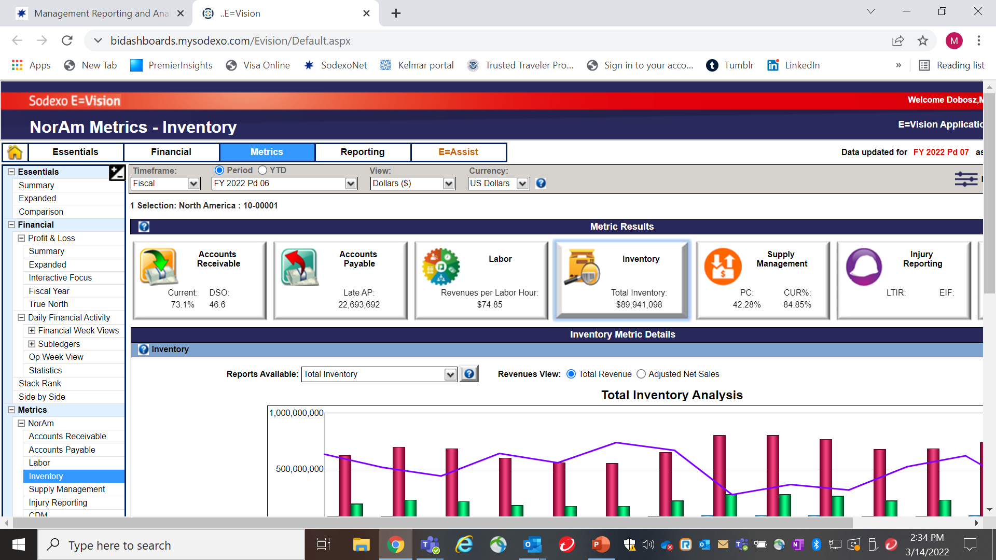
Inventory Trend Analysis (con’t)
Click on “Inventory” & update hierarchy if needed

Slide 50
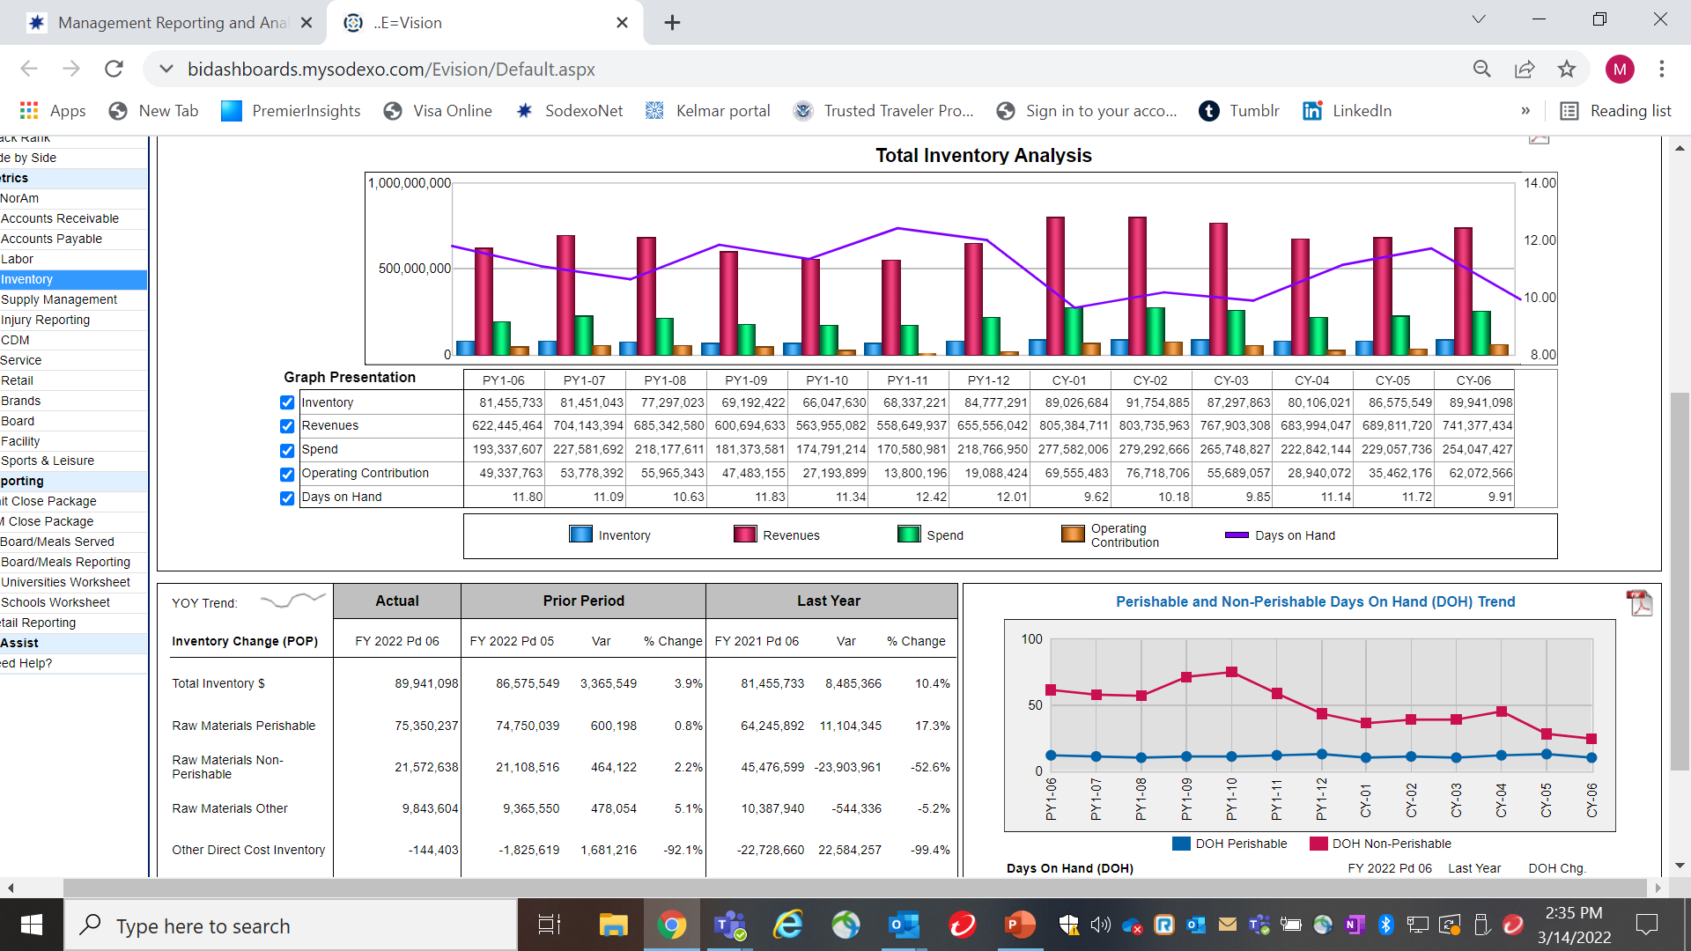
Inventory Trend Alanysis (Con’t)

Slide 51

QUESTIONS

Slide 52
05
  Career Profile – Bob Schweickert, Director II, Accounting,
  FSS Contract Administration
Notes:
We welcome our guest, Bob Schweickert, DIR II, Accounting, FSS Contract Administration

Slide 53


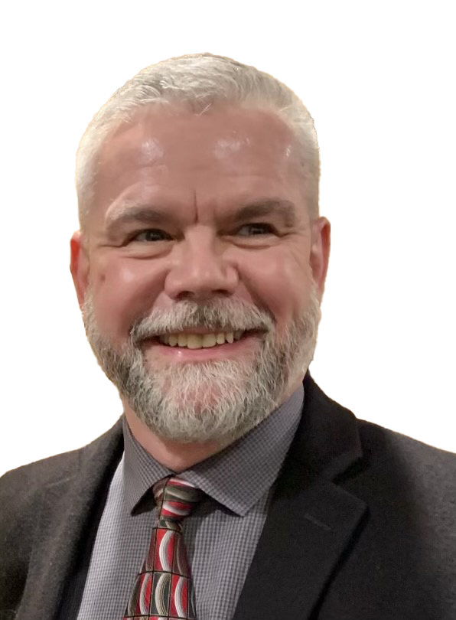
Other | Finance Shared Services | Corporate Services | Universities | Government Services
Director II
Accounting
Sr. Manager Accounting
Finance Director
Finance Manager
USMC
Controller
Temp. Stretch Assignment
Commonwealth Games
BC, Canada
Accountant
(Earned CPA)
Food Service Manager
Unit Controller
Unit Controller
Operations Accountant
Operations Accountant
Kwajalein
Marshall Islands
Revenue Reporting Clerk
Bob Schweickert
Director II, Accounting, Finance Shared Services Contract Administration
Role (List your current role first, then the others in chronological order going back in time) | If the role is with Sodexo, what department, team or segment were you part of in this role? | If not a Sodexo role, what company were you working for?
Director II, Accounting | FSS Contract Administration | Buffalo
Sr. Manager, Accounting | FSS Operations Accounting | Buffalo
Director, Finance | Government Services | HQ/Buffalo
Finance Manager-USMC | Government Services | HQ
Accountant |  | Woodcock & Associates, PC VA - earned CPA license
Unit Controller-American Univ | Universities | DC
Unit Controller-Raytheon | Corporate Services | Kwajalein, Marshall Islands
Operations Accountant Controller (stretch assignment) | FSS Operations Accounting 1994 Commonwealth Games | Buffalo British Columbia, Canada
Food Service Manager | Corporate Services | Batavia/Rochester
Operations Accountant | FSS Operations Accounting | Buffalo
Revenue Reporting Clerk | FSS Revenue Accounting | Buffalo

Slide 54

Questions

Slide 55
Thank you

