Slide 1
FY24 Unit Controller Call Series
January, 2024
We’ll get started momentarily
PLEASE keep lines muted
This call will be recorded
corinne.szabo@sodexo.com
Notes:
Welcome – this call will be recorded. Start recording!
Welcome to the FY24 Unit Controller Network call series! HAPPY NEW YEAR!!
The purpose of the monthly Controller Network Call is to inform the network group about topics that impact the controller role on a timely schedule.
The topics in this call series address programs/system updates to support change management, drive adoption and finance reporting best practices. Feedback and topic suggestions are always welcome.
Previous call content resources can be found on the UFS launch site, “Controller Corner,” main page, lower right. Content is posted at the conclusion of each call and distributed in chat during the call. Content is available for previous 6 months.
I am CS, w/ Finance Shared Services (FSS), coordinator of the CN call series, and your host for today.
This is the first/second of two calls for the month of January. If you wish to include other team members for this month’s agenda, please forward the meeting invitation for Thursday am. If you would like to invite other members on your team to join the Controller Network Call Series. please send an email to corinne.szabo@sodexo.com. I will add them to the Controller Network Call meeting invite distribution list.
Thank you for joining today. To anyone new to the network – Welcome to the call series.

Slide 2
Agenda
Safety Moment – Jill Helms
Q2 Collections – Brad Hamman
E=Vision, New Enhancement Features & Demo – Susan Chapman
Q&A
Notes:
Today’s agenda –
To demonstrate our commitment to safety and our safety culture at Sodexo, we begin each meeting with a Safety Moment – I have an open invitation to anyone listening in to volunteer for a future call and present a safety moment. If you’re looking for an opportunity to share a safety experience or learning, or just want to practice presenting, please reach out to me. Today we welcome back Jill Helms, UFS Support Specialist, to present our Safety Moment
Next up:
Q2 Collections – Brad Hamman
We’ll transfer over to the final topic and demo of
E=Vision New Enhancement Features in user interface and reports – Susan Chapman
Q&A
Please use the chat function to submit any questions that you may have as we run through the agenda topics. We will pause to address questions between topics and if we run out of time we will follow up via email.
Finally – feel free to use the Reactions button as we proceed through today’s call. With everyone muted, it is a nice way to contribute and engage and we appreciate the energy.

Slide 3
Safety Moment
Extreme Winter Weather
Notes:
Jill Helms

Slide 4
Safety Moment: Extreme Winter Weather
In some areas of the country, temperatures can drop dramatically in a very short time. Preparation for cold weather is as important as protection from cold weather.
When cold temperatures can’t be avoided, follow these tips:
Carry cold weather gear such as extra socks, gloves, hats, jacket, blankets, a change of clothes and a thermos of hot liquid
Include a thermometer and chemical hot packs in your first aid kit
Take breaks from the cold by going inside on a regular basis
Drink water or warm beverages (non-alcoholic) to prevent dehydration
Monitor your physical condition and that of your coworkers
Keep driveway and walkway clear of snow and ice to help prevent falls.
Don’t shovel if you are more prone to injury
Choose the right shovel
Use proper shoveling form
Notes:
When cold temperatures can’t be avoided, follow these tips:
Carry cold weather gear such as extra socks, gloves, hats, jacket, blankets, a change of clothes and a thermos of hot liquid
Include a thermometer and chemical hot packs in your first aid kit
Take breaks from the cold by going inside on a regular basis
Drink water or warm beverages (non-alcoholic) to prevent dehydration
Monitor your physical condition and that of your coworkers
Keep driveway and walkway clear of snow and ice to help prevent falls.
Know if You Shouldn't Shovel - Certain people should avoid shoveling snow, since they may be more prone to injury. If you have a history of heart problems, you should avoid this activity.
Choose the Right Shovel - When using a snow shovel make sure the shovel fits your body size and your level
of strength. Using one that is too short means that you will be leaning forward more as
you shovel the snow, and you are running the risk of a back injury by doing so.
Use Proper Shoveling Form - Keep your back straight while bending your knees and squatting down with your legs apart. Do not throw the
shovelfuls of snow over your shoulder or to the side, carry them to where you want to place the snow.

Slide 5
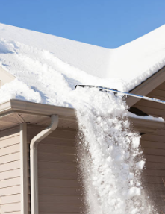
Safety Moment: Extreme Winter Weather
If a lot of snow has accumulated on the roof of your home, you may need to remove it to avoid leaks. Snow is heavy and can strain the structure of your house.
Keep these tips in mind:
Work from the Ground if Possible - The safest way to remove snow from the roof of your property is to do so from ground level using a rake. Don't stand directly below the area you are focusing on when removing snow from the roof of your home.
Don't Work Alone - If you need to go up onto the roof to deal with the snow, don't do so alone. Get someone else to act as a spotter and use a harness or a rope for extra security. Wearing boots with good traction or adding boot chains to your footwear is required if you are going to be doing this type of work.
Don't Pile the Snow - Don't pile the snow up before moving it off the roof. The weight of accumulated snow sitting in one area can damage the affected area and can even lead to a collapse.
Notes:
If a lot of snow has accumulated on the roof of your home, you may need to remove it to avoid leaks. Snow is heavy and can strain the structure of your house.
Keep these tips in mind:
Work from the Ground if Possible - The safest way to remove snow from the roof of your property is to do so from ground level using a rake. Don't stand directly below the area you are focusing on when removing snow from the roof of your home.
Don't Work Alone - If you need to go up onto the roof to deal with the snow, don't do so alone. Get someone else to act as a spotter and use a harness or a rope for extra security. Wearing boots with good traction or adding boot chains to your footwear is required if you are going to be doing this type of work.
Don't Pile the Snow - Don't pile the snow up before moving it off the roof. The weight of accumulated snow sitting in one area can damage the affected area and can even lead to a collapse.
Corinne – Thank you Jill, this is a very relevant topic, especially since I just saw the notification go out that the Finance Service Center in Buffalo will be closed tomorrow, due to inclement weather – expected snow, extremely low temperatures, and high winds. Stay safe everyone!!

Slide 6
Let’s Collect It for Q2 FY24
Deadline for February Payments

Slide 7
Collection Deadline for Quarter 2, FY24
Your help is needed to increase our cash flow. To ensure that your AR payments, bank deposits, cash receipts, and cash balances are properly credited for Quarter 2, all deposits must be made on or before Thursday February 29th.
Please observe the following deadlines depending on your payment method.
Select the payment link(s) for your current payment method below for further details :
ELECTRONIC (ACH/WIRE) PAYMENTS
CHECK PAYMENTS
REMINDER:
The preferred method of invoice payments is ACH. ACH payments are timely, more secure and less costly.
Please contact Accounts Receivable at AccountsReceivable.NorAm@sodexo.com or 1-800-828-7762, Option 2, Option 2 for more information and to request the ACH details for your client.

Slide 8
Electronic Payments – Deadline for Quarter 2 FY24
Client ACH payments post to Sodexo’s bank account 1 to 2 business days after the client releases the payment to their bank. Determine with your client Finance or AP Department whether their bank ACH is 1- or 2-Day processing.
2 Day ACH: Tuesday February 27th
If ACH is 2-day processing, ACH must be released from client’s bank on or before the 27th with a value date of February 29th
1 Day ACH: Wednesday February 28th
If ACH is a 1-day processing, ACH must be released from client’s bank on or before the 28th with a value date of February 29th
Thursday February 29th
For client payments to post to Sodexo’s bank account on Thursday February 29th, client must initiate a SAME DAY electronic funds transfer payment on the 29th with a value date of February 29th

Slide 9
Check Payments – Deadline for Quarter 2 FY24
Deadline for Q2 FY24 AR Collections for CHECK payments sent to Lockbox must be deposited in the Lockbox by 10:30 AM (ET) Thursday February 29th
Lock Box address:
Sodexo Inc & Affiliates
Attn: 360170
500 Ross St 154-0455
Pittsburgh, PA 15262-0001
Telephone (412) 234-4381
Total Check Amounts | Important Dates | Action to Take
Total Checks greater than $2,500 | Tuesday February 27th | Overnight checks to the Lockbox address above with Next day delivery
Total Checks greater than $2,500 | Wednesday February 28th | Overnight checks to the Lockbox with Next Day Air EARLY AM Delivery
Total Checks greater than $100,000 | Thursday February 29th before 2:00 PM ET. | Call the FSS AR Department at 1-800-828-7762 option 2, option 2 before 2 PM ET

Slide 10
Payment Fraud
Threat Actors are continuing their efforts posing as Sodexo employee to commit fraud against our clients.
Tell customers NEVER to conduct electronic funds transactions with Sodexo via email. Always call the AR Department to verify any requests and to check the sender’s domain
Ensure that any requests for funds transfer received have 2nd and/or 3rd level validation procedures in place (i.e., DM/GM approvals, always call your customer to verify legitimacy etc.)
Using email for financial transactions in general is strongly discouraged
Immediately contact FSS Accounts Receivables department if you suspect possible fraud at: AccountsReceivable.NorAm@sodexo.com or 1-800-828-7762, Option 2, Option 2
Thank you, your actions are making a difference!

Slide 11
Best Practices for Collections
Be professional, be courteous – but firm. It is important to be understanding with the Client; however, we have the right to know when payment is expected for services rendered.
Bill it! Sodexo Noram saw a sizeable increased in unbilled AR in FY23 which impacts DSO and Cash Flow. Please make best efforts for billings to be generated in a timely fashion.
Working with client AP Departments - they might be difficult to communicate with at times. If the 1st level contacts are not responding, escalate to the next level.
Follow up is key for past due and missed payments. Other Vendors are asking for payment. We need to ensure ours are given the same priority as other vendors.
Are you hearing financial distress? If the client is unable to commit to any payment and/or if claims of financial distress (i.e. cash flow issues). Refer the account immediately the FSS Credit and Collections team at Creditcollection.NORAM@Sodexo.COM.

Slide 12
Q&A

Slide 13
01
E=Vision User Interface Update
Hierarchy Selector
Sparklines

Slide 14
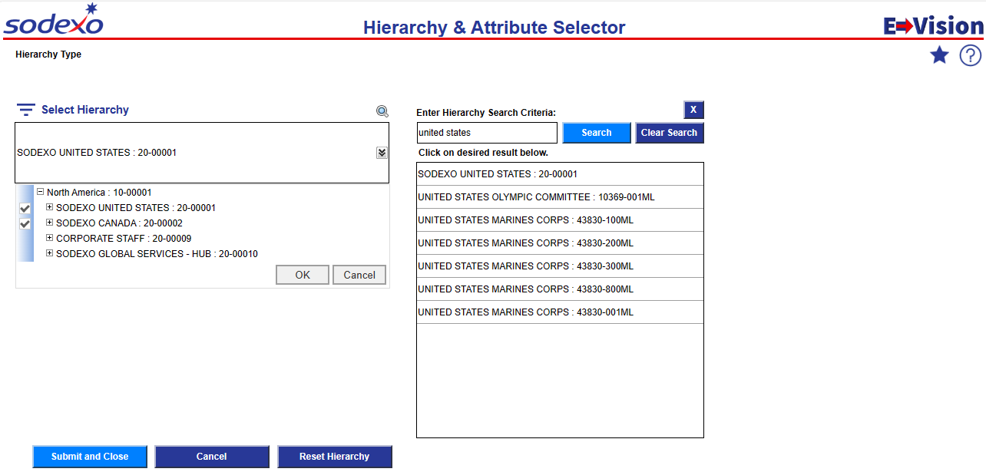
Hierarchy Selector
Using the Search Feature
Selecting from the Drill Through
Click here to open the search feature
Close search to select attributes
If Closed, click the arrow to open the hierarchy drill through
Enter the name or number, then click Search
Click the +/- boxes to drill through the hierarchy
Click the name to auto populate the hierarchy filter
Click to select and place a check mark on selections
Click Submit and Close to use the selected hierarchy

Slide 15
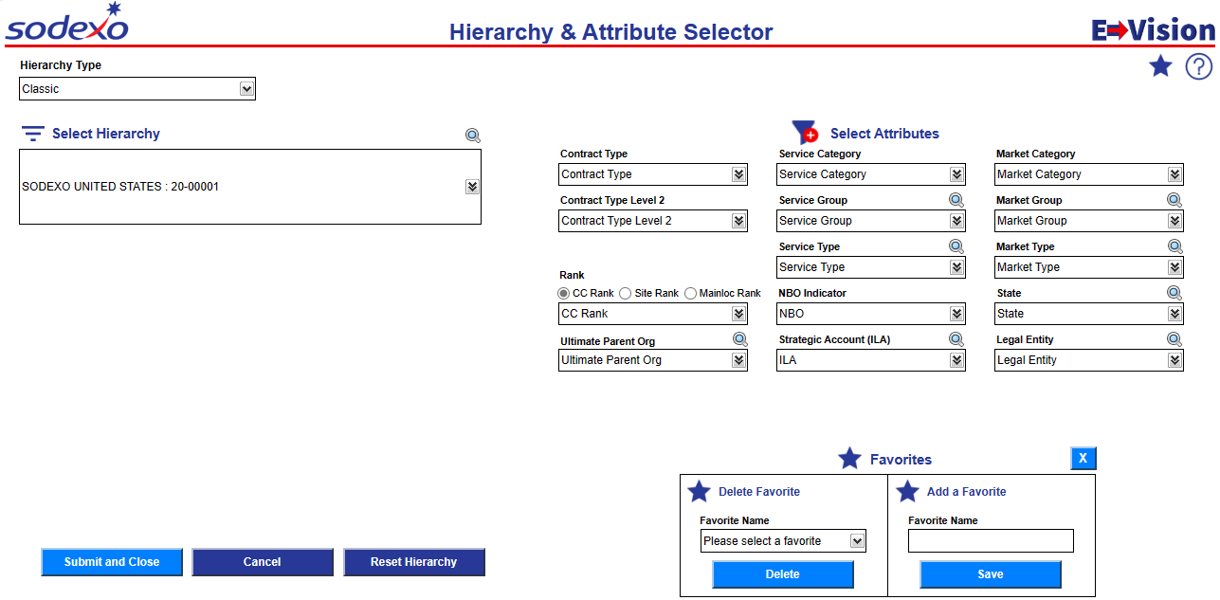
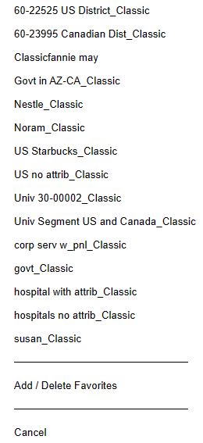
Favorites
Using the Favorites Feature
Reminder: Select a saved favorite from any page in the dashboard by clicking on the star icon.
Click to open favorites
Select Favorite: select the named favorite from the list
Click to add or remove a favorite
Click Submit and Close to use the selected hierarchy
Delete: Select from the drop down and click delete.
Add a New Favorite: select the desired Hierarchy and Attributes, type name & click Save

Slide 16
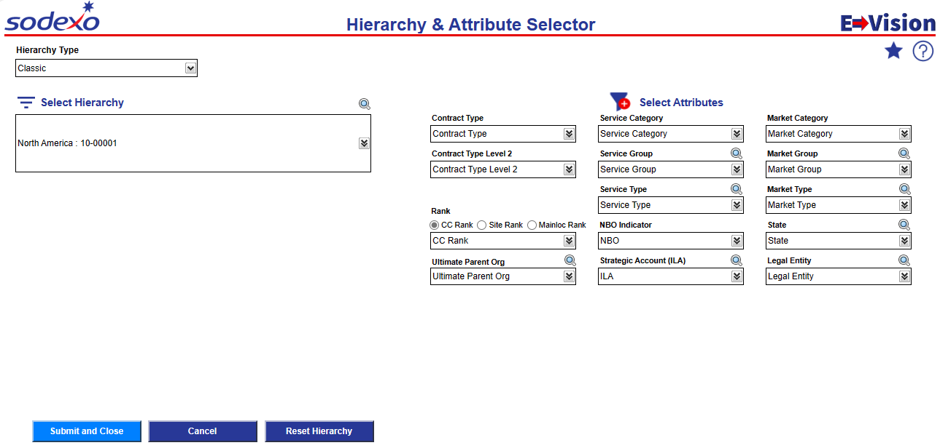
Attribute Selector
Selecting Attribute Filters
Attributes are not available within the Daily Financial Activity Views.
Select desired attributes from the drop downs. Multiple selection is available. Your filtered hierarchy will be based on the attributes selected.
Contract Type: Contract structure
Rank: How long CC/Site/ML has been open or closed
Ult Parent Org: Client name or parent organization
Service: The type of service offered from high level category to granular type
NBO: DRIVE indicator
Strategic Account: International large account tag
Market: Client makeup where we provide services from high level category to granular type
State: State
Legal Entity: Sodexo legal designations – great way to identify large cross-sectional groups like Sodexo Magic
Click to search by name or number. Partial name or number can be used
Click Submit and Close to use the selected hierarchy & attributes

Slide 17
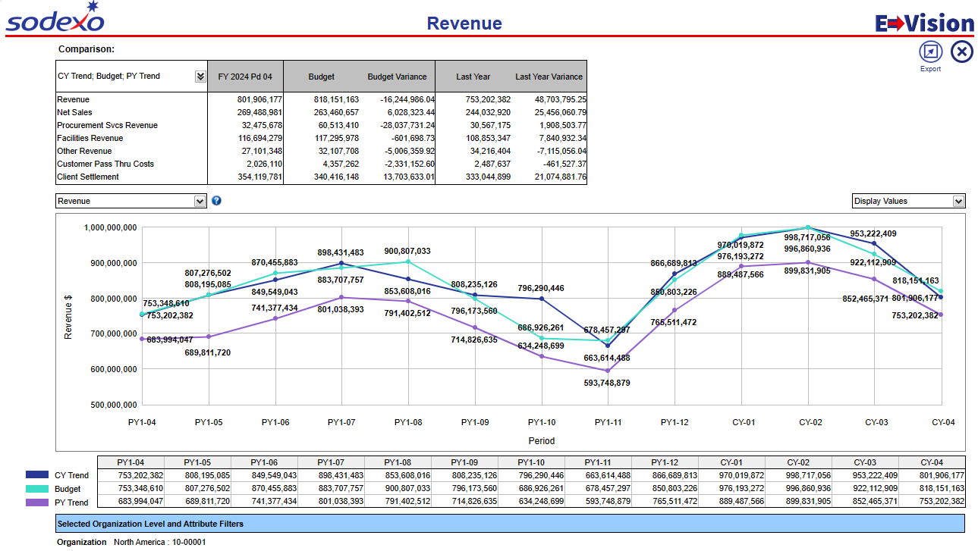
Sparklines
Updated colors and page sizing for improved readability

Slide 18
02
Reporting Enhancement
New Blended Meal & Facility Reporting
Updated Fiscal Year View

Slide 19
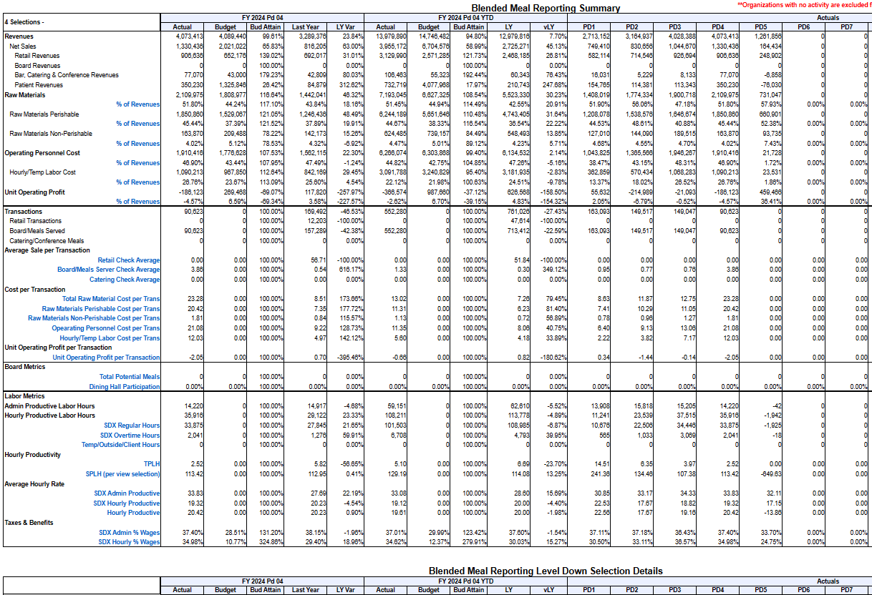
Reporting: Blended Meals & Facility Reports
Single click access to level down reporting
Includes key financial and metric comparisons to understand your business
View data comparisons to Actual or Forecast
Forecast metrics included (where forecasted)
Interactive Features
%Rev or %NS views
Level selections
Actual or Forecast Comparison

Slide 20
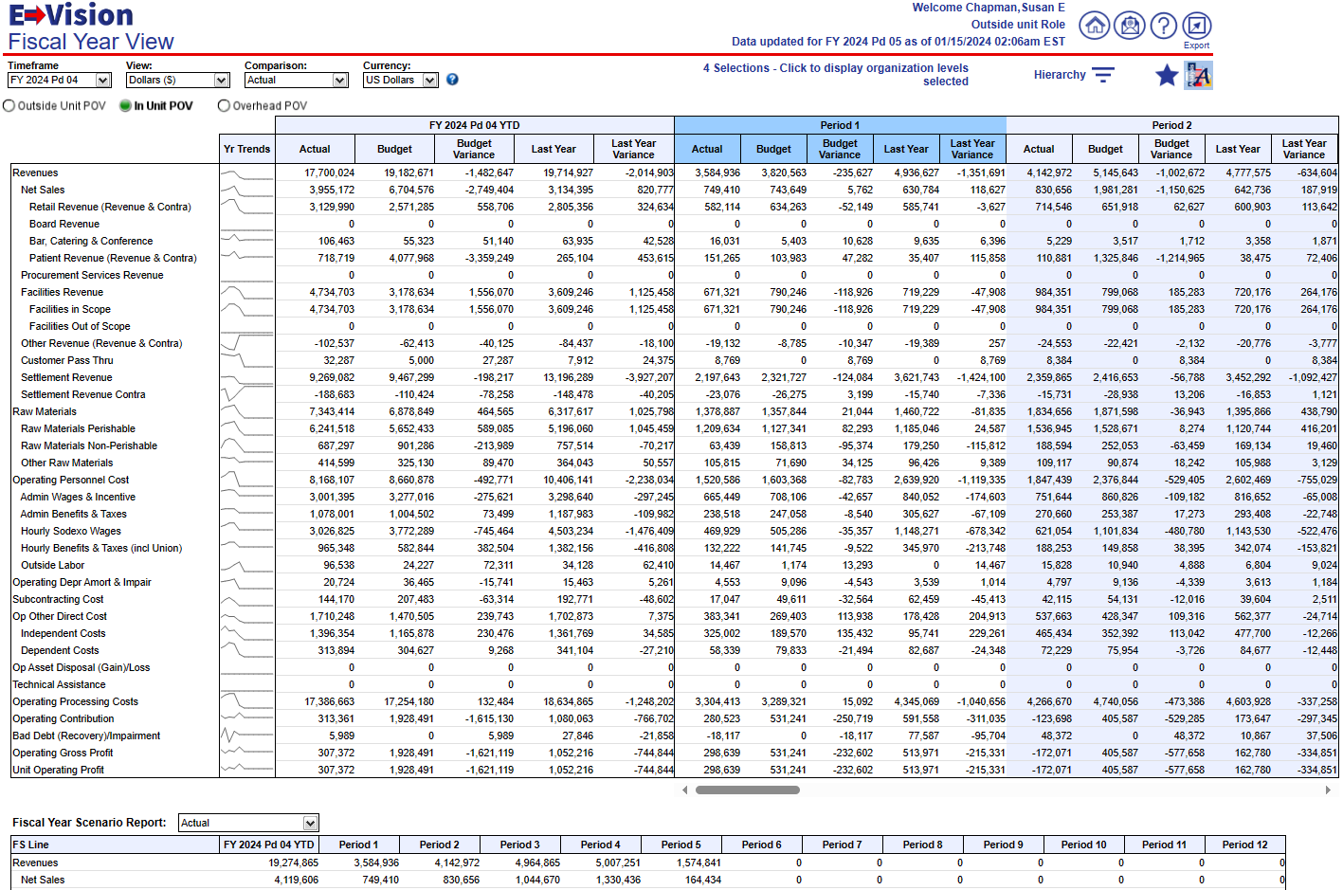
P&L Fiscal Year
Full Fiscal Year View
Analyze Financial Variances to Actual or Forecast
Fiscal Year Scenario Report for side-by-side period review
Interactive Features
Sparklines expand to display Fiscal Year Trendline Graph & Data Table

Slide 21
03
Resources
Sodexo Net MR&A
On Screen Help
Reporting Email Box

Slide 22
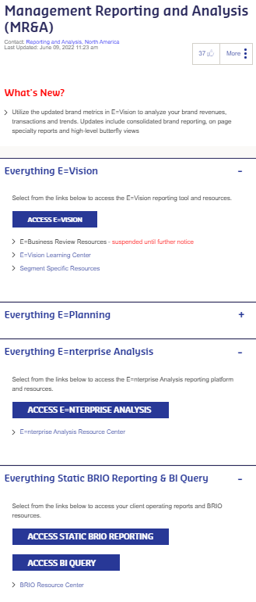
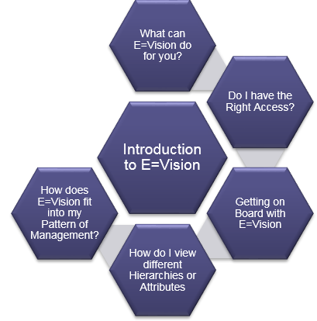
Resources
Technical Assistance: 888-667-9111 and follow the prompts for E=Vision
Functional Assistance: ReportingAndAnalysis.Noram@Sodexo.com
Access Resources from MR&A Page on Sodexo Net.
Learning Center
View Micro Trainings
Access Support Guides
Enterprise Analysis
Support Guides
On Screen Assistance
Click on ? Icons to view instructions, quick tips & calculation information
Open E=Assist tab to view Micro learning videos or support materials

