Slide 1
FY25 Unit
Controllers
Call Series
February 2025
corinne.szabo@sodexo.com
Notes:
Welcome – this call will be recorded. Start recording!
Welcome to the FY25 Unit Controller Network call series! The purpose of the monthly Controller Network Call is to inform the network group about topics that impact the controller role on a timely schedule.
The topics in this call series address programs/system updates to support change management, drive adoption and finance reporting best practices. Feedback and topic suggestions are always welcome.
Previous call content resources for the past 6 months, can be found on the UFS launch site, “Controller Corner,” main page, lower right. Content is posted at the conclusion of each call and distributed in chat during the call.
I am CS, w/ Finance Shared Services (FSS), coordinator of the CN call series, and your host for today.
This is the first/second of two calls for the month of February. If you wish to include other team members for this month’s agenda, please forward the meeting invitation for Thursday am.
We have multiple attendees with different roles within in-unit finance, many of which have been added by request. If you would like to invite other members on your team to join the Controller Network Call Series. please send an email to corinne.szabo@sodexo.com. I will add them to the list for all future Controller Network Call meetings. For anyone joining us for the first time - welcome to the call series.
And to those returning and everyone on the call, thanks for joining.
(click)

Slide 2
Agenda
Safety Moment – Wendy Doster
Q2 Collect It – Mary Beth Riley, Brad Hamman
Ivanti SoUnified vs. SoFinance – Corinne Szabo
UFS and SAP Fiori Security Access User Tips– Jill Helms
SAP Fiori Financial Adjustments Application Update – Wendy Cano
Q&A
Notes:
Our February Agenda:
To demonstrate our commitment to safety and our safety culture at Sodexo, we begin each meeting with a Safety Moment – I have an open invitation to anyone listening in to volunteer for a future call and present a safety moment. If you’re looking for an opportunity to share a safety experience or learning, or just want to practice presenting, please reach out to me. I’m happy to say we have a volunteer returning this month – thank you Wendy Doster from our FSS Credit & Collections team.
We continue from our FSS Order to Cash, Credit & Collections team with Mary Beth Riley / Brad Hamman reviewing Q2 collection deadlines
With a recent change in technical support and security access procedures, Jill Helms and I have a few user tips we want to pass on to this group….
First, I’ll be reviewing a brief overview of when to use SoUnified vs. the SoFinance tool
Followed by Jill’s guidance on UFS and SAP Fiori security access form user tips
And to wrap up our agenda today
We welcome back Wendy Cano to provide an update on the new SAP Fiori Finance Adjustments Application
For Q&A - Please use the chat function within this Team meeting to submit any questions that you may have as we run through the agenda topics. We will pause to address questions between topics and if we run out of time we will follow up via email.
And don’t hesitate to use the Reactions button as we proceed through today’s call. With everyone muted, it is a nice way to contribute and engage and we appreciate your participation & energy.

Slide 3
Safety Moment
Life Resources EAP Wendy Doster
Notes:
Wendy Doster– FSS Credit & Collections to present our safety moment on Life Resources EAP, formerly TELUS Health…..

Slide 4
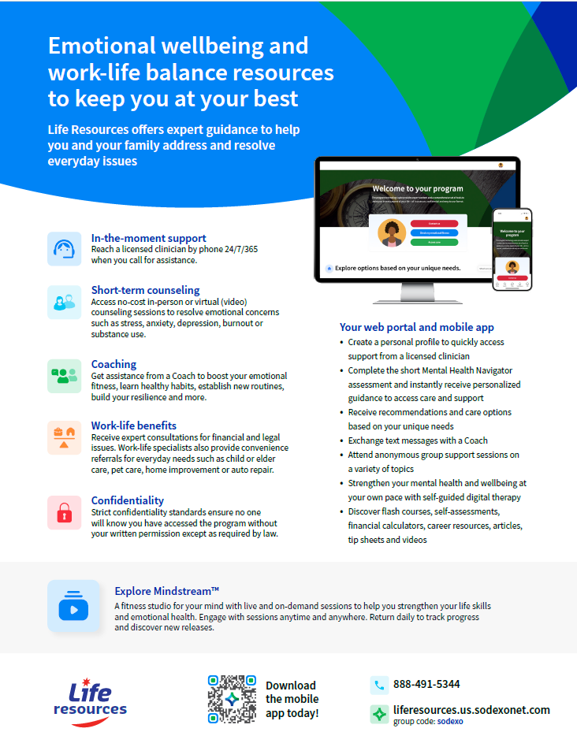
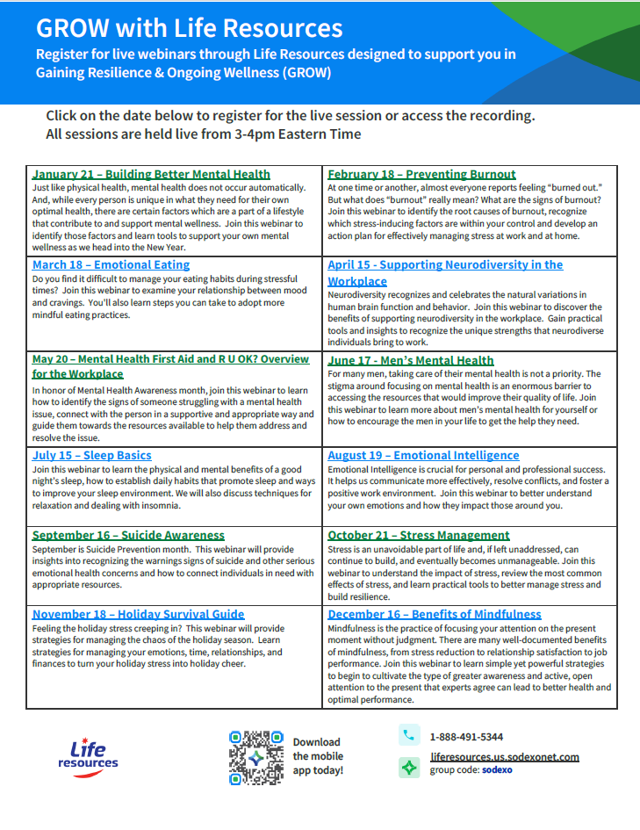

Slide 5
Notes:
Mary Beth

Slide 6
Notes:
PDF Documents to be provided separately.

Slide 7
Let’s Collect It for Q2 FY25
Deadline for February 2025 Payments

Slide 8
Collection Deadline for Quarter 2, FY25
Your help is needed to increase our cash flow. To ensure that your AR payments, bank deposits, cash receipts, and cash balances are properly credited for Quarter 2, all deposits must be made on or before Friday February 28^{th,} 2025.
Please observe the following deadlines depending on your payment method.
Select the payment link(s) for your current payment method below for further details :
ELECTRONIC (ACH/WIRE) PAYMENTS
CHECK PAYMENTS
REMINDER:
The preferred method of invoice payments is ACH. ACH payments are timely, more secure and less costly.
Please contact Accounts Receivable via SoFinance or 1-800-828-7762, Option 2, Option 2 for more information and to request the ACH details for your client.

Slide 9
Electronic Payments – Deadline for Quarter 2 FY25
Client ACH payments post to Sodexo’s bank account 1 to 2 business days after the client releases the payment to their bank. Determine with your client Finance or AP Department whether their bank ACH is 1- or 2-Day processing.
2 Day ACH: Wednesday February 26th
If ACH is 2-day processing, ACH must be released from client’s bank on or before the 26th with a value date of February 28th
1 Day ACH: Thursday February 27th
If ACH is a 1-day processing, ACH must be released from client’s bank on or before the 27th with a value date of February 28th
Friday February 28th
For client payments to post to Sodexo’s bank account on Friday February 28th, client must initiate a SAME DAY electronic funds transfer payment on the 28th with a value date of February 28th

Slide 10
Check Payments – Deadline for Quarter 2 FY25
Deadline for Q2 FY25 AR Collections for CHECK payments sent to Lockbox must be deposited by 10:30AM (ET) Friday February 28th.
Lock Box address:
Sodexo Inc & Affiliates
Attn: 360170
500 Ross St 154-0455
Pittsburgh, PA 15262-0001
Telephone (412) 234-4381
By Wednesday February 26th if your total checks are greater than $2,500, Overnight the checks and remittance details to the lockbox address above for next day delivery
By Thursday February 27th if your total checks are greater than $2,500, Overnight the checks and remittance details to the lockbox address above with Next Day Air Early AM Delivery
On Friday February 28th before 2pm ET, contact the FSS AR department at 1-800-828-7762 Option 2 Option 2 for instructions

Slide 11
Payment Fraud
Threat Actors are continuing their efforts posing as Sodexo employee to commit fraud against our clients.
Tell customers NEVER to conduct electronic funds transactions with Sodexo via email. Always call the AR Department to verify any requests and to check the sender’s domain
Ensure that any requests for funds transfer received have 2nd and/or 3rd level validation procedures in place (i.e., DM/GM approvals, always call your customer to verify legitimacy etc.)
Using email for financial transactions in general is strongly discouraged
Immediately contact FSS Accounts Receivables department if you suspect possible fraud: Kelsey.Szpylman@sodexo.com and Jeremy.Kelly@sodexo.com or 1-800-828-7762, Option 2, Option 2”
Thank you, your actions are making a difference!

Slide 12
Questions?

Slide 13
SoUnified vs. SoFinance

Slide 14
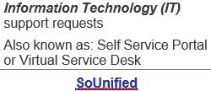
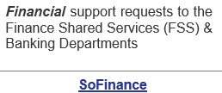
SoUnified vs. SoFinance
When to Use SoUnified vs SoFinance Eng_Fr.docx
Notes:
Based on feedback from operations to the Finance team, we understand there are questions around the two separate customer support ticketing portals we use in Sodexo to submit requests for assistance.
(click)
SoUnified is used to submit requests to our Information Technology (IT) team and supports all Information Technology (IT) requests, including security access requests. SoUnified is also known as the Self Service Portal or Virtual Service Desk, and is accessed through the Sodexo Employee Portal.
(click)
SoFinance is used to submit requests to our Finance Shared Services (FSS) and Banking team. SoFinance tool is for Financial support requests to the Finance Shared Services & Banking departments and is access through MySodexo > Other applications. These two portals, though they share a similar UI, are not connected to each other, so it’s important to use the correct one for your request so you can be helped as quickly as possible.
Linked here is a hot off the press document created by the Finance team to assist you in understanding the different customer support ticketing portals and more details on the service each tool provides.
(Share document)
This document will also be shared in chat during this call and will be included in the Unit Financial Systems Newsletter this week. It will also be posted on the UFS launch site for easy reference..
My ask for everyone on the call – please download this SoUnified va. SoFinance document for reference and for SHARING. You have an opportunity to meet with other team members through your day-to-day or upcoming meetings that will help us reinforce this reference guide. Please take this away and help spread this message about the Support portals available.

Slide 15
When to Use SoUnified vs. SoFinance
Password resets Resolving an error message Signing in issues – Multi-Factor Authentication (MFA) Mobile application support Hardware replacements, buying computers and software INFOR POS, Everyday food ordering platform and Kronos technical support Unit Financial System (UFS) technical support All other finance and food applications technical support | Accounts Payable Accounts Receivable Banking Bank/Merchant Reconciliation Credit & Collections Management Finance Continuous Improvement & Integrations P-Card & Vendor Administration Revenue Accounting Segment Support Account Adjustments Unit Financial System (UFS) general inquiries All other finance non-technical support

Slide 16
SoUnified vs. SoFinance Resources
SoUnified Knowledge Base Visit the Knowledge Base area within the SoUnified Self Service Portal for: User guides of various applications, software and hardware. ‘How to’ articles to assist you with: › Resolving problems and error messages › Specific access requests › Requesting software and hardware Informative reference documents, such as application overviews and support contacts SoUnified Self Service Mobile Portal Overview / User Guide | SodexoNet: SoFinance 10 Minute e-Leaning Quick Reference User Guide Comprehensive User Guide Log-in Troubleshooting Guide Quick Tip for Including Screenshots Quick Tip for Contacting Segment Support Email to SoFinance Crosswalk FAQs
Notes:
Emails that auto-generate tickets in SoUnified - ServiceDesk.NorAm@Sodexo.com, Helpdeskufssupport.Noram@sodexo.com, AccessManagement.NorAm@sodexo.com

Slide 17
PDF document to be distributed for reference

Slide 18
Tips for Requesting Web UFS Access in SoUnified
D E M O

Slide 19
Tips for Requesting Web UFS Access in SoUnified

Slide 20
Tips for Requesting Web UFS Access in SoUnified
Am I a Multiuser Account? (This account type is not common)
Do you use multiple log-in IDs for Web UFS to report financials for more than one business segment? (i.e. Health Care and Corporate Services)
I do not - No, you are not a multiuser. Please avoid selecting this option when submitting access for Web UFS.
I do - Yes, you are a multiuser. However, you should only select this option if you are adding access for your extra ID, not your primary ID that you also use for Outlook, Sodexo_Net etc.
When requesting access to add nodes to your extra ID, it is necessary to include ALL nodes you need in this access, not just the node you are adding.

Slide 21
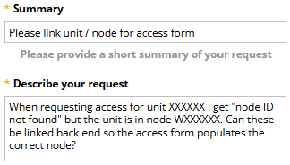
Tips for Requesting Web UFS Access in SoUnified
“Node ID Not Found” Error Appears for Unit
Are you trying to submit an access request form in SoUnified for Web UFS and getting a “node ID not found” error? Please don’t submit the access request if this error is displayed for any unit # added. This can be caused by a few things (and easily fixed):
The unit was not part of the original node creation and was added later as a subunit.
Try using the primary unit of the node instead to request access, not the sub-unit. (Web UFS Access is by the node ID not the unit. You only need to add a single unit for each node that you require access to.)
To correct the “node ID not found” error for future requests, please submit a SoFinance UFS General Request asking to have the unit / node linked back end. Please provide the unit #(s) and Node ID in the request.
Or send an email to the UFS Administrator with the same details unitfinancialsystemsadministration.noram@sodexo.com.

Slide 22
Tips for Requesting Web UFS Access in SoUnified
“Node ID Not Found” Error Appears for Unit
A node was never created for the unit you need access to.
Can the unit be added to an existing node?
No - You will need to submit a SoUnified request form for a Web UFS New Node. Review the user guide to walk you through the request.
Once you receive the “fulfilled” email, submit Web UFS access request in SoUnified
Yes - this is added unit level. Review the user guide to help you add it.
If you already have access to the existing node, no further access requests are necessary.
If you do not have access to the existing node, submit Web UFS access request in SoUnified
If you aren’t sure if the unit has a node or if it is already set up in Web UFS, please submit a SoFinance, UFS General request and we can look that up for you. You can also email the UFS Administrator for this information. unitfinancialsystemsadministration.noram@sodexo.com.

Slide 23
Questions?

Slide 24
SAP Fiori Financial Adjustments Application Update – February 2025
Notes:
Previously named SAP Fiori Journal Entry Application

Slide 25
What is the SAP Fiori Financial Adjustments Application?
SAP Fiori Financial Adjustments is a new application that allows you to submit financial adjustment requests during financial close directly in SAP
Once submitted, the Segment Support accountants review, edit (if needed), and approve/post as a journal entry
The application also allows you to create and post transfers throughout the month
Once the application is rolled out to your segment, you will use the SAP Fiori Financial Adjustments application to enter transfers and adjustment requests
For UFS Transfers:
Instead of using the Transfer Module in UFS to create revenue, expense, and labor transfers, you will enter them using the SAP Fiori application
For Financial Close Adjustment Requests:
Instead of entering adjustment requests in the Excel Standard Close Adjustment Form, opening a ticket in SoFinance, and uploading the Excel form in the ticket, you will submit financial adjustment requests using the Fiori application
This will save you time, as the application will automatically create a ticket in SoFinance to track progress
Notes:
A review of what the Financial Adjustments app is.

Slide 26
Update
SAP Fiori Financial Adjustments Application/SoFinance Interface Glitch
Some adjustment requests submitted through the SAP Fiori Financial Adjustments application were not triggering a SoFinance ticket due to a recent Global information security update
Interface Glitch Resolved
The NorAm SAP and Global SoFinance teams worked together to find, test and implement a solution
Adjustment requests submitted through the application are now triggering a SoFinance ticket as designed
The roll out of the SAP Fiori Financial Adjustments application to additional segments was temporarily on hold, but has resumed this month
Notes:
Updates since the January Unit Controllers calls

Slide 27
Roll Out Status
Airlines segment users attended a live Orientation and Q&A virtual meeting
Application rolled-out to the Airlines segment
SoFinance and Financial Adjustments project teams worked to resolve the interface glitch
JAN 2025
Segment Support accountants validated the solution for the interface glitch worked as intended during period 5 financial close
At School segment leaders received communication about the tool and go-live
At School operators and segment finance received communication and training materials
FEB 2025
At School segment users to attend a live Orientation and Q&A virtual meeting
Application roll-out to the At School segment
Communication and training materials to be provided to users in the Campus segment
MAR 2025

Slide 28
Revised Application Roll Out Schedule
Segment | Orientation/Go-Live Month | Notification/Training
Government - Completed | December | November
Airlines - Completed | January | December
At School | March | February
Campus | April | March
Corporate Services | May | April
Energy & Resources | May | April
Seniors | June | May
Health Care | June | May
Canada | July | June
InReach | TBD | TBD
Corporate Staff | TBD | TBD
***Subject to Change***
Notes:
Reminder of the revised roll out schedule

Slide 29
Application Rollout Steps
Fiori users will receive training prior to your segment’s go-live date
Training materials have been created to help you learn how to use the new tool including:
eLearning
Step-by-step instructions for each adjustment type
Video walkthroughs for each adjustment type
Users invited to attend live Orientation and Q&A virtual meeting
Users are strongly encouraged to take the training prior to using the application
Access to the Fiori application will be provided prior to your segment’s go-live date
Anyone with UFS access will receive access to the FOOD O2C or FM O2C role in Fiori
Additional access requests should be directed to Corinne Szabo
Hierarchy access mirrors your access in BRIO
Notes:
What you can expect prior to your segments go-live.

Slide 30
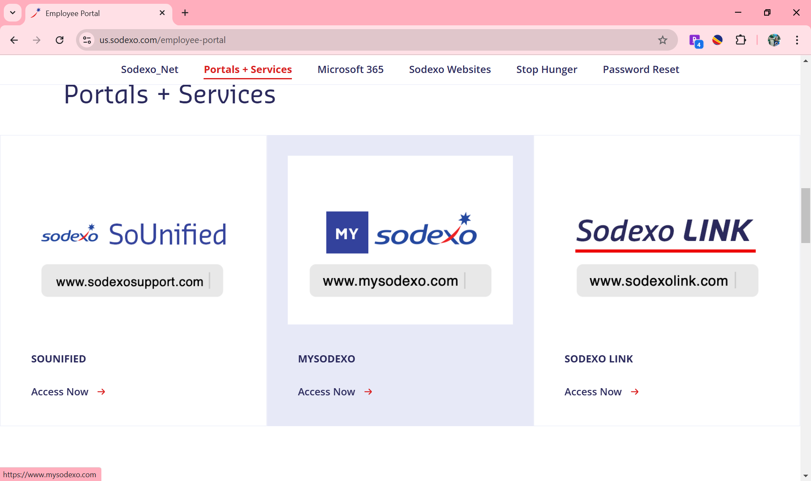
How to Access Fiori Applications

Slide 31
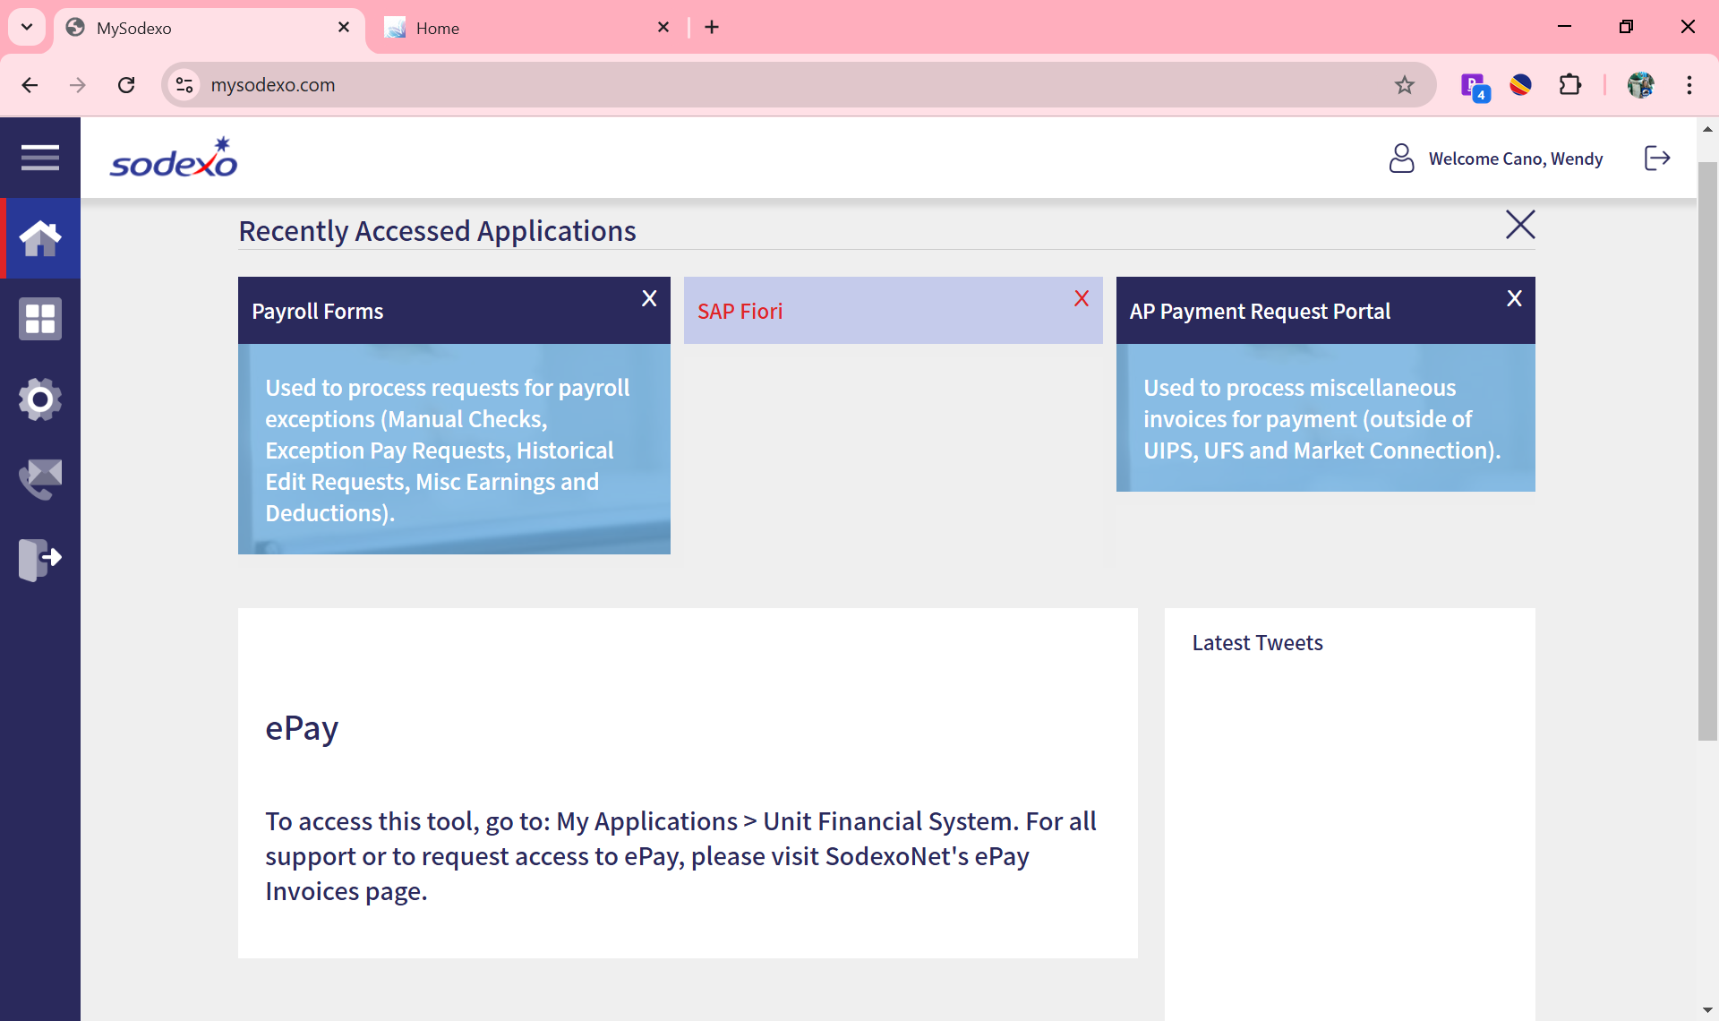
How to Access Fiori Applications Cont.

Slide 32
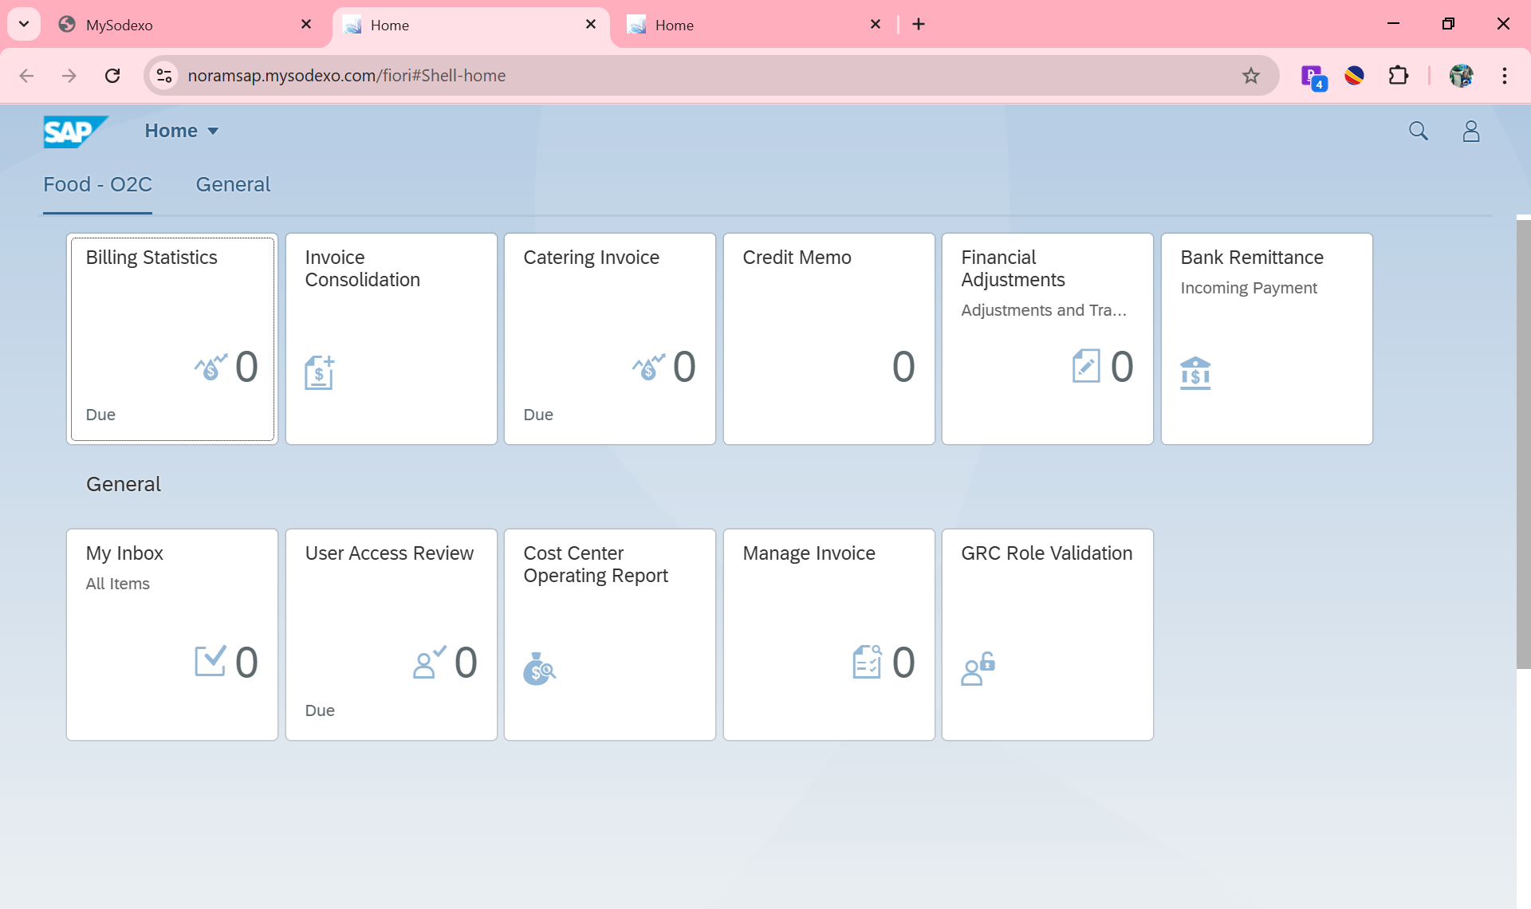
Fiori Home Page

Slide 33
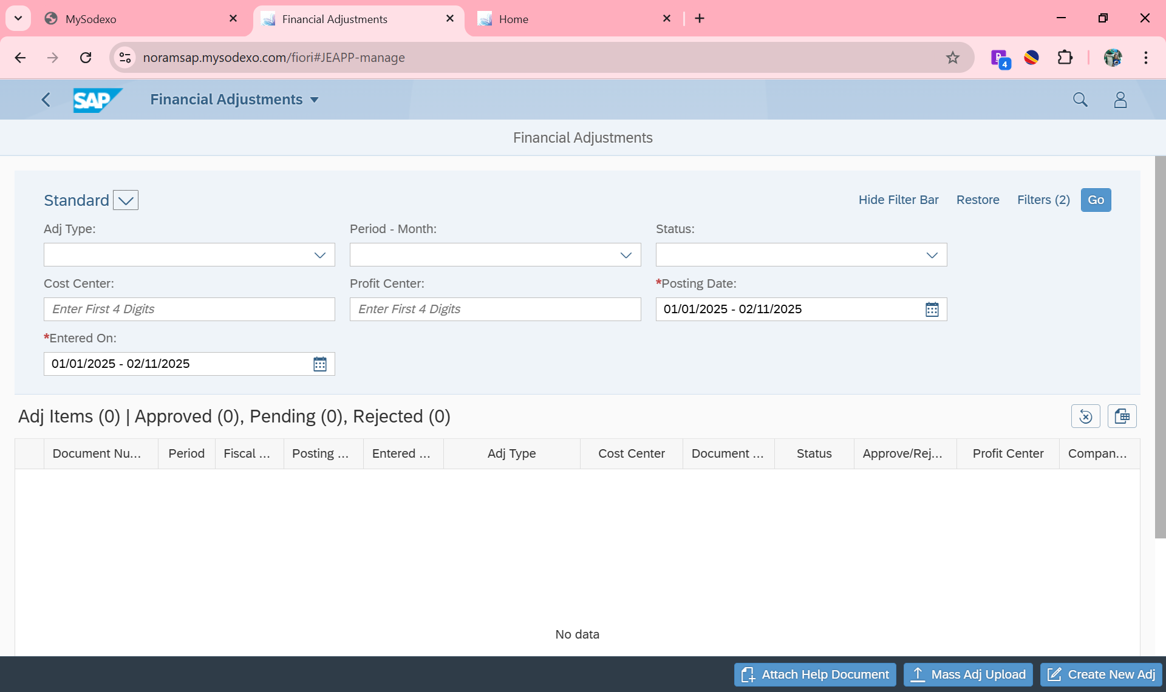
Financial Adjustments Application
Notes:
Screen shot of the landing page

Slide 34
New Enhancement Coming Soon
A new ‘Download’ button has been added on the landing page of the application
Once clicked, you can download header data or line item data
Header Data:
Shows all the adjustments you have submitted, the status of those adjustments and the header details
Line Item Data:
Shows all the details included in the adjustment request, including the offset account number
The filters allow you to choose what activity you would like included in the reports and the reset button allows you to clear your filters
Notes:
On last month’s Unit Controllers calls, Fiori users asked questions about reports in the application.
The enhancement request from those users led to this enhancement.

Slide 35
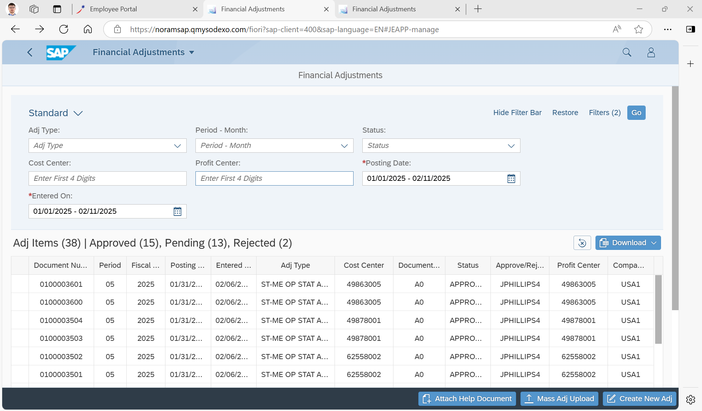
New Enhancement

Slide 36
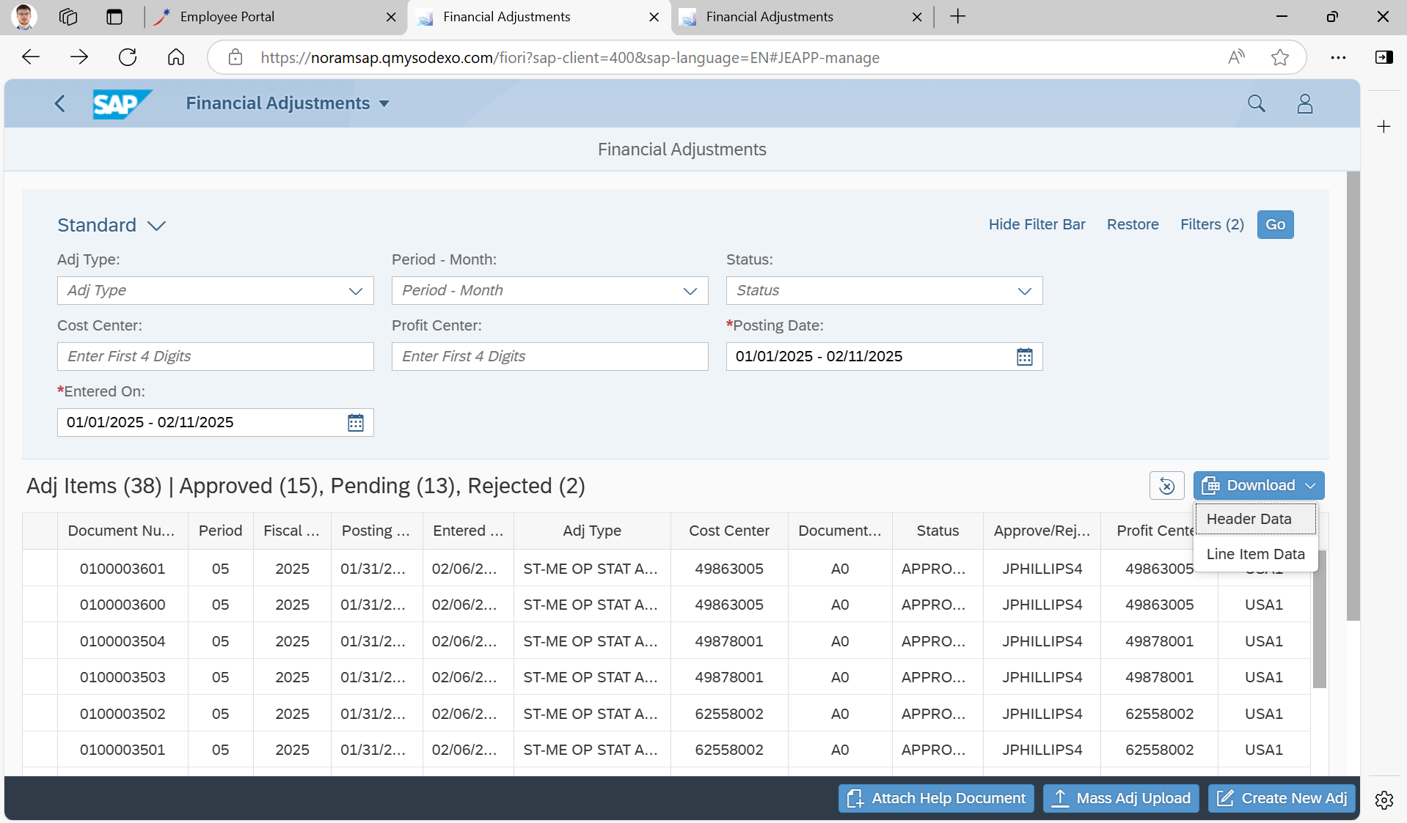
New Enhancement Cont.

Slide 37
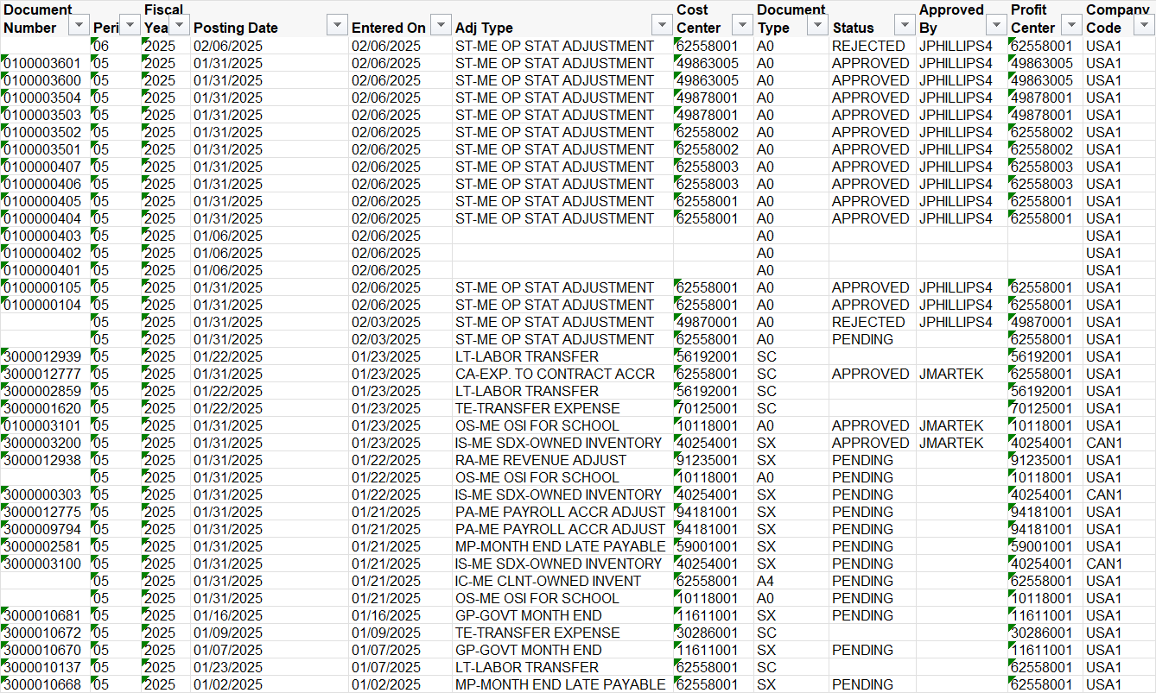
Downloaded Header Data

Slide 38
Downloaded Line Item Data

Slide 39
Share Your Feedback!
The project team welcomes your feedback
What do you like?
What don’t you like?
What would make the tool better?

Slide 40
Questions?

Slide 41
Notes:
Thank you, Presenters, – Wendy Doster, Mary Beth / Brad, Wendy Cano, and Jill Helms
All supporting the Q&A in chat – here and offline
Everyone attending today – we appreciate your time.
This concludes our call.

