Slide 1
FY24 Unit Controller Call Series
February, 2024
We’ll get started momentarily
PLEASE keep lines muted
This call will be recorded
corinne.szabo@sodexo.com
Notes:
Welcome – this call will be recorded. Start recording!
Welcome to the FY24 Unit Controller Network call series! The purpose of the monthly Controller Network Call is to inform the network group about topics that impact the controller role on a timely schedule.
The topics in this call series address programs/system updates to support change management, drive adoption and finance reporting best practices. Feedback and topic suggestions are always welcome.
Previous call content resources can be found on the UFS launch site, “Controller Corner,” main page, lower right. Content is posted at the conclusion of each call and distributed in chat during the call. Content is available for previous 6 months.
I am CS, w/ Finance Shared Services (FSS), coordinator of the CN call series, and your host for today.
This is the first/second of two calls for the month of February. If you wish to include other team members for this month’s agenda, please forward the meeting invitation for Thursday am. If you would like to invite other members on your team to join the Controller Network Call Series. please send an email to corinne.szabo@sodexo.com. I will add them to the Controller Network Call meeting invite distribution list.
Thank you for joining today. To anyone new to the network – Welcome to the call series.

Slide 2
Agenda
Safety Moment – Corinne Szabo
Q2 Collections – Brad Hamman
E=Vision/E=nterprise Analysis Training – Angela Fried
Finance Shared Services Update:
FSS & Banking Optimization – Stephanie VanDusen
P2P Work Update – Mark Dobosz, Steve Dabrowski
SoFinance – Anthony Priore
FSS Segment Support – Lynn Valentine
Q&A
Notes:
I am so proud to share our loaded agenda for today we are planning to cover several topics and have multiple presenters joining us -
To demonstrate our commitment to safety and our safety culture at Sodexo, we begin each meeting with a Safety Moment – I have an open invitation to anyone listening in to volunteer for a future call and present a safety moment. If you’re looking for an opportunity to share a safety experience or learning, or just want to practice presenting, please reach out to me.
Next up:
Q2 Collections – Brad Hamman
E=Vision/E=nterprise Analysis – here to introduce upcoming training, we welcome Angela Fried, Learning & Facilitation team
We have a lot of change happening in Finance Shared Services, and here to kick off the remaining topics is our new Order to Cash (O2C) Lead, Stephanie VanDusen
FSS Updates -Stephanie VanDusen ………… to discuss FSS & Banking Optimization, followed by
Purchase to Pay (P2P) work update– Mark Dobosz & Steve Dabrowski
SoFinance Update – we welcome back Tony Priore
FSS Segment Support – Lynn Valentine
Q&A – we will continue to pause between topics to address questions in chat
Please use the chat function within this Team meeting to submit any questions that you may have as we run through the agenda topics. We will pause to address questions between topics and if we run out of time we will follow up via email.
Finally – feel free to use the Reactions button as we proceed through today’s call. With everyone muted, it is a nice way to contribute and engage and we appreciate the energy.

Slide 3
Safety Moment
Better Sleep!

Slide 4
Mindful is full plates. Full flavor. Positive support for your journey to good health.
Visit mindful.sodexo.com for recipes, fitness tips, motivation and a lot more!
8 Tips for a Better Sleep
Tired of tossing and turning? Here’s how to finally get the rest you crave.
Eat for ZZZs
Exercise daily
Make bedtime a priority
Shower at night
Be cool
Avoid screen glare
Create a soothing environment
Nix the nightcap
https://www.mindful.sodexo.com/8-tips-for-the-best-sleep-ever/
Notes:
Do you ever have trouble falling asleep or sleeping through the night? You’re not alone. Forty-eight percent of Americans report occasional sleep problems, and 13 percent say they rarely or never get a good night’s sleep. Even if you just occasionally have a tough time drifting off, these simple tricks can help you get to sleep—and stay asleep.
Eat for ZZZs. “Foods that are rich in vitamin B6 are vital to a healthy night’s sleep because B6 helps the body produce the sleep hormone melatonin,” says Brooke Alpert, registered dietitian and founder of B Nutritious. Find it in foods like fish, lentils, beans, red meat, and brown rice.
Exercise daily. Physical activity makes you tired and reduces stress. As a result, it improves sleep quality and increases the amount of time you’re likely to sleep. When is the best time to exercise? Early morning and afternoon activity may reset your sleep-wake cycle by raising body temperature, then allowing it to drop and trigger sleepiness a few hours later. But if you prefer to work out in the evening or before bedtime, go ahead. It turns out that exercising at night doesn’t affect everyone’s sleep—it really depends on the individual.
Make bedtime a priority. People who were motivated to get a good night’s sleep reported longer sleep and fewer wakeful periods during the night. Make sleep a priority by creating a relaxing pre-bed ritual for yourself, like listening to soothing music or reading a magazine. Also, try to stick to a sleep schedule—even on the weekends, when you may be tempted to stay up late and sleep in the next morning.
Shower at night. Standing under the spray may help you wake up in the morning, but bathing before bed may also actually help you sleep better. The reason? After you finish taking a warm bath or shower, the quick drop in your temperature relaxes your body and helps you sleep more deeply.
Be cool. Keep your bedroom temperature between 60 and 67 degrees Fahrenheit for optimal sleep. Sleeping in a hot room disrupts your sleep, so use an air conditioner or fan to keep your environment cool and comfortable.
Avoid screen glare. Electronic devices like smartphones, TVs, and tablets make it harder for you to drift off because they emit blue light, which suppresses melatonin (the hormone that helps you sleep). Aim to turn them off 90 minutes before going to bed so they don’t mess with your slumber.
Create a soothing environment. Take computers, work materials, and televisions out of your bedroom or sleeping area. If you associate a particular activity or item with anxiety about sleeping, remove it from your bedtime routine.
Nix the nightcap. While a glass or two of wine may make you feel sleepy and relaxed, alcohol disrupts your sleep patterns when you injest less than two hours before bed. Keep the cocktails to early evening to avoid tossing and turning—and getting up to use the bathroom—in the middle of the night.

Slide 5
https://www.mindful.sodexo.com/
Notes:
Why Mindful?
Sodexo is committed to creating healthy environments for our customers. Central to this effort is providing healthy, nutritious foods. We’ve listened to our customers. We’ve researched marketplace trends. Our executive chefs and registered dietitians worked together to create an exciting collection of recipes. The result is Mindful by Sodexo – an approach that focuses on transparency of ingredients, delicious food, satisfying portions and clarity in message so that making Mindful choices becomes second nature. While designed for use in our cafes, Mindful is an approach that you can easily adopt at home with your family.
https://www.mindful.sodexo.com/

Slide 6
Let’s Collect It for Q2 FY24
Deadline for February Payments
Notes:
Brad Hamman

Slide 7
Collection Deadline for Quarter 2, FY24
Your help is needed to increase our cash flow. To ensure that your AR payments, bank deposits, cash receipts, and cash balances are properly credited for Quarter 2, all deposits must be made on or before Thursday February 29th.
Please observe the following deadlines depending on your payment method.
Select the payment link(s) for your current payment method below for further details :
ELECTRONIC (ACH/WIRE) PAYMENTS
CHECK PAYMENTS
REMINDER:
The preferred method of invoice payments is ACH. ACH payments are timely, more secure and less costly.
Please contact Accounts Receivable at AccountsReceivable.NorAm@sodexo.com or 1-800-828-7762, Option 2, Option 2 for more information and to request the ACH details for your client.

Slide 8
Electronic Payments – Deadline for Quarter 2 FY24
Client ACH payments post to Sodexo’s bank account 1 to 2 business days after the client releases the payment to their bank. Determine with your client Finance or AP Department whether their bank ACH is 1- or 2-Day processing.
2 Day ACH: Tuesday February 27th
If ACH is 2-day processing, ACH must be released from client’s bank on or before the 27th with a value date of February 29th
1 Day ACH: Wednesday February 28th
If ACH is a 1-day processing, ACH must be released from client’s bank on or before the 28th with a value date of February 29th
Thursday February 29th
For client payments to post to Sodexo’s bank account on Thursday February 29th, client must initiate a SAME DAY electronic funds transfer payment on the 29th with a value date of February 29th

Slide 9
Check Payments – Deadline for Quarter 2 FY24
Deadline for Q2 FY24 AR Collections for CHECK payments sent to Lockbox must be deposited in the Lockbox by 10:30 AM (ET) Thursday February 29th
Lock Box address:
Sodexo Inc & Affiliates
Attn: 360170
500 Ross St 154-0455
Pittsburgh, PA 15262-0001
Telephone (412) 234-4381
Total Check Amounts | Important Dates | Action to Take
Total Checks greater than $2,500 | Tuesday February 27th | Overnight checks to the Lockbox address above with Next day delivery
Total Checks greater than $2,500 | Wednesday February 28th | Overnight checks to the Lockbox with Next Day Air EARLY AM Delivery
Total Checks greater than $100,000 | Thursday February 29th before 2:00 PM ET. | Call the FSS AR Department at 1-800-828-7762 option 2, option 2 before 2 PM ET

Slide 10
Payment Fraud
Threat Actors are continuing their efforts posing as Sodexo employee to commit fraud against our clients.
Tell customers NEVER to conduct electronic funds transactions with Sodexo via email. Always call the AR Department to verify any requests and to check the sender’s domain
Ensure that any requests for funds transfer received have 2nd and/or 3rd level validation procedures in place (i.e., DM/GM approvals, always call your customer to verify legitimacy etc.)
Using email for financial transactions in general is strongly discouraged
Immediately contact FSS Accounts Receivables department if you suspect possible fraud at: AccountsReceivable.NorAm@sodexo.com or 1-800-828-7762, Option 2, Option 2
Thank you, your actions are making a difference!

Slide 11
Q&A

Slide 12
E=Vision / E=nterprise Analysis Training
Coming February 27, 2024

Slide 13
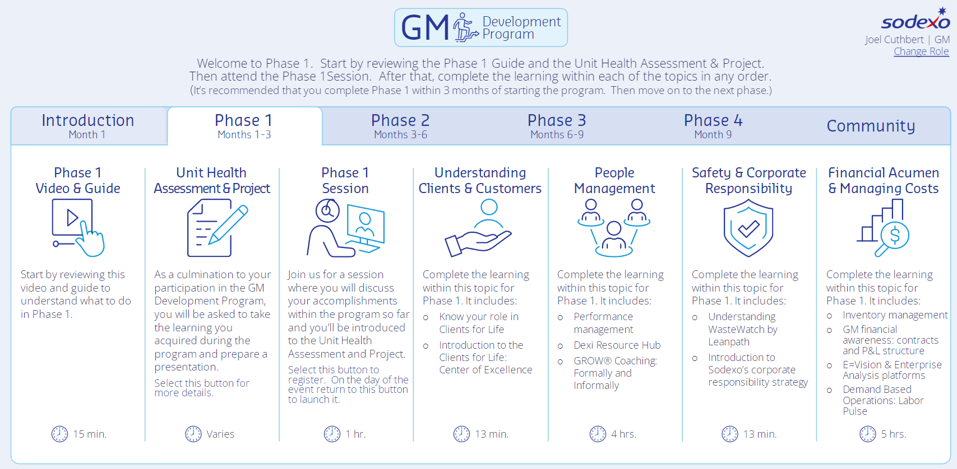
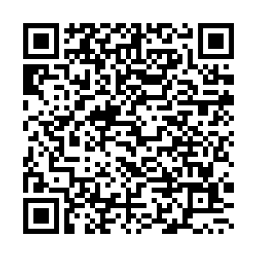
Register for E=Vision and Enterprise Analysis: Platform Reviews on Feb. 27
Join the experts for an in-depth review of the tools used to help you make important financial decisions, including managing your inventory and avoiding waste
Phase 1
Financial Acumen
& Managing Costs
Available to anyone with unit financial responsibilities
Attend an interactive virtual learning experience
Featuring hands-on, instructor-led training
Focused on the E=Vision and Enterprise Analysis tools
Led by Sodexo Finance subject matter experts (SMEs)
Scan the QR code or
search keyword
‘E=Vision’ in Ingenium
Notes:
We think the best way to get to know a new system is by rolling up your sleeves and learning hands on. Doing so with the people who know it best doesn’t hurt either!
That’s why I encourage you to register for the upcoming Feb. 27 E=Vision and Enterprise Analysis: Platform Reviews call.
This training is available through our GM Development Program portal, but open to anyone with unit financial responsibilities.
These are two incredibly important tools that can help you make key financial decisions, , including managing your unit inventory and avoiding waste.
During this 2-hour session, our Sodexo Finance Team members will lead you through an interactive, hands-on training session using the E=Vision and Enterprise Analysis tools and answer any questions you may have.
To get started, scan the QR Code on the screen to get to the GM Development Program portal.
Once you are there, click on the “Phase 1” tab and then select the Financial Acumen & Managing Costs” option at the right of the portal to register.
Or, you can search keyword “E=Vision” in Ingenium to access and register for the course directly.

Slide 14
Finance Shared Services Update
Notes:
Hello everyone, I’m Stephanie VanDusen, head of the Order to Cash function at the Finance Shared Services Center, and I am also part of the core team supporting the optimization of Finance Shared Services & Banking.

Slide 15
Today’s Topics
Finance Shared Services & Banking Optimization
SoFinance
Segment Support Re-Structure

Slide 16
Evolution of Finance Shared Services
Our priorities for FY24-25
Improve How We Support the Segments
Update Workflows & Service Level Agreements (SLAs)
Re-Align the Organization
Prepare for S/4HANA
Document Standard Operating Procedures (SOPs)
Due Diligence for Data Migration
Support Sodexo’s Mergers & Acquisitions (M&A) Priorities
Streamline & Optimize Financial Integration of Acquisitions
Our Goal
Optimize our ability to support NorAm’s operating & financial needs by embracing the global community to which we belong and fully leveraging best practices related to processes, tools, technology and resources to accomplish our objectives.
Engage & Develop Our People
Foster a Sense of Community
Leverage Career Development Resources
Evaluate & Adopt Best Practices
Implement the SoFinance System & Processes
Ensure Work is Completed by the Right Resources in the Right Place
Align With Industry Standards
Improve Internal Controls
Identify an internal controls leader
Foster a strong control environment
Notes:
Stephanie:
I wanted to circle back on the overarching priorities for Finance Shared Services & Banking as a back drop for the updates you will hear today.
On the screen, you can see our priorities for FY24 – 25, and today’s updates relate to the upper right side of the screen: Improving how we support the segments, and the lower left side of the screen: Evaluate & Adopt Best Practices.
Next Slide

Slide 17
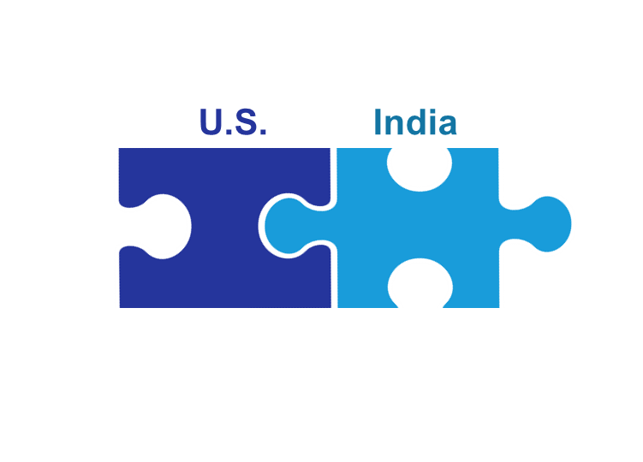
Optimizing Finance Shared Services Support to NorAm
Leveraging Best Practices, Knowledge, Technology & Innovation
End-to-End Service Request Management (Ticketing)
Partnering with Sodexo Business Services in Mumbai
Re-structure NorAm Segment Support Teams to Provide End-to-End Segment Accounting Support
Better Defined Service Level Agreements
Establish One Single Point of Contact per Cost Center
Better Visibility to Status of Inquiries/Requests
Continued NorAm Service Hours & Contact Process
Ongoing Continuous Improvement
We Will Need to Adopt the New Tools & Processes – “Let Go” of the Old Ways
Anticipate & Plan for “Bumps” We Are Bound to Have Along the Way
Notes:
Stephanie:
Michelle Haag joined the Unit Controller call before the holidays and provided an overview of these three key initiatives that are part of our overarching priorities.
I’d like to start with the topic on the right, optimizing global resources, which involves partnering with Sodexo Business Services in Mumbai (or SBS Mumbai) to support NorAm.
Some of you may have seen the recent update that was e-mailed to the finance community and also in the Loop news letter, announcing that we have now “gone live” with this partnership, and our Mumbai colleagues are working independently to complete their assigned work activities. I also want to share that we successfully completed our first close working together as a team.
Things are going well, but we are also working together to smooth out the bumps we’ve identified through the transition and we welcome your feedback and ask for your patience as we all improve together.
Now as part of this, and of all three initiatives you see on the screen, we have a fair degree of employee movement and re-assignment of work within our team. This means that the person you might have a relationship with and who you might reach directly out to might not be the right person to contact any more.
So what does this mean?
It means that you should reach out to the FSS & Banking team using SoFinance if you are contacting one of the functions in the pilot phase (Tony will review who those are in just a few minutes)
And if you are contacting any other FSS & Banking Function, you should use the available shared mailbox until SoFinance becomes available.
If you happen to reach out directly to an individual and receive a note back about how to contact that team moving forward, either with a shared mailbox or a link to SoFinance, please commit to using that method moving forward. This way, your request will get to the correct person as quickly as possible.
In April, when we go live with the rest of the FSS & Banking departments in SoFinance, you’ll be able to go directly there to submit your support request - so we ask for your patience through this transition phase.
Now, related to this topic, our AP team has been fielding quite a few inquiries, so Mark Doboz, head of the Purchase to Pay function at the Finance Shared Services center will provide answers to some of the questions he’s been receiving.
Mark to present
(Stephanie to reinforce in real time that some of the things Mark is mentioning apply across all of FSS)

Slide 18
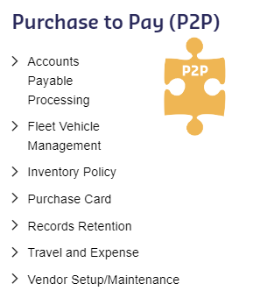
Agenda
Organization
Major Functions
Accomplishments/Challenges
Priorities/Projects
FSS
Purchase to Pay
Work Update
15 February 2024
Notes:
Mark to present
(Stephanie to reinforce in real time that some of the things Mark is mentioning apply across all of FSS)

Slide 19
P2P and Our Partnership with Sodexo Business Services (SBS) Mumbai
Our Goal:
To optimally support our customers with zero impact to vendors and employees
Units will still process invoices via existing methods (TMC, UFS, AP Portal)
Scanning of UFS Invoices & Cash Reporting will be sent to same e–mail boxes
Inventory will be reported via current UFS or TMC process
Travel arrangements will remain on SCOTT and ER submission via Concur
Vendor set-ups will continue to be submitted via e-VAR
Processes Do Not Change:
P2P activities now supported by SBS:
Vendor set up
Invoice processing
Document scanning
EDI enablements
Travel & Expense and Pcard audits
Vendor statement analysis
Analytics & reporting
P2P activities completed in NorAm:
Fleet
Vendor & employee payments
COLD
Inventory
Manual tasks

Slide 20
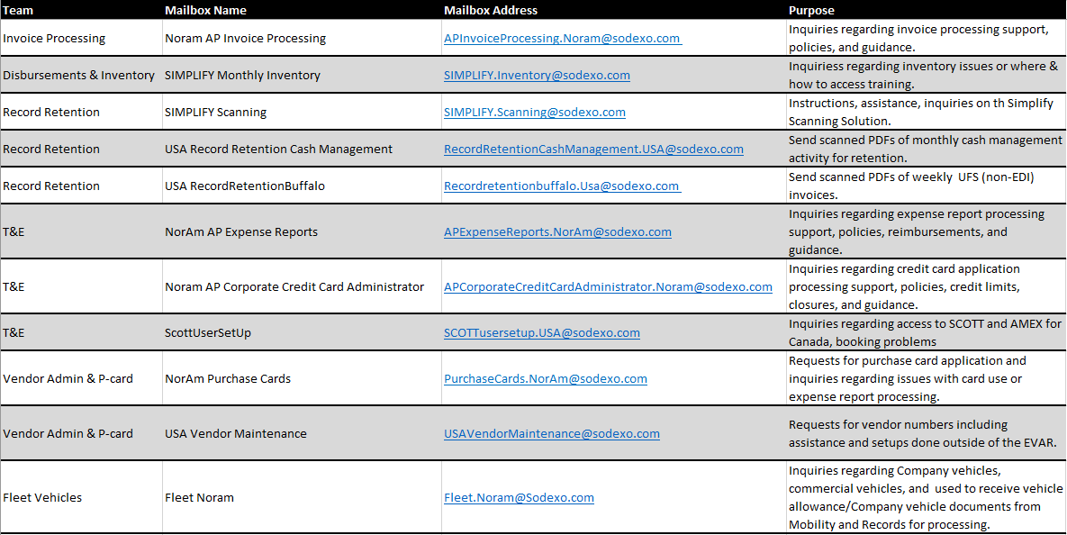
Purchase to Pay Work Shared Mail Boxes
Use until is available for all departments mid April
Use
Now

Slide 21
Optimizing Finance Shared Services Support to NorAm
Leveraging Best Practices, Knowledge, Technology & Innovation
End-to-End Service Request Management (Ticketing)
Partnering with Sodexo Business Services in Mumbai
Re-structure NorAm Segment Support Teams to Provide End-to-End Segment Accounting Support
Better Defined Service Level Agreements
Establish One Single Point of Contact per Cost Center
Better Visibility to Status of Inquiries/Requests
Continued NorAm Service Hours & Contact Process
Ongoing Continuous Improvement
We Will Need to Adopt the New Tools & Processes – “Let Go” of the Old Ways
Anticipate & Plan for “Bumps” We Are Bound to Have Along the Way
Notes:
Stephanie: (may insert this slide again as an intro)
(Stephanie to reinforce in real time that some of the things Mark is mentioning apply across all of FSS)
OK, let’s go on to an update on SoFinance from Tony Priore, who is the business leader for this initiative

Slide 22
SoFinance
Notes:
Tony

Slide 23
Sodexo’s global end-to-end approach to managing inquiries and requests to our Finance Shared Services Center
What is SoFinance?
Why are we implementing SoFinance?
SoFinance is Sodexo’s global end-to-end approach to managing inquiries and requests to our Finance Shared Services Center. (Ticketing system)
Better support to the business by providing a ticketing system where both our Finance Shared Services team and our customers have a clear understanding of service requests and their status.
Communication and workflow supporting those requests will be all in one place instead of having the risk of being lost through e-mail and phone calls.
Data to help us target impactful opportunities to improve financial processes
Our current Heat ticketing system is obsolete and can no longer support our needs.
Who will use SoFinance?
Finance Shared Services and
Our customers in the field
Who will join our colleagues in Europe and APMEA who are already using SoFinance.
Notes:
Explain what SoFinance is
Will launch phase I in December where you’ll experience it the most if you interact with Revenue Accounting, Accounts Receivable, and Banking Administration
Asia Pacific Middle East Africa (FORMALLY KOWN AS APAC)

Slide 24
What was Included in SoFinance Phase I (Pilot)
Accounts Receivable Banking Administration Credit & Collections Management Finance Continuous Improvement & Integrations Revenue Accounting UFS
Phase I (Pilot)
Go Live
December

Slide 25
Where We are Going……
Phase II - Go Live April
R2R - Segment Support
Accountant of Record
R2R – Corporate Activities
Contract Analytics & Reporting
P2P
Internal Controls
Banking
Notes:
Here are the functions included in the first phase of SoFinance, and you’ll hear more about this and what to expect closer to December, when this phase goes live.

Slide 26
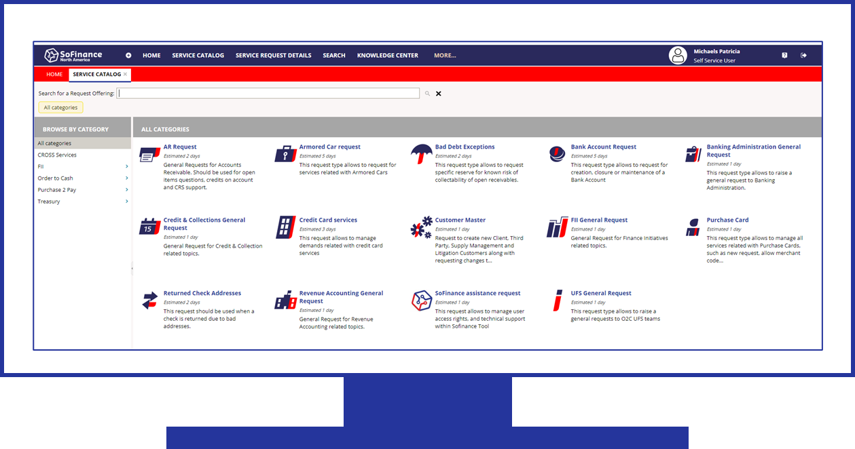
What Does This Mean for You?
 | You will receive an e-mail confirmation of your requests for pilot functions which: Acknowledges your request Provides a ticket number and a link to the SoFinance portal where you can monitor progress on your request.
 | For future correspondence related to a specific service reques: You may reply to the SoFinance email Or add comments directly within the SoFinance portal.
 | You may also continue to contact Finance Shared Services & Banking the way you usually do for new service requests, or You may now use the SoFinance self-service portal to submit a service request for one of the Finance Shared Services & Banking functions included in the Pilot.

Slide 27
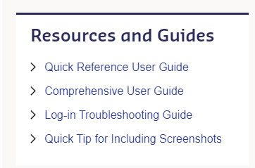
UPDATES
Notes:
What is SoFinance – this is Sodexo’s end-to-end service cloud-based request management system used within our global community of Finance shared service centers.
Who will use SoFinance – everyone in Buffalo (FSS & Banking) and all our customers in the field (GM, Controller, Segment Finance, Chef’s, etc..)
Why – we need it! Continuing down the path of using Outlook is not sustainable. This tool will allow us to provide our customers with a Best Practice experience , so that they have a clear understating on how to request assistance and can clearly see the status of that request.
This technology will capture and track progress and completion of service requests – all the information will be in one place and available to everyone who is supporting an inquiry or the requestor to view the latest and greatest update.
We must drive inquires to the right team on the first try! I cannot express that enough!

Slide 28
As members of the Finance Community:
Take the time to become familiar with SoFinance by using it
Build awareness and encourage your colleagues & business partners to use SoFinance
Share feedback to improve adoption and customer support
Notes:
Tony:

Slide 29
Service Catalog

Slide 30
Questions?

Slide 31
Optimizing Finance Shared Services Support to NorAm
Leveraging Best Practices, Knowledge, Technology & Innovation
End-to-End Service Request Management (Ticketing)
Partnering with Sodexo Business Services in Mumbai
Re-structure NorAm Segment Support Teams to Provide End-to-End Segment Accounting Support
Better Defined Service Level Agreements
Establish One Single Point of Contact per Cost Center
Better Visibility to Status of Inquiries/Requests
Continued NorAm Service Hours & Contact Process
Ongoing Continuous Improvement
We Will Need to Adopt the New Tools & Processes – “Let Go” of the Old Ways
Anticipate & Plan for “Bumps” We Are Bound to Have Along the Way
Notes:
Stephanie: (may insert this slide again as an intro)
Thank you Tony
And finally, Lynn Valentine, head of the Record to Report team focused on Segment Support will provide an update on how things are going with their organizational change

Slide 32
FSS Segment Support
Coming April 9, 2024
Notes:
Lynn

Slide 33
Finance Shared Services Organization
Order to Cash | Record to Report Segment Support | Record to Report Corporate Functions | Internal Controls | Master Data Management | Purchase to Pay | Finance Continuous Improvement & Integrations | Banking
Credit & Collections Management | Client Balance Sheet | Balance Sheet Accounting | Integrated Internal Control | Contracts Management | AP Processing | Finance Initiatives & Integrations | Banking Administration
Revenue Accounting | Operations Accounting | Entity Accounting |  | Contract Analytics & Reporting | Travel & Expense | Finance Process Improvements | Banking & Credit Card Operations
UFS & UIPS Initiatives | Government Accounting | Fixed Assets |  | Contract Compliance | AP Admin Vendor Master P-Card |  | SoGo
Accounts Receivable Mgt. |  |  |  | Contract Acctg. Tech. & Billing | Record Retention |  | Banking Systems
 |  |  |  | Licensing | Fleet Management
 |  |  |  | FSS Administration, Training, Work Instructions | Disbursements & Inventory
Notes:
As a result of this, they have re-structured segment support to become one team by merging Client Balance Sheet, Operations Accounting, and Government Accounting all into one team called Segment Support which you see circled in red here.
The team is still working through this change and is expected to be up and running in January.

Slide 34
Why We’re Making this Change
Segment Support Overview:
Be a better business partner to those we serve by providing a single point of contact
Enable our Segment Support team to be proactive instead of reactive
Provide consistent accounting treatment, analysis, and research for each Segment
Provide KRIs/metrics to identify areas for continuous improvement
Enable employee movement and collaboration within Segment Support, reinforcing opportunities to expand networks, capabilities, and careers

Slide 35
Segment Support Responsibilities
One Team
Provide a Single Point of Contact (SPOC) for All NorAm Contracts … Support problem resolution across FSS, Corporate Controller, FP&R, IT and Operations, to enhance customer service | Provide a | Provide Decision Support for All Segments Related To…
Align with the NorAm Segment Structure…
P&L
Balance Sheet
SG&A Activity
Oversee and Manage the Financial Close Process… Partner with segments, & transversal finance functions Ensure accurate client statements & billing Implement close process enhancements | Manage Contract Amendment Administration… System set-up & updates Client billing Retro adjustments | Oversee & Complete Client Balance Sheet Activities… Oversight, Reconciliation & Review of client contractual balance sheet accounts | Facilitate Compliance … Support the segments to help them comply with accounting policies and reporting procedures | Partner With the Master Data Management (MDM) Team… For procedures & reporting for new business setup, including M&A Technology & support

Slide 36
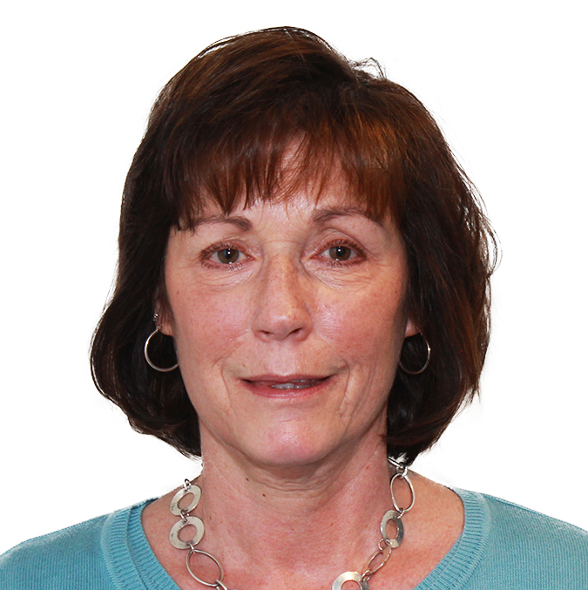
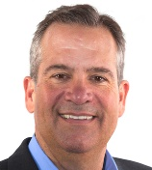
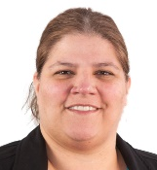
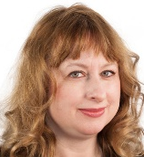
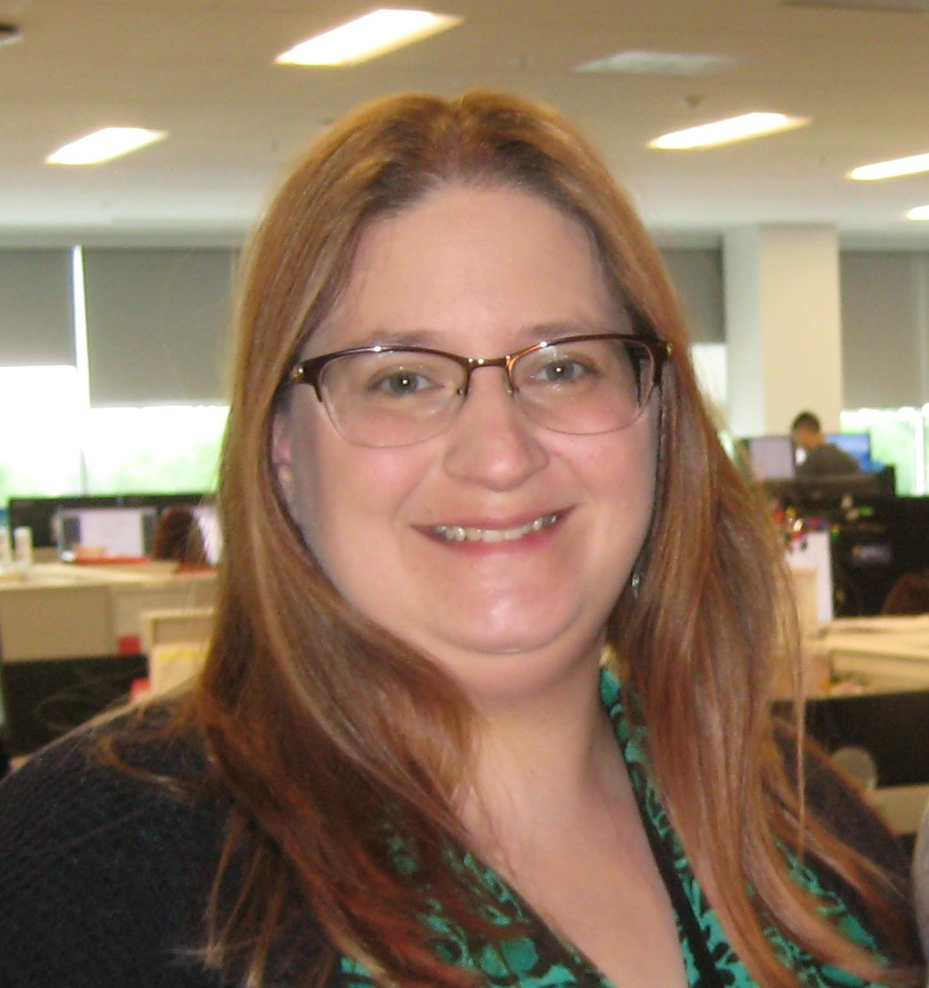
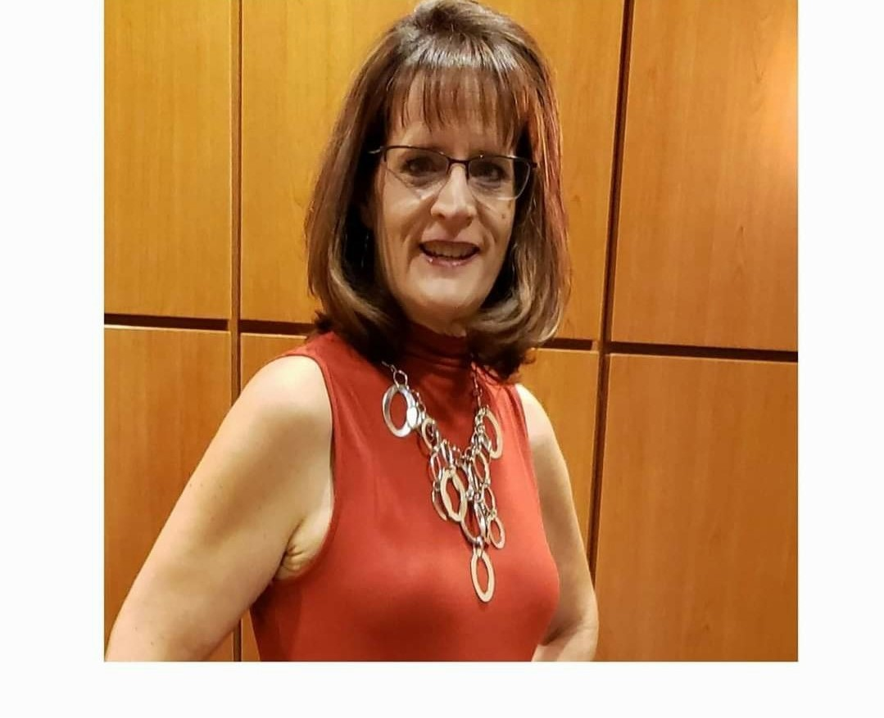
Record to Report (R2R) Segment Support
Lynn Valentine
Sodexo Live!
Airline Lounges
Rob Metzen
Debra Schoenrock
Sue Burns
Lauren Burton
Ann Marie Marbaker
Healthcare,
Senior Living
Campus,
Government
Corp. Services, E&R
Schools
Canada
Kyle Plekan
(Govt)

Slide 37
What Won’t Change |  | What Is Changing
For now, the way you contact Finance Shared Services & Banking for support remains the same You will never need to choose whether to contact the U.S. or India Finance Shared Services support will continue to be provided by Sodexo employees Support is not being outsourced to a 3rd party The accounting fiscal calendar and deadlines don’t change There will continue to be Finance Shared Services & Banking teams in NorAm They will also continue to own and be responsible for NorAm business processes Field customer support business hours remain the same The financial reporting tools you use will remain the same (i.e. UFS, E=Vision etc.) |  | The Segment Support team will provide enhanced capabilities to meet your needs with a dedicated point of contact per cost center You can now use the SoFinance portal to contact Finance Shared Services & to track your service requests for pilot functions, with the rest of FSS & Banking available in April You now receive an e-mail with referencing a ticket for your requests to departments participating in SoFinance pilot (and later for the rest) Service requests to Finance Shared Services & Banking may be routed differently behind the scenes: some to the US and some to India You may work with someone different than the individual(s) you currently work with in Finance Shared Services & Banking
Notes:
ANIMATED SLIDE
Stephanie:
Thank you Tony and Lynn.
So we covered a lot, and I thought we could end with this summary of what won’t change and what will – go through slides - this is very similar the slide Michelle walked you through before
Read What Won’t Change
Click to reveal what is changing - then read those
Thank everyone and be available for questions at the end

Slide 38
Q&A

