Slide 1
FY24 Unit Controller Call Series
December, 2023
We’ll get started momentarily
PLEASE keep lines muted
This call will be recorded
corinne.szabo@sodexo.com
Notes:
Welcome – this call will be recorded. Start recording!
Welcome to the FY24 Unit Controller Network call series!
The purpose of the monthly Controller Network Call is to inform the network group about topics that impact the controller role on a timely schedule.
The topics in this call series address programs/system updates to support change management, drive adoption and finance reporting best practices. Feedback and topic suggestions are always welcome.
Previous call content resources can be found on the UFS launch site, “Controller Corner,” main page, lower right. Content is posted at the conclusion of each call and distributed in chat during the call. Content is available for previous 6 months.
I am CS, w/ Financial Shared Services (FSS), coordinator of the CN call series, and your host for today.
This is the first/second of two calls for the month of December. If you wish to include other team members for this month’s agenda, please forward the meeting invitation for Thursday am. If you would like to invite other members on your team to join the Controller Network Call Series. please send an email to corinne.szabo@sodexo.com. I will add them to the Controller Network Call meeting invite distribution list.
Thank you for joining today. To anyone new to the network – Welcome to the call series.

Slide 2
Agenda
Safety Moment – Tyna Swatek
UFS Collection Letters (Reports) – Corinne Szabo, Jill Helms
MySodexo (MSA) Landing Page – Rebecca Miller
SoFinance Update– Anthony Priore
Special Guest - ? Tuesday only
Q&A
Notes:
Today’s agenda –
To demonstrate our commitment to safety and our safety culture at Sodexo, we begin each meeting with a Safety Moment – I have an open invitation to anyone listening in to volunteer for a future call and present a safety moment. If you’re looking for an opportunity to share a safety experience or learning, or just want to practice presenting, please reach out to me. Today we welcome Tyna Swatek, Unit Controller II, Healthcare, to present our Safety Moment
UFS – Collection letters? I have a quick request around AR Reports within UFS
MySodexo – Rebecca Miller is returning to provide an update on the MSA Landing Page
SoFinance – Tony Priore to provide an update from the introduction of SoFinance last month.
Please use the chat function to submit any questions that you may have as we run through the agenda topics. We will pause to address questions between topics and if we run out of time we will follow up via email.
Finally – feel free to use the Reactions button as we proceed through today’s call. With everyone muted, it is a nice way to contribute and engage and we appreciate the energy.

Slide 3
Safety Moment
Holiday Shopping
Notes:
Tyna Swatek -

Slide 4
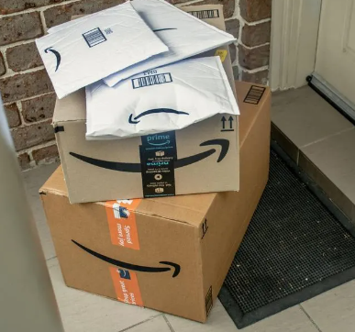
Safety Moment: Holiday Shopping Safety Tips
Keep your purse close to your body or your wallet in an inside coat pocket or front of pants pocket.
Don’t take your money out until asked and avoid carrying a large amount of cash.
Whenever possible do shopping in the daylight.
Be aware of your surroundings and keep car locked.
Get keys out of pocket/purse before leaving the store.
Do not leave package items visible in your vehicle. Place in the trunk or cover up. Once you’re home, make sure you bring them inside with you.
Online shoppers if having packages shipped;
Don’t let your packages sit – Leaving packages on your porch, in your mailbox overnight is an open invitations to thieves.
Signature on delivery – Consider having your packages delivered only when someone can sign for them.
If possible, sign up to receive an email or text message when your package arrives and when it’s actually delivered.

Slide 5
UFS Collection Reports
Notes:
Jill and I are working with our UFS developers to assess usage of some of our UFS reports. Some reports are written in older technology and we need to prioritize which ones are used to rewrite in .NET. We’d like to review a specific report / collection letters, used for collecting on non-contractual invoices…. I’ll take a minute to focus on the collection letters in the AR Tracking function in UFS and I’d like your feedback.

Slide 6
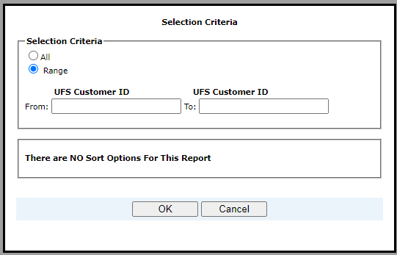
UFS Collection Report – Collection Letters
Notes:
This is for Non-Contractual invoices – Collection letters are included in the Billing Reports option within UFS. Revenues > Billing > Reports
The top screen is the A/R tracking browser within UFS Revenues > Billing > A/R Tracking. UFS lists open and unpaid late invoices in the top browser box on the A/R tracking tab in browse mode. all open and past due invoices are listed for the customer.
(test node view, please ignore dates and descriptions)
From Revenues > Billing > Reports you see collection Letter options – Less than 60 days late, Collection Letter between 60 – 90 days late, and collection letter – More than 90 Days Late. - the PAYMENT TERMS of the customer set up in UFS drives the criteria for the collection letters / reports.
When selecting a report – you have selection criteria you can populate to general all, or by customer range.

Slide 7
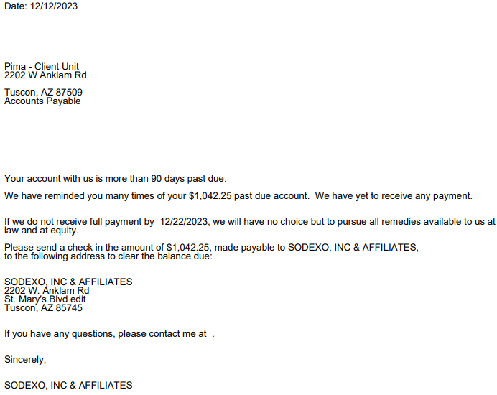
UFS Collection Report
Notes:
Here is a sample of the report – Collection Letter – More than 90 Days Late. the customer info is filled in the letters automatically by UFS,
These letters / reports need to be updated in UFS. nothing transmits from AR Tracking module so it is difficult to assess usage.
We are reviewing reports within UFS to update .NET format – to manage the priority with multiple reports we are assessing the usage to determine if these reports should be updated within the application where the customer data feeds the customer receiver information, or are these report samples sufficient to be published as an open template in the Finance Forms Library on SN. If you ARE Using the collection letter reports in the A/R Tracking function within UFS please let us know in the chat or send an email.

Slide 8
UFS Collection Reports Feedback requested – Are you using the Collection Letters / Reports? UnitFinancialSystemsAdministration.NorAm@sodexo.com
Notes:
We would like your feedback

Slide 9
MySodexoApps (MSA) Landing Page Cloud Migration Project Update
Notes:
Suggested Design Tollgate Attendance (at minimum):
- Business Project Lead
- Technical Project Lead
- IS&T Operations & Infrastructure Lead
- IS&T Information Security Lead
- Business Process Leader (ITSC Representative)
- IT Leader (IT VP)
- Receiver
- Project Sponsor
- Other respective stakeholders (technical / non-technical)

Slide 10
Project Update for MSA Landing Page and Enterprise Portal Suite of Applications
The updated project go-live date is January 8, 2024.
Note: Functionality will remain the same. You will just see a new look on the page:
Current MSA landing page: “New” MSA landing page:
Notes:
Rebecca

Slide 11
Q&A

Slide 12
SoFinance Update

Slide 13
Evolution of NorAm Finance Shared Services
Our priorities for FY24-25
Improve How We Support the Segments
Update Workflows & Service Level Agreements (SLAs)
Re-Align the Organization
Prepare for S/4HANA
Document Standard Operating Procedures (SOPs)
Due Diligence for Data Migration
Support Sodexo’s Mergers & Acquisitions (M&A) Priorities
Streamline & Optimize Financial Integration of Acquisitions
Our Goal
Optimize our ability to support NorAm’s operating & financial needs by embracing the global community to which we belong and fully leveraging best practices related to processes, tools, technology and resources to accomplish our objectives.
Engage & Develop Our People
Foster a Sense of Community
Leverage Career Development Resources
Evaluate & Adopt Best Practices
Implement the SoFinance System & Processes
Ensure Work is Completed by the Right Resources in the Right Place
Align With Industry Standards
Improve Internal Controls
Identify an internal controls leader
Foster a strong control environment
Notes:
Here is the second FSS priority I want to spend some time on
Read the bullets – then start with SoFinance

Slide 14
Sodexo’s global end-to-end approach to managing inquiries and requests to our Finance Shared Services Center
What is SoFinance?
Why are we implementing SoFinance?
SoFinance is Sodexo’s global end-to-end approach to managing inquiries and requests to our Finance Shared Services Center. (Ticketing system)
Better support to the business by providing a ticketing system where both our Finance Shared Services team and our customers have a clear understanding of service requests and their status.
Communication and workflow supporting those requests will be all in one place instead of having the risk of being lost through e-mail and phone calls.
Data to help us target impactful opportunities to improve financial processes
Our current Heat ticketing system is obsolete and can no longer support our needs.
Who will use SoFinance?
Finance Shared Services and
Our customers in the field
Who will join our colleagues in Europe and APMEA who are already using SoFinance.
Notes:
Explain what SoFinance is
Will launch phase I in December where you’ll experience it the most if you interact with Revenue Accounting, Accounts Receivable, and Banking Administration
Asia Pacific Middle East Africa (FORMALLY KOWN AS APAC)

Slide 15
What is Included in SoFinance Phase I (Pilot)
Accounts Receivable Banking & Credit Card Operations Credit & Collections Management Finance Continuous Improvement & Integrations Revenue Accounting UFS & UIPS Any Open Heat Ticket: P-Card & Vendor Administration Banking Bank/Merchant Reconciliation Accounts Payable Processing
Phase I (Pilot)
Go Live
Mid
December

Slide 16
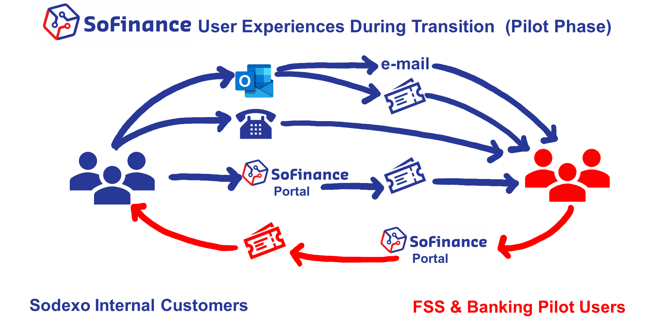
User Experiences During Transition (Pilot Phase)
e-mail
Portal
Portal
Sodexo Internal Customers
FSS & Banking Pilot Users
Today
Pilot & Rest
Goal

Slide 17
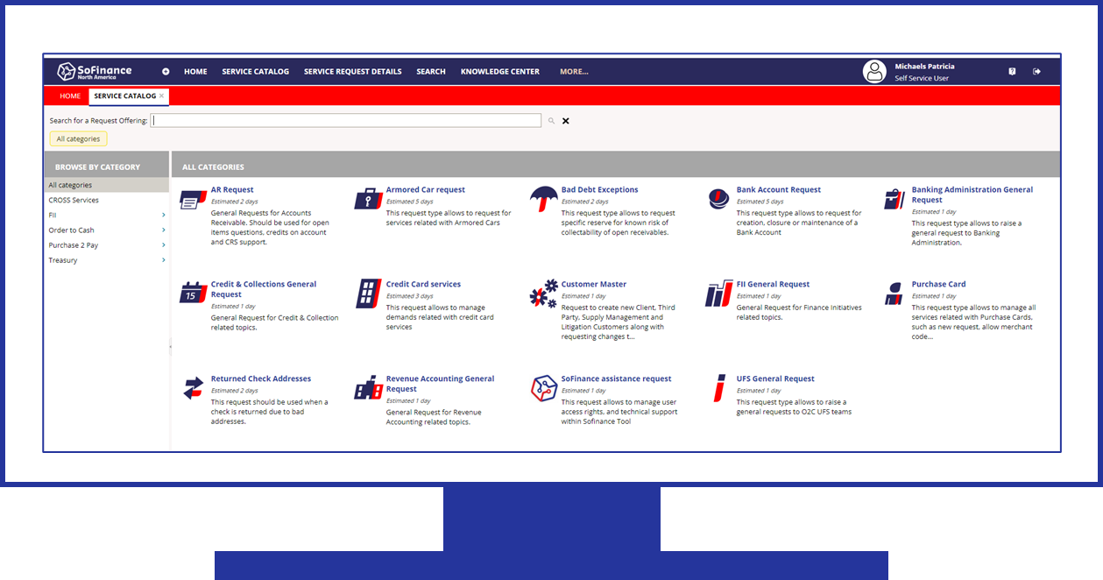
What Does This Mean for You?
 | You will receive an e-mail confirmation of your requests for pilot functions which: Acknowledges your request Provides a ticket number and a link to the SoFinance portal where you can monitor progress on your request.
 | For future correspondence related to a specific service reques: You may reply to the SoFinance email Or add comments directly within the SoFinance portal.
 | You may also continue to contact Finance Shared Services & Banking the way you usually do for new service requests, or You may now use the SoFinance self-service portal to submit a service request for one of the Finance Shared Services & Banking functions included in the Pilot.

Slide 18
What You Can Expect Next
Dec 11th
Nov 13-22nd
April 2024
Hypercare
Pilot Go Live!
Pilot Department Training
UAT Testing
Remaining FSS & Banking Departments Go Live
Build End User Customer Awareness
Notes:
Tony,

Slide 19
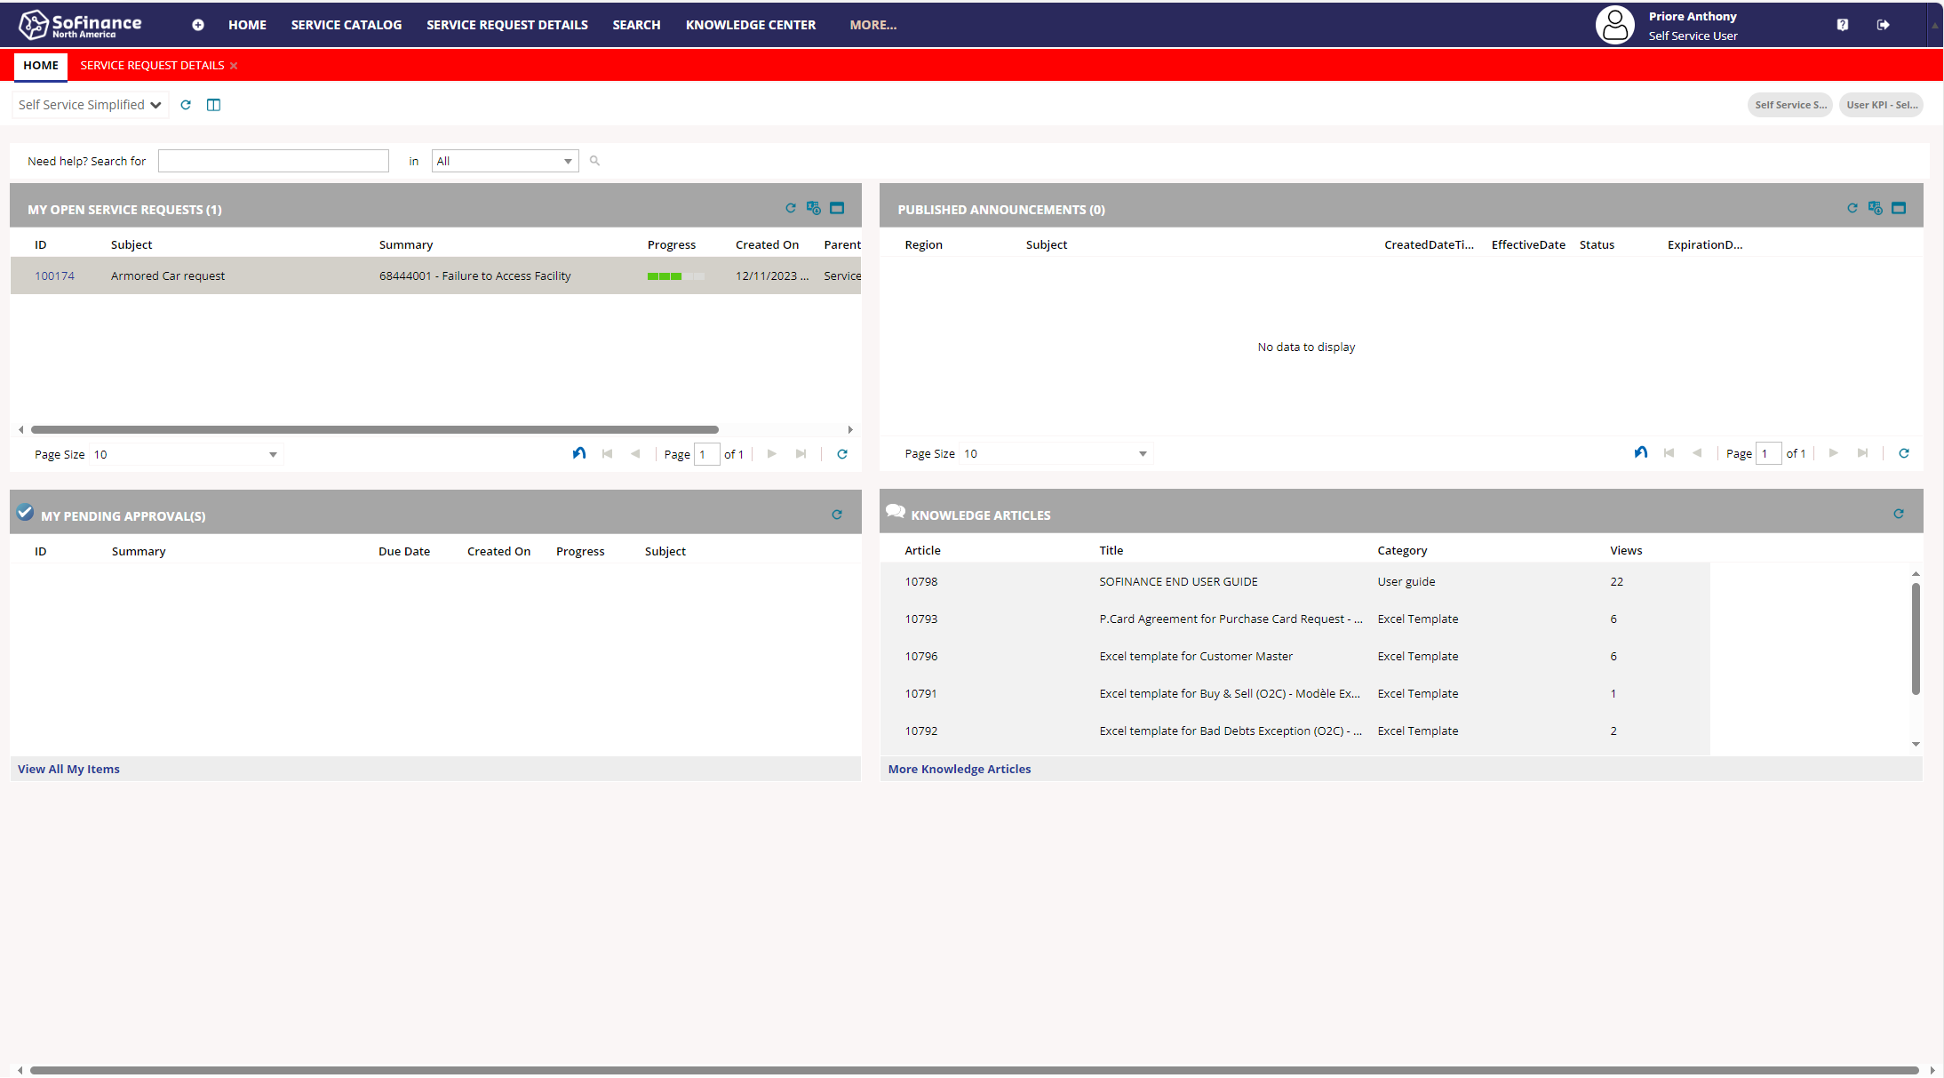
Home Page
Notes:
Tony to take control

Slide 20
Service Catalog
Notes:
Tony to take control

Slide 21
Accessing SoFinance | The link to the SoFinance portal, along with user guides are available here on Sodexo_Net. You can also access SoFinance by clicking on the link included in your service request confirmation e-mail PLEASE NOTE: On the SoFinance landing page, DO NOT enter a user name and password, simply click on “Sign in with G@Tes” to access the portal.

Slide 22
Questions?

Slide 23
Q&A

Slide 24
Thank you

