Slide 1
  FY22 JULY CONTROLLER CALL
  JULY 19 and 20, 2022
  INVENTORY TRAINING and REVIEW
  MARK DOBOSZ

Slide 2
INVENTORY – GIA Audit AREAS OF FOCUS
  Audit covers Inventory included on Sodexo balance sheet
    Sodexo Owned or Client Owned / Sodexo Managed should be separately identified & access restricted to essential staff only
    Training Documents are not signed and retained at Unit
    Unit Inventory Sheets do not match UFS Input values
    Lack of Trend analyses performed on Inventory balances by GM/DM
    Inventory Cost extensions are not consistent with TMC pricing. Non-TMC item costing must match last purchase price
    Segregation of duties note: count team members should not be involved in data entry work for inventory extensions or Inventory summary report.
    Inventory adjustments & transfers are not properly reviewed & documented
  All frontline staff must be provided annual inventory training

Slide 3
INVENTORY FY2022 – What’s New
  Exempt employees required to take Ingenium Training yearly
  GM’s / DM’s must ensure all frontline staff are properly trained using the TOPS inventory training module
    Universities & K-12 should be part of “Back to School” training
    HealthCare should include in monthly training sessions
    New employees involved with taking of inventories should be provided training ASAP
  GM responsible for documenting frontline staff that were included in the TOPS training sessions using the sign-in sheet example provided in TOPS material
  Training sign-in sheets must be kept on premises by GM and available to Auditors as requested

Slide 4
INVENTORY FY2022 – Focus on Training
  Inventory training will be mandatory for all employees involved with the inventory process (counters, writers, GM/DM, recorders)
  Inventory training will be provided to all frontline staff during employee training sessions and also ASAP for all new employees
  Refresher testing every 2 years for all staff
  Revised training materials available on SodexoNet
  Training results to be maintained by Units to be presented to Sr Management/GIA upon request
  Ingenium training for Site Leads to be mandatory
    Knowledge test option in process for FY23
    TOPS modules updated to train frontline staff
    Must ensure all members have taken training and document

Slide 5
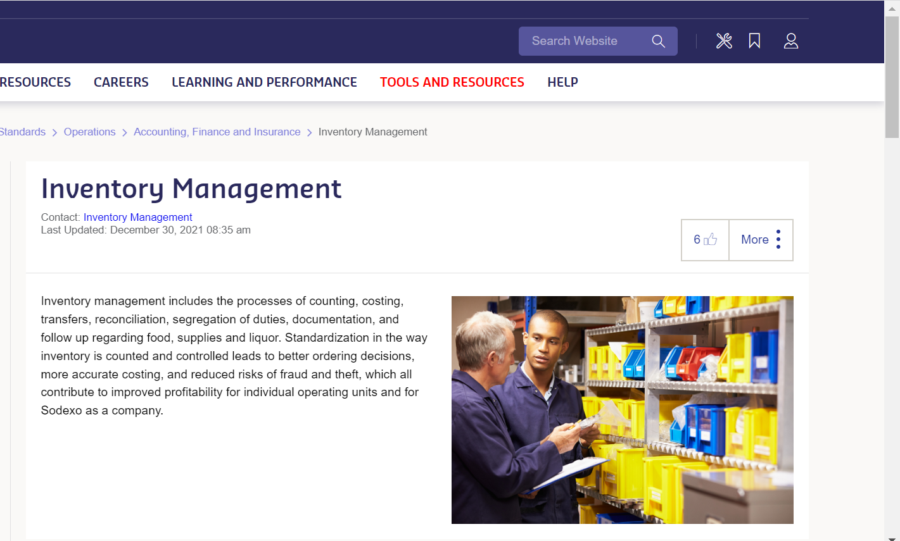
SODEXONET: INVENTORY MANAGEMENT PAGE

Slide 6
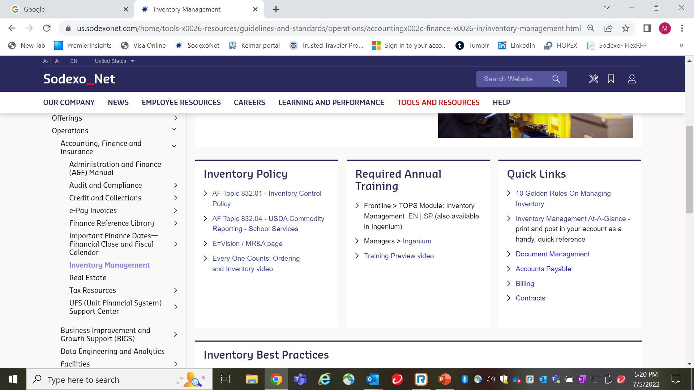

Slide 7
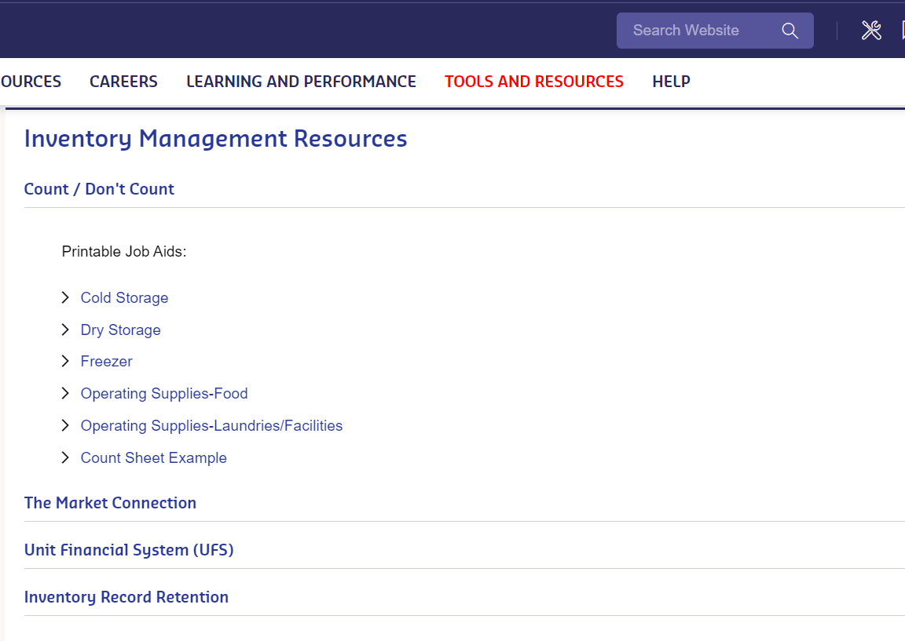

Slide 8
PwC Year-End Inventory Audit
Coming soon…
What:
      PwC Year-End Inventory Audit
      ~20 on-site audits (PwC will be at the unit)
      ~15 desk audits (documentation review only)
      1 surprise on-site audit
    When:
    On-site audits - Wednesday, August 31st
    Desk audits - Thursday, September 1st - Wednesday, September 7th
Who:
All segments – any active unit can be selected for audit
Additional information and opportunities to ask questions:
August Controller Calls on August 16th and 18th
Subject Matter Expert Call(s) – see Year-End Audit Command Center on SodexoNet
YE Audit Command Center open August 25th – September 7th - call 1-347-779-1810

Slide 9
INTERNAL CONTROL / AP CONTACTS
Integrated Internal Control Department (I2C) | Greg Steele 716-428-8563 Bob Borrelli 716-428-8744 Greg.Steele@sodexo.com Robert.Borrelli@sodexo.com Chad Mayerhofer 716-428-8124 Yvonne D’Aloise 716-428-8637 Chad.Mayerhofer@sodexo.com Yvonne.Daloise@sodexo.com
Accounts Payable: Inventory | Mark Dobosz 716-428-8271 Laurie Edgar 716-428-8343 Mark.Dobosz@sodexo.com Laurie.Edgar@sodexo.com

Slide 10
APPENDIX: RESOURCE INFORMATION
Pg 10, 11: Inventory Best Practices
Pg 12-17: UFS Transfer Module
Pg 18-20: Month-End Corrections:
  Pg 19 = Sodexo Owned Inventory
  Pg 20 = Client Owned Inventory
Pg 21-24: :Trend Analysis using Enterprise Analysis

Slide 11
INVENTORY AUDIT – Monthly Inventory Best Practices
  Make sure that the inventory is taken with respect to your sites knowledge of food receipts being delivered & sales YTG
    P6 and P12 +> MUST take inventory on last day of the month, preferably after last meal served
    All other inventories can be counted within last 4 days of the month-end
    Some operating Segments may have more strict guidance on when to take inventories based on thei business models. Please follow those guidelines if they apply to your business.
  Ensure that all inventory sheets are signed by both the counter and the recorder (must be different for Segregation controls).
  Have a copy of the Inventory Policy and 10 Golden rules available on-site for easy and quick reference
  Ensure that items not to be counted are clearly identified and segregated
  Ensure pricing of inventory is consistent with TMC costs

Slide 12
INVENTORY AUDIT – Best Practices (Continued)
  Review inventory results against prior financial results by using data and KPI’s identified in e-Vision:
    Examine trends of COGS % to Revenue
    Review DoH (Days on Hand) calculation and inventory value trends
    Review trend results with site Management to understand fluctuations and reasons
  Obsolete, spoiled, and damaged inventory should be clearly identified and separated from inventory
  GM to ensure that inventory count sheets are properly costed and values are accurately recorded on UFS
  Work with your RDM to obtain support staff to take inventory so that you can meet “Segregation of Duty” requirements

Slide 13
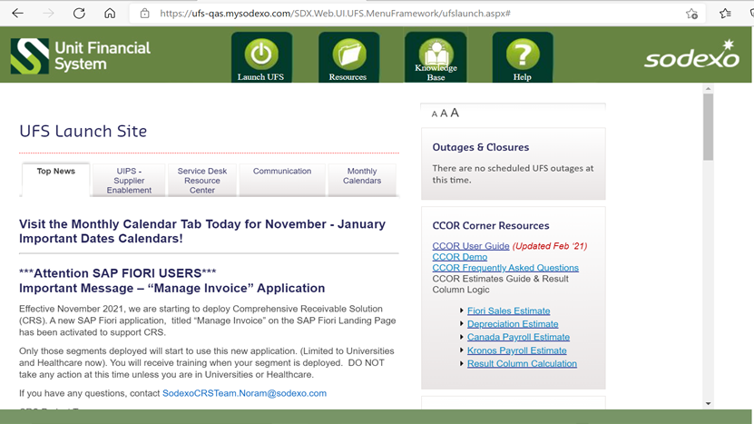
UFS INVENTORY TRANSFER MODULE

Slide 14
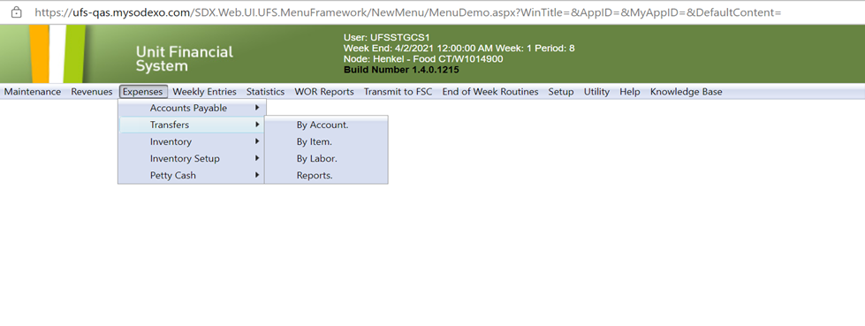
INVENTORY TRANSFER OPTION

Slide 15
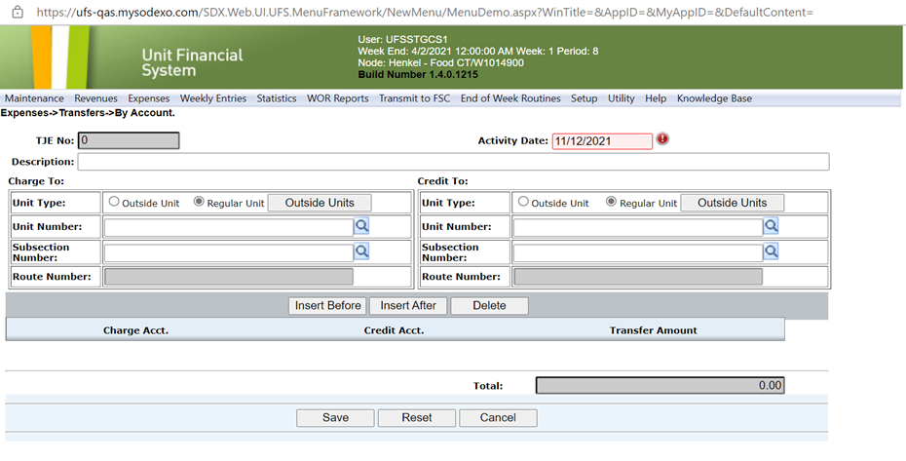
Inventory Transfers by “Account”

Slide 16
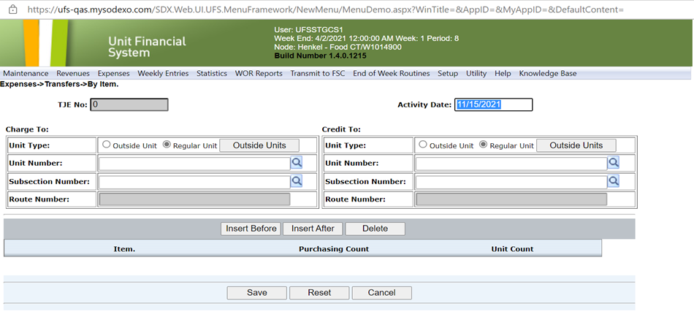
Inventory Transfers by “Item”
“ROUTE NUMBER” used by Vending Units only

Slide 17
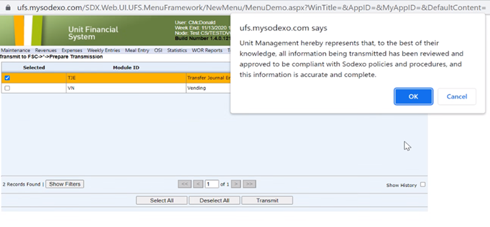
JE Submission & Confirmation receipt

Slide 18
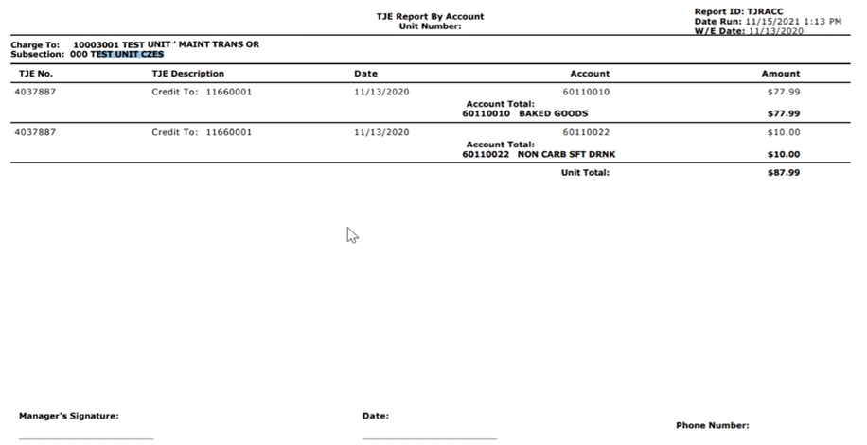
JE Details
Signed JE and backup details should be held by the Unit for audit review as needed

Slide 19
Month-End Inventory Corrections
See FSS AF TOPIC 821-01: “Transfers Cost & Non-Employee Labor”
Identifies rules for cost transfers (communication & approval, timing, U2U xfers, Direct vs O/H units, etc)
Excel based form with separate tabs for each area of correction (form includes tabs for other corrections as well)
Available on SodexoNet or from your OA
Used for correcting month-end balances only after final transmission has been sent into SAP (typically BD+2 or early BD+3)
Work with OA ClientAccounting.NorAm@sodexo.com as needed to help with filling out the form if necessary

Slide 20
Std Close Adj Form: SDX Owned Inventory adjustment
“Prelim Ending Inv Amount” is the amount shown on Financial reports (DFAV, CCOR, CRED).
Commodities are also adj for ending inventory amount
Ensure that all Inventory is costed at latest UFS cost w/o mark-up
Should only be used after last w/e inventory was transmitted
to SAP
Example shown is a small sample of the entire Excel file
Back-up for the inventory Xfer or adj should be held at the Unit for future audit as needed

Slide 21
Std Close Adj Form: CLIENT Owned Inventory Adjustment
Cannot Xfer Commodity inventory from 1 cost center to another.
Unlike Sdx owned inv, this tab corrects the reported “variance” in GL accounts from P-A to P-B
Form to be used only after final inventory transmission sent in SAP
All Back-up details are to be kept by the Unit to support audits as needed
Example shown is a small example of the full form

Slide 22
Inventory Trend Analysis – Accessing the Enterprise Tool
GIA observation: Sites reporting inventory values without review of results or trends:
SodexoNet
E=nterprise Analysis Resource Center (icon – page 2)
Management Reporting & Analysis (Finance Link in Right Hand margin)
Everything E = vision
Access E = Vision
Welcome to E=Vision (see next slide)

Slide 23
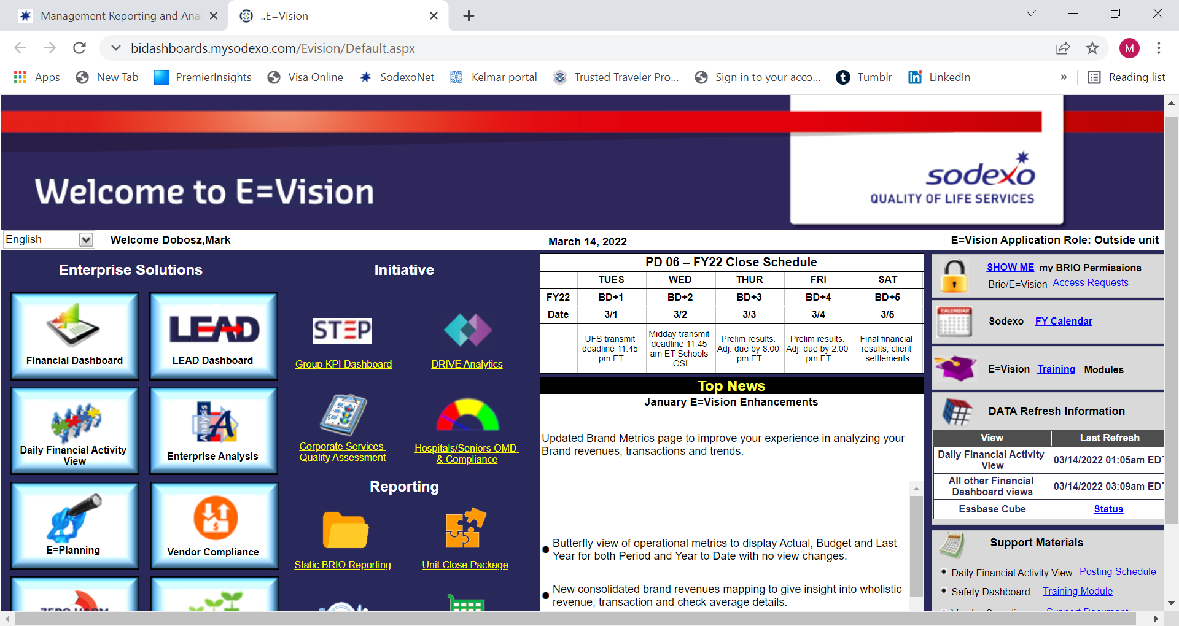
Inventory Trend Analysis (con’t)
Click on “Financial Dashboard”

Slide 24
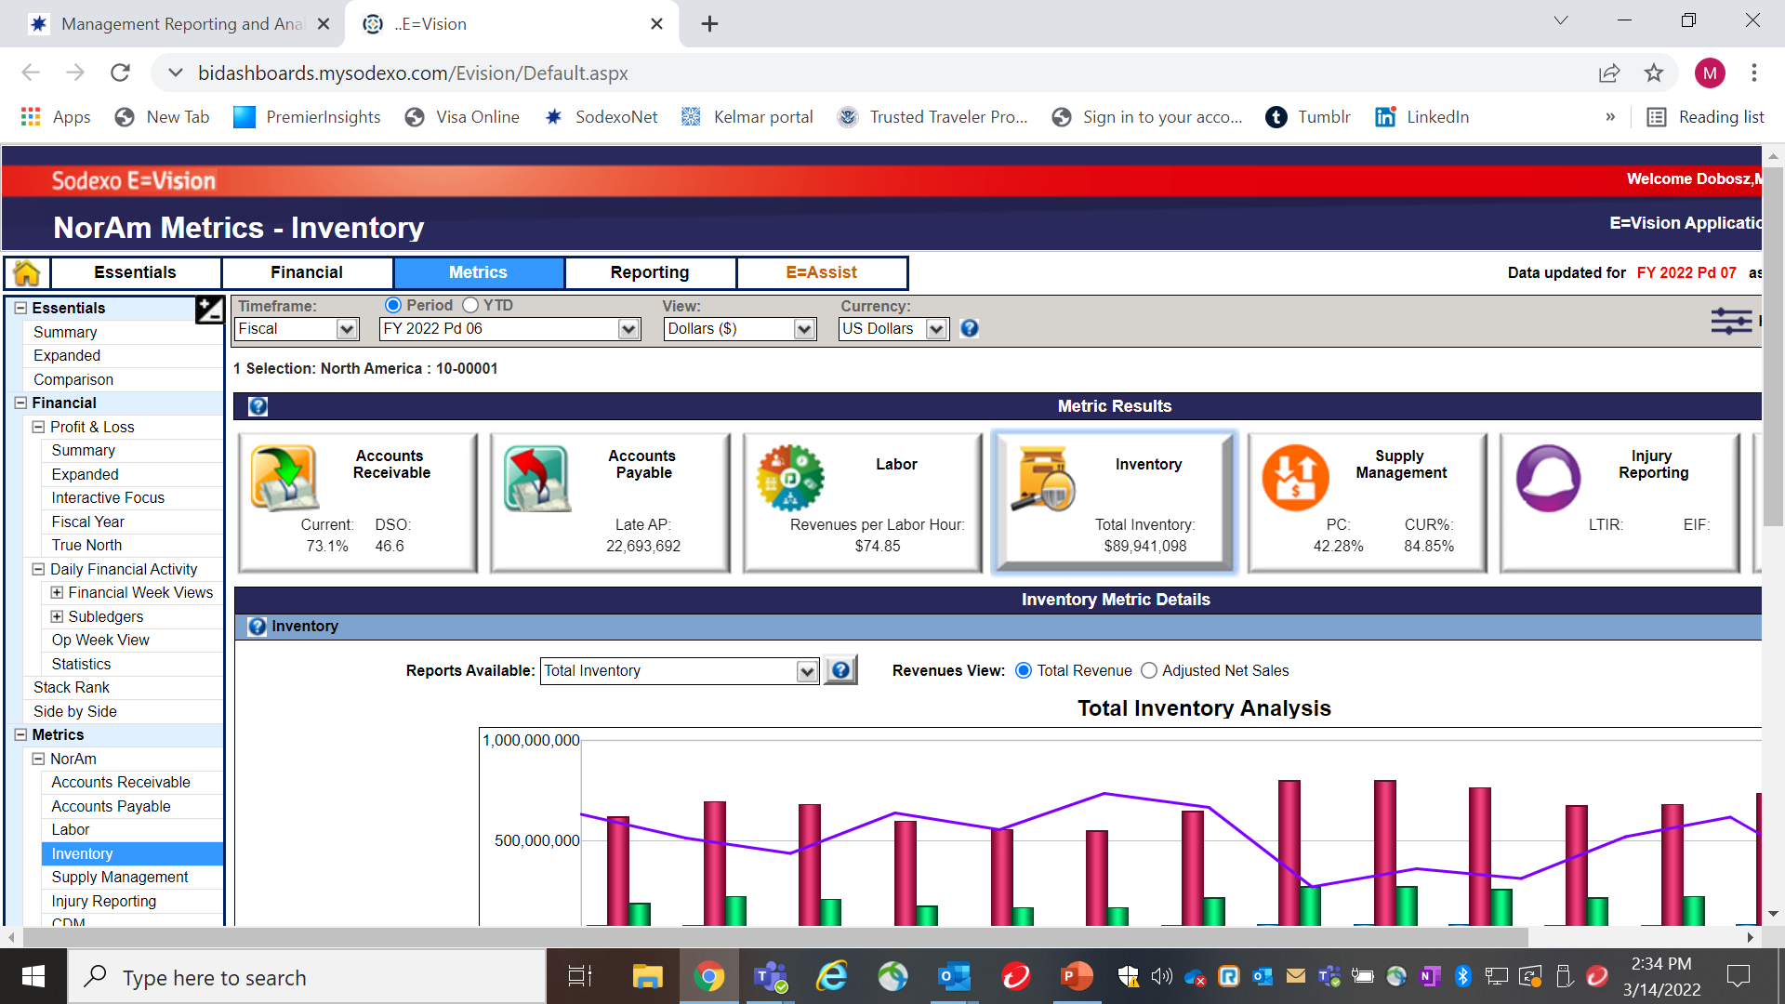
Inventory Trend Analysis (con’t)
Click on “Inventory” & update hierarchy if needed

Slide 25
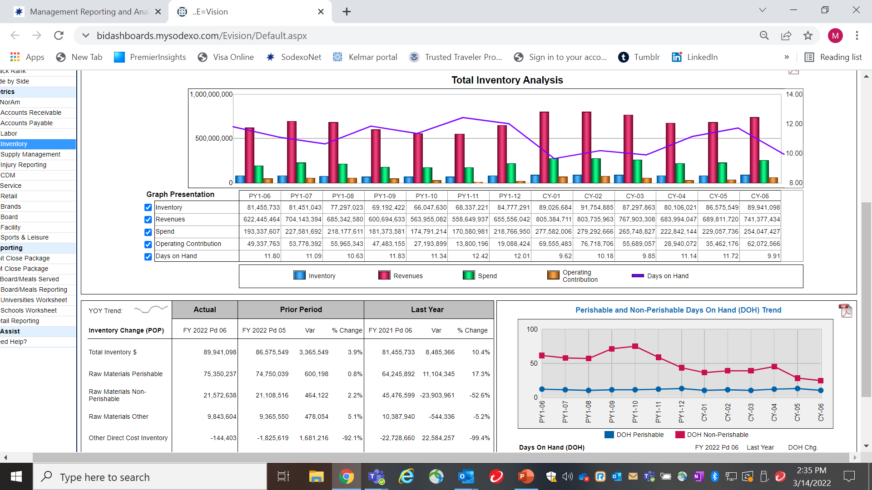
Inventory Trend Alanysis (Con’t)

