Slide 1
FY22 Unit Controller Call Series
    November 2021
We’ll get started momentarily
PLEASE keep lines muted
Notes:
Welcome the FY22 Controller Call Series call. this call series –
*created by unit controllers and supported by Finance to review topics and inform the Controller Network about timely topics that impact the controller role.
I am CS, w/ Financial Shared Services (FSS), coordinator of the CN call series, and your host for today.
To anyone new to Network - *Welcome to this call series.
Our DL for this call series has been updated in Sept to include everyone with a “Controller” title role (US). To invite others from your team to the network, send me an email to add to the DL, or simply forward invites for topics that benefit your team.

Slide 2
Agenda
Safety Moment - Jill Helms
UFS – SAP Fiori Link - Jill Helms
Inventory Transfers and Corrections - Mark Dobosz
Cash Deposit Decoupling - Jason Mazurkiewicz / Brittany Pavlovic
Metric Reporting in EV - Susan Chapman
Questions
Notes:
Today’s call is the first/second of two Unit Controller Calls for the month of November. The content of both calls is the same.
Please submit any questions you may have as we roll through the agenda. We will pause at the end of each topic to address questions. If we run out of time and do not address your question on the call, we will follow up with you via email. Please be sure to include your full name on any critical questions so we are able to respond to you via email, if necessary.
As employees of Sodexo, no matter what level, you are expected to personally demonstrate your commitment to improving our health and safety culture. Our goal is zero accidents. A Safety Moment during every meeting will demonstrate the importance of the health and safety culture at Sodexo.

Slide 3
Safety Moment
Holiday Safety Tips

Slide 4



Tips to Protect You and Your Home During the Holidays
Holiday Theft: Theft overall tends to rise in the months of November and December. Lock up your vehicles and home. Make sure not to run extension cords through windows or garage doors.
Leave the Lights on: Thieves usually don’t approach homes that appear to be occupied. Leave on outside lights at night. Leave on lights inside the home to give the appearance that someone is home.
Package Delivery: More and more people are purchasing gifts online and having them shipped to their home. With this trend more people are falling victim to porch pirates. If you are expecting packages, request signature confirmation or have a trusted neighbor hold on to it for you.
Cooking Hazards: A fried turkey is DELICIOUS. A fried house due to a deep fryer accident is NOT. Make sure you read the instructions on how to prepare your turkey safely and please use the deep fryer OUTSIDE.
Decoration Hazards: Christmas tree fires can be devastating for what is normally such a beacon of happiness. If you have a live tree, make sure that it has water every day, and ensure that any lights you use are checked for breaks or exposed wires.
Social Media: Be careful about what you share on social media. If you share your gifts received, be sure your location is not tagged in the post. If you are traveling to visit family or going on a holiday vacation, wait until after your trip to post about it.
4
November 2021 – Safety Moment
Notes:
Holiday Theft: Theft overall tends to rise in the months of November and December. Best thing to do is make sure you secure everything you can. Lock up your vehicles and home. Make sure not to run extension cords through windows or garage doors. Just the slightest crack can expose a home to thieves.
Leave the Lights on: Thieves usually don’t approach homes that appear to be occupied. Leave on outside lights at night or set them with a timer. Leave on lights inside the home to give the appearance that someone is home.
Package Delivery: More and more people are purchasing gifts online and having them shipped to their home. With this trend more people are falling victim to porch pirates. If you are expecting packages, request signature confirmation or have a trusted neighbor hold on to it for you.
Cooking Hazards: A fried turkey is DELICIOUS. A fried house due to a deep fryer accident is NOT. Make sure you read the instructions on how to prepare your turkey safely and please use the deep fryer OUTSIDE.
Decoration Hazards: Speaking of fires, Christmas tree fires can be devastating for what is normally such a beacon of happiness. If you have a live tree, make sure that it has water every day, and ensure that any lights you use are checked for breaks or exposed wires.
Creative Disposal: Dispose of your gift boxes creatively. Try and break down boxes and other packaging as to not give away the wonderful gifts your family received.
Social Media: Be careful about what you share on social media. If you share your gifts received, be sure your location is not tagged in the post. If you are traveling to visit family or going on a holiday vacation, wait until after your trip to post about it.

Slide 5
UFS Update
SAP Fiori Menu

Slide 6
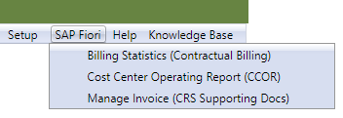
UFS Update
NEW
With the November UFS Updates, an SAP Fiori menu with application submenus will be installed. Depending on the UFS Version you use, the submenus you see will vary.
Health Care, Universities and Canada ONLY:
  Billing Statistics (Contractual Billing)
All Versions:
  Cost Center Operating Report (CCOR)
  Manage Invoice (CRS Supporting Docs)
The “Manage Invoice” submenu is part of the Comprehensive Receivable Solution (CRS) being deployed beginning this month. Only those segments deployed will start to use the new application. You will receive training when your segment is deployed.
6
November 2021 – UFS Update
Notes:
SAP Fiori menu item added to the UFS application header for all users!!!

Slide 7
November 2021 Controller Calls
Proper recording of Inventory Transfers and Corrections
November 16 & 18, 2021

Slide 8
GIA INVENTORY AUDIT FINDINGS
8
November 2021 - Inventory

Slide 9
Inventory Transfer Overview
Inventory practices vary across Segments: Timing, Product, Costing, Transfers, Storage Areas, Staff, DRIVE vs Non-DRIVE
Group Internal Audit (GIA) identified this as an area of concern in previous audits
Inventory transfers can occur between cost centers, concession stands, or food groups (G/L accounts) within a cost center
Inventory Policy (AF 832-01) is silent on the transfer process, so Segments have devised their own processes/procedures
Focus will be on the following 3 types of Inventory Activity:
  A) Concession Stand Transfers
  B) Unit to Unit adjustments/Transfers
  C) Final Month-End Financial Sheet Adjustments
9
November 2021 - Inventory

Slide 10
Concession Stand Transfers
Refer to AF 711-18 for proper reporting of Sales & Cash Receipts for Units that utilize Non-Profit Organizations (NPO)
  This typically applies to Universities & S&L Segment activity
  Inventory Management (in/out) must be carefully controlled
  Inventory transfers to/from each stand must be recorded on an “Inventory Transfer Sheet” (ITS) or other electronic means
  ITS must identify the transferred items: Name, Qty, To/From location, and Cost
  Cost of Inventory transfer should be at product purchase price
  ITS must be signed by both parties in the transfer (To/From)
  A copy is to be kept by both parties
  ITS must be completed in ink
  Units use the form & input data into UFS for the transfer
10
November 2021 - Inventory

Slide 11
INVENTORY TRANSFER SHEET (example)
11
November 2021 - Inventory

Slide 12
Unit-to-Unit Inventory Transfers
Historically, this was accomplished using form 119-05, but is now obsolete
U2U Inventory transfers are to be done via the UFS module
Units can transfer to another Unit by “Account” or by “Item Number”
You cannot transfer commodity inventory from U2U; only GL accounts
  But these transfers should be rare
Xfer of costs should be based on the most recent UFS purchase price of items being transferred
Xfers via UFS are transmitted hourly to SAP in a “batch-mode”
Receiving Unit is notified of Xfer. Xfer data appears in CCOR reports
XFERS in SAP identified by various “record types”:
  Type #22 = Transfer JE
  Type #23 = JE of Sodexo Owned Inventory
  Type #24 = JE of Client Owned Inventory
12
November 2021 - Inventory

Slide 13
FORM 119-05: OBSOLETE…..USE UFS Transfer Module
13
November 2021 - Inventory

Slide 14
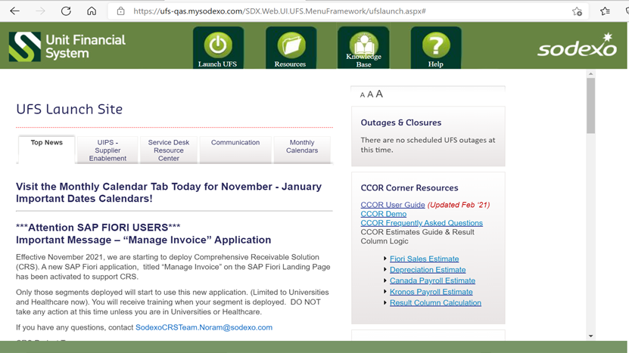
UFS Inventory Transfer Module
14
November 2021 - Inventory

Slide 15
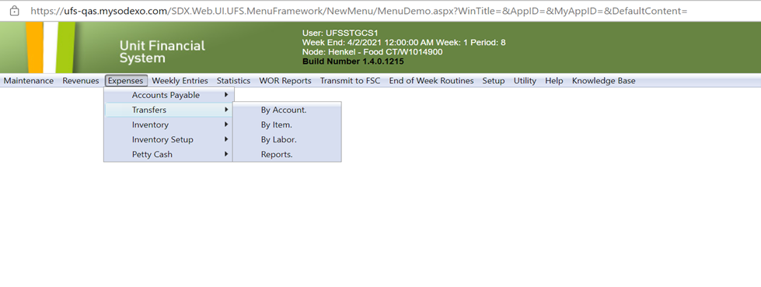
Inventory Transfer Option
15
November 2021 - Inventory

Slide 16
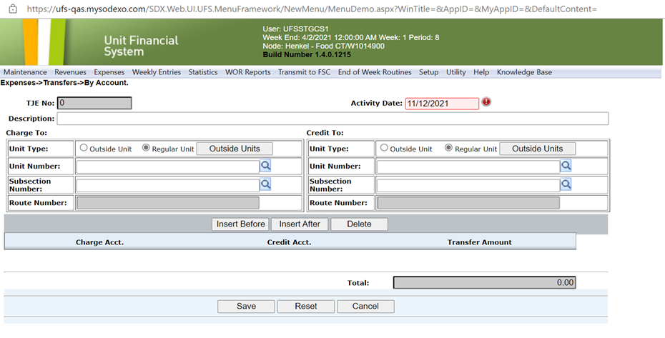
Inventory Transfers by “Account”
16
November 2021 - Inventory

Slide 17
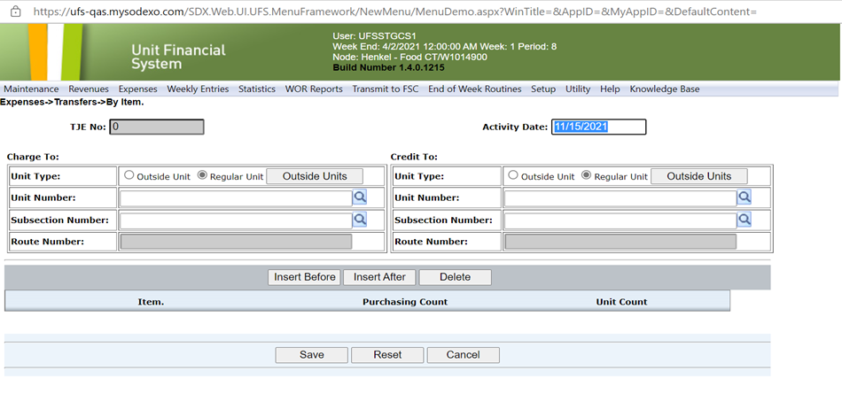
Inventory Transfers by “Item”
“ROUTE NUMBER” used by Vending Units only
17
November 2021 - Inventory

Slide 18
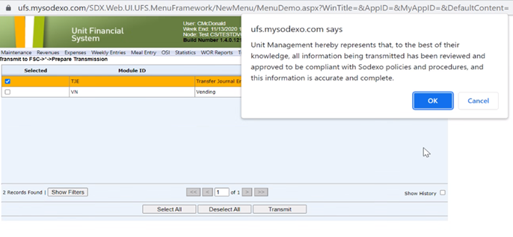
JE Submission & Confirmation receipt
18
November 2021 - Inventory

Slide 19
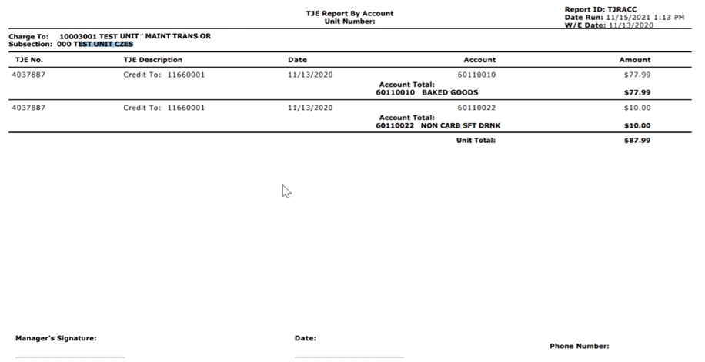
JE Details
Signed JE and backup details should be held by the Unit for audit review as needed
19
November 2021 - Inventory

Slide 20
Month-End Inventory Corrections
See FSS AF TOPIC 821-01: “Transfers Cost & Non-Employee Labor”
Identifies rules for cost transfers (communication & approval, timing, U2U xfers, Direct vs O/H units, etc.)
Excel based form with separate tabs for each area of correction (form includes tabs for other corrections as well)
Available on Sodexo_Net or from your OA
Used for correcting month-end balances only after final transmission has been sent into SAP (typically BD+2 or early BD+3)
Work with OA ClientAccounting.NorAm@sodexo.com as needed to help with filling out the form if necessary
20
November 2021 - Inventory

Slide 21
Std Close Adj Form: SDX Owned Inventory adjustment
“Prelim Ending Inv Amount” is the amount shown on Financial reports (DFAV, CCOR, CRED).
Commodities are also adj for ending inventory amount
Ensure that all Inventory is costed at latest UFS cost w/o mark-up
Should only be used after last w/e inventory was transmitted
to SAP
Example shown is a small sample of the entire Excel file
Back-up for the inventory Xfer or adj should be held at the Unit for future audit as needed
21
November 2021 - Inventory

Slide 22
Std Close Adj Form: CLIENT Owned Inventory Adjustment
Cannot Xfer Commodity inventory from 1 cost center to another.
Unlike Sdx owned inv, this tab corrects the reported “variance” in GL accounts from P-A to P-B
Form to be used only after final inventory transmission sent in SAP
All Back-up details are to be kept by the Unit to support audits as needed
Example shown is a small example of the full form
22
November 2021 - Inventory

Slide 23
UFS Cash Deposit Decoupling

Slide 24

What is UFS Cash Decoupling?
UFS allows user to transmit a Cash Management entry without the entry requiring a bank deposit. Multiple days cash may now be bundled to one bank deposit. All cash entries for the week must be deposited to the bank prior to performing a new week setup.

Slide 25


Why is decoupling cash from Daily UFS cash management transmission important?
#1 Bank Service Fee Impact
    Main driver for bank service fees are the number of bank deposits and the cost of coin orders
    Cash decoupling allows you to reduce bank service fees by up to 50%
  More Benefits
    Reduce the number of bank deposits
    Take back your time by reducing the trips to the bank each week
    Efficiently using cash on hand
    Recycle small bills and coin with your unit fund in order to deposit mainly large bills
    Allows to reduce frequency and amount of coin orders

Slide 26

UFS Cash Decoupling Details
  Transmit Cash Management entry without the entry requiring a bank deposit.
  Daily Cash Receipts not yet deposited must be stored in the
  safe apart from unit fund and included on the safe log.
  Stub weeks continue to be treated as a separate week.
All cash entries must be attached to a deposit prior to performing a new week setup.
All deposits and deposit over/shorts will be included in the cash management report

Slide 27

UFS Deposit Over/Short Functionality
  If a UFS Deposit Overage exists, soft error message appears:
    “Did you select all of your cash entries?”
    Common causes; Erroneously depositing of the unit fund or Sales not reported
      If a UFS Deposit Shortage exists, soft error message appears:
    “Are you sure you want to report a deposit shortage of $xx. Please check your deposit ticket amount(s) and the deposit amounts in the cash entries for the week. If you have already transmitted an error, please contact NorAm Revenue Accounting.”
    Common causes; Not depositing all cash receipts, Safe Theft, Miscounting of Cashier Reconciliation, or Erroneous Cash Entry
All Deposit over/shorts require user to select a deposit over/short reason.

Slide 28


Eligibility Requirements
Most Units will meet one of the two qualifying criteria to decouple deposits
  For cost centers with Armored Car Service: The number of deposits prepared should agree with the number of scheduled pickups contracted with the armored car service provider.
  For cost centers who utilize Bank Branch deposits: All cash receipts collected must be deposited weekly. The number of deposits and timing per week is such that on average, no more than $2,000 cash receipts to remain overnight at the cost center.
  An additional deposit may be required to adhere to UFS new week setup timing.
  Based on cash volume, some cost centers will continue
  to prepare and deposit cash daily.

Slide 29
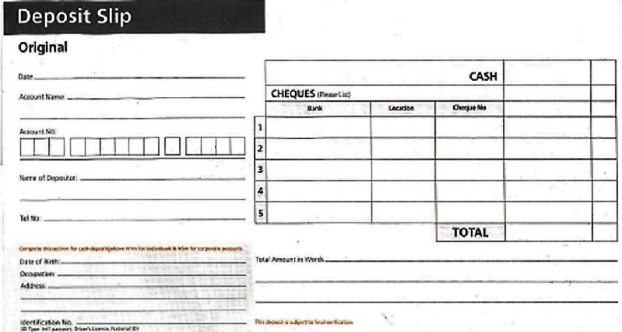
Important Reminders
It is important to transmit cash daily
It is important to report deposit in UFS when deposited into the bank
All float amount have to be deposited on a weekend even if an armored car pickup is not until the following week
All deposits must be ready and prepared in advance for schedule armored car pickups
This Photo by Unknown Author is licensed under CC BY-SA

Slide 30
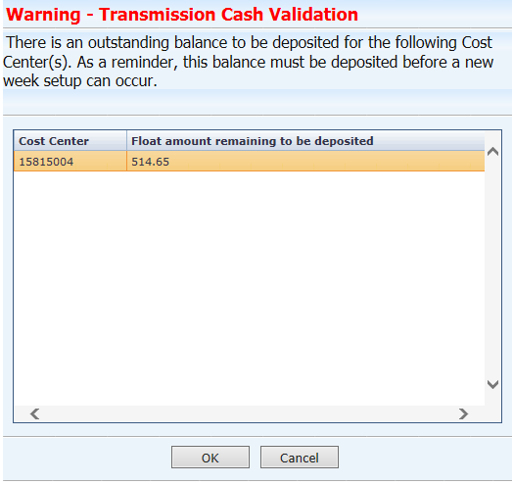
UFS Reminder – New Week Setup Not Deposited

Slide 31
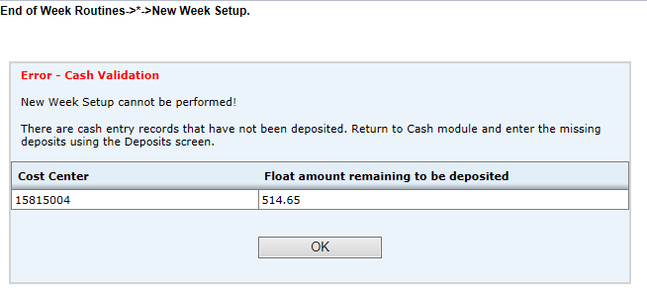
UFS Reminder – New week setup error: Cash entries not deposited

Slide 32

Contact information
Revenue Accounting 1-800-828-7762, option 2, option1 revenuereportingcompliance.Noram@sodexo.com
Banking Operations 1-800-828-7762, option 5, option 2
banking.Noram@Sodexo.com
Training and Research Material:
Open Forum Calls
FAQ document
UFS Work Instructions

Slide 33

Metric Reporting
    November 2021

Slide 34
What Can E=Vision Do for Me?
Essentials
Summary: Closed period reporting in a scorecard format
Comparison: Key financial and operational metrics for selected hierarchy and next level down comparison reporting
Financial
Profit & Loss: Profit and Loss reporting based on your SAP reported financials
Daily Financial Activity: Daily financial information to the GL with supporting SAP details and statistics
Metrics
North America: Key operational metrics (AR, AP, Labor, Inventory, Supply Management & Injury Reporting) for all divisions
Service: Key performance indicators based on the services provided (Retail, Brand, Board, Facility and Sports & Leisure)
Stack Rank: Rank your units on identified key metrics
Side by Side: Comparison reporting based on attributes within your division
Reporting
Unit Reporting Package: Single click access to key unit operator reports
DM Reporting Package: Single click access to key DM Reports
Expanded: Includes current period graphics and expanded fiscal year detail
Service Metric Reporting: Single click access to level down reporting on key financials and metrics for retail and board

Slide 35
Reporting Uses Statistics Entered Using UFS
Transactional Statistics entered with Cash Reporting
  Transaction statistics entered by type of transaction (i.e. Starbucks vs Café)
  Impacts: Check Average, Transactions per Labor Hour, Cost per Transaction
Population Statistics entered by all divisions but University US
  Population
  Impacts: Participation
Facility Statistics entered monthly by all divisions but University US
  Square Footage, Cleanable Sq Footage, Acreage, Population
  Impacts: Cost and Labor calculations per Square Foot / Cleanable Square Foot / Acre / Population
Meals Served Statistics entered by all divisions but University US, Schools, Hospitals and Seniors
  #Total Meal Count (9999.7466), #Other Meals (9999.7424), #Box Meals (9999.4086) entered via UFS
  Schools entered via OSI, Universities entered via Measures, Hospitals/Seniors entered via OMD
  Impacts: Meals Served, Revenues per Meal, UOP per Meal, Cost per Meal, Meals per Labor Hr

Slide 36
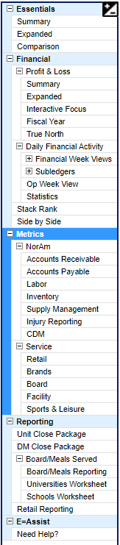
Where Can I Find Reporting For Statistics
E=Vision Reporting
Transactional Statistics / Meals Served / Population
  Metrics: Labor
  Service: Retail, Brands, Board
  Reporting: Retail Reporting, Board/Meals Reporting
Facility Statistics
  Metrics: Labor
  Services: Facility

Slide 37
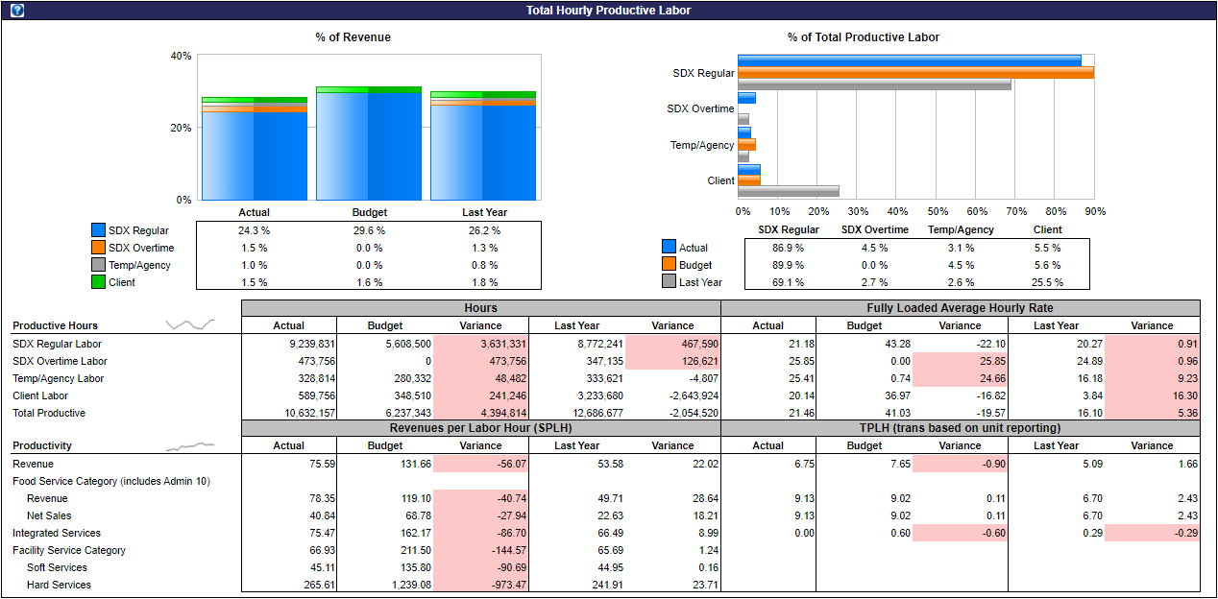
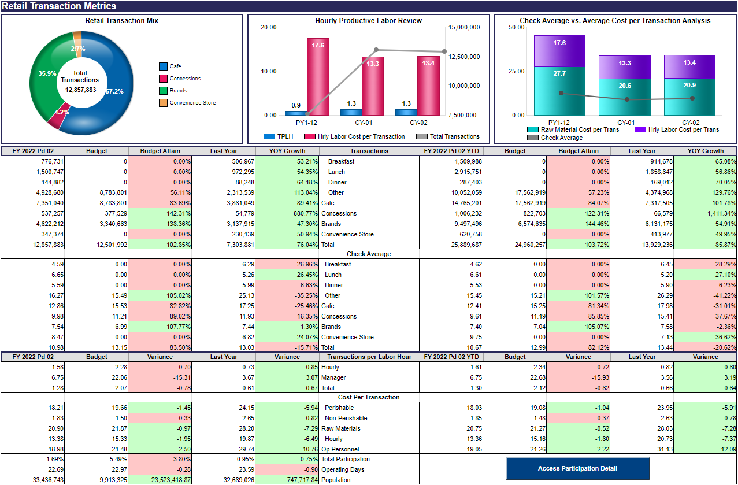
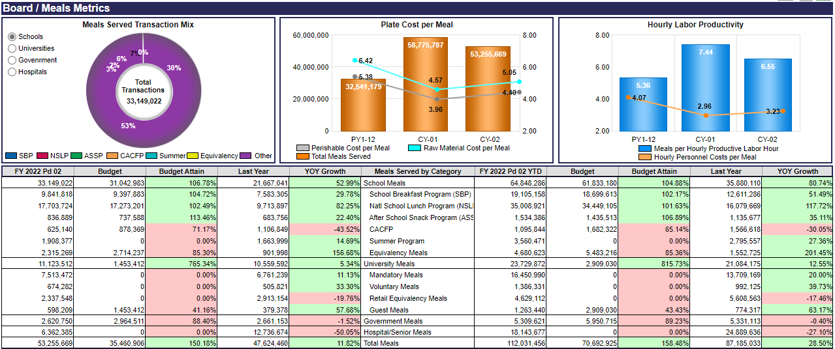
Metrics
Metric pages designed for statistics being reported
  Views developed based on operator feedback
  Metrics identified by field & Sodexo standardized KPIs
November 2021 - Reporting Series - Intro to E=Vision

Slide 38
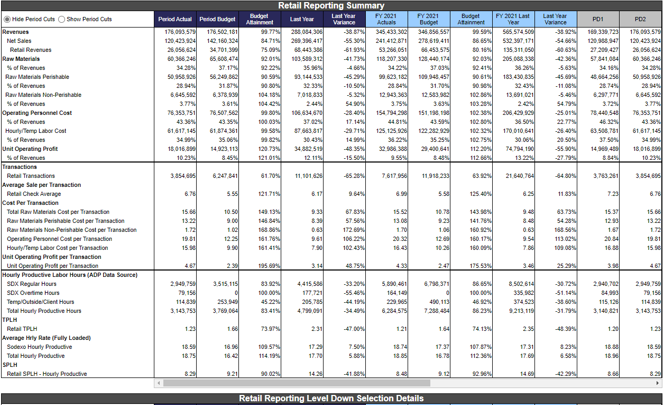
Reporting: Board & Retail Reports
Single click access to level down retail and board reporting
Includes key financial and metric comparisons to understand your business
Interactive Features
  Timeframe
  %Rev or %NS views
  Board meal or meal equivalent views
  Level selections
  Show/Hide Cuts
November 2021 - Reporting Series - Intro to E=Vision

Slide 39
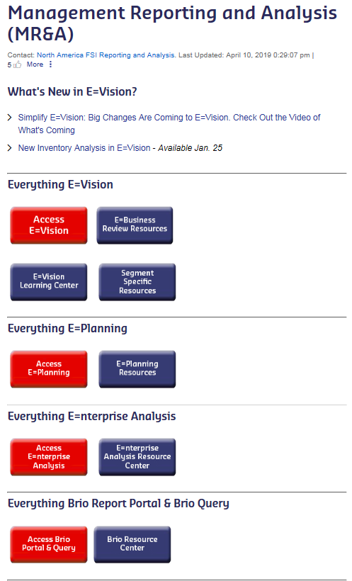
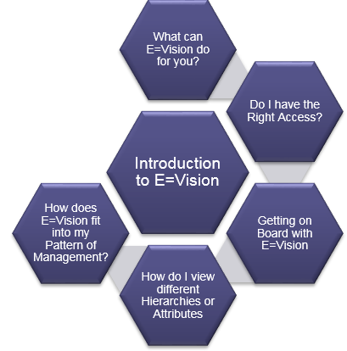
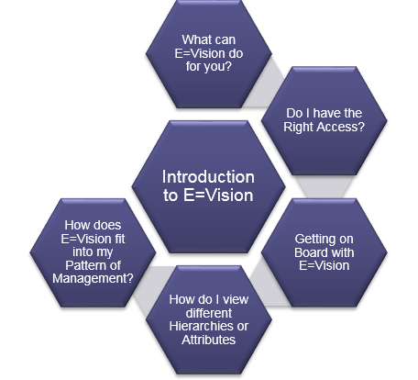
Resources
Technical Assistance: 888-667-9111 and follow the prompts for E=Vision
Functional Assistance: ReportingAndAnalysis.Noram@Sodexo.com
Access Resources from MR&A Page on Sodexo Net.
Learning Center
  View Micro Trainings
  Access Support Guides
Enterprise Analysis
  Support Guides
On Screen Assistance
Click on ? Icons to view instructions, quick tips & calculation information
Open E=Assist tab to view Micro learning videos or support materials
November 2021 - Reporting Series - Intro to E=Vision

Slide 40

QUESTIONS
40

Slide 41
Thank you

