Slide 1

FY22 Unit Controller Call Series
  March 2022
We’ll get started momentarily
PLEASE keep lines muted
Notes:
Welcome the FY22 Controller Call Series. this call series – *created by unit controllers and supported by Finance to review topics and inform the Controller Network about timely topics that impact the controller role. This is our first of two calls for the month of March.
I am CS, w/ Financial Shared Services (FSS), coordinator of the CN call series, and your host for today.
To anyone new to Network - *Welcome to this call series.
Just a little background on who is included - Our DL for these calls is refreshed each FY with anyone who has a “Controller” title. We also have many different in-unit finance roles included from US and CA and encourage your assistance in shoring up the DL as members transition and our network develops. A recent sweep of UFS user data at the end of H1, identified a few additional members who were added to the call series. I’m glad you’re listening in today.
To include others, as applicable, send me an email to add them, or simply forward invites when you see topics that benefit your team.

Slide 2

01
  Agenda
    Safety Moment – Nicholas Flick
    Inventory Policy Review – Mark Dobosz
    Career Profile – Cindy Scott (Part 2)
      Career Path
      Running your business as a P&L
    Questions
Notes:
To demonstrate our commitment to safety and our safety culture at Sodexo, we begin each meeting with a Safety Moment – I have an open invitation to anyone listening in to volunteer for a future call and present a safety moment. If you’re looking for an opportunity to share a safety experience or learning, or just want to practice presenting, please reach out to me.
Today we welcome Nicholas Flick Arizona Christian University
Welcome back Mark Dobosz, our FSS Director and Lead for Purchase to Pay to provide a review on inventory policy
And returning from last month is Cindy Scott, VP NorAm Finance, Seniors, to wrap up the second half of her presentation from last month – Career Path, and Running your business as a P&L
Please use the chat function to submit any questions that you may have as we run through the agenda topics. We will pause to address questions between topics and if we run out of time we will follow up via email.
Turning over the audio to Nicholas

Slide 3

02
  Safety Moment
    Common Sense Safety
Notes:
Nicholas Flick, Controller from Arizona Christian University

Slide 4

Safety Moment: Common Sense Safety
Taking safety seriously means paying attention to every part of your job and what goes on around you.
Safety Do
Know safety rules and regulations
Pay attention to what you are doing
Treat safety as an important part of your job
Remind other workers about safety procedures
Pay attention during safety meetings and training
Ask questions about work or procedures you do not understand
Safety Do Not
Do not assume safety is someone else’s job
Do not ignore safety hazards
Do not fool around or horseplay
Do not be overconfident with jobs you have done many times
Do not use equipment in ways for which it was not intended
Do not get pressured into ignoring safety procedures because of tight schedules
Most accidents are caused by a failure to use common sense!
Notes:
Nicholas Flick, Controller from Arizona Christian University

Slide 5
03
  Inventory Policy Review
Notes:
Mark Dobosz, Director II, FSS Accounting – Purchase to Pay Lead

Slide 6
GIA AUDIT OBJECTIVES
Identify and review Facility Management and Food Service sites with high / unusual Inventory Trends across NorAm Market segments. This will include a detailed analysis of all NorAm site data for: Revenues, Food Costs, Gross Profit and Inventory balances
Review the ‘Inventory Process’ in place and assess whether it adequately covers all key risks relating to Inventory management
Ensure there are appropriate tools in place to manage, monitor and report Inventory Trends, both centrally and at site level
Assess whether employees are fully aware of Inventory company policies and procedures and verify the level of compliance at site level.
Review and follow-up the status of all action plans relating to the previous Inventory assessment

Slide 7
INVENTORY – GIA Audit AREAS OF FOCUS
  Audit covers Inventory included on Sodexo balance sheet
    Sodexo Owned or Client Owned / Sodexo Managed should be separately identified & access restricted to essential staff only
    Training Documents are not signed and retained at Unit
    Unit Inventory Sheets do not match UFS Input values
    Lack of Trend analyses performed on Inventory balances by GM/DM
    Inventory Cost extensions are not consistent with TMC pricing. Non-TMC item costing must match last purchase price
    Segregation of duties note: count team members should not be involved in data entry work for inventory extensions or Inventory summary report.
    Inventory adjustments & transfers are not properly reviewed & documented
    All frontline staff to take annual inventory training

Slide 8
INVENTORY FY2022 – Focus on Training
  Inventory training will be mandatory for all new employees involved with Inventory process
  Refresher testing every 2 years for all staff
  Revised training materials in process. ETC = Q4
  Training results to be tracked & presented to Sr Management

Slide 9
INVENTORY AUDIT – Monthly Inventory Best Practices
  Make sure that the inventory is taken with respect to your sites knowledge of food receipts being delivered & sales YTG
    P6 and P12 +> MUST take inventory on last day of the month, preferably after last meal served
    All other inventories can be counted within last 4 days of the month-end
    Some operating Segments may have more strict guidance on when to take inventories based on thei business models. Please follow those guidelines if they apply to your business.
  Ensure that all inventory sheets are signed by both the counter and the recorder (must be different for Segregation controls).
  Have a copy of the Inventory Policy and 10 Golden rules available on-site for easy and quick reference
  Ensure that items not to be counted are clearly identified and segregated
  Ensure pricing of inventory is consistent with TMC costs

Slide 10
INVENTORY AUDIT – Best Practices (Continued)
  Review inventory results against prior financial results by using data and KPI’s identified in e-Vision:
    Examine trends of COGS % to Revenue
    Review DoH (Days on Hand) calculation and inventory value trends
    Review trend results with site Management to understand fluctuations and reasons
  Obsolete, spoiled, and damaged inventory should be clearly identified and separated from inventory
  GM to ensure that inventory count sheets are properly costed and values are accurately recorded on UFS
  Work with your RDM to obtain support staff to take inventory so that you can meet “Segregation of Duty” requirements

Slide 11
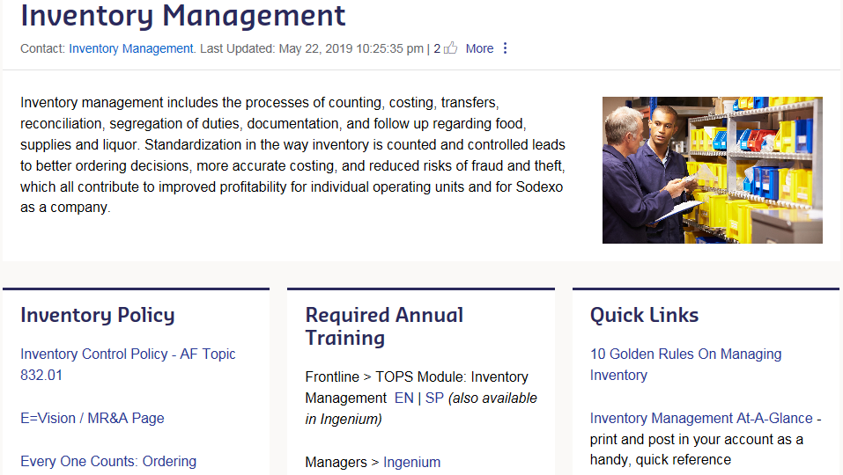
INVENTORY MANAGEMENT PAGE - SODEXONET
  Home > Tools & Resources > Guidelines and Standards > Operations > Accounting, Finance and Insurance > Inventory Management

Slide 12
INTERNAL CONTROL / AP CONTACTS
Integrated Internal Control Department (I2C) | Greg Steele 716-428-8563 Bob Borrelli 716-428-8744 Greg.Steele@sodexo.com Robert.Borrelli@sodexo.com Chad Mayerhofer 716-428-8124 Yvonne D’Aloise 716-428-8637 Chad.Mayerhofer@sodexo.com Yvonne.Daloise@sodexo.com
Accounts Payable: Inventory | Mark Dobosz 716-428-8271 Laurie Edgar 716-428-8343 Mark.Dobosz@sodexo.com Laurie.Edgar@sodexo.com

Slide 13
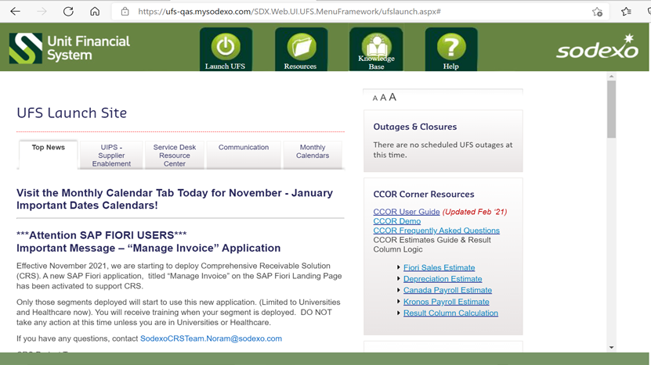
UFS INVENTORY TRANSFER MODULE

Slide 14
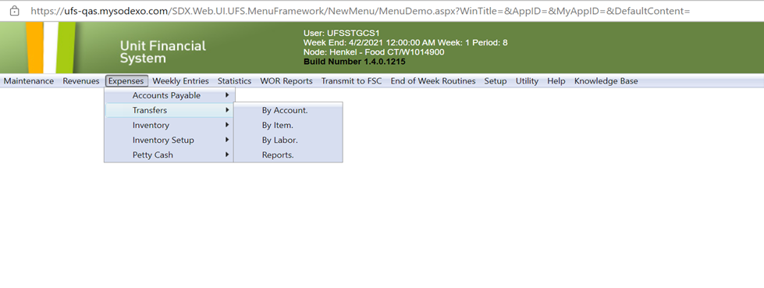
INVENTORY TRANSFER OPTION

Slide 15
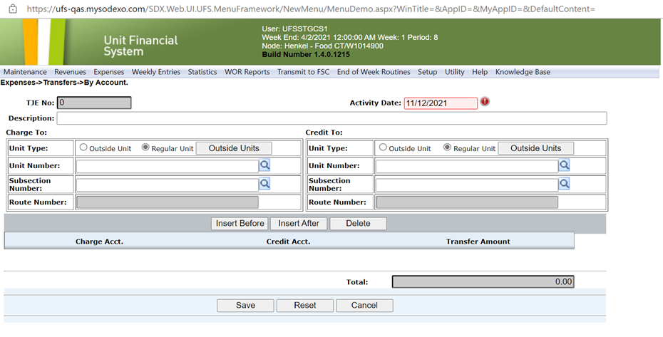
Inventory Transfers by “Account”

Slide 16
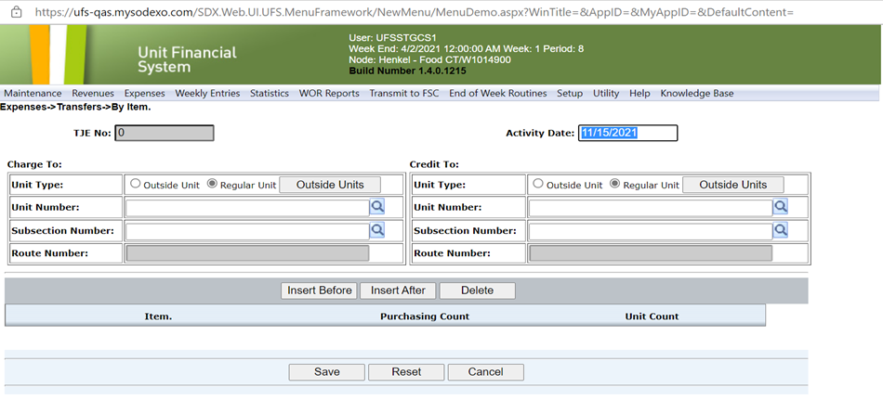
Inventory Transfers by “Item”
“ROUTE NUMBER” used by Vending Units only

Slide 17
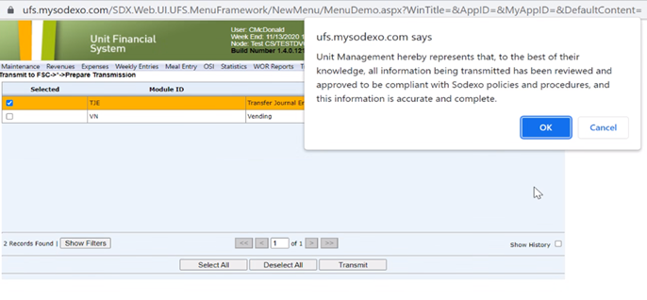
JE Submission & Confirmation receipt

Slide 18
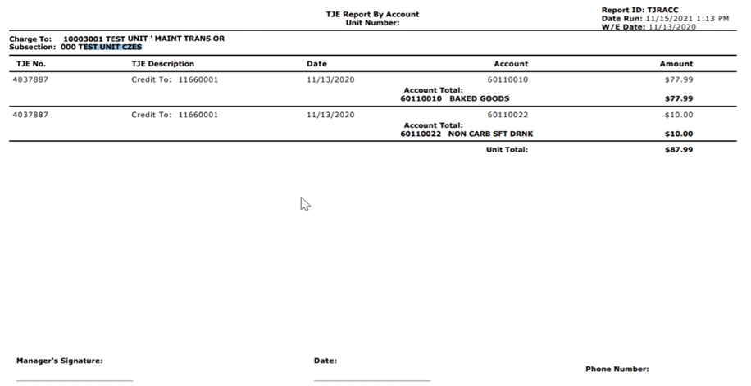
JE Details
Signed JE and backup details should be held by the Unit for audit review as needed

Slide 19
Month-End Inventory Corrections
See FSS AF TOPIC 821-01: “Transfers Cost & Non-Employee Labor”
Identifies rules for cost transfers (communication & approval, timing, U2U xfers, Direct vs O/H units, etc)
Excel based form with separate tabs for each area of correction (form includes tabs for other corrections as well)
Available on SodexoNet or from your OA
Used for correcting month-end balances only after final transmission has been sent into SAP (typically BD+2 or early BD+3)
Work with OA ClientAccounting.NorAm@sodexo.com as needed to help with filling out the form if necessary

Slide 20
Std Close Adj Form: SDX Owned Inventory adjustment
“Prelim Ending Inv Amount” is the amount shown on Financial reports (DFAV, CCOR, CRED).
Commodities are also adj for ending inventory amount
Ensure that all Inventory is costed at latest UFS cost w/o mark-up
Should only be used after last w/e inventory was transmitted
to SAP
Example shown is a small sample of the entire Excel file
Back-up for the inventory Xfer or adj should be held at the Unit for future audit as needed

Slide 21
Std Close Adj Form: CLIENT Owned Inventory Adjustment
Cannot Xfer Commodity inventory from 1 cost center to another.
Unlike Sdx owned inv, this tab corrects the reported “variance” in GL accounts from P-A to P-B
Form to be used only after final inventory transmission sent in SAP
All Back-up details are to be kept by the Unit to support audits as needed
Example shown is a small example of the full form

Slide 22
Inventory Trend Analysis – Accessing the Enterprise Tool
GIA observation: Sites reporting inventory values without review of results or trends:
SodexoNet
E=nterprise Analysis RC (icon – page 2)
Management Reporting & Analysis (Finance Link in Right Hand margin)
Everything E = vision
Access E = Vision
Welcome to E=Vision (see next slide)

Slide 23
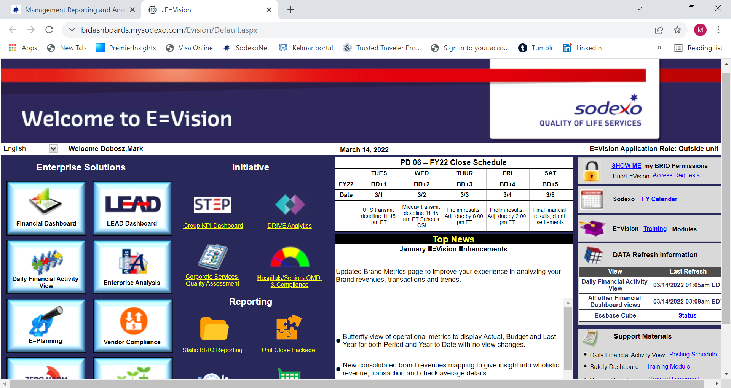
Inventory Trend Analysis (con’t)
Click on “Financial Dashboard”

Slide 24
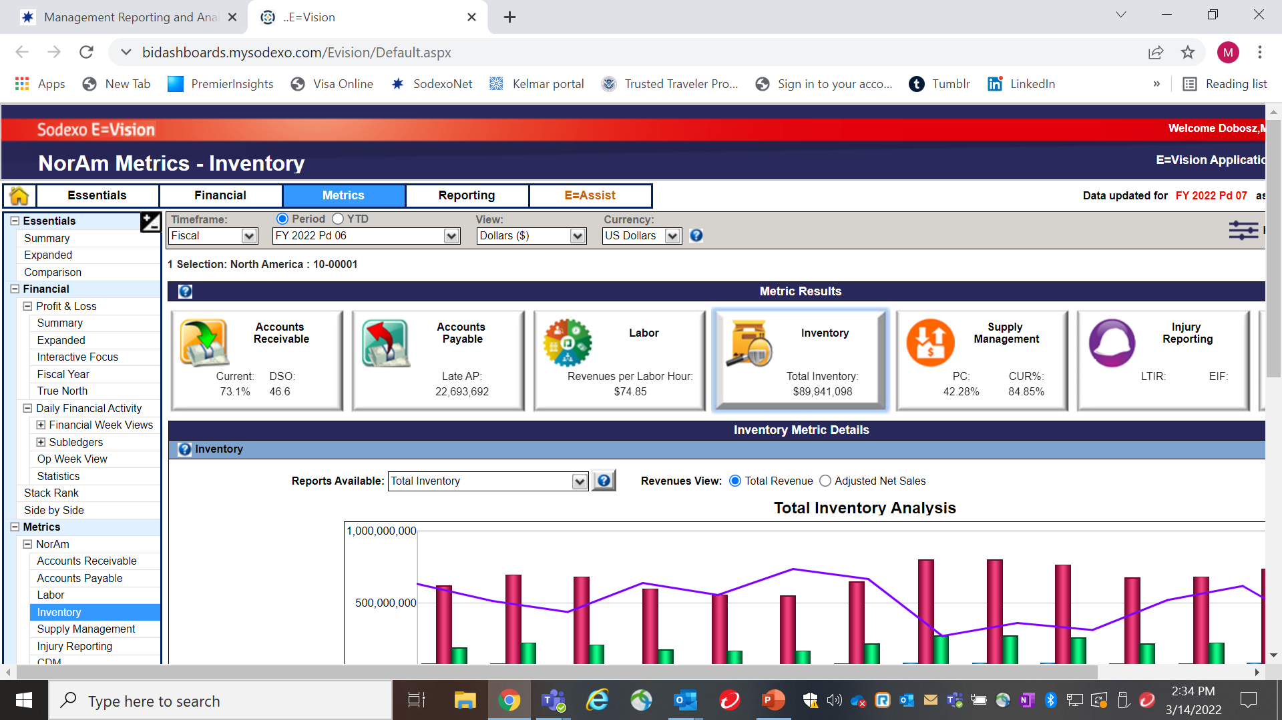
Inventory Trend Analysis (con’t)
Click on “Inventory” & update hierarchy if needed

Slide 25
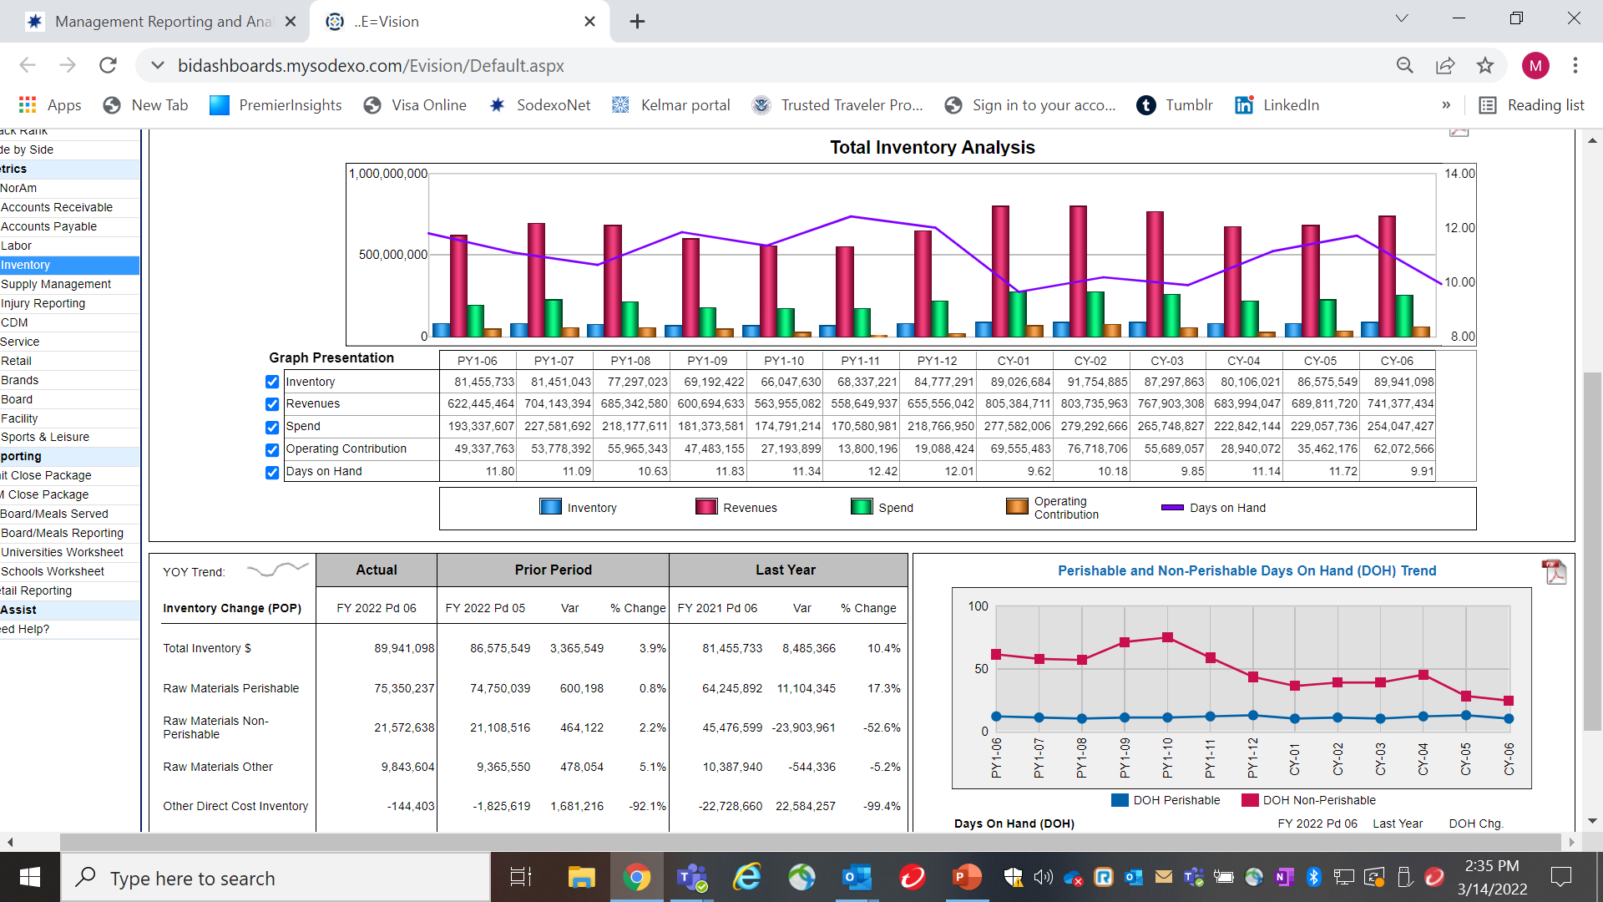
Inventory Trend Alanysis (Con’t)

Slide 26

QUESTIONS

Slide 27
04
  Career Profile – Cindy Scott
  VP Noram Finance, Seniors

Slide 28
A Career with Sodexo!
Support Positions
Learn as much as you can
Don’t be afraid to step sideways or backwards!
You are the captain of your own ship!
Learn operations, systems, finances!
Contract Management
NETWORK!!!
Volunteer!
Diversity!
Succession Planning!
Listen and learn!
Ask questions
BE BOLD!!!!
What is your passion???
Think Globally!
Segment Experience – multiple divisions!

Slide 29
Financial Acumen Training
Training Modules

Slide 30


