Slide 1

FY22 Unit Controller Call Series
    February 2022
We’ll get started momentarily
PLEASE keep lines muted
Thursday’s call has been CANCELLED
Notes:
Happy New Year! This is our first call in 2022 so HNY . Today will be our ONLY call for the month of February, so we will be recording this session…… (click)
Before I move on – please note that the Thursday call, scheduled for 3:00 ET tomorrow has been cancelled. I sent an email to all attendees on Monday and an invite cancellation, but I’m getting feedback that some still show the meeting on tomorrow’s calendar. I no longer have the invite to resend, so please ignore or delete tomorrow’s controller call and I will communicate out to all with today’s recorded session. (click)
I’ll Pause now to start our recording and we’ll get started: RECORD
Welcome the FY22 Controller Call Series. this call series –
*created by unit controllers and supported by Finance to review topics and inform the Controller Network about timely topics that impact the controller role.
I am CS, w/ Financial Shared Services (FSS), coordinator of the CN call series, and your host for today.
To anyone new to Network - *Welcome to this call series.
I’m glad you are listening in today. Just a little background - Our DL for these calls is refreshed each FY with anyone who has a “Controller” title. We also have many different in-unit finance roles included from US and CA and encourage your assistance in shoring up the DL as members transition and our network develops. To include others from your team, send me an email to add them, or simply forward invites when you see topics that benefit your team.

Slide 2
Agenda
Safety Moment - Lorene Mietz
          Fraud Attempts via Email
Guest Speaker - Cindy Scott
          Running your business as a P&L
          Career Path
Q2 Collections – Brad Hamman
Brands Reporting E=Vision – Susan Chapman
Questions
Notes:
Our agenda today includes:
Safety Moment regarding fraud attempts via email – Lorene Mietz will provide an update with an AP twist
New agenda segment for this call series– inviting a guest speaker who has been promoted from our ranks to share their career journey and/or insight on business best practices. More to come as this segment is in development for future calls. Today -I’m excited to share that we have Cindy Scott as our guest.
Following Cindy we have two additional key topics:
We welcome back Brad Hamman from Credit & Collections to guide us through Q2.
And Susan Chapman to provide an enhancement update on Brands Reporting in E=Vision.
Please use the chat function to submit any questions you may have as we roll through the agenda. Thank you, Jill Helms, for joining us today and monitoring. We will pause at the end of each topic to address questions. If we run out of time before we address your question, we will follow up with you via email.

Slide 3


Safety Moment - Fraud Attempts Via Email
Notes:
We begin with A Safety Moment during every meeting to demonstrate the importance of the health and safety culture at Sodexo. Sometimes these topics go well beyond physical safety – here to share more is Lorene Mietz

Slide 4
Compromising Emails
Business email compromise (BEC)—also known as email account compromise (EAC); is one of the most financially damaging online crimes. It exploits the fact that so many of us rely on email to conduct business—both personal and professional.
In a BEC scam, criminals send an email message that appears to come from a known source making a legitimate request, like in these examples:
  A vendor your company regularly deals with sends an invoice with an updated mailing address.
  A company CEO asks her assistant to purchase dozens of gift cards to send out as employee rewards. They ask for the serial numbers so they can email them out right away.
  A homebuyer receives a message from their title company with instructions on how to wire a down payment.
Versions of these scenarios happened to real victims. All the messages were fake. And in each case, thousands—or even hundreds of thousands—of dollars were sent to criminals instead.

Slide 5
How Criminals Carry Out BEC Scams
A scammer might:
Spoof an email account or website. Slight variations on legitimate addresses (john.kelly@examplecompany.com vs. john.kelley@examplecompany.com) fool victims into thinking fake accounts are authentic.
Send spearphishing emails. These messages look like they’re from a trusted sender to trick victims into revealing confidential information. That information lets criminals access company accounts, calendars, and data that gives them the details they need to carry out the BEC schemes.
Use malware. Malicious software can infiltrate company networks and gain access to legitimate email threads about billing and invoices. That information is used to time requests or send messages, so accountants or financial officers don’t question payment requests. Malware also lets criminals gain undetected access to a victim’s data, including passwords and financial account information.

Slide 6
Increase in Fraudulent Requests – AP, Payroll & AR
Fraudster Emails Seen by Accounts Payable
  Additional Characters Added to the Company Name
    “The” was added in Front of Company Name:
    “S” Added to The End of Company Name:
  Misspelled Company Name (A in facility changed to E):
  Domain Does not Contain Company Name@att.net
Be alert & be diligent in unwanted or unexpected e-mails

Slide 7
How YOU Can Help Stop Fraud Within Sodexo
“Urgent Request”
  Vendor claims they will “only” accept ACH payments.
  Email coming from VP or SVP requesting immediate payment of an invoice
Confirm Request
  If vendor is demanding immediate payment made by ACH – reach out to vendor to confirm the request. Do not “reply” to email
  Call VP or SVP requesting immediate payment. Do not “reply” to email
Review email Address
  If possible, review email address from prior communications.
  Look for any additional characters added to the domain – Ex. “the”, “s”
  Look for miss spellings in the company name – Ex. Email domain showing as “sodeco” vs. “sodexo”
  Email domain does not contain the company name – Ex. “att.net”, “gmail.com”
Report Fraud to Information Security NORAM at infosec.noram@sodexo.com

Slide 8
How To Protect Yourself
Be careful with what information you share online or on social media. By openly sharing things like pet names, schools you attended, links to family members, and your birthday, you can give a scammer all the information they need to guess your password or answer your security questions.
Don’t click on anything in an unsolicited email or text message asking you to update or verify account information. Look up the company’s phone number on your own (don’t use the one a potential scammer is providing) and call the company to ask if the request is legitimate.
Carefully examine the email address, URL, and spelling used in any correspondence. Scammers use slight differences to trick your eye and gain your trust.
Be careful what you download. Never open an email attachment from someone you don't know and be wary of email attachments forwarded to you.
Set up two-factor (or multi-factor) authentication on any account that allows it, and never disable it.
Verify payment and purchase requests in person if possible or by calling the person to make sure it is legitimate. You should verify any change in account number or payment procedures with the person making the request.
Be especially wary if the requestor is pressing you to act quickly.

Slide 9
ACH Requests
09.10.2019 Business Email Compromise: The $26 Billion Scam
Business email compromise/email account compromise is a sophisticated scam that targets both businesses and individuals who perform legitimate transfer-of-funds requests.
The BEC/EAC scam continues to grow and evolve, targeting small, medium, and large business and personal transactions. Between May 2018 and July 2019, there was a 100 percent increase in identified global exposed losses. The increase is also due in part to greater awareness of the scam, which encourages reporting to the IC3 and international and financial partners. The scam has been reported in all 50 states and 177 countries. Fraudulent transfers have been sent to at least 140 countries.
Based on the financial data, banks located in China and Hong Kong remain the primary destinations of fraudulent funds. However, the Federal Bureau of Investigation has seen an increase of fraudulent transfers sent to the United Kingdom, Mexico, and Turkey.
The following BEC/EAC statistics were reported to the IC3 and are derived from multiple sources, including IC3 and international law enforcement complaint data and filings from financial institutions between October 2013 and July 2019:

Slide 10
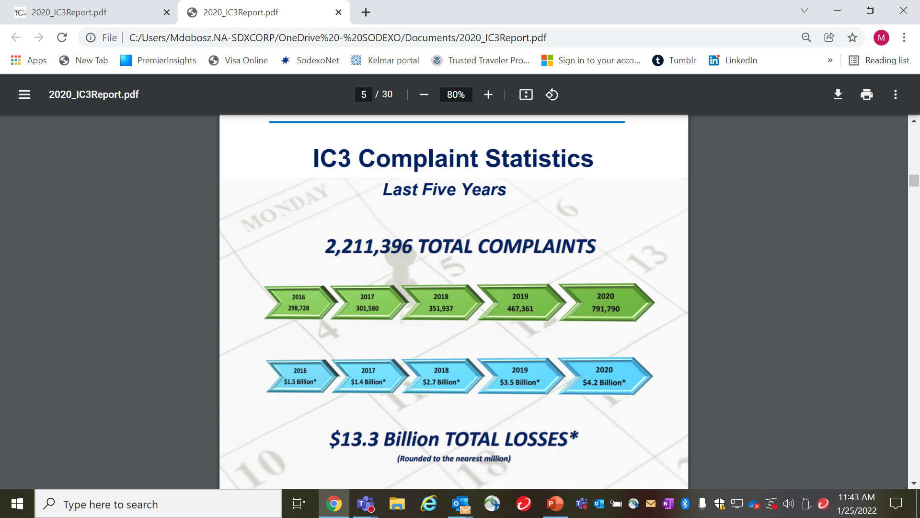
Internet Crime Complaint Center
Notes:
Ic3 = Internet Crime Complaint Center……all reported internet false claims should be reported to them

Slide 11
Guest Speaker
Cindy Scott, VP Noram Finance, Seniors
Unit Controller Network Call, February 2022

Slide 12
A Career with Sodexo!
Support Positions
Learn as much as you can
Don’t be afraid to step sideways or backwards!
You are the captain of your own ship!
Learn operations, systems, finances!
Contract Management
NETWORK!!!
Volunteer!
Diversity!
Succession Planning!
Listen and learn!
Ask questions
BE BOLD!!!!
What is your passion???
Think Globally!
Segment Experience – multiple divisions!

Slide 13
Financial Acumen Training
Training Modules

Slide 14
H1 Collections and CRS Update
February 2022
Notes:
Welcome back Brad Hamman

Slide 15

Goals of Today’s Session
Review banking deadlines for H1 Close
Update of current status of the CRS project
Best Practices for Collections
Review of Payment Fraud

Slide 16


CRS Overview
US – Collect It!

Slide 17
US - Collect It! Deadline for Quarter 2, FY22
Your help is needed to increase our cash flow. To ensure that your AR payments, bank deposits, cash receipts, and cash balances are properly credited for Quarter 2, all deposits must be made on or before Monday,
February 28th.
Please observe the following deadlines depending on your payment method.
Select the payment link(s) below for further details:
ELECTRONIC (ACH) PAYMENTS
CHECK PAYMENTS

Slide 18
US - Electronic Payments – Deadline for Quarter 2 FY22
Client ACH payments post to Sodexo’s bank account 1 to 2 business days after the client releases the payment to their bank. Determine with your client Finance or AP Department whether their bank ACH is 1- or 2-Day processing
2 Day ACH: Thursday February 24th
If ACH is 2-day processing, ACH must be released from client’s bank on or before the 24th with a value date of February 28th
1 Day ACH: Friday February 25th
    If ACH is a 1-day processing, ACH must be released from client’s bank on or before the 25th with a value date of February 28th
Monday February 28th
    For client payments to post to Sodexo’s bank account on Monday February 28th, client must initiate a SAME DAY wire transfer payment of up to $100,000 on the 28th with a value date of February 28th

Slide 19
US - Check Payments – Deadline for Quarter 2 FY22
Quarter 2 Deadline for AR Collections for CHECK payments sent to Lockbox must be deposited in the Lockbox by 10:30 AM (ET) Monday February 28th
Lock Box address:
Sodexo Inc & Affiliates
Attn: 360170
500 Ross St 154-0455
Pittsburgh, PA 15262-0001
Telephone (412)234-4381
Total Check Amounts | Important Dates | Action to Take
Total Checks greater than $2,500 | Thursday February 24th | Overnight checks to the Lockbox address above with Next day delivery
Total Checks greater than $2,500 | Friday February 25th | Overnight checks to the Lockbox with Next Day Air EARLY AM Delivery
Total Checks greater than $100,000 | Monday February 28th before 2:00 PM ET. | Call the FSS AR Department at 1-800-828- 7762 option 2, option 2 before 2 PM ET

Slide 20

CRS Overview
Canada – Collect It!

Slide 21
Canada - Collect It! Deadline for Quarter 2, FY22
Your help is needed to increase our cash flow. To ensure that your AR payments, bank deposits, cash receipts, and cash balances are properly credited for Quarter 2, all deposits must be made on or before Monday,
February 28th.
Please observe the following deadlines depending on your payment method.
Select the payment link(s) below for further details:
ELECTRONIC (EFT/Wire) PAYMENTS
CHEQUE PAYMENTS

Slide 22
Canada - Electronic Payments – Deadline for Quarter 2 FY22;
Client EFT payments post to Sodexo’s bank account 1 to 2 business days after the client releases the payment to their bank. Determine with your client Finance or AP Department whether their bank EFT is 1- or 2-Day processing
2 Day EFT: Thursday February 24th
If EFT is 2-day processing, EFT must be released from client’s bank on or before the 24th with a value date of February 28th
1 Day EFT: February 25th
    If EFT is a 1-day processing, EFT must be released from client’s bank on or before the 25th with a value date of February 28th
Monday February 28th
    For client payments to post to Sodexo’s bank account on Tuesday February 28th, client must initiate a SAME DAY wire transfer payment on the 28th with a value date of February 28th

Slide 23
Canada - Cheque Payments – Deadline for Quarter 2 FY22
Quarter 2 Deadline for AR Collections for Cheque payments sent to Lockbox must be deposited in the Lockbox by 10:30 AM (ET) Monday February 28th
Lock Box address:
BMO Wholesale Remittance Processing Services
4 Prince Andrew Place (Loading Dock 4)
Don Mills, Ontario M3C 2H4
Attn: T57840C – Sodexo Canada Ltd.
416-643-4398
Total Cheque Amounts | Important Dates | Action to Take
Total Cheques greater than $2,500 | Thursday February 24th | Overnight cheques to the Lockbox address above with Next day delivery
Total Cheques greater than $2,500 | Friday February 25th | Overnight cheques to the Lockbox with Next Day Air EARLY AM Delivery
Total Cheques greater than $100,000 | Monday February 28th before 2:00 PM ET. | Call the FSS AR Department at 1-800-828- 7762 option 2, option 2 before 2 PM ET

Slide 24

CRS Overview
CRS Overview

Slide 25

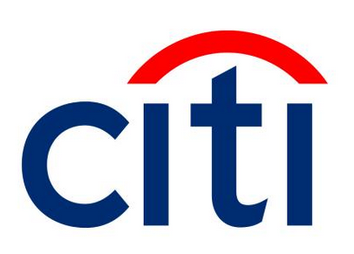









(CRS) Technology YOU Will Use
Sodexo/Client conversations to discuss service provided & present the invoice continue to take place as they do now.
NEW: Automated delivery of invoice & supporting documentation using the Present & Pay portal
®
Unit team prepares the client invoice using current tools & processes
GMs, DM/CEs etc. make/review notes of collections efforts within the tool
Clients may continue to use current payment methods: lockbox ACH/EFT/check
or…
NEW: Client business partners and accounts payable team can now use the state-of-the-art self-service
Present & Pay portal to review & pay invoices, research invoice history, or if necessary, ask a questions or dispute a charge
Present & Pay
SAP Fiori “Manage Invoice”
Operations teams spend more time positively nurturing client relationships and less on uncomfortable discussions about overdue payments
Credit & Collections
Sodexo financial team leverages technology to effectively match payments to invoices
NEW: Client receives automated payment reminders when necessary
Invoices paid more quickly, improving Sodexo’s accounts receivables performance
NEW: Sodexo expanded Centralized Direct Collections Team provides centralized support to operations by working with clients to secure overdue payments, using defined escalation steps
Collections team make/review note of collection efforts within the tool

Slide 26
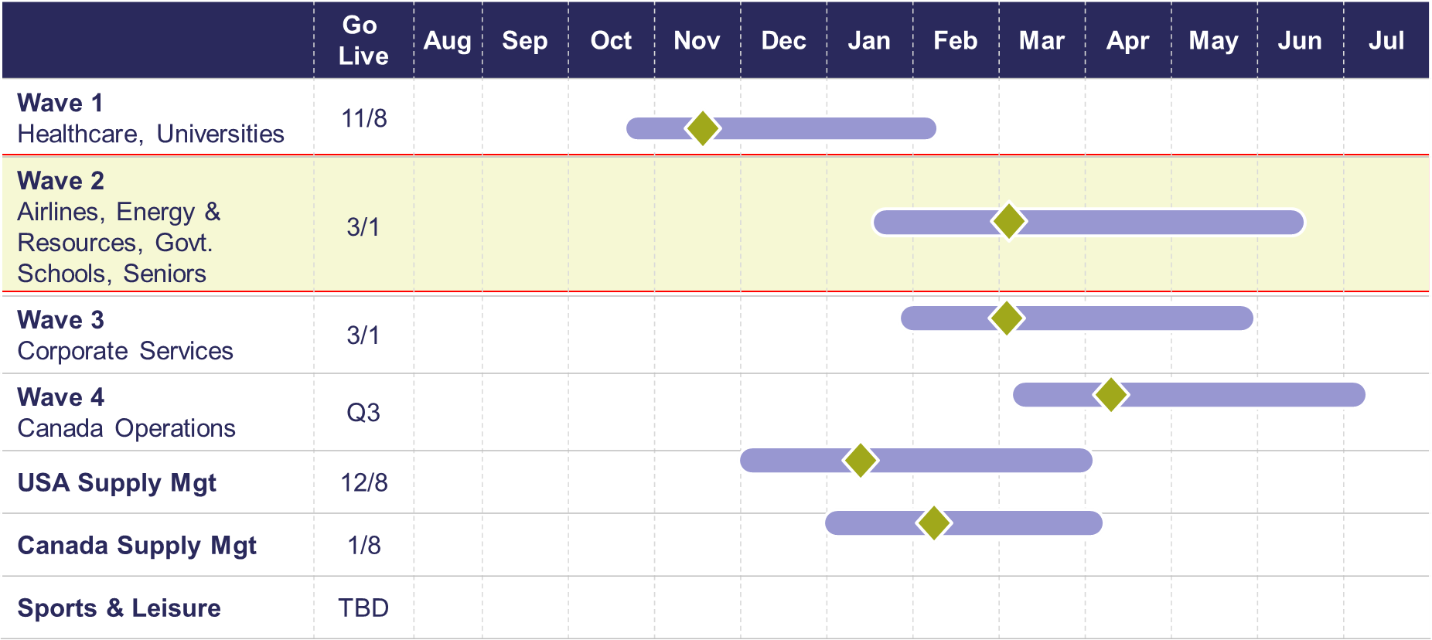
Deployment Schedule

Slide 27

Training, Tools & Resources
Sodexo_Net CRS Page
  SHORT Overview video for CRS end to end process
  Infographic with talking points
  FAQs
  Present & Pay client introduction sheet
Office Hours
  Drop-in to ask a question or share feedback during the times posted on your calendar
Help & Job Aides
  Help built right into the CRS tools
  Job aides to view or download
Virtual Training Sessions
  Learn the CRS process, tools available, and how to use them
Client Conversation Tools
  Manager Talking Points
  Client Introductory Sheet
  Client Present and Pay FAQs

Slide 28

CRS Overview
Best Practices &
Payment Fraud

Slide 29
Best Practices for Collections
Be professional, be courteous – but firm.
It is important to be understanding with the Client; however, we have the right to know when payment is expected for services rendered.
Working with remote AP Departments
Most AP departments are still likely working remote, they will have access to email and phone messages. If the 1st level contacts are not responding, escalate to the next level.
Follow up is key for past due and missed payments.
Other Vendors are asking for payment. We need to ensure ours are given the same priority as other vendors.
Are you hearing financial distress?
If the client is unable to commit to any payment and/or if claims of financial distress (i.e. cash flow issues). Refer the account immediately the FSS Credit and Collections team at Creditcollection.NORAM@Sodexo.COM.

Slide 30
Payment Fraud
Threat Actors are continuing their efforts posing as Sodexo employee to commit fraud against our clients.
  Tell customers NEVER to conduct electronic funds transactions with Sodexo via email.
  Always call the AR Department to verify any requests and to check the sender’s domain
  Ensure that any requests for funds transfer received have 2nd and/or 3rd level validation procedures in place (i.e., DM/GM approvals, always call your customer to verify legitimacy etc.)
  Using email for financial transactions in general is strongly discouraged
  Immediately contact FSS Accounts Receivables department if you suspect possible fraud at: AccountsReceivableNorAm@sodexo.com or 1-800-828-7762, Option 2, Option 2
Thank you, your actions are making a difference!

Slide 31

Q&A
Audience Q&A
This Photo by Unknown Author is licensed under CC BY-SA-NC

Slide 32
E=Vision Demo
Brands Reporting
February 2022

Slide 33



QUESTIONS

Slide 34
Thank you

