Slide 1
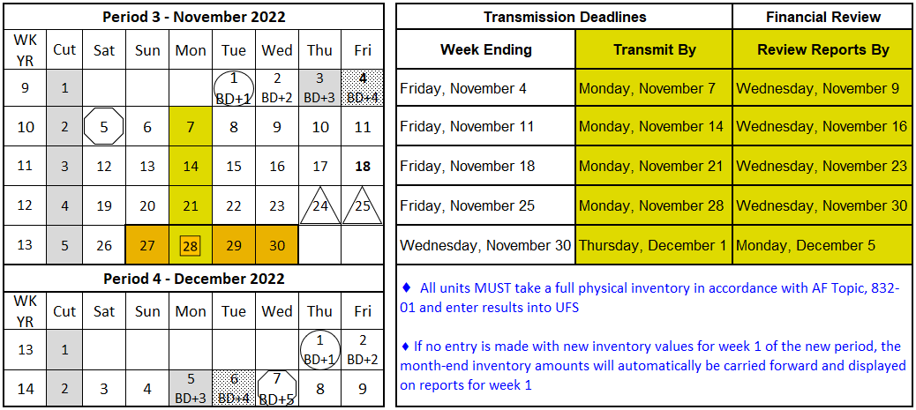
November 2022 Important Dates
Final month end transmission deadline 11:45 pm (ET) 1st business day of month (BD+1).
Financial Close - Day 1 (BD+3) - Review Preliminary Reports All Adjustments Due
Financial Close - Day 2 (BD+4) - Analyze Financial Results
Final Period End Settlement Invoices Available (D+5)
Weekly transmissions due
Conduct physical inventory
Kronos data must be updated and saved by noon ET 12/2 (BD+2) for data to be captured for the automatic payroll accrual
Fiori (client invoices) finalized and approved by 5:00 pm ET on 12/2 (BD+2) will post on the “Settlement To” date
Unit level adjustments will be processed on 12/5 (BD+3) and 12/6 (BD+4)
Review financial reports and data available on Brio and E=Vision on 12/5 (BD+3) and 12/6 (BD+4). A NOC alert will be sent by 6:30 a.m. ET when financial results are delayed
REMINDER: Inventory can only be transmitted once per node, per UFS week-ending date.
Visit the Financial Close – All U.S. Segments Sodexo_Net page for more financial close deadline details.

