Slide 1
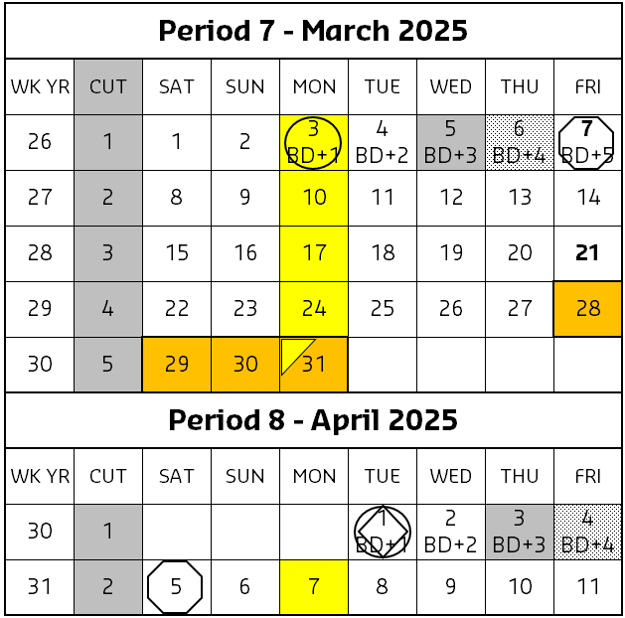
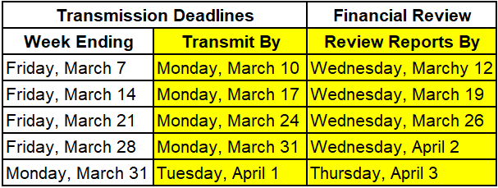
March 2025 Important Dates
Final month end transmission deadline 11:45 pm (ET) 1st business day of month (BD+1).
Financial Close - Day 1 (BD+3) Review Preliminary Reports All Adjustments Due
Financial Close - Day 2 (BD+4) - Analyze Financial Results
All units MUST take a full physical inventory in accordance with AF Topic, 832-01 and enter results into UFS If no entry is made with new inventory values for week 1 of the new period, the month-end inventory amounts will automatically be carried forward and displayed on reports for week 1
Final Period End Settlement Invoices Available (D+5)
Weekly transmissions due
Conduct physical inventory
REMINDER: Inventory can only be transmitted once per node, per UFS week-ending date.
Reminder - Electronic invoices approved after noon (ET) on 4/2 (BD+2) will be delayed for posting to the following day.
Kronos data must be updated and saved by noon ET 4/2 (BD+2) for data to be captured for the automatic payroll accrual
Fiori (client invoices) finalized and approved by 5:00 pm ET on 4/2 (BD+2) will post on the “Settlement To” date
Unit level adjustments will be processed on 4/3 (BD+3) and 4/4 (BD+4)
Review financial reports and data available on Brio and E=Vision on 4/3 (BD+3) and 4/4 (BD+4). A NOC alert will be sent by 6:30 a.m. ET when financial results are delayed
Visit the Financial Close – All U.S. Segments Sodexo_Net page for more financial close deadline details.

