Slide 1

  FY 2023 Year-End District Call
Notes:
Thank you, Corinne, for inviting us to speak on the year end process that is approaching.
Corinne – This call is being recorded. Thank you all for joining this FY23 Year-End version of the Operations Accounting District Calls. I’m Corinne Szabo with FSS, and your host for today.

Slide 2
Agenda
01
  Safety Moment
  Lyme Disease
05
  FY23 Checklist
02
  Inclusion Spotlight
  US Tribal Nations
06
  Best Practices
03
  FY23 Year-End Calendar
07
  Year-End Collections
04
  FY23 Deadlines
08
  Appendix
Notes:
Here is the agenda that will be covered by the OA and Credit & Collections teams.
To demonstrate our Safety and DE&I culture at Sodexo, we kick off each call with a safety moment and inclusion spotlight.
Our YE topics to be covered include:
YE Calendar
YE Deadlines
YE Checklist
Best Practices for the preceding agenda items and also
YE collections
As we wrap up today’s agenda we will have an overview of the Appendix and resources included therein.
We will open the chat at the end of the call to take any questions that you may have. Due to the high volume of attendees, we will not unmute lines. You may see that chat is not yet available, but I’ll open chat towards the end of the call and we encourage you to use chat to submit your questions.
this is the first/second of two calls this week. The agenda / content for both calls is the same. If you are joining today, you do not have to join the second call. If, however, you have team members who will benefit from this content, please forward the invitation for tomorrow’s call.
The materials presented today and the recording will be posted in chat at the conclusion of the call.
Thank you all for joining –
Transition to Greg Wiesen to get us started

Slide 3

Lyme Disease Prevention
Safety
Moment
Notes:
Script: Today’s safety moment will cover the origins, signs, and prevention methods regarding Lyme Disease. Especially with summer and warmer weather ahead of us, it’s extremely important to be cautious and careful when spending time outside. Here are a few tips to help you stay safe this summer!

Slide 4
Lyme Disease Prevention
Know where to expect ticks:
Ticks live in moist and humid environments, particularly in or near wooded or grassy areas
To avoid ticks, walk in the center of trails and avoid tall vegetation
Signs/Symptoms of Lyme Disease:
Distinctive circular rash within three to 30 days of being bitten
Early symptoms include rashes, fever, chills, fatigue, headache, muscle aches/pains
Repellent Usage:
Use a repellent with DEET on skin or clothing:
  Repellents containing 20% or more DEET can be applied to the skin, and they can protect up to several hours.
  Parents should apply repellents to their children, taking care to avoid application to hands, eyes, and mouth.
Use a repellent with permethrin on clothing and gear
  Products containing permethrin can be used to treat boots, clothing, and camping gear.
Notes:
Script: Lyme Disease is caused by a bacteria that is carried by ticks in the upper Midwestern, Northeastern, and mid-Atlantic states in the US as well as Europe and Canada. Humans are at risk of Lyme Disease if they are bitten by a tick that happens to carry the certain disease-causing bacteria. Ticks are most active during the warmer months of April-September and inhabit areas that are largely grassy, bushy, or wooded.
Precautions like avoiding high grass and walking in the center of trails can lower risk of being bitten. Additionally, usage of repellents that contain DEET, a chemical that works to repel ticks among other common insects like fleas and mosquitos, on skin, and permethrin on clothing and equipment are a proactive way to lessen the chance of tick bites. After returning indoors, it’s important to check clothing, gear, pets, and skin for ticks.
If you are bitten by a tick, it’s crucial to look out for any Lyme Disease symptoms and changes in your body in the following days. The most common and distinctive symptom is a red, circular rash surrounding the tick bite. This rash is often described as resembling a bull’s eye on a dart board. If left untreated, long-term symptoms can include numbness in hands or legs, arthritis, and memory loss. Make sure you’re doing everything you can to ensure a safe, healthy, and fun summer!

Slide 5

Tribal Nations in the United States
Inclusion Spotlight
Notes:
Script: Today’s inclusion spotlight focuses on tribal nations in the United States, including American Indian or Alaska Native (AIAN) tribes, bands, nations, pueblos, villages, or communities, according to the Federally Recognized Indian Tribe List Act of 1994.
Our focus is on the great number of diverse tribal nations that exist throughout the United States, how many people those nations represent, and the size of tribal nation land. These statistics are a first step before we can fully honor and celebrate indigenous peoples, their rich cultural heritage, history, and contributions. What a missed opportunity for us all to be enriched when the tribal nations are often our neighbors. (click)
Should your team be inspired and/or need to engage in a deeper dialogue, please reach out to the Diversity, Equity & Inclusion Team (dei.usa@sodexo.com) for support.

Slide 6
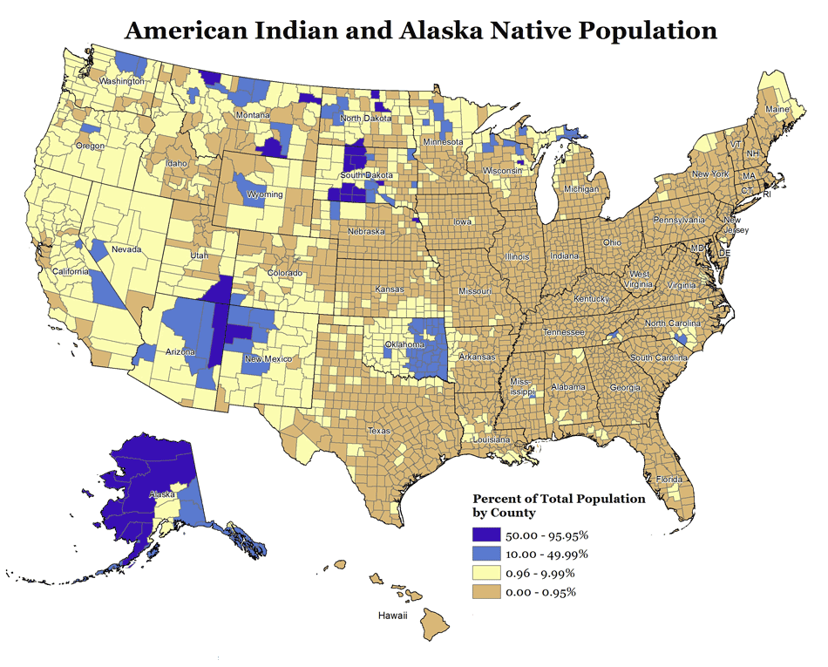
Number of Tribes and Population
There are 574 federally recognized tribal nations in the United States. Approximately 229 of these are located in Alaska.
Native Americans and Alaska Natives now account for 6.79 million people, more than 2% of the total U.S. population.
The American Indian and Alaska Native population grew by 27.1% between 2010 and 2020.
Notes:
Talking Points:
The Native Americans and Alaska Natives demographic is growing, and currently accounts for more than 2% of the U.S. population. Does it surprise you that over 1.5 million of Native Americans reside in California, Oklahoma and Arizona alone…that 15 of 50 states have Native American populations of over 100,000…and that Alaska has the highest relative population of Native Americans, who make up almost 20% of the state's total population?
Of the 574 federally recognized tribal nations, the Navajo Nation and Cherokee Nation are the largest, with a combined population of almost 800,000.
Despite these substantial numbers, indigenous peoples are often seen as an “invisible minority” due to a lack of representation in history books, media and popular culture.

Slide 7
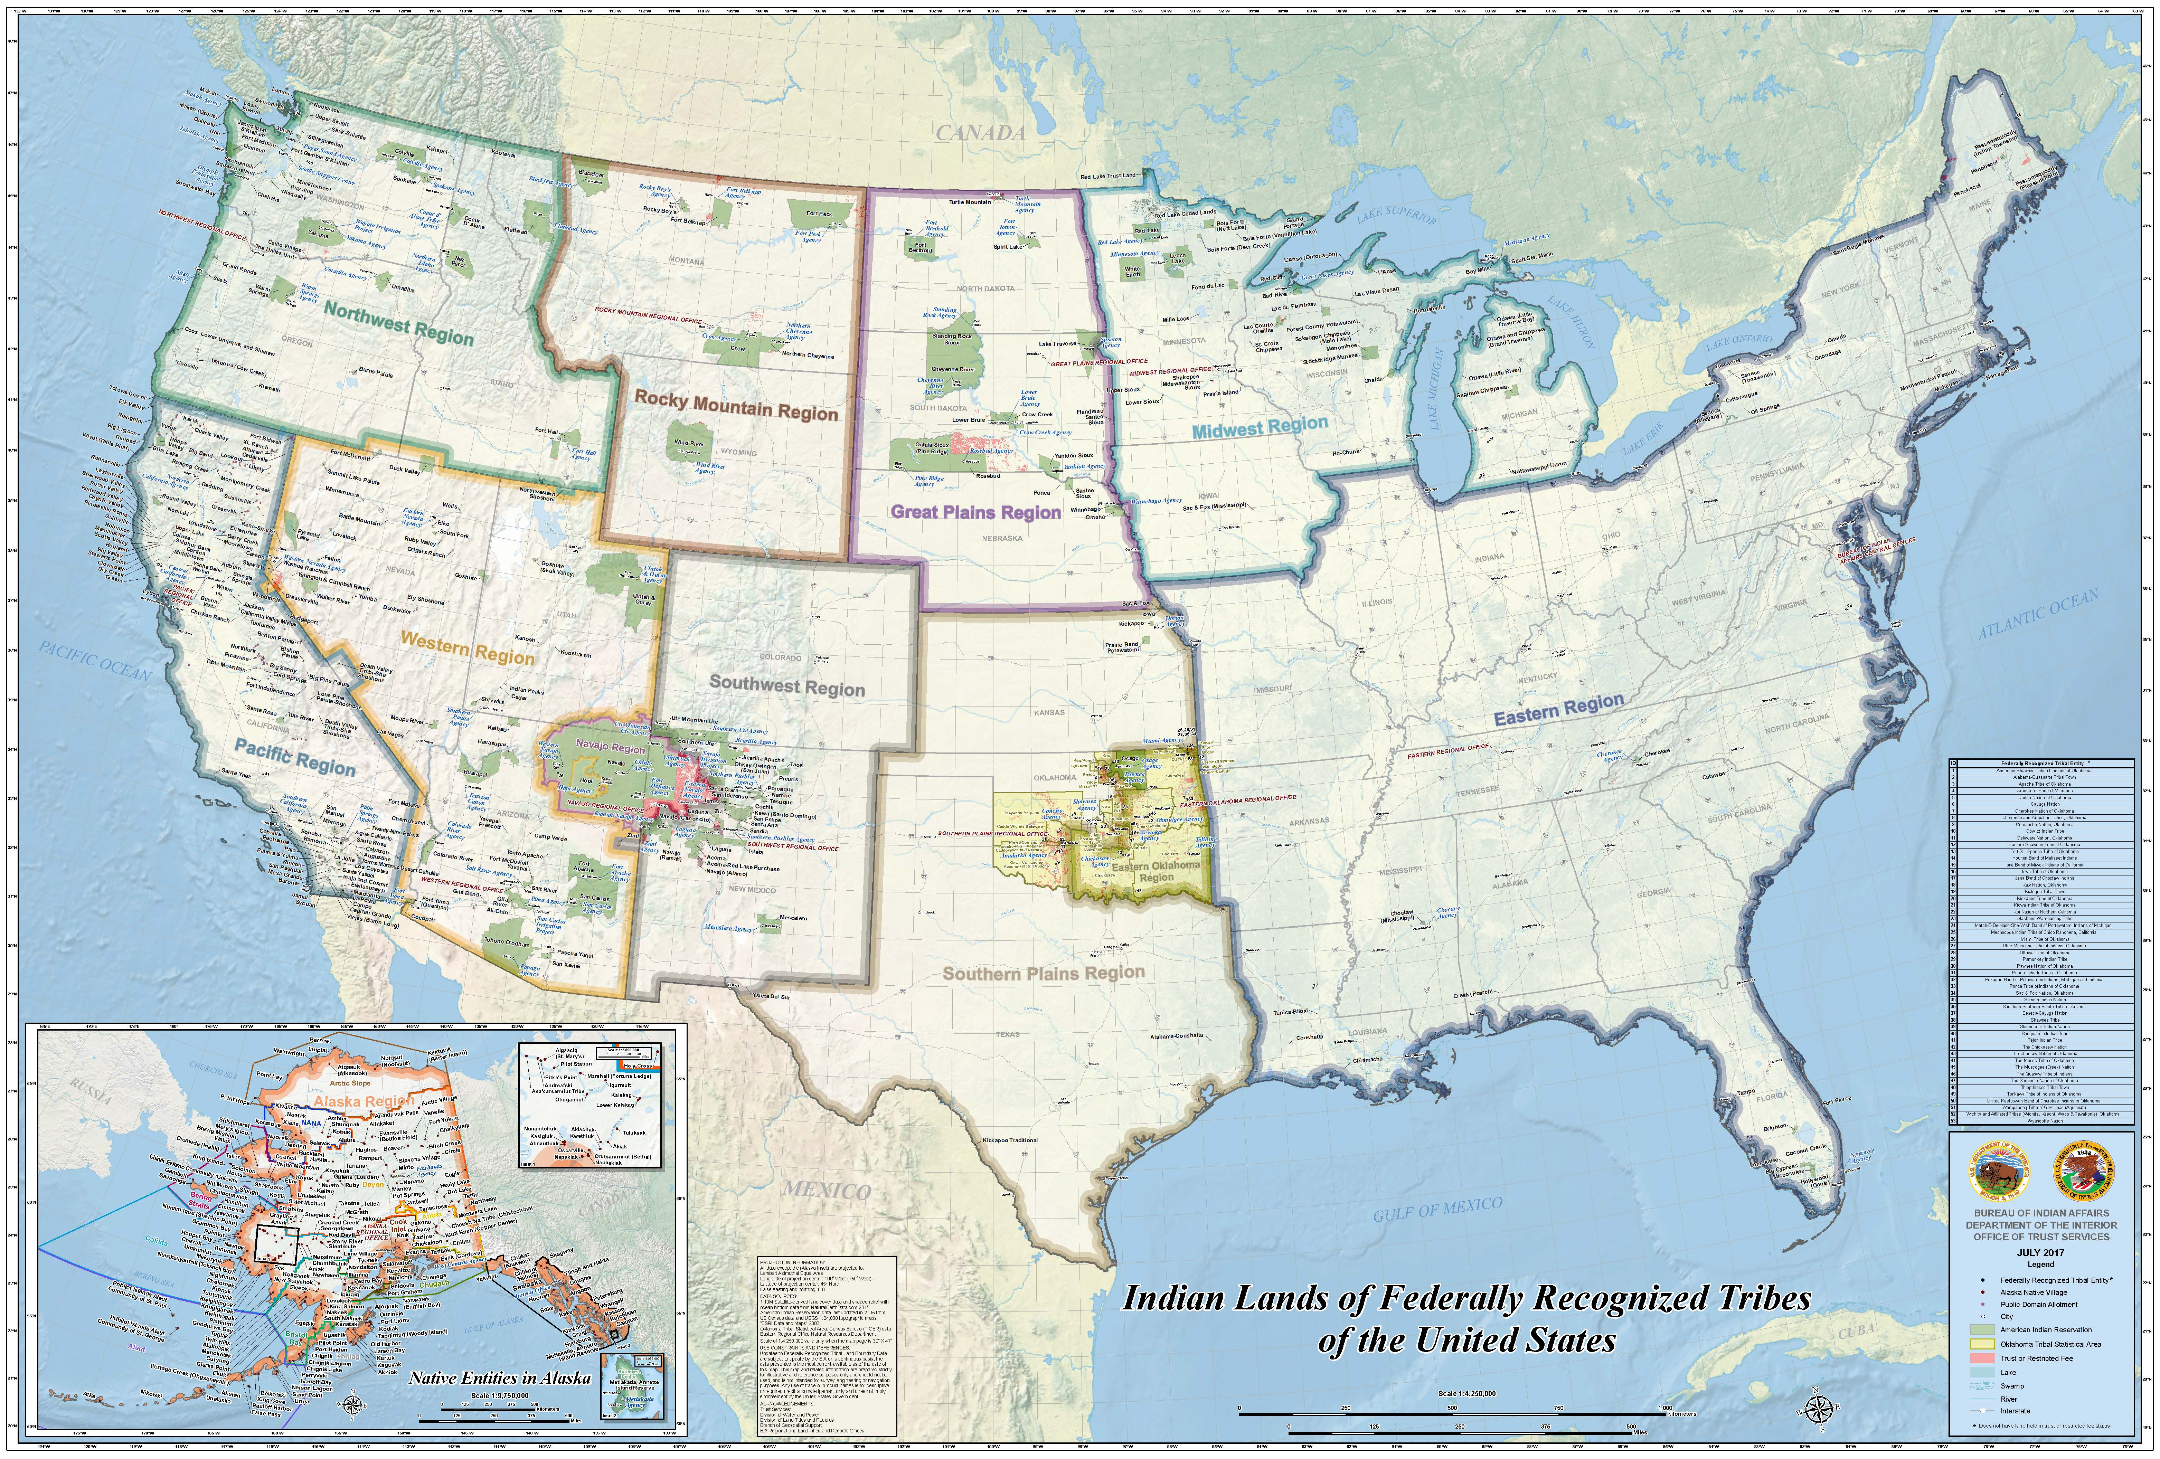
Tribal Land Ownership
Of the 574 Tribal Nations, 326 have reservations and 248 do not.
The Navajo Nation is the largest land area retained by a Native American Tribe in the United States and covers an area of 27,425 square miles (17,552,000 acres).
The total land of all Tribal Nations combined is about 156,250 square miles (100 million acres) and would make Indian Country the fourth largest state in the United States.
Notes:
Talking Points:
Just as some might underestimate the size of the American Indian or Alaska Native (AIAN) population, the amount of tribal land in the U.S. may also be a surprise.
The Navajo Nation is both the largest tribal nation by population, and also by total land. If it were its own state, it would be the 40th largest in the nation. It is larger than West Virginia and slightly smaller than South Carolina. Nineteen tribal nations have a land base larger than Rhode Island, and twelve have a land base larger than Delaware. However, some tribal lands are as small as a few acres, and some tribal nations hold no land at all.
70% of the Native American and Alaska Native population lives outside of tribal lands, which can also be used for hunting, fishing, or as burial grounds.

Slide 8

Learn More!
Engage with the NAAC Employee Business Resource Group.
Watch “How the Navajo Nation Works (A Country Within a Country?)”
Watch TED Talks by Native American thought leaders such as Ron (Muqsahkwat) Corn, Jr., Matika Wilbur, LoVina Louie, and Gregg Deal.
View these interactive resources:
  Native Land Digital Land Acknowledgement Map
  U.S Department of Indian Affairs Land Areas of Federally-Recognized Tribes
  Native Land Zip Code Search
Notes:
Script: (will not read through script) - Transition to Josh
Hopefully, these statistics about tribal nations are eye-opening. By understanding and appreciating these facts, we may be more prepared to engage in deeper conversations about the unique cultures and struggles of AIAN people. Here are some things we can do to learn more:
Engage with NAAC, the Native American and Aboriginal Council, a Sodexo Employee Business Resource Group.
Watch Wendover Productions’ short documentary on the history of the Navajo Nation and the logistics of how the largest tribal nation functions.
Utilize interactive maps to access detailed views of the locations of tribal lands.
Explore the works of various Native American speakers describing the unique and diverse experiences of various tribal nations.
(Note: The information in this spotlight was gathered from numerous notable publications and academic studies, referenced on the last slide.)

Slide 9
References
Tribal Nations & the United States: An Introduction
Navajo Nation Becomes Largest Tribe in U.S. After Pandemic Enrollment Surge
10 Biggest Native American Tribes Today
Navajo Nation Profile
National (U.S.) States: Size in Square Miles
Census Shows Increase in Native Population
World Population Review: Native American Population 2022
What Are Tribal Nations and Reservations?
Law Insider: Tribal Nation definition
American Indian Tribes in North Carolina
Native Americans: The Nation's Invisible Minority
Invisibility, Disappearance, and the Native American Future
Emerging Ideas: The near invisibility of Native Americans and their families within the flagship journals of family science
Notes:
Bullets for reference only.
Greg to transition to Joshua

Slide 10
PD 12/23 – Close Update
District Controller Call Series © Sodexo July 2023. All rights Reserved
Notes:
Josh

Slide 11
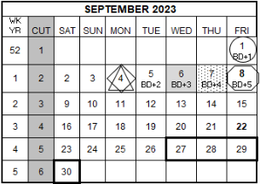

FY23 PD12 – Monthly Financial Close Update
August Financial Close Schedule Changes
Close schedule has been adjusted to recognize the Labor Day Holiday
Schedule PD12 | FRI 9/1 | SAT 9/2 | SUN 9/3 | MON 9/4 | TUE 9/5 | WED 9/6 | THUR 9/7 | FRI 9/8 | SAT 9/9 | SUN 9/10 | MON 9/11
Original > | BD+1 |  |  | BD+2 | BD+3 | BD+4 | BD+5
Revised > | BD+1 |  |  | HOLIDAY | BD+2 | BD+3 | BD+4 | BD+5 |  |  | BD+6
 | UFS transmission deadline 11:45 pm ET |  |  |  | Midday transmission 11:45 am ET (Schools OSI) | Review prelim results & request adjustments due by 8:00 pm ET | Analyze financial results – final adjustments due by 2:00 pm ET | Final financial results; client settlements available; Tax Entries Only | Tax Entries Only | Tax Entries Only | Final Tax Entries Only
Notes:
This is the updated FY 2023 Close Calendar to adjust for the Labor Day Holiday
Pd 12 close which also marks the last close for FY 23 has been adjusted to recognize the US and Canada Labor Day holiday. We will be celebrating the holiday on Monday, September 4th.
•We are taking a “pause” on September 4th which would have been BD+2.
We will resume on Tuesday, September 5th, with our typical BD+2 activities.
•Wednesday, September 6th is BD +3. Adjustments will be processed through 8 pm Eastern Time.
Thursday September 7th is BD+4 and the cutoff for adjustments will be 2pm Eastern Time.
Friday, September 8th is BD+5 and all reports will be final and client statements and settlements will be available.
Since it is year end, there are high level entries and processes that need to be completed before we can finalize PD 12 and FY 23
Once these year end processes are complete, the following Period 1 FY 2024 activities will resume:
•Period 1 E=vision/CCOR reporting: Estimated availability - September 14th
•
•September weekly invoices will be delayed, their estimated availability is September 13th
•
One question that we typically get is, “What happens with Transmission deadlines for week-ending September 1st which is the first week of Period 1/2024, if I do not transmit on Monday, September 4th? ”
If you are unable to transmit by the Monday 11:45pm deadline, your transmission will post in the following week of Period 1 to week-ending September 8th. This will not affect your Period 12 data.

Slide 12

FY2023 PD12 Monthly Deadlines Highlighted
Fixed Asset Department
August 17th at 12 pm ET: CE & AE payments, reclasses, disposals submitted and approved in the Asset Management Portal (AMP)
Contract Management Department - Contracts/Amendments:
August 18th at 5 pm ET: all documents must be sent to the proper segment Contract Management mailbox
Accounts Receivable – COLLECT IT!
August 11th at 5 pm ET: submit advanced billing (pre-bill) to increase likelihood of collection by August 31st
August 31st at 5 pm ET: submit properly approved AR adjustments
August 31st at 10:30 am ET: AR Payments over $2,500 must be received (overnight to Lockbox)
September 1st at 12 pm ET: Request Final Bad Debt Exception
Payroll:
August 24th at 2 pm ET: Submit Historical Edit Forms (if needed) for any prior pay periods to PayrollOps.USA@sodexo.com. The timeframe that can be edited is January 1, 2023 up to previous pay cycle.
Notes:
In addition to the items already mentioned, here are various deadlines you should be aware of prior to Year-end Close.
In order for Capital Expenditure and Authorized Expenditure payments to be processed, they must be submitted and approved in the portal by Aug 17th
Typically the Asset Management Portal(AMP) requests need to be approved within 5 days, however for year end Fixed Assets is asking the request be approved by August 17th.
If time allows Fixed Assets may continue to process requests for FY23 after the deadline. Review the AMP request on BD+1, if it has not been approved by Fixed Assets send an email to your accountant requesting deferral of the expense. If the expense is not deferred in FY23, Fixed Assets will not be able to set up an asset in FY24.
The deadline for all new contractual documents submitted to be processed for FY 23 is Aug 18th. Please send to the appropriate Contract Mgmt mailbox.
If you miss the deadline, still send your documents in to Contract Management as they will continue processing dually signed documents up until Close, as time allows.
For any signed contractual documents that have not been processed by Contract Management, Operations Accounting will reach out to the unit so an accrual can be submitted.
All requests for accruals on unsigned documents can be sent to your accountant, but we will require VP approval, support for the amount, and a copy of the draft. Rate Sheets with Client approval can be sent directly to Contract Management to process.
For Accounts Receivable:
Your FY2024 client agreement may require advance billing for working capital, board bill, or estimated cost of operations. If this invoice will not be auto generated by Buffalo please generate in Fiori or UFS and present to client by August 11th to allow time to collect payment by the 31st
Submit properly approved AR adjustments by Aug 31st 5 pm
AR Payments over $2500 must be received by Aug 31st 10:30 am
If a Client Payment of $100K or greater is received, immediately contact Sodexo AR. AR and Treasury will attempt to make alternate arrangements for payments over $100k. Call the AR Department at 1 800 828 7762 option 2, option 2 or email: AccountsReceivable.NorAm@sodexo.com
Sept 1st noon is the deadline to request final bad debt exceptions.
Payroll Operations will need any Historical Edit Forms for prior pay periods submitted by August 24th at 2pm to PayrollOps.USA@sodexo.com. The timeframe that can be edited is January 1, 2023 up to the previous pay cycle.

Slide 13
FY2023 PD12 Monthly Deadlines Highlighted
Accounts Payable
Fleet:
August 21st at 12 pm ET: Fleet transfer and disposal requests must be submitted and approved in AMP
Expense Reports and P-Cards:
August 21st at 5 pm ET: expense reports approved by managers in Concur
August 21st at 5 pm ET: outstanding PCard transactions must be submitted and approved on expense report
Vendor Invoices:
August 31st by 11:59 pm ET: Maximo Users to complete Goods Receipt submissions within SAP/Fiori
September 1st at 11:45 pm ET: Submit requests for missing electronic invoices in the Missing Electronic Invoice Investigation Portal
September 5th at 12 pm ET: electronic invoices must be approved in TMC or e-Pay
September 5th at 12 pm ET: manual invoices must be transmitted in UFS
September 5th at 12 pm ET: approved AP portal requests
September 5th at 3 pm ET: Maximo Users to complete Invoice Receipt submissions within SAP/Fiori
Notes:
AMP requests for Fleet transfers or disposals must be submitted and approved by August 21st at noon.
If time allows, Fleet may continue to process requests for FY23 after the deadline. Review the AMP request on BD+1, if it has not been approved by Fleet send an email to your accountant requesting deferral of the expense. If the expense is not deferred in FY23, Fleet will not be able to set the asset up in FY24.
Please have expense reports and PCard purchases approved by your manager by Aug 21 at 5 pm ET
If you miss the deadline, still submit expense reports and Pcard reports for normal processing. If the expense is not posted or auto-accrued by AP by BD+3, send a request to your accountant to accrue the expenses and include supporting documentation and approval. Manual accruals for expense reports and Pcards are only permitted during year-end close.
Maximo users please complete Goods Receipt submission within SAP/FIORI by Aug 31st midnight
Please submit requests for missing electronic invoices in the Missing Electronic Investigation portal by Sept 1st.
Do NOT hold up the final UFS transmission past the deadline if you are waiting for a vendor invoice.
Approve or reject all vendor invoices in TMC or EPAY by sept 5th at noon. All pending invoices with a date of Aug 31st or prior will automatically be accrued.
Manual AP invoices processed through UFS and AP portal requests are due at noon September 5th, BD+2
Maximo users please complete Invoice Receipt submissions within SAP/FIORI by September 5th at 3 pm ET
If you miss any of these deadlines, still submit invoices for normal processing. If the expense is not posted or auto-accrued by AP by BD+3, send a request to your accountant to accrue using the Late Payable tab on the Standard Close Adjustment Form.

Slide 14
Have You Completed?
BD+1 Friday, September 1
UFS Transmissions 11:45 pm ET
Physical Ending Inventory must be taken on the last day of the month, August 31st
BD+3 Wednesday, September 6
Review DFAV/CCOR
Review Preliminary Operating Statement and CRED Reports
Submit adjustments no later than 8 pm ET
BD+4 Thursday, September 7
Final Review DFAV/CCOR
Review Preliminary Operating Statement and CRED Reports
Submit adjustments no later than 2 pm ET
This is the last day adjustments can be made for FY 2023
BD+2 Tuesday, September 5
Kronos data updated and saved by 12 pm ET (for accurate labor accrual)
FIORI Statistics updated by 5 pm ET
(for accurate sales accrual)
Approve any Credit memo or Cancellation requests raised in FIORI Apps by 5 pm ET
Review DFAV/CCOR
Submit adjustments no later than 5 pm ET
BD+5 Friday, September 8
Final Client OS and settlement invoices are available in BRIO
Client settlements checks will be available
Above-the-unit adjustments may be processed by Transversal FP&A and Corporate Controller
Notes:
This slide provides a checklist for tasks to be completed during close week, organized by date and time.
As a best practice, review DFAV and CCOR on a weekly basis prior to close to post adjustments and ask questions before month end.
All transmissions must be completed by 11:45pm ET on Sept 1, BD+1.
For the Schools Segment, OSI data may be transmitted by 11:45 am ET on Sept 5, BD+2.
Kronos data must be updated and saved by Noon ET on Sept 5.
Please complete your FIORI Statistics billings by 5pm ET on Sept 5.
Approvals for credit memo or cancellation requests within the Manage Invoices app in Fiori must also be completed by 5pm on Sept 5.
Please review your financials in the DFAV and CCOR and submit adjustments by 5pm ET on Sept 5.
Wednesday, Sept 6 is BD+3. Please review your preliminary financials on your DFAV and CCOR as well as your Operating Statements and CRED reports.
Please submit adjustments no later than 8pm to have them reflected on BD+4 prelims.
Thursday, Sept 7 is BD+4. Please make a final review of your preliminary reports to ensure everything is accurate and any entries from the previous day posted as expected. If any changes are needed, please submit requests by 2pm ET. This will be the last day to make unit-level adjustments for FY23. If your request is going to be near the 2pm deadline, please reach out to your Accountant to make sure they are aware the adjustment is coming.
Friday, Sept 8 is BD+5. Final client reports and invoices will be available for download in Brio. Client settlement checks will be available. High level adjustments may be processed – profit effect only. Client reports cannot be changed.

Slide 15

Best Practices
  Review Financial Reports on weekly basis
  Use CCOR to validate financial results in ‘real time’ – Think Daily
  Fixed Assets – submit data within the Asset Management Portal (AMP) when you receive the vendor invoice or as soon as possible
  Contact your accountant throughout the month:
    Process adjustments that can’t be corrected at the unit
    Submit questions on unexplained activity
    Email Subject Line must contain one cost center number
  Frequently Adjusted Items
    Inventory – review prior to transmitting to ensure all items have been included
    Reporting missing vendor invoices (AP Department)
Notes:
Think daily or at minimum a weekly review is needed.
To ensure a successful period end, review financials weekly.
Complete your UFS transmissions by weekly and period end deadlines – get your data in!
A benefit of using CCOR To Validate is that this report shows your results in real time. You can use this report to review your numbers prior to BD+3 preliminary financials, and request adjustments as needed. Please note CCOR does not contain Statistical Activity.
Fixed Assets – If you submit a fixed asset request through the AMP tool near the end of the month, please validate that it has been processed within the current month. If it has not been processed, the expense may need to be deferred. Please contact your accountant and provide the AMP Request #, the GL Account & the cost center so we can process an entry.
Contact your Operations Accountant during the month if adjustments cannot be processed through UFS and a manual adjustment is needed.
When sending a message to the Operations Accounting group mailbox, enter one 8-digit cost center # in the Subject Line. This will assist us in routing your email to your accountant and will decrease processing time.
Please feel free to read through the Appendix for additional details.
Inventory – Inventory must be transmitted by 11:45 PM ET on BD+1. These figures will show up in the CCOR. Final Inventory figures are available around 1PM on BD2. If you need to adjust inventory, you can submit an adjustment as soon as you notice one is needed.
Accounts Payable – To reduce Late Payable Accruals, use the Missing Invoice Portal for Electronic Vendors. If submitted by BD+1, the invoice will be automatically accrued on BD+2. The link to the Missing Invoices portal can be found by searching UFS through SodexoNet and selecting Missing Invoice Investigation Portal under the Know the Procedures section. We also included a link in the appendix section of this deck.

Slide 16
Year End Collections
Bill It! If it is not billed, then it can’t be collected. Unbilled AR is included in DSO and can heavily impact our Cash Flow.
Focus on large balances at year end including those not past due yet.
Be aware of deadlines. Funds must be deposited in Sodexo’s bank account by 8/31 to be posted for Fiscal Year End.
Are you hearing financial distress?
If the client is unable to commit to any payment and/or if claims of financial distress (i.e. cash flow issues). Refer the account immediately the FSS Credit and Collections team at Creditcollection.NORAM@Sodexo.COM.
Notes:
Brad Hamman – transition to Deb Schoenrock and Sue Burns

Slide 17
Appendix Contents
Helpful Information
What to do if you miss a deadline
Fixed Assets
Contracts / Amendments
Expense Reports and P-Cards
Accounts Receivable / Credit & Collections
Accounts Payable Invoices
Revenue Accounting
Inventory
Billing
Specific Bad Debt Provisions
Payroll – Kronos and Labor Transfers
Year-End Temp Labor Expense Posting and Accrual
Operations Accounting
Collect It
Period 1 FY24 Activities
Notes:
Deb Schoenrock

Slide 18

Questions

Slide 19
Thank you

Slide 20
Appendix
District Controller Call Series © Sodexo July 2023. All rights Reserved

Slide 21
Helpful Information
Email Addresses:
Billing Department: FSSBilling.Noram@sodexo.com
Operations Accounting: ClientAccounting.NorAm@sodexo.com
  Add one cost center number to subject line
Accounts Payable: APInvoiceProcessing.Noram@sodexo.com
Fixed Asset Department: FixedAssetProcessing.Noram@sodexo.com
Links:
Asset Management Portal (AMP): https://us.sodexonet.com/home/tools-x0026-resources/guidelines-and-standards/operations/accountingx002c-finance-x0026-in/audit-and-compliance/fixed-asset-center.html
Missing Invoice Portal: https://www.mysodexo.com/sites/mySodexo/home/application-resources/ap-missing-invoice.html
Standard Close Adjustment Form: https://us.sodexonet.com/home/tools-x0026-resources/forms-center/contentcol1-area/forms-center/standard-close-adjustment-form.html
Financial Close Schedule: (sodexonet.com)
Notes:
Details and Timing
The Fiori Sales Accrual is an automated program that posts an accrual for revenue that has not yet been billed
The program is meant to book estimated revenue for the days that are between the final billing and the last day of the month.
For Example, if billing was completed through the 28th and the month ends on the 30th, the program would accrue two days of estimated sales
The accrual program will calculate for each line item.
The system will calculate an accrual for each line in the Fiori contract.
The system calculates the average daily sales for each line item by taking the total pre-tax amount billed divided by the number of days. It then multiplies this amount by the number of days from the last service date to the end of the month.
Board Day Statistics - The program takes the pretax amount and divides it by the number of days that were entered through Fiori stats to come up with the average daily sales.
Dollar/Count Statistics – The program takes the amounts billed and divides by the number of days that the invoice is for. Ex. Weekly Billing – would take each line and divide by 7 to get an average daily amount.
The accrual program runs each month at 5:00 PM ET on BD+2
The system will accrue for any contracts that are active in the Fiori Portal
Adjustments to the accrual can be requested during month end close via the Standard Close Adjustment form
If there are Fiori contracts no longer needed, request FSS Billing Department to block the contract
Once blocked, it will no longer accrue sales.

Slide 22
What to do if you miss a deadline
Fixed Asset Department
If time allows Fixed Assets may continue to process requests for FY23 after the deadline. Review the AMP request on BD+1, if it has not been approved by Fixed Assets send an email to your accountant requesting deferral of the expense. If the expense is not deferred in FY23, Fixed Assets will not be able to set up an asset in FY24.
Contract Management Department - Contracts/Amendments:
Still send your documents in to Contract Management as they will continue processing dually signed documents up until Close, as time allows.
For any signed contractual documents that have not been processed by Contract Management, OA will reach out to the unit so an accrual can be submitted.
All requests for accruals on unsigned documents can be sent to your accountant, but we will require VP approval, support for the amount, and a copy of the draft.
Accounts Receivable – COLLECT IT!
For a Client payment to post to Sodexo’s bank account on Wednesday, August 31st, client must initiate a same day wire transfer payment on the 31st with a value date of August 31st.
  Clients should verify their banks depositing schedule. If a client misses their bank’s deadline, Sodexo will not receive funds on August 31st.
If a Client Payment of $100K or greater is received, immediately contact Sodexo AR. AR and Treasury will attempt to make alternative arrangements for payments over $100k and greater. Call the AR Department at 1 800 828 7762 option 2, option 2 or email: AccountsReceivable.NorAm@sodexo.com

Slide 23
What to do if you miss a deadline
Accounts Payable
Fleet:
If time allows, Fleet may continue to process requests for FY23 after the deadline. Review the AMP request on BD+1, if it has not been approved by Fleet send an email to your accountant requesting deferral of the expense. If the expense is not deferred in FY23, Fleet will not be able to set up an asset in FY24.
Expense Reports and P-Cards:
Submit expense reports and P-Card reports for normal processing. If the expense is not posted or auto-accrued by AP by BD+3, send a request to your accountant to accrue expenses including supporting documentation and approval. Manual accruals for expense reports and P-Cards are only permitted during year-end close.
Vendor Invoices:
Submit invoices for normal processing. If the expense is not posted or auto-accrued by AP by BD+3, send a request to your accountant to accrue using the Late Payable tab on the Standard Close Adjustment Form.

Slide 24
Fixed Assets
All Fixed Asset requests for CE payments, AE payments, reclasses, & disposals must be approved in the Asset Management Portal (AMP) by August 17th 12:00 pm (Noon) ET to ensure processing for PD 12.
Do not hold invoices in Market Connection that need to be amortized. These invoices will be included in the Market Connection accrual and expensed. Approve the invoices and submit necessary paperwork to Fixed Assets to have the asset setup through the Asset Management Portal (AMP).
All Fixed Asset transfer requests must be submitted in AMP by August 21st 12:00 pm (Noon) ET to ensure processing for PD 12.
Notes:
If items are purchased and need to be amortized, any AE & CE requests for CE payments, AE payments, reclasses, and disposals need to be submitted by August 17th 12:00 pm ET to ensure expenses are charged in the correct Fiscal Year. All Fixed Asset transfer requests must be submitted in AMP by August 21st 12:00 pm ET to ensure processing for PD 12. Additionally, any invoices that are received in Market Connection that need to be amortized, should be approved and submitted to the Fixed Assets department to have the asset set up. These invoices SHOULD NOT be held as they will be accrued automatically.

Slide 25

Contracts/Amendments
Do you have new contractual items/rates effective FY 2023?
  Send new contracts and amendments to the proper Contract Management mailbox by
  5:00 pm ET on August 18th
  Segment E-Mail Mailboxes:
    USA BSC B-I Client Contracts – B&I Contracts
    NorAm BSC Canada Client Contracts – Canada Contracts
    USA BSC Schools Client Contracts – Schools Contracts
    USA BSC Health Care Client Contracts – Health Care Contracts
    USA BSC Campus Client Contracts – University
Notes:
Submit contracts and amendments by 5:00 pm ET on August 18th to guarantee processing for year-end close to appropriate contract mailbox.

Slide 26
Expense Reports and P-Cards
Travel & Expense Reports
Expense reports must be submitted and approved by your manager in Concur by August 21st to guarantee FY 2023 posting.
Expense reports submitted and approved after this date are not guaranteed to post in FY 2023.
There is no automatic accrual to capture any unapproved reports.
Manual expense reports must have a week ending date of 8/31/23 or prior to post in FY23
P-Cards
Outstanding P-Card transactions should be submitted and approved on an expense report by August 21st to ensure costs are recorded accurately
An accrual journal entry will be recorded for all P-Card transactions that are un-submitted, un-approved and un-released at the end of the period.
Notes:
T&E reports must be submitted and approved by your manager by 8/21 to post in FY 2023. Reports approved after that date are NOT guaranteed to post in FY 2023. There is a chance they will depending on when the auditors finish the reports submitted by 8/23. Manual Expense Reports must have Week Ending Date of 8/31/23 or earlier, to post in FY 2023.
Each period outstanding PCard transactions are accrued to miscellaneous expense. The accrual posts in the last week of the period and includes un-submitted transactions, transactions waiting for approval, and transactions on approved expense reports which have not been released by the Expense Report team. This accrual reverses in the first week of the new period. To ensure your costs are recorded accurately for the end of FY 2023, submit any outstanding PCard transactions on an expense report by, 8/21/23.
Properly approve (through employee and manager) Expense Reports for PCard and Travel expenditures through Concur Expense Management Tool or launch Concur from SodexoNet page.
Accrue for significant items if not in Concur by 8/31.
Please refer to AF Topic 811-15 Sodexo PCard or contact Purchasecards.Noram@Sodexo.com with any questions.

Slide 27
Accounts Receivable/Credit Collections
Does your contract require a Client Advanced Billing (pre-bill) or working capital for FY 2024?
  Submit any advanced billing by August 11th to ensure collection by August 31st
Review and follow the COLLECT IT page.
Send in properly approved AR adjustments to AccountsReceivable.NorAM@sodexo.com by August 31st 5 pm ET to ensure they will be processed for year end.
Overnight all AR Payments over $2,500 to the below Lockboxes so that it is received by August 31st at 10:30 am ET.
Make sure that the client has their ACH/Wire transfers set up.
US Lockbox:
Sodexo Inc & Affiliates
ATTN: 360170
500 Ross St. 154-0455
Pittsburgh, PA 15262-0001
Canada Lockbox:
BMO Wholesale Remittance Processing Services
4 Prince Andrew Place, Dock 4
Don Mills, ON M3C 2H4
ATTN: T57840C – Sodexo Canada Ltd
(416) 643-4398
Notes:
Please refer to the Collect It documents available on Sodexo Net to review the deadlines for check and electronic payments.
If there is a payment of $100K or greater, contact AR to confirm how to get the payment deposited before year end.
Don’t wait until the 30th – 31st of August to get items in for Accounts Receivables
Start overnighting all check payments over $2,500 to the lockboxes to ensure that it is received by 10:30 am ET (early morning delivery), Thursday August 31st
This is to ensure that the payments are received on time. If the payments are delivered on the 31st after the morning delivery, then it will not be guaranteed to be reflected in FY 2023.

Slide 28
Accounts Payable Invoices
Electronic invoices must be approved in TMC or e-Pay by 12:00 pm ET on September 5th (BD+2).
Manual invoices must be transmitted in UFS by 12:00 pm ET on September 5th (BD+2). The AP manual invoices will be posted to the week ending date that is open in UFS.
Maximo Users
  Goods Receipt submissions within SAP/Fiori by August 31st 11:59 pm ET
  Invoice Receipt submissions within SAP/Fiori by September 5th 3:00 pm ET.
Notes:
All vendor invoices received at the cost center need to be processed by your final transmission. If an invoice is received after the final transmission, a Close Adjustment Form needs to be submitted to Operations Accounting so the invoice can be accrued (JE Threshold Does Not Apply For Year End). Do NOT hold up the final transmission past the deadline if you are waiting for a vendor invoice.
All direct pay invoices need to be reviewed and approved, so that they are paid in the correct year. The same goes for all Market connection invoices. Please ensure that the invoices are allocated to the proper G/L accounts and are approved/reconciled. Any unapproved or unreconciled invoices will be accrued for. Therefore, do not “hold” any invoices in TMC.
Electronic invoices can be approved in TMC or e-Pay through 12:00 pm ET on Tuesday, September 5th (BD+2). They will post based on the invoice date as follows:
August invoice dates (or prior) will post to August 31st.
September invoice dates will post to the invoice approval date.
Paper invoices can be transmitted in UFS through 12:00 pm ET on Tuesday, September 5th (BD+2). They will be posted to the week ending date that is open in UFS.
Maximo users – complete Goods Receipt submissions within SAP/Fiori by August 31^{st,} and Invoice Receipt submissions within SAP/Fiori by August September 5th 3 pm ET

Slide 29
Revenue Accounting
Cash Management activity should be transmitted daily.
Deadline for the following transmissions for Fiscal Year End need to be made by September 1st by 11:45 pm ET:
    Cash Management
    Internal Resident and Warehouse Vending
    UFS Invoices and Billing Memos:
      Catering/Function Invoicing
      Payroll Deductions Invoicing
      Unbilled Register activity Invoicing
Unit-Managed Gift Certificate Logs and Prepaid Card Liability logs need to be submitted by September 1st.
Everyday (Dynamify)
  August 31st revenue will be posted September 1st
  Adjustments to revenue, if necessary, will be posted by 4:00 pm ET September 5th
  Transfer Journal Entries are not necessary
Notes:
Transmitting Cash Management activity daily helps reduce errors and allows for quicker financial review.
Final Transmission for each month should be completed by 11:45 pm ET on BD+1. For August month end, BD+1 is September 1st. That includes Cash Management activity and any UFS Invoicing or Billing Memos that are for August services.
Unit-Managed Prepaid Liability logs need to be submitted by BD+2. For August month end, BD+2 is Tuesday September 5th
Dynamify/Everyday is posted on a day delay, so the sales from August 31st will be posted by September 1st
A reconciliation that compares all the daily posting activity to a monthly file and will post any adjustments by September 5th

Slide 30
Inventory
An accurate Ending Inventory needs to be taken on the last day of the month and transmitted in the last week of the period.
Cost centers with Sodexo Owned or Sodexo Managed Inventory will have Ending Inventory system carried from previous periods unless inventory is transmitted in PD 12.
Cost centers with Client Owned Inventory need to ensure the correct change of inventory is recorded.
  A change of inventory is calculated by taking the Beginning Inventory less the Ending Inventory that was transmitted.
Notes:
It is important to transmit an accurate ending inventory for the end of the fiscal year. Cost centers with Sodexo Owned or Client Owned/Sodexo Managed Inventory that do not transmit an ending inventory, will have the prior ending inventory carried for PD 12.
If your cost center has Client Owned Inventory (reported in statistical accounts), a variance of Beginning less Ending Inventory is posted. Please review the variance to ensure the correct change in inventory is recorded.
Introduction for Mark

Slide 31
Billing
FY 2023 UFS billing deadline is 11:45 pm ET on September 1st
FY 2023 FIORI invoices must be finalized in the FIORI Statistics module by 5:00 pm ET on September 5th (BD+2)
The FIORI Statistics sales accrual will post as usual at the end of the day on September 5th by 5:00 pm ET. The accrual will post for any unit that utilizes this billing module unless there is a temporary close timeframe set in the PaCCC tool that lasts until after August 31st or the last billing week of PD 12/2023 is skipped in the Fiori invoice module.
Notes:
If there were any services done by Sodexo in FY 2023, and you did not generate a UFS invoice, make sure all UFS invoices are transmitted by 11:45 pm ET on September 1st to ensure this revenue is accrued. If the deadline is missed transmit the UFS invoice and send the completed invoice with adjustment form to the Operations Accounting mailbox so your accountant of record can properly accrue this revenue within PD 12/2023.
Finalize any statistical billing within FIORI pertaining to FY 2023 by September 5th at 5:00 pm.
If there is not supposed to be invoiced revenue for the last week of PD 12/2023 then do not forget to ‘skip’ the billing date. The “skip” stops the automatic accrual from calculating and recording an erroneous sales accrual to financial results.

Slide 32
Specific Bad Debt Provisions
Final Bad Debt Exception requests are due September 1st by 12:00 pm ET.
Requests must be submitted with the proper approvals to:
AccountsReceivable.NorAm@sodexo.com

Slide 33

Payroll – Kronos and Labor Transfers
By August 24th submit Historical Edit Forms (if needed) for any prior pay periods to PayrollOps.USA@sodexo.com. The timeframe that can be edited is January 1, 2023 up to previous pay cycle.
Kronos data must be updated and saved by September 5th by 12:00 pm ET
Confirm employees that worked at another cost center are transferred to the correct cost center through the current payroll reporting methods
If an employee’s wages were not allocated correctly, complete a labor transfer in UFS by September 1st at 11:45 pm ET
Links to US and Canada Payroll dates
  US: Financial Close—All U.S. Segments
  Canada: Financial Close
Notes:
Cost centers need to make sure that all payroll is processed timely. If any employee worked at another cost center, the employee will need to allocate their payroll to the correct cost center through the current payroll reporting method. If an employee is not charged to the correct cost center through payroll, then a labor transfer needs to be completed in UFS, using the labor transfer module.

Slide 34
Year-End Temp Labor Expense Posting and Accrual
A unit level accrual will be calculated and posted for all Temp Labor activity incurred but not billed.
For year-end close we ask that you do the following:
  Ensure that all employees time for August 20th-26th is reviewed, approved, and any necessary edits are completed by August 29th.
  Ensure that all time for all employees are punching into the Kronos clocks for August 27th-31st, as that data will be pulled directly from Kronos and accrued for no later than September 1st.
sodexotempfinderinquiries.usa@sodexo.com

Slide 35
Year-End Temp Labor Expense Posting and Accrual
Temp Labor expense from August 20th- August 26th will post in SAP and to the DFAV on Thursday, August 31st.
An Accrual for Temp Labor expense outside of Kronos will be posted on Wednesday, August 31st for the following dates, August 27th-31st. Actual costs will be posted to the DFAV on September 5th.

Slide 36
Operations Accounting
Adjustments - Standard Close Adjustment Form linked below:
  Standard Close Adjustment Form
Forward to ClientAccounting.Noram@sodexo.com please include one 8-digit cost center number in the subject line without any periods, spaces, or dashes.
Government units - forward to their respective Analyst.
The $2,500 JE threshold does not apply during Year End
Questions regarding the Year End Close click link below for appropriate departments
  Call Topic List
Notes:
Important items

Slide 37
PD 1 FY 2024 Activities
The following PD 1/2024 activities will resume after all year end processes are completed:
September Invoices:
  Weekly and bi-weekly invoices billing through 9/1/23 estimated available 9/13
  Weekly and bi-weekly invoices billing through 9/8/23 estimated available 9/15
Period 1 E=Vision reporting: Estimated availability - September 14th

Slide 38
AR Collections deadline for Q4 FY23
It’s Year End
Let’sCollect It!
Deadline for Year End Quarter 4 FY23
Payments

Slide 39
Year End Deadline for Quarter 4, FY23
Your help is needed to increase our cash flow. To ensure that your AR payments, bank deposits, cash receipts, and cash balances are properly credited for Quarter 4, all deposits must be made on or before Thursday August 31st.
Please observe the following deadlines depending on your payment method.
Select the payment link(s) for your current payment method below for further details :
ELECTRONIC (ACH/WIRE) PAYMENTS
CHECK PAYMENTS
REMINDER:
The preferred method of invoice payments is ACH. ACH payments are timely, more secure and less costly.
Please contact Accounts Receivable at AccountsReceivableNorAm@sodexo.com or 1-800-828-7762, Option 2, Option 2 for more information and to request the ACH details for your client.

Slide 40
Electronic Payments – Deadline for Quarter 4 FY23
Client ACH payments post to Sodexo’s bank account 1 to 2 business days after the client releases the payment to their bank. Determine with your client Finance or AP Department whether their bank ACH is 1- or 2-Day processing.
2 Day ACH: Tuesday August 29th
If ACH is 2-day processing, ACH must be released from client’s bank on or before the 29th with a value date of August 31st
1 Day ACH: Wednesday August 30th
    If ACH is a 1-day processing, ACH must be released from client’s bank on or before the 30th with a value date of August 31st
Thursday August 31st
    For client payments to post to Sodexo’s bank account on Wednesday August 31st, client must initiate a SAME DAY electronic funds transfer payment on the 31st with a value date of August 31st

Slide 41
Check Payments – Deadline for Quarter 4 FY23
Quarter 4 Deadline for AR Collections for CHECK payments sent to Lockbox must be deposited in the Lockbox by 10:30 AM (ET) Thursday August 31st
Lock Box address:
Sodexo Inc & Affiliates
Attn: 360170
500 Ross St 154-0455
Pittsburgh, PA 15262-0001
Telephone (412) 234-4381
Total Check Amounts | Important Dates | Action to Take
Total Checks greater than $2,500 | Tuesday August 29th | Overnight checks to the Lockbox address above with Next day delivery
Total Checks greater than $2,500 | Wednesday August 30th | Overnight checks to the Lockbox with Next Day Air EARLY AM Delivery
Total Checks greater than $100,000 | Thursday August 31st before 2:00 PM ET. | Call the FSS AR Department at 1-800-828-7762 option 2, option 2 before 2 PM ET

Slide 42
Payment Fraud
Threat Actors are continuing their efforts posing as Sodexo employee to commit fraud against our clients.
  Tell customers NEVER to conduct electronic funds transactions with Sodexo via email.
  Always call the AR Department to verify any requests and to check the sender’s domain
  Ensure that any requests for funds transfer received have 2nd and/or 3rd level validation procedures in place (i.e., DM/GM approvals, always call your customer to verify legitimacy etc.)
  Using email for financial transactions in general is strongly discouraged
  Immediately contact FSS Accounts Receivables department if you suspect possible fraud at: AccountsReceivableNorAm@sodexo.com or 1-800-828-7762, Option 2, Option 2
Thank you, your actions are making a difference!

